Slide 1
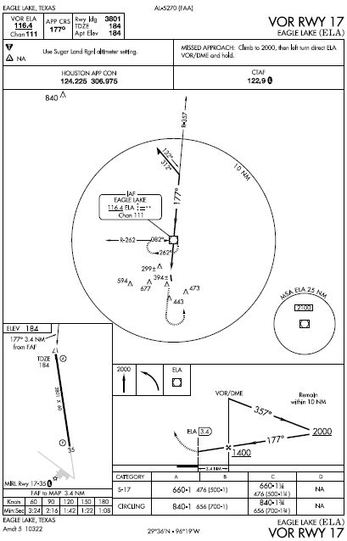
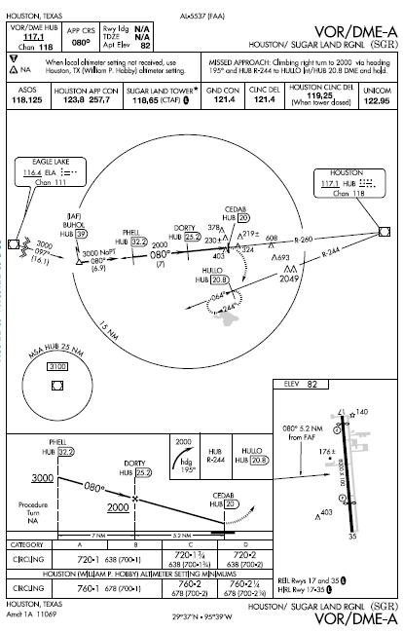
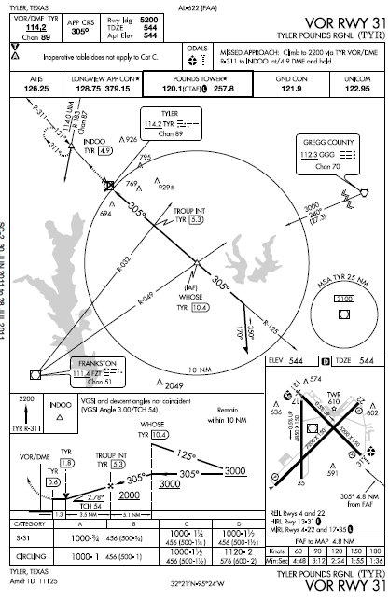
VOR Approaches

Slide 2
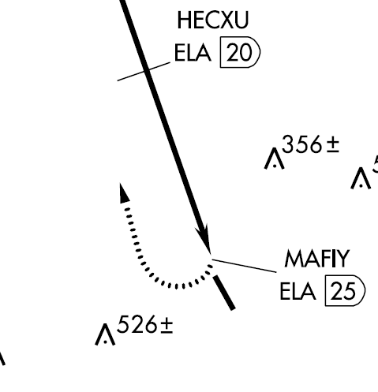
VOR Approach Nomenclature
VOR RWY ## – Approach to a specific runway
Aligned within 30° of the runway heading
Crosses extended centerline of runway
Descent gradient <400’ NM from FAF to TCH
VOR A – Letter approach
Runway is more than 30° from the runway heading
Descent gradient is > 400’/nm from the FAF to the TCH
Obstacle prevents developing straight in minimums
VOR Course doesn’t cross the runway’s extended centerline

Slide 3
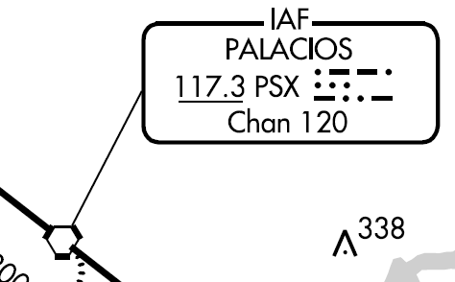
VOR Approach Nomenclature
VOR is short for VHF Omni-directional radio range
VOR DME – Operable DME required to use the approach
DME Arc – Arc must be >7 NM from the airport
TACAN - Military tactical air navigation (TACAN) equipment. When installed with a VOR, it is known as a VORTAC
Phantom or Ghost VOR – Occurs when a TACAN is not frequency paired with a VOR, but the frequency is presented to enable DME tuning – e.g., Ellington ILS 17R EFD TAC 31 is on frequency (109.4)
VOT - A VOT is a low-power VOR station that transmits only the 360° radial to use as a VOR receiver check
Tacan
Vortac
Ghost

Slide 4
VOR Approach Background
One of the most widely used types of approach
Can use VORs either on and off of the destination airport for the approach and the VOR normally is the IAF
One VOR can serve several airports (e.g. Hobby VOR) – Hobby, Sugar Land, La Porte, etc.
VOR approaches can be on the TO or FROM side of a VOR
May or may not have a final approach fix
It is a non-precision approach as there is no vertical guidance
MDAs as low as 250’ AGL
VOR radial typically intersects the extended runway centerline 3000’ from the threshold for a straight in approach
300’ of obstacle clearance in the final approach area

Slide 5
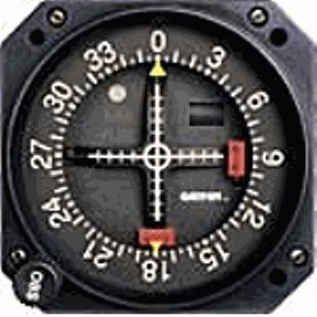
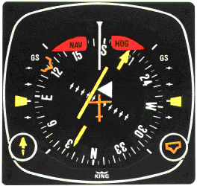
VOR Equipment
Nav receiver and CDI display, HSI or glass cockpit display
Some approaches also require a DME receiver
Can substitute GPS distance – BUT be careful measuring points may not be the same

Slide 6
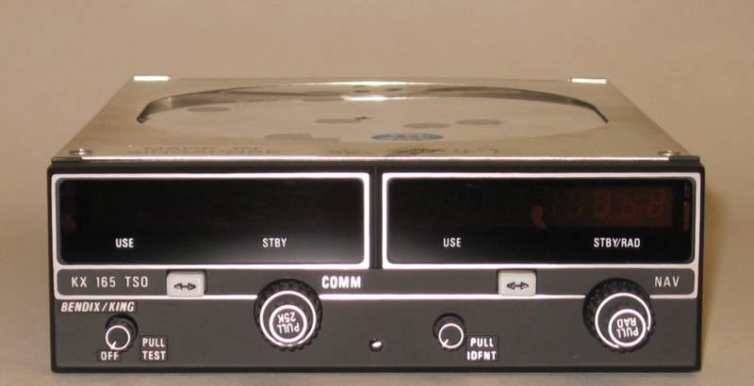
VOR Equipment
VOR Frequency Display – In use and stand-by
Identification feature and volume control
Tuning knob
Some receivers will display the radial you are on

Slide 7
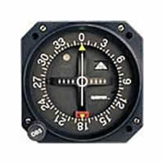
VOR Equipment
Course Selected
To/From indicator
Course deviation indicator
OBS – or radial selector

Slide 8
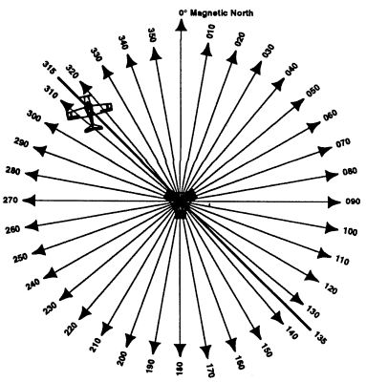
VOR Information Received
Two signals are transmitted from the VOR ground station.
The first signal is a non-directional reference signal.
The second signal is a rotating variable phase signal that transmits around the entire 360 degree circle approximately 30 times per second. This signal is transmitted by antennas circling the reference signal antenna.
The reference phase signal is transmitted every time the rotating signal goes past the 0 radial.
Radial information is derived by your receiver from the difference in time between the two signals.
VORs transmit between 108 to 117.95 MHz

Slide 9
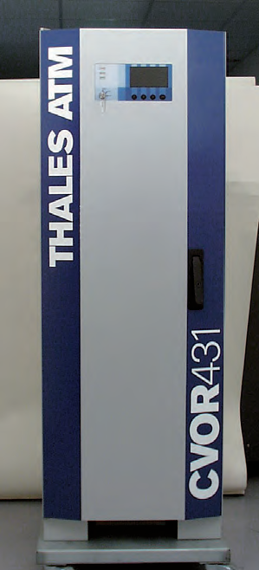
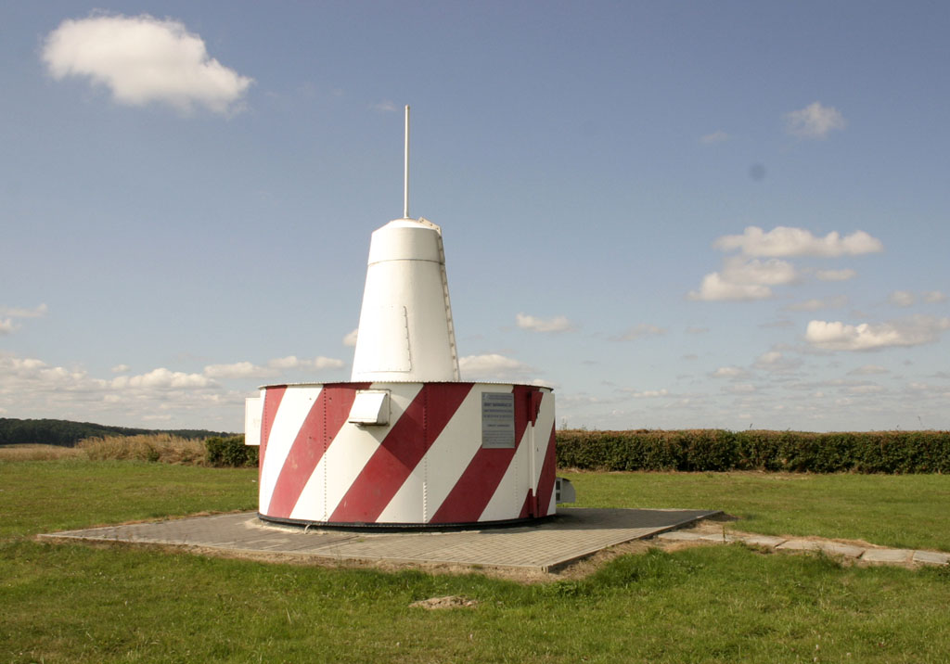
VOR Ground Station

Slide 10
DME Receiver
Remoted frequency
DME receiver tuned frequency
Tuning / volume knob
Distance
Ground speed / time functions
DME paired VOR frequency

Slide 11
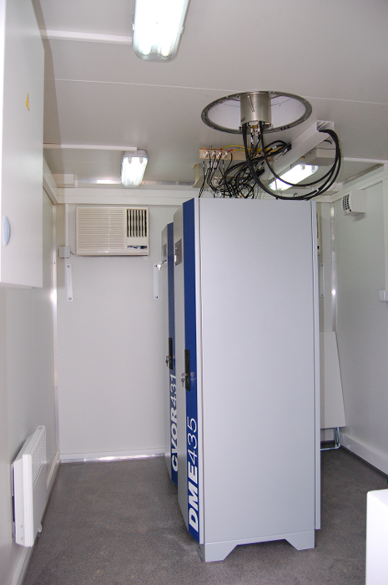
DME Transmitter
DME antenna

Slide 12
Using the VOR Signals
Tune the VOR frequency on the aircraft’s receiver
Morse code identifier – identify the VOR and keep the identifier on in the background as you may have no other indication of station failure
DME coded identifier is transmitted once for every 3 or 4 times the VOR identifier transmits. About once every 30 seconds. DME identifier is also higher-pitched 1350 Hz compared with 1020 Hz for a VOR.
Can also listen to DME identifier on the DME receiver in many cases

Slide 13
Using the CDI
CDI is a navigation instrument – Keep it in the scan
Set the OBS to the course
Confirm there is no failure flag and that the needle does not have erratic indications
Look at CDI for needle location and trend; BUT FLY THE ATTITUDE INDICATOR / DG – don’t chase the CDI
Center the needle as early as practicable
Initially steer desired radial +/- wind correction
Make corrections with gentle coordinated turns to reference headings on the DG using bracketing
Make corrections early and often to avoid the need for large corrections – remember corrections become finer and finer as you get closer to the VOR due to the “funnel effect” of the signal and will have zone of confusion near the VOR

Slide 14
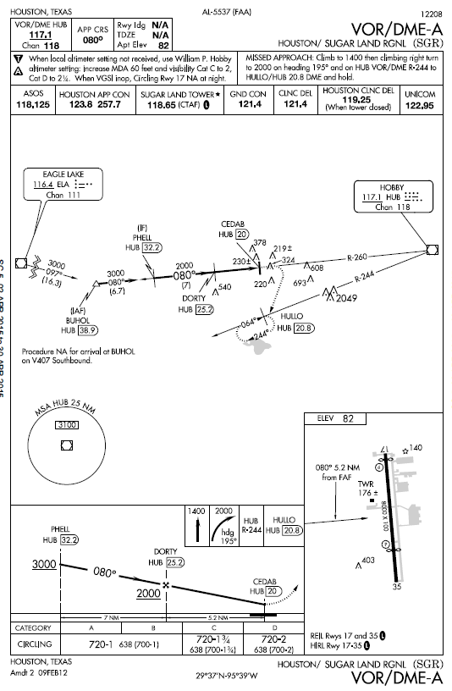
Let’s Fly - IAF
Starting the Approach
Approach starts at the initial approach fix (IAF) – There can be several IAF’s – IAFS join at one or more common intermediate segments
You will reach the IAF from a “feeder route” which can be a radar vector
Must fly the entire procedure unless otherwise advised by ATC

Slide 15
Let’s Fly - IAF
Starting the Approach
IAF is where the initial approach segment begins.
Purpose is to align the aircraft with the intermediate or final approach segment
Accomplished by using a DME arc, a course reversal, such as a procedure turn or holding pattern, or straight in route
IAF is usually a designated intersection, VOR, NDB, or DME fix
IAF may be collocated with the intermediate fix of the instrument approach. In that case there is no initial approach segment
Segment usually ends at the intermediate approach segment or at an Intermediate Fix (IF)

Slide 16
Let’s Fly – Intermediate Segment
Starting the Approach
Intermediate segment positions the aircraft for the final descent to the airport
Normally aligned within 30° of the final approach course
Segment begins when
you are proceeding inbound to the FAF,
are properly aligned with the final approach course, and
are located within the prescribed distance before the FAF
May not be charted –
Approach with a procedure turn is the most common example of an uncharted IF
intermediate segment begins when you intercept the inbound course after completing the procedure turn
Ends at beginning of Final approach

Slide 17
Let’s Fly – Final Segment
Starting the Approach
Final approach segment begins at a designated FAF, depicted as a Maltese cross (X) on the profile view, or at the point where the aircraft is established inbound on the final approach course
Mandatory ATC report
When leaving the FAF
When you go missed in non-radar environment

Slide 18
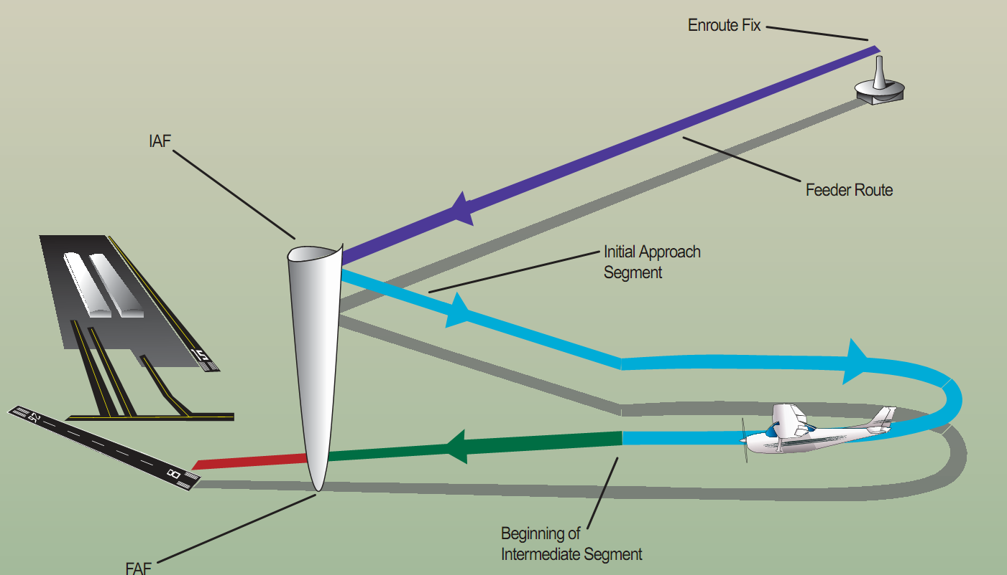
Let’s Fly Approach Segments
Outer marker or other fix

Slide 19
Before the Initial Segment
Preflight – Plan the approach – Must be familiar with “all available information concerning a flight” prior to departure and FDC Notams
Enroute – Get weather (ATIS, FSS information, etc.) to help determine likely approaches and review
Calculate / review performance data, approach speeds, and power settings – confirm aircraft and weather are appropriate for the ILS procedure for aircraft’s certified category or, if higher, the actual speed to be flown
Set navigation / communication and automation - The navigation equipment required for an approach is generally indicated by the title of the procedure and chart notes

Slide 20
Before the Initial Segment
Review and brief the approach – Don’t forget to brief the missed approach
Commit to memory
Altitude step downs
MDA
Time from FAF to MAP or DME Visibility minimums
Missed approach procedure (at least initial steps)
Begin reducing speed
Obtain ASOS/ATIS/AWOS on comm 2 – listen in the background
Note the time you cross the IAF

Slide 21
Initial Segment
Complete briefing the approach
Begin landing checklist – complete before final segment
Reset comm and nav radios with required frequencies
Comply with the clearance and approach
Finish reducing power to approach settings (consider wind gusts, shear and turbulence)
Configure aircraft for landing – Flaps
Fuel related items set for landing (pumps, mixture, selectors)

Slide 22
Initial Segment - Briefing
Brief and review approach to assure you can execute it - Complete before end of segment
Runway length, Touchdown Zone elevation and airport elevation
VOR identifier and frequency
Final approach course
Approach name
Takeoff minimums / procedures – non-standard
Missed approach information
Special notes – often important!
Frequencies
Minimums for use as an alternate –> non-standard - - Can’t be used as a legal alternate
Dark = pilot controlled lighting;

Slide 23
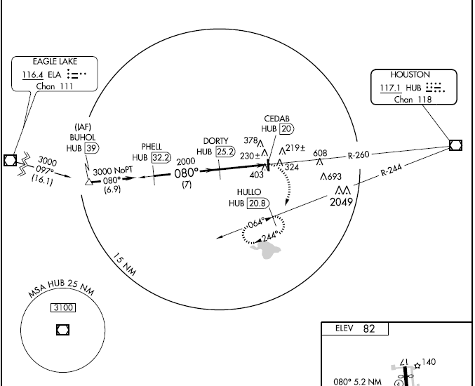
Initial Segment - Briefing
Plan view – mentally run through the approach
DME to VOR
Altitude and heading for segment
Feeder route
Missed approach frequency information
IAF with no procedure turn
Obstruction (highest)
Mileage to intersection from the nav aid
Missed approach hold DME point
Distance and center identifier
Holding course – in and outbound
Initial missed
approach
course
Sector minimum safe altitude
Center of MSA

Slide 24
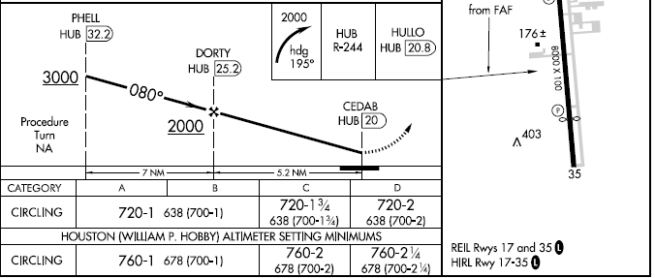
Initial Segment - Briefing
Profile view – mentally run through the approach
Minimum altitude you can descend to inbound to intercept
Graphical missed approach information
Non-precision FAF (point to begin MAP timing)
Inbound course
Runway
No procedure turn authorized note
Aircraft category
A <= 90
B < 121
C < 141
Minimums
Mileage to threshold
lighting

Slide 25
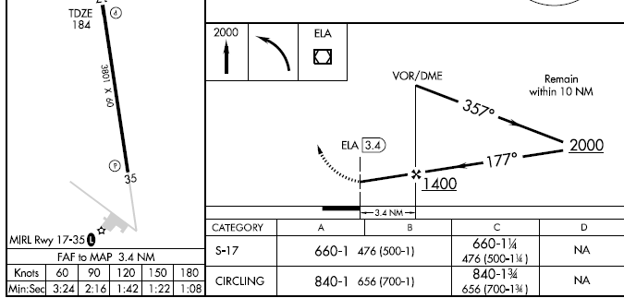
Non-DME Off Airport VOR Profile Briefing
Graphical missed approach information
Outbound course to procedure turn
Procedure turn limiting note
Minimum altitude once you cross the VOR outbound
Runway
lighting
Inbound course
Minimums
MAP DME from VOR
Minimum segment altitude
Aircraft category
A <= 90
B < 121
C < 141
Missed Approach Timing Information
Non-precision FAF (point to begin MAP timing)

Slide 26
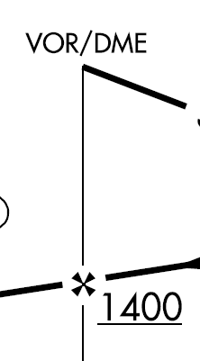
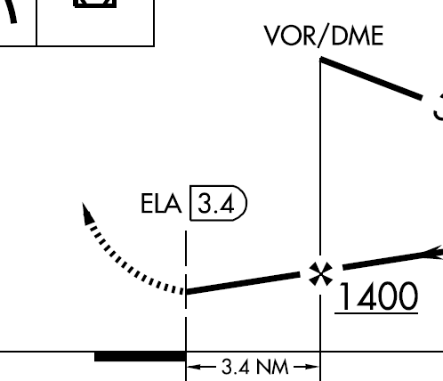
Initial Segment - Briefing
Missed Approach Timing Information (if ground speed information is unavailable)
Add tailwind to airspeed (1/2 wind speed for quartering winds)
Subtract headwind from airspeed (1/2 wind speed for quartering winds)
Time even if DME is available as a back-up

Slide 27
Let’s Fly – The Initial Segment
Radios tuned to VOR to 117.1
Confirm Morse code and leave on in the background
Reduce power to approach setting
Cross over the BUHOL at 3,000 feet
As the VOR needle begins to move note the rate of movement to center the needle on the inbound course on HUB (080°) – determine heading to hold with the wind correction angle

Slide 28
VOR Procedures Off-Airport VOR
Off-airport VOR is often the FAF and may also be the IAF
For procedure turn go 1 to 2 minutes outbound before beginning the procedure turn – may need more time depending on the winds, etc.
Missed approach point (MAP) may be determined from VOR FAF by time, DME, or another navaid

Slide 29
VOR Procedures On-Airport VOR
You can tell VOR is on the airport from the approach chart profile view
Generally an on airport VOR approach will have no depicted final approach fix. In which case, the final approach segment begins at the final approach point (FAP).
The FAP is the point where you are established in-bound on the final approach course from the procedure turn/radar vector and can begin the final approach descent
For a procedure turn fly out 3 to 4 minutes before the procedure turn to assure adequate distance to become established inbound
VOR is the MAP – when TO/FROM flag changes

Slide 30
VOR Procedures VOR DME
Flown the same as other VOR approaches except that DME can be used for various fixes including:
IAF
FAF
MAP
Procedure turn limits
Step down altitudes
Transitions

Slide 31
IAF With Course Reversal
Radios tuned to VOR to 116.4
Confirm Morse code and leave on in the background
Reduce power to approach setting
Cross over the VOR at 2,000 feet or higher.
As you pass the VOR turn north to intercept the outbound procedure turn (357 radial). Past the VOR descend to 2000.
After 1 to 2 minutes turn left to 312° for 1 minute
Then right turn to 132° after 1 minute
Then intercept inbound course based on CDI to 177°
Once established inbound you are in the intermediate segment and can descend to 1400’

Slide 32
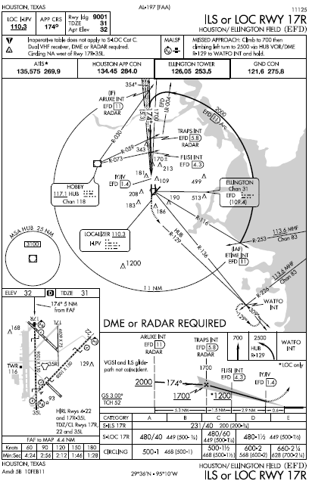
IAF With DME Arc
Radios tuned to VOR to 109.4 (although this is a ghost VOR it will give you DME)
Confirm Morse code and leave on in the background
Intercept the DME arc (lead your turn to avoid overshooting the arc) at the IAF Entime intersection and then follow the arc – place your left wing-tip towards the VOR – watch your DME to stay within approx . 1 mile
Minimum arc altitude is 2000’
On an actual VOR your heading will be about 90 degrees from the radial your on +/- wind correction
When you get to the lead radial begin your turn into the inbound VOR course (although this approach is a localizer)
Reduce power to approach setting
Intercept inbound course based on CDI to 174°
Once established inbound the procedures are the same as other localizer approaches

Slide 33
Let’s Fly – The Intermediate Segment
Inbound on HUB (080°)
Verify power settings for the approach and drop first notch of flaps
After PHELL descend from 3000 to 2000
Descent rate rule of thumb for 3° is approximately 5 X your groundspeed
Set radios for missed approach Nav 2 to 117.1 CDI to 64 (To setting for the 244 radial)
Corrections become smaller and smaller the closer you get

Slide 34
Let’s Fly – The Intermediate Segment
Likely to be told to switch to local frequency – swap comm 1 to 118.65 when transferred to SGR Tower
Complete landing checklist as much as possible
You are now at the final segment!

Slide 35
Let’s Fly – The Final Segment
At FAF (DORTY) start timing for missed approach if non-DME approach (timing is based upon ground speed)
Expeditious but safe descent (gen <700 ft min @ 90 kts) – However, if there is an angle of descent, you should calculate the corresponding rate of descent (inside back cover of TERPS)
Maintain a constant speed – level and descending
FAF inbound report to ATC required in non-radar environment
Likely to be told to switch to local frequency – swap comm 1 to 118.65
Confirm gear down
Second notch flaps – Check in white arc

Slide 36
Let’s Fly – The Final Segment
Final speed reduction
Glance out the window to look for the runway environment
Begin level off about 100’ before you reach the MDA 720’ (780’ with Hobby altimeter setting)
Airport Communications
Tower
Non-towered airport – Broadcast your intentions on the CTAF
Approach you are executing
Your position (every mile for last 5 miles)
Arrival over the FAF inbound
Missed approach

Slide 37
Let’s Fly – The Final Segment
If you now have an identifiable segment of the approach environment unmistakably visible and identifiable you may continue the approach if:
Visibility is above the minimums for approach category
You are in a position to make a normal descent to the intended runway using normal maneuvers
FAR 91.175
If not, commence missed approach turn - do not turn out early (e.g. if full needle deflection)
MAP identified by
TO / FROM reversal
DME fix
Time from VOR
Other – e.g. cross radial

Slide 38
Let’s Fly – The Final Segment
Commence circle to land
When aligned with final, drop full flaps and land
At MAP:
Runway environment in sight
Visibility above minimums
Able to make a normal descent to intended runway

Slide 39
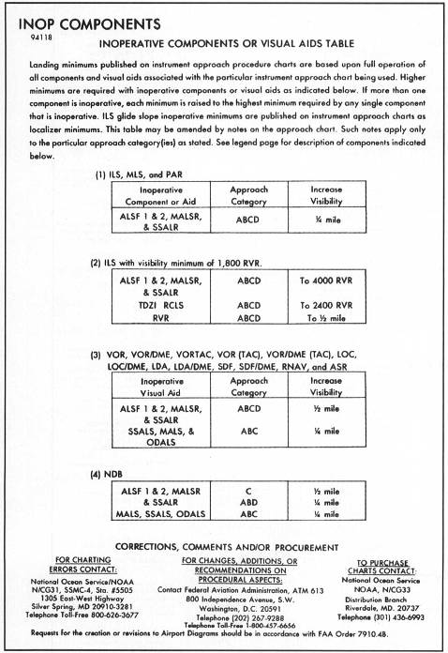
VOR Approach Problems
Report any instrument or communication malfunctions to ATC
If full deflection of the CDI at any time, go missed but follow the course do not turn out early
Inoperative components
No change in MDA
Increase visibility requirements – ¼ to ½ sm

Slide 40
Considerations
If you are low generally do NOT climb – level off and re-intercept
Make small adjustments – see what happens and readjust
Remember sensitivity increases as you get near the VOR
DO NOT FLY VOR needles – bad things will happen! FLY the DG and AI
With aircraft properly trimmed small changes in power will cause a pitch change and allow you to maintain airspeed
Must execute missed after the MAP if you lose sighting of the runway environment
Runway environment
Approach lighting system – not below 100’ AGL until you see red side lights or red terminating bar
Runway or runway markings or lights
Threshold, threshold markings or lighting
REILS
VASI
Touchdown zone or markings or lighting
Know for the approach
IAF and how to arrive at the FAF
Minimum altitudes for each segment and MDA
Missed approach procedure

Slide 41
Common Errors
Failure to have essential approach information in memory
IAF
FAF
Altitudes, including MDA
MAP
Poor communications
Failure to complete checklist items or use checklist
Descent below altitudes (keep a cushion on checkride)

Slide 42
QUESTIONS

