Slide 1
VOR
VOR
NAVIGATION
VORTAC
VOR / DME

Slide 2
VOR / DME Terminology
CDI – Course deviation indicator is a needle hinged to move laterally across the instrument face to show course deviation
DME – Distance measuring equipment
HSI - combines the DG heading indicator with the CDI to provide better situational awareness of location with respect to the course line
TACAN - Military tactical air navigation (TACAN) equipment
VORTAC - When a TACAN is co-located with a VOR, it is known as a VORTAC
VOR is short for Very-High Frequency Omnidirectional Range
VOR / DME - When a DME station is co-located with a VOR, it is known as a VOR / DME
VOT - A VOT is a low-power VOR station that transmits only the 360° radial to use as a VOR receiver check
Phantom or Ghost VOR – Occurs when a TACAN is not frequency paired with a VOR, but a VOR frequency is presented to enable DME tuning – e.g., Ellington (EFD) ILS 17R EFD TAC 31 is on frequency (109.4)

Slide 3
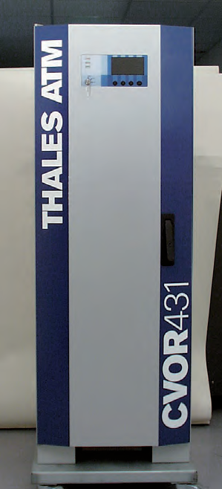
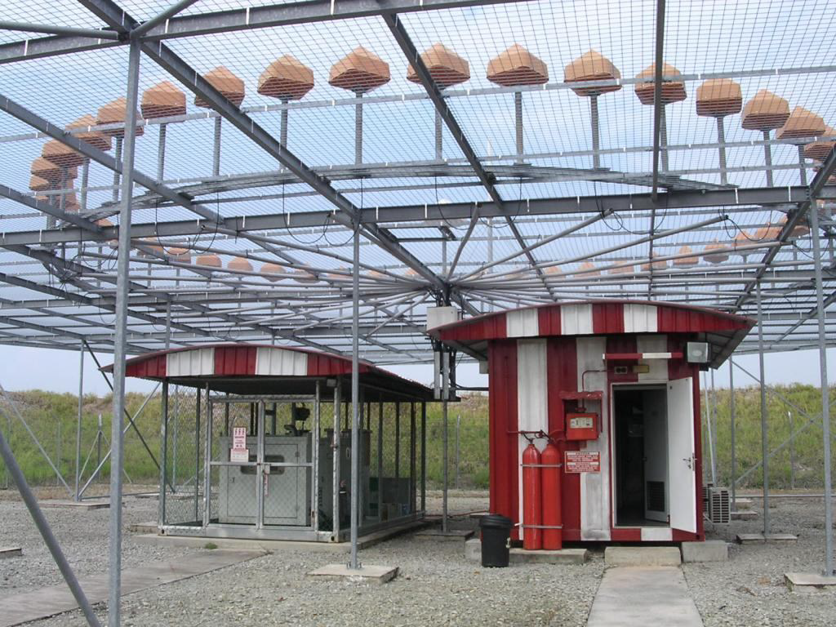
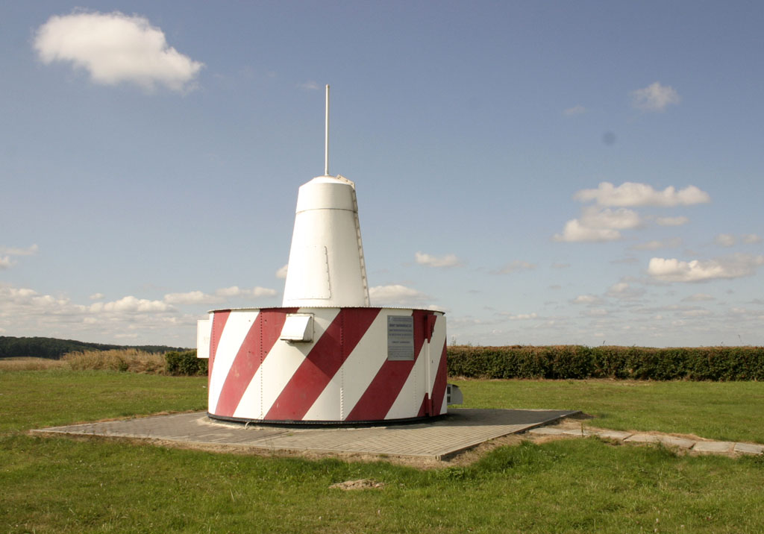
VOR Ground Station

Slide 4
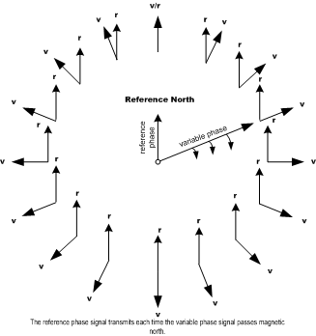
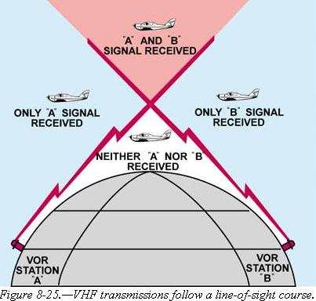
VOR Station Signals
Two signals are transmitted from the ground station
Non-directional reference phase
Transmitted every time the variable phase transmission sweeps past magnetic north - 0°
Rotating variable phase
Transmits cyclically around the 360 degrees of the azimuth approximately 30 times per second
This signal is transmitted by the antennas circling around station
Both signals are transmitted 30 times per second
Radial information is derived by aircraft’s receiver from the difference in time between the two signals (which is different for each radial) – called phase difference
Courses oriented FROM the station are called radials
VOR operates in the 108 to 118Mhz VHF range
Low power – Generally 50 (terminal VOR) to 200W (high altitude)
VORs transmit “line of sight”
Lower you fly, the closer you must be to pick up a signal
Accuracy is within ± 1°

Slide 5
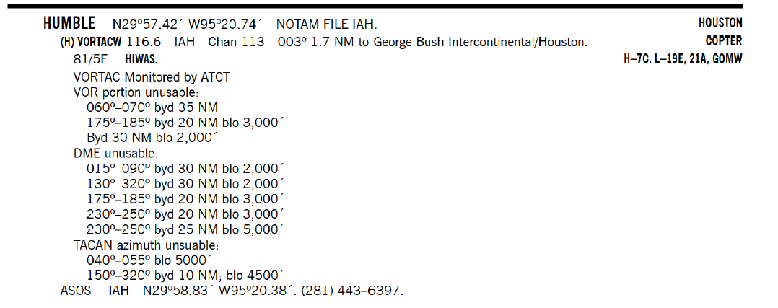
VOR Station Signals
VOR is oriented to magnetic north
BUT the VOR uses the variation that was established when the VOR was installed or last updated
Variation of the VOR is shown in the AFD
Elevation of the VOR / Variation

Slide 6
VOR Station Signal Restrictions
Signals are not always available in all service areas
Check AFD
Check Notams
Monitored status of VOR
Unusable VOR areas
Unusable DME areas
Unusable TACAN areas

Slide 7
VOR Station Signals Unmonitored VOR
VORs, VORTACs, and TACANs have an automatic course alignment and signal monitor (ACM). The ACM is usually connected to a remote alarm. When the ACM detects a malfunction, the unit switches to a standby transmitter. If the standby transmitter does not work properly, the facility will shut down.
“Unmonitored" means that there is no ability to observe the VOR’s operational status due to a problem or because the VOR was not designed to be monitored
An unmonitored VOR / DME is likely functioning normally
To use, tune and identify the unmonitored VOR
If a reliable signal is not received, notify ATC so they may conﬁrm if the VOR is out-of-service
A reliable signal can be used – BUT maintain a constant listening watch on the frequency and vigilantly watch for flags
Remember, an airport may not be used for an alternate if the airport NAVAID is unmonitored

Slide 8
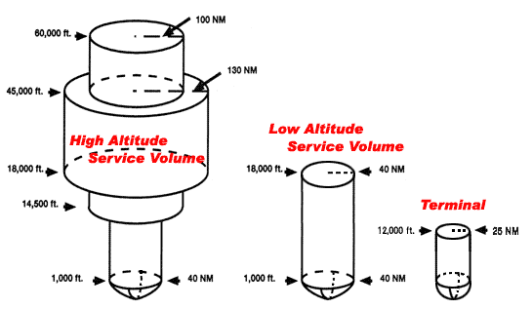
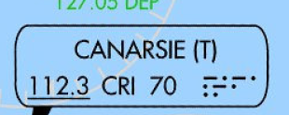
VOR Ground Station Classes
"L" and "T" VORs have an (L) or (T) after the identifier on NACO Enroute High Altitude charts. "T" VORs on NACO Enroute Low Altitude charts have a (T) following the identifier. H and L classes are not differentiated on the chart.
LOW
From 1,000 feet AGL up to and including 18,000 feet AGL -> 40 NM.
HIGH
From 1,000 feet AGL up to and including 14,500 feet AGL -> 40 NM
From 14,500 AGL up to and including 60,000 feet -> 100 NM
From 18,000 feet AGL up to and including 45,000 feet AGL -> 130 NM.
TERMINAL
From 1,000 feet AGL up to and including 12,000 feet AGL -> 25 NM
Noted with (T), (L) and (H) on Jepp enroute charts in the VOR box

Slide 9
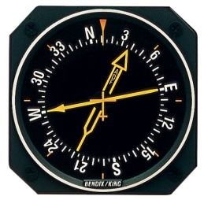
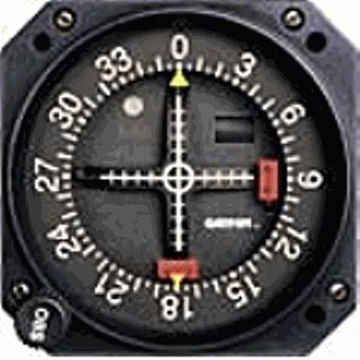
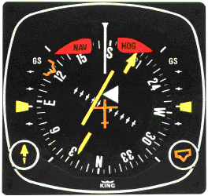
VOR Aircraft Equipment
Nav receiver and VOR indicator instrument (CDI display, HSI, RMI or glass cockpit display)
DME receiver
Can substitute GPS distance – BUT be careful measuring points may not be the same
RMI
CDI
HSI

Slide 10
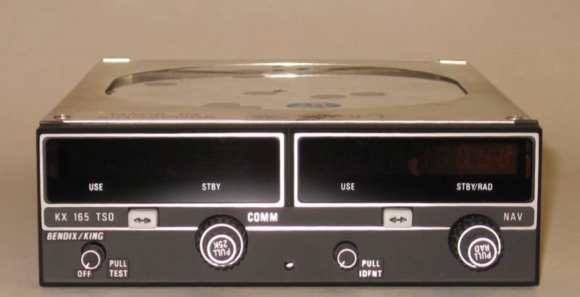
VOR Aircraft Equipment
VOR Frequency Display – In use and stand-by
Identification feature and volume control
Tuning knob
Some receivers will display the radial you are on

Slide 11
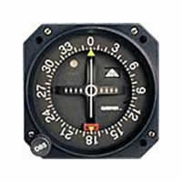
VOR Aircraft Equipment VOR Indicator Instruments
OBS Selected
To/From indicator
Course deviation indicator (CDI)
CDI
HSI
OBS – or radial selector

Slide 12
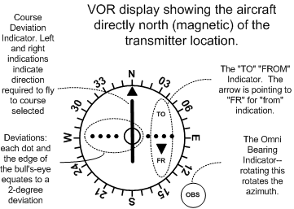
VOR Aircraft Equipment
Fly to the
Bar!
VOR Indicator’s three main parts:
the Omni Bearing Selector (OBS) - rotating azimuth dial (Rotating Course Card) which provides for bearing selection
the Course Deviation Indicator (CDI) - vertical needle that moves laterally along a row of dots, each dot representing 2°; the CDI can be centered by rotating the OBS; when this is done the aircraft position on the indicated VOR radial
TO/FROM flag – Indicates whether the aircraft bearing is on the “to” or “from” side of the VOR

Slide 13
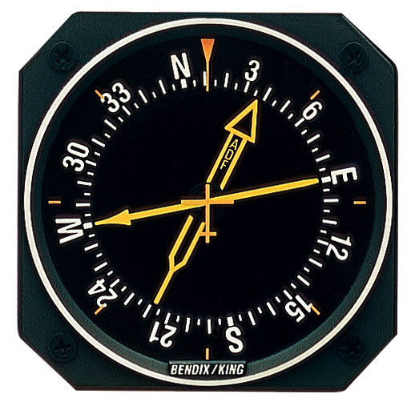
Radio Magnetic Indicator (RMI)
RMI is a bearing indicator
The bearing indicator (pointer) always points to the VOR station
The bearing indicator, in turn, is superimposed on an azimuth display that is virtually identical to the aircraft’s heading indicator
In the example to the right, the aircraft is flying a heading of 010°, the bearing to the VOR is 270°, and the aircraft is currently crossing the 090° Radial
ADF
VOR Pointer

Slide 14
VOR Aircraft Equipment
VOR indicator instrument Warning Flags
“OFF” flag
Indicates an usable or unreliable signal
Flag retracts from view when signal strength is sufficient for reliable indications
Nav radio may not be powered
Insufficient signal strength may also be indicated by a blank or OFF in the TO/FROM window

Slide 15
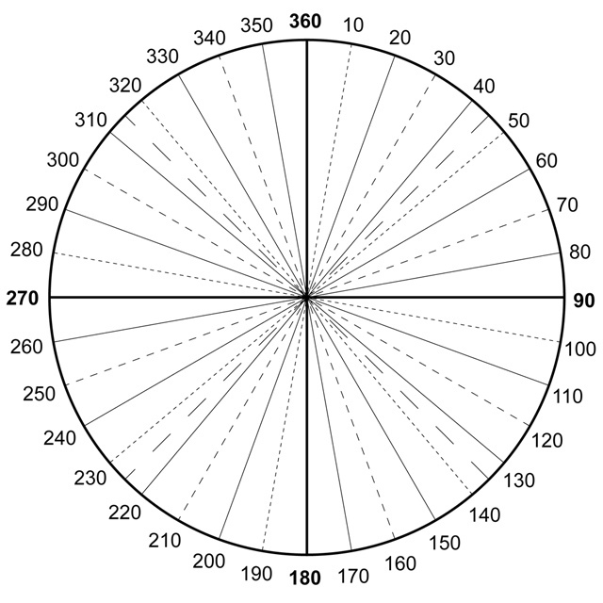
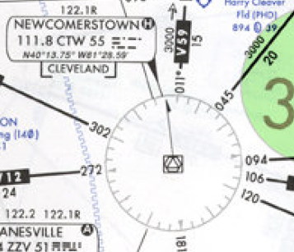
Radials
There are 360 radials radiating from the VOR
The CDI (needle) will center when you turn the OBS to the radial you are on and will have a FROM indication
The CDI (needle) will ALSO center AGAIN when you turn the OBS to the radial 180° from the one you are on. This radial will have a TO indication

Slide 16
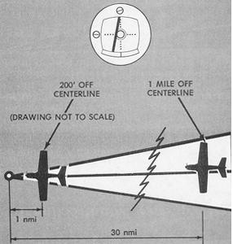
Radials
Each radial represents 1°
How far apart are the radials?
At 60 NM from the station radials are 1 NM apart
Distance for crossing radials - Distance = (Miles from station / 60) X number of degrees difference between radials
E.g., -- (15 miles from station / 60) x (going from 090° radial to 080° radial or 10° difference) = 2.5 NM between the radials
Width of a radial increases with distance from the station
Hence CDI becomes “more sensitive” as you get closer to the station
“Funnel effect” of the signal

Slide 17
Using the VOR Signals Don’t Use the VOR Until you know it's working
Tune the VOR frequency on the aircraft’s receiver
Identify the VOR
Use the “indent” function on the receiver to hear the VOR Morse code identifier (three letters)
Dots and dashes are shown on IFR charts and approach plates
Confirm there is no failure flag and that the needle does not have erratic indications
DME coded identifier is transmitted once for every 3 or 4 times the VOR identifier transmits. About once every 30 seconds. DME identifier is also higher-pitched 1350 Hz compared with 1020 Hz for a VOR
Can also listen to DME identifier on the DME receiver in many cases
Test - Center the CDI and check that the selected heading changes by 10 degrees at full scale CDI deflection
Failure
flag

Slide 18
Interpreting – CDI Needle
The CDI needle represents the desired VOR “radial” under the course index
If the CDI is 1 dot off of the center, the airplane is 2° off the selected radial (if 5 dots per side are indicated)
The CDI will deflect to either side depending on how many degrees the aircraft is off the selected radial
Full deflection of the CDI from the selected radial indicates the aircraft is 10° or more from the selected radial
Course Index
Dots

Slide 19
Interpreting – TO/FROM Flag
The TO / FROM flag reflects the aircraft’s position relative to a line through the VOR that is perpendicular to the radial shown under the index
In this case the perpendicular line runs from the 270° radial to the 090° radial
Which means the aircraft is on a radial from the 090° radial to the 270° radial on the bottom half of the instrument

Slide 20
Interpreting – TO/FROM Flag
The flag always indicates the course to the VOR! Assuming the aircraft is moving in the general direction of the OBS
A “TO” flag means the aircraft has not yet passed the VOR on that radial
A FROM flag, however, means the aircraft is past the station on the indicated radial and, if on that heading, moving further away
If the TO / FROM is blank or neutral, the aircraft is in the “zone of confusion” or on a radial perpendicular to the OBS (90° or 270° in this case)

Slide 21
Interpreting – TO/FROM Flag
If the TO Flag points down (from), the course to the station will be in the lower part of the instrument face (flying the course under the course index will take you away from the station)
If the TO Flag points up, the course to the station will be in the upper part of the instrument face as the plane is located in the lower part
When the CDI is centered, the course to the station is indicated either under the upper or lower course index of the instrument depending on the TO/FROM Flag
If the CDI is not centered then the course must be interpolated by the number of dots the CDI is off-center

Slide 22
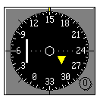
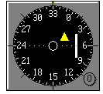
Interaction of the CDI Needle and TO/FROM Flag
The course index defines the selected radial
The selected radial also sets which side the TO/FROM flag points to
When 150° course is changed to 330° course the FROM flag would show TO as the radial is changed 180 degrees – Note that the CDI also changes sides

Slide 23
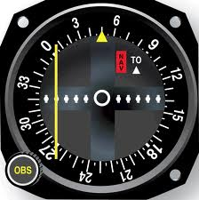
Interpreting – Where Am I
The position of the aircraft in relation to the VOR station is always:
On the opposite side of the TO flag
On the opposite side of the CDI
The VOR is on the bearing of the OBS hdg ±CDI deviation
With a TO flag left is minus right is plus.
With a FROM flag left is plus and right is minus.
However, it is easier to look at the end of the CDI needle which is on the same side (top or bottom) as the VOR (indicated by the FLAG) and use that as an indicator of whether the radial is + or - the CDI needle
Aircraft is in the lower right quadrant of the VOR
- Station is ahead of the aircraft
- Aircraft is to the right of the radial

Slide 24
Interpreting – Where Am I Thinking in Quadrants
The CDI needle eliminates half of all possible headings to the station (Left or Right)
The TO / FROM indicator eliminates half of all possible headings to the station (Ahead or behind)
The result is that the VOR indicator instrument always provides the course to the station within ninety degrees -- "quadrature"

Slide 25
Interpreting – Where Am I Thinking in Quadrants
The OBS in this example is tuned to the 150° radial
CDI needle shows that all headings intersecting the 150° radial lie on the left side of the OBS, between 150 and 330°
TO/FROM flag indicates that the headings to the station lie at the bottom of the OBS between 060 and 240°
Superimposing the two hemispheres, it is clear that the headings that intercept the 150° radial and fly toward the station lie between 060 and 330°
To intercept the 150° radial at a 45° angle and flying toward the station requires a course of 015° (60° - 45°)
Conversely, intercepting the 150° radial at a 45° angle and flying away from the station requires a course of 105° (60° + 45°)

Slide 26
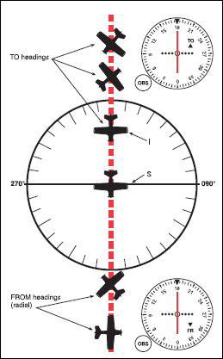
Interpreting – Where Am I Direction of the Aircraft
The VOR will have the same indications regardless of which way the airplane’s nose is pointing
To keep the CDI needle indication moving in the correct direction
When flying to the station, the OBS should be tuned to the reciprocal of the desired radial to keep the heading to the station at the top of the VOR indicator instrument and on the side of the CDI
E.g., If flying inbound to the station on the 180° radial, the OBS should be tuned to the 360° radial
When flying away from the station, the OBS should be tuned to the radial on which you are departing from the station
E.g., If flying outbound from the station on the 180° radial, the OBS should be tuned to the 180° radial
If you set the OBS to the reciprocal of where it should be, the CDI will reflect reverse sensing. To correct for reverse sensing needle deflection you must fly away from the needle.
To avoid this reverse sensing situation, set the VOR to agree with your intended course.

Slide 27
Where Am I
To find the aircraft’s position relative to a VOR
Rotate the OBS until FROM appears in the window
Then center the CDI needle
The index line at the top of the instrument indicates the VOR radial on which the aircraft is located
The course to the VOR is the reciprocal of the radial on which the aircraft is located
With an RMI, the RMI needle tail will indicate which radial you are located on

Slide 28
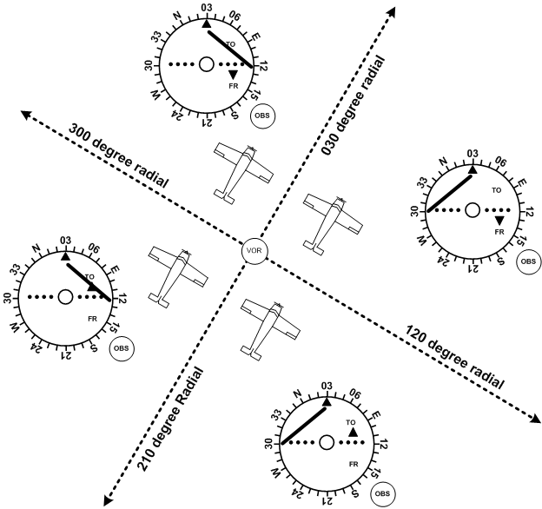
Interpreting – Where Am I
Located on same side of VOR hemisphere from the radial – hence “FROM” indication - VOR is behind the aircraft
VOR indicator instrument CDI display information has nothing to do with the heading of the aircraft!
Think of the four quadrants to understand where you are
In the example with the 030° radial selected (top of the Azimuth card)
Observe the CDI indications change based on which quadrant the aircraft is in
Aircraft orientation has no effect
Selected radial
CDI Needle shows direction to fly to reach the selected radial
You are on the opposite side of VOR hemisphere from the radial – hence “TO” indication - VOR is in front of the aircraft

Slide 29
Interpreting – Where Am I
FLY TOWARDS THE NEEDLE TO REACH THE COURSE
If the CDI is deflected to the right, it means the aircraft is to the left of course and you must fly to the right to intercept the 030° radial
This logic only works if the aircraft is oriented to the OBS selection
CDI Needle shows direction to fly to reach the selected radial

Slide 30
Going Somewhere? Tracking and Homing
Keeping the CDI centered will take the aircraft to the station
To track to the station, the OBS value at the index is not changed
To track FROM the station: a) position the aircraft on the desired radial; b) center the CDI needle with a FROM indication; and c) fly the appropriate course to keep the CDI centered. If the CDI deflects, right or left, fly a corrective course towards the CDI needle to re-center the CDI
To home to the station, the CDI needle is periodically centered, and the new course under the index is used for the aircraft heading
Homing will follow a circuitous route to the station, just as with ADF homing. Tracking to the station is almost always used.

Slide 31
Going Somewhere? Intercepting a Course
Turn to a heading to roughly parallel your desired course
Rotate the OBS until the CDI needle centers with a TO flag showing for an inbound course or a FROM flag for a course away from the VOR
Note the number of degrees between the course which centers the CDI and your desired course
Double the difference to find an intercept angle
Angle should not be less than 20° or more than 90°
Rotate the OBS to the desired radial
Turn toward the CDI to your selected intercept angle
When the CDI begins to center you are closing in on the desired radial and should begin reducing the intercept angle to turn on the desired radial
Timing is key to avoid under or overshooting the desired radial
Can judge by the speed at which the CDI is moving towards the center

Slide 32
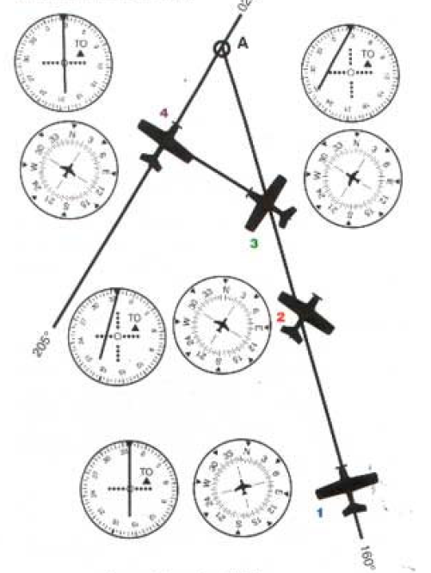
Going Somewhere? Intercepting a Course
Reduce the intercept angle to turn on the desired radial
Assume you are on the 160° radial and want to intercept a 025° course to track inbound to the station
Compute intercept and then turn to the intercept heading
Intercept Computation
Rotate OBS to center it with TO flag (340°)
Find degrees of difference between desired course and OBS (025° - 340° = 45° difference)
Double the difference = 90°
Rotate OBS to 025°
Intercept course = 025°- 90° = 295° (this course can also be quickly seen at the 90° mark on the VOR instrument)
Note: Can be easier to subtract 180 degrees initially and compute in the lower hemisphere
Turn to a heading of 025°
Inbound on the 160° radial – Heading 340°

Slide 33
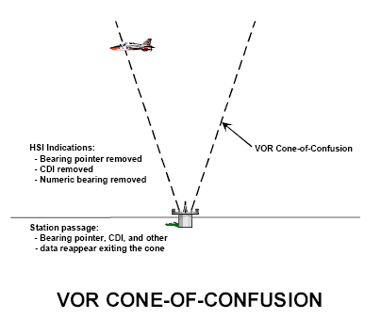
Zone of Confusion
An inverted cone that is centered over the VOR is called the zone of confusion
In the zone of confusion the CDI needle becomes very sensitive and oscillates from side to side and may become unusable
You may see an off flag on the TO / FROM indicator or CDI
Cone gets smaller as your altitude above the station decreases

Slide 34
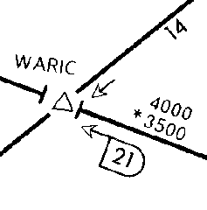
Radials Identifying an Intersection
You may need to identify an intersection of two VOR radials
where an airway changes heading
to intercept another airway
change in minimum altitude
holding point
reporting point for ATC
Intersection is identified by two VOR radials or sometimes one VOR radial and DME
DME

Slide 35
Radials Identifying an Intersection
Tune and identify each station on a separate VOR
Set the OBS on each
Wait for both CDI needles to center and/or DME to be reached
Can also use 1 VOR switching between frequencies and radials

Slide 36
High Altitude VOR Use DME / RNAV Required
FAR 91.205(e)
If VOR navigation is used at or above FL 240 the aircraft must be equipped with approved DME or a suitable RNAV system
When the required DME or RNAV system fails at and above FL 240, the pilot in command of the aircraft must notify ATC immediately, and then may continue operations at and above FL 240 to the next airport of intended landing where repairs or replacement of the equipment can be made

Slide 37
VOR Operational Errors
Failure to properly identify a station
Failure to check the accuracy / sensitivity of the instrument
Turning in wrong direction from mis-perceived orientation
Failure to check ambiguity indicator, resulting in reverse sensing and corrections in the wrong direction
Failure to initially parallel desired radial on a track interception problem
Overshooting or undershooting radial on interception
Over-controlling corrections during tracking, especially close to the station when the CDI is very sensitive
Misinterpretation of station passage (voice transmission may cause transient fluctuation of TO/FROM indicator)
Chasing the CDI needle resulting in homing instead of tracking
Certain propeller RPM settings may cause CDI fluctuation of up to 6° (correct with slight RPM change)

Slide 38
Required VOR Equipment Checks
FAR 91.171 requires 30-day VOR checks if using VOR for IFR operations
Test Types
VOT – Must be within +/- 4°
Test signal – Radio repair station – Must be within +/- 4°
Surface Check point – Must be within +/- 4° - check can be done on the ground or in the air in many cases
If no VOT or surface checkpoint is available – then use an Airborne checkpoint - Must be within +/- 6°
If no VOT or checkpoint – then fly directly over a prominent ground point along a VOR radial that lies along the centerline of a VOR airway (preferably >20 miles from the VOR) and note the VOR indication - Must be within +/- 6°
If two independent VORs onboard the aircraft – Tune each VOR to the same station and center the CDI needles – Maximum differential between the indicated bearings cannot be more than 4°
Record the results in the aircraft log or other log
Date
Place
Bearing error
Signature of person conducting the check
Date | Place | Bearing Error | Signature

Slide 39
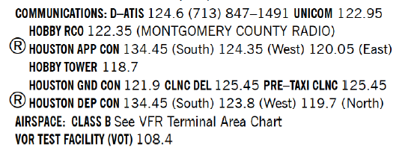
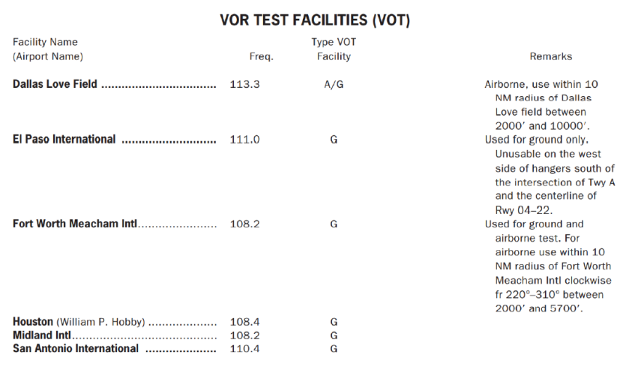
VOR Test Facility (VOT)
The VOT transmits a signal which allows you to determine the operational status / accuracy of a VOR receiver:
on the ground
Some are available while in the air, but only in those areas and at the altitudes authorized in the A/FD or supplement
VOT locations are published in the A/FD on the applicable airport page and in the supplement
Two means of identification are used.
Morse code
Continuous tone
Information concerning a VOT’s test signal can be obtained from the local FSS
To use the VOT service:
Tune the VOT frequency on the VOR receiver
Center the CDI with a FROM indication
With the CDI centered, the OBS should read 0° with the TO/FROM indication showing FROM or 180°with TO showing in the TO/FROM indication.
An RMI should indicate 180° on any OBS setting

Slide 40
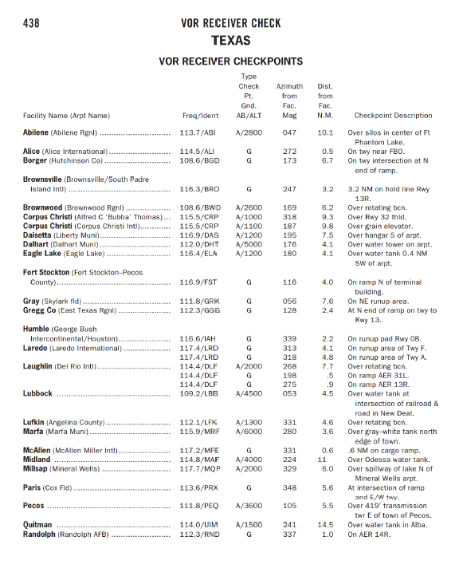
Certified VOR Checkpoint
Both airborne and ground checkpoints
Represent certified radials that should be received at specific points on the ground or over a specific landmark while airborne
Certified checkpoint locations are published in the A/FD supplement

Slide 41
DME Receiver
Remoted frequency
DME receiver tuned frequency
Tuning / volume knob
Distance
Ground speed / time functions
DME paired VOR frequency

Slide 42
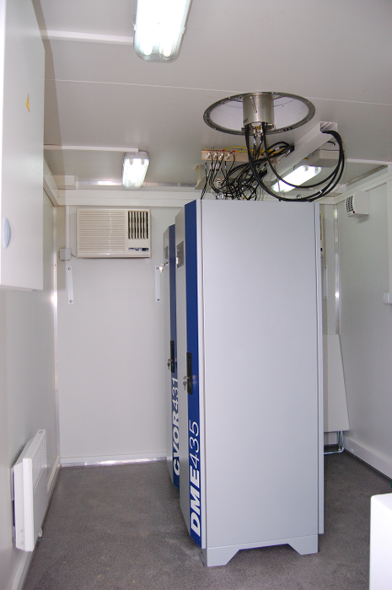
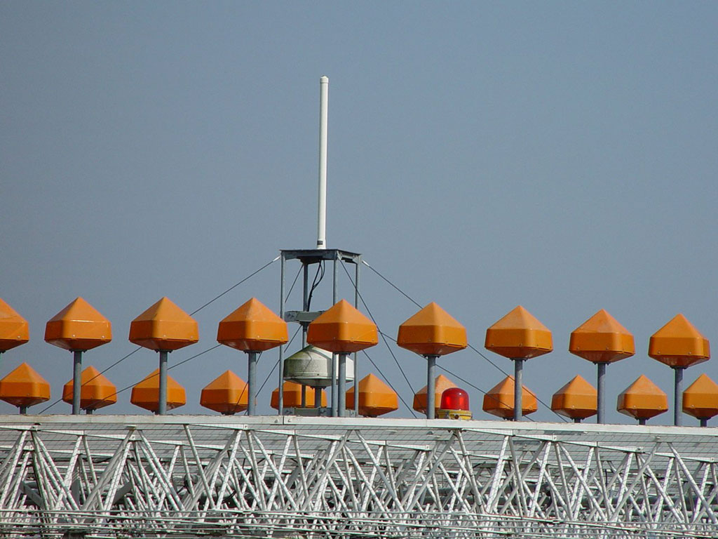
DME Ground Station
DME antenna

Slide 43
DME Characteristics
DME ground station is a separate piece of equipment with a separate antenna, even though paired with a VOR or TACAN
Aircraft DME unit (interrogator) generates a pulsed signal (interrogation) which is accepted by the DME ground station transceiver.
The DME station transceiver then generates pulsed signals (replies) that are sent back and accepted by the aircraft’s DME unit
Aircraft unit then computes distance by measuring the total round trip time of the interrogation and its reply
After two successful replies, a groundspeed can be calculated
DME Operates in the 962-1215 MHz (UHF) frequency band
BUT DME frequencies are paired with VOR frequencies; therefore, by selecting the VOR VHF signal, the appropriate UHF frequency is automatically selected in the DME equipment
System error (airborne and ground) is less than ±0.5 nm or 3 percent of the distance

Slide 44
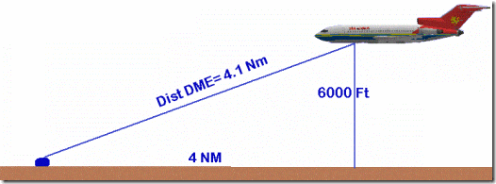
DME Operation
DME displays distance from or to a ground station
Two types of ground stations
VOR-DME
VORTAC
Identification is the same as for the VOR, except that the code repeats only once every 30 seconds
Distance is slant range, thus at 6,000’ over the station the DME reads 1NM even though the plane is directly over the station
DME allows you to find a positive position fix with only one VOR, using radial + distance to define fix
Some receivers have ETA information, however the data is not accurate unless proceeding directly to the station
The closer the airplane is to the DME station, the hypotenuse distance (slant range) is more affected by the vertical distance instead of the horizontal distance.
DME error is greatest when the aircraft is high and close to the DME station.

Slide 45
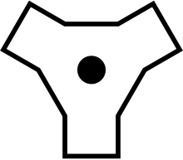
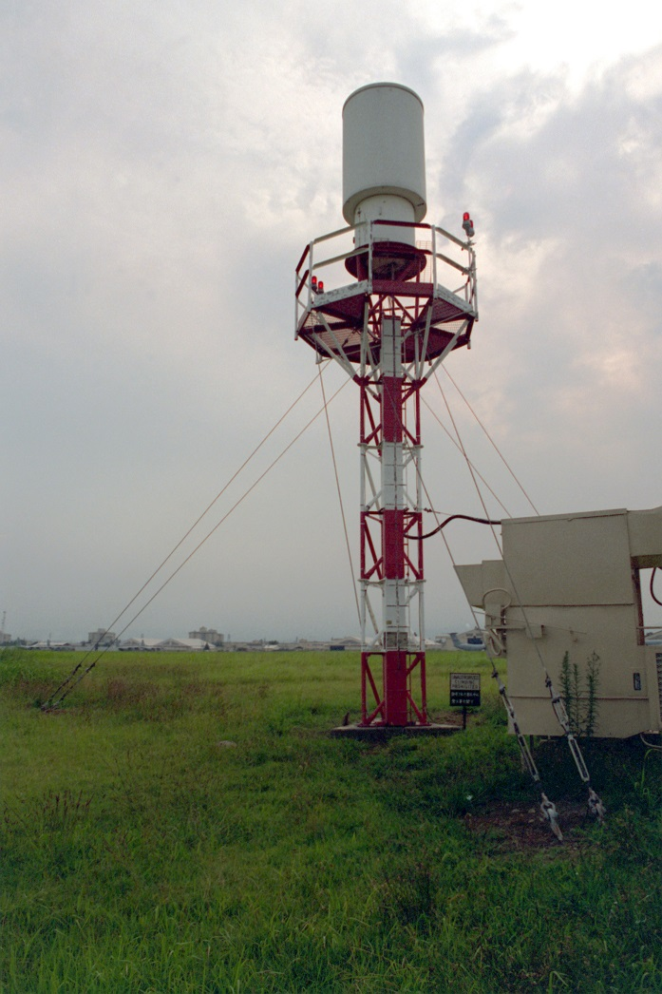
TACAN
TACAN, is a navigation system created for military aircraft
More accurate version of the civilian DME system
DME portion of TACAN is available for civilian use at VORTACs
Can provide distance up to 390NM

Slide 46
Questions

Slide 47
Disclaimer
Instrument flight can be dangerous. Do not rely solely on this presentation – PROFESSIONAL INSTRUCTION IS REQUIRED
The foregoing material should not be relied upon for flight.
ALTHOUGH THE ABOVE INFORMATION IS FROM SOURCES BELIEVED TO BE RELIABLE SUCH INFORMATION HAS NOT BEEN VERIFIED, AND NO EXPRESS REPRESENTATION IS MADE NOR IS ANY TO BE IMPLIED AS TO THE ACCURACY THEREOF, AND IT IS SUBMITTED SUBJECT TO ERRORS, OMISSIONS, CHANGE.

