Slide 1
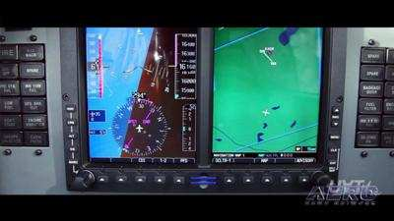
Unusual Attitudes
Unusual Attitudes
Unusual Attitudes
Unusual Attitudes

Slide 2
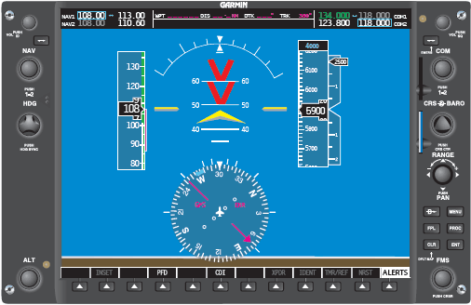
Causes of Unusual Flight Attitudes
Turbulence
Disorientation
Instrument failure
Confusion
Preoccupation with cockpit duties
Poor instrument scan / cross checking
Errors in instrument interpretation
Lack of proficiency in aircraft control

Slide 3
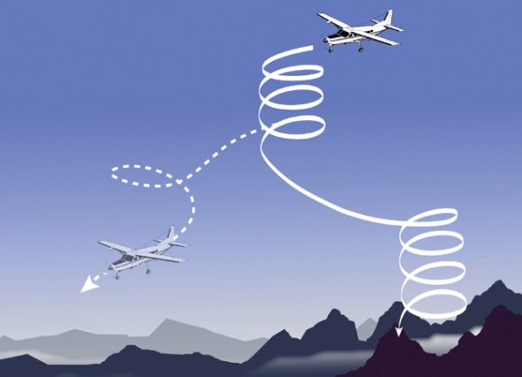
Graveyard Spiral IMC Loss of Control
If you fail to properly monitor instruments, for whatever reason, when you look back at the panel, you are most likely to be in a spiral dive
All airplanes that exhibit normal stability have an over-banking tendency usually begins bank angle 40°
Expect a spiral dive and train for it

Slide 4
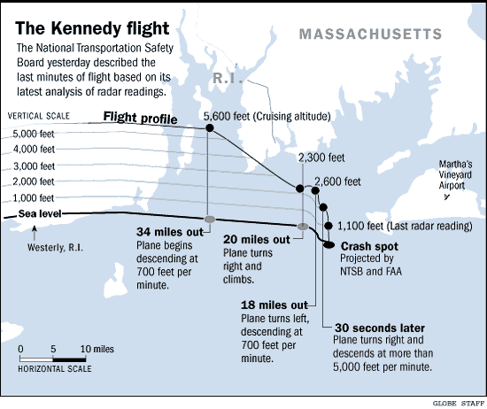
Kennedy Crash
N9253N was descending at approximately 900 fpm.
Around 2600’ he banked to the right at a constant rate.
Within 10 seconds, bank reached 45° and was 5° nose down.
The bank and pitch angles continued to increase thereafter at a constant rate until, 35 seconds later, the plane hit the water at a bank angle of 125°, a nose-down pitch attitude of 30°, descending in excess of 4,700 fpm.
The airspeed indicator and vertical speed indicator were at their maximum limits and the engine was developing full takeoff power.
The transition from "usual" to "unusual" required but 45 seconds

Slide 5
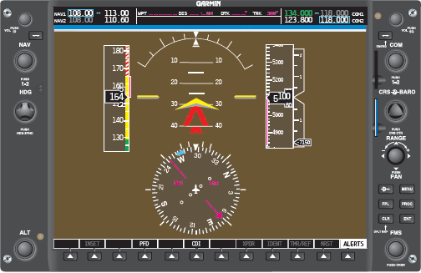
Recognizing an Unusual Attitude
First rule – Believe your instruments
Even if your body senses are screaming at
you that the instruments must be wrong
Promptly analyze the situation and take steps to correct your attitude
As a general rule, if an instrument’s rate of movement or indication is not what you would normally expect in the maneuver, assume an unusual attitude and increase the speed of cross-check to confirm the attitude, instrument error, or instrument malfunction

Slide 6
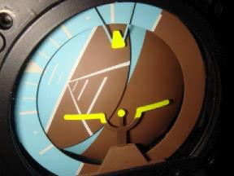
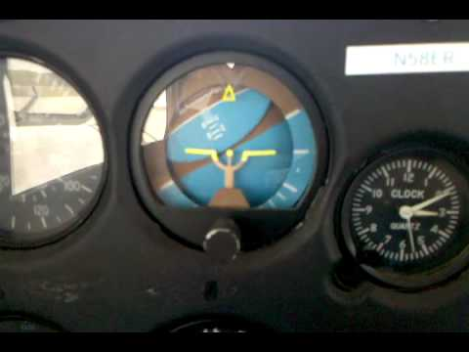
Recovery
As soon as an unusual attitude is detected, use the POH recommended recovery procedures
If there are no recommended procedures in the POH, recovery should be initiated by reference to the ASI, altimeter, VSI, and turn coordinator
Remember the AI may have tumbled

Slide 7
Recovery
Initial recovery objective is to regain straight and level flight. THEN a gradual return to the reference altitude and heading should be made
Do not attempt to return directly to the desired altitude and heading. This may increase disorientation or lead to another unusual attitude
Level pitch attitude is indicated by the reversal and stabilization of the ASI and altimeter needles
Pilots not used to unusual attitude recoveries will most likely panic and pull back on the yoke instinctively
At bank angles approaching 90 degrees, no amount of pull will produce sufficient vertical lift to keep the aircraft from spiraling downward

Slide 8
Recovery
Adverse effects from inappropriately pulling back on the yoke:
Induced drag increases with increased lift
Pulling will tighten the spiral dive
Above the maneuvering speed, pulling too hard could result in structural failure of the aircraft
Below maneuvering speed, pulling above the "aerodynamic limit" will cause an accelerated stall
At bank angles over 90 degrees, any lift on the wings will literally pull the nose to the ground

Slide 9
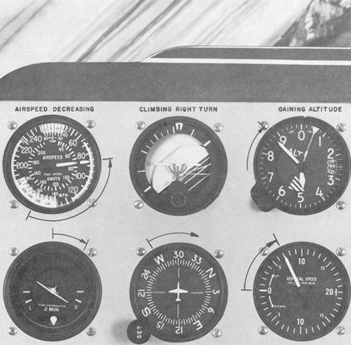
Recognizing an Unusual Nose High Attitude
Look at and analyze your flight instruments
Airspeed is dropping
Altitude is increasing
VSI is positive
Attitude indicator is showing a climb and possibly banking
Turn Coordinator - Greater than
standard rate turn (Full Deflection)

Slide 10
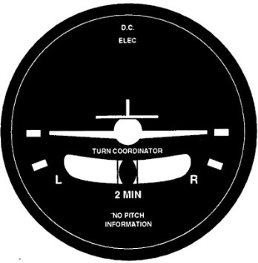
Recovery Nose High Attitude
Recovery from a low-airspeed, nose-high banking attitude - Take the following steps:
Increase power or full power to prevent a stall
Lower the nose to prevent a stall
Correct the bank by using the ailerons and rudder pressure so that you are in level flight and your turn coordinator is coordinated so that the miniature aircraft is level and the ball is centered
Use turn coordinator not the AI to determine turn direction as AI may have tumbled

Slide 11
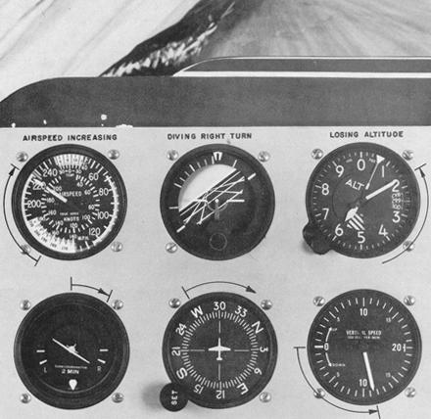
Recognizing an Unusual Nose Low Attitude
Recognizing a Nose-Low Unusual Attitude
Airspeed will be increasing
Altitude will be decreasing
VSI will show a negative rate of climb
Attitude indicator will be nose-low and possibly banking
Turn Coordinator - Greater than standard rate turn (Full Deflection)

Slide 12
Recovery Nose Low Attitude
Recovery from a nose-low banking attitude – Take the following steps:
Decrease Power or Power to Idle to prevent excessive airspeed and reduce altitude loss
Correct the bank attitude by using the ailerons and rudder pressure
Increasing the pitch while in a descending turn will tend to steepen the turn
Load factors are also increased with bank angle
Use turn coordinator not AI to determine turn direction as AI may have tumbled
Keep the ball centered – slips and skids increase disorientation and delay recovery
Raise the nose to level flight attitude by smoothly pulling back on the elevator
Keep controls coordinated to avoid a stall / spin
Avoid over-controlling and return to and trim for straight and level flight
After initial correction made, quickly scan to assure you have not over-controlled

Slide 13
Pitch
As the airspeed indicator needle stops moving, the aircraft is in a level attitude
Use the stationary altimeter needle as a guide to hold that altitude as wings are rolled level and a normal straight and level configuration is regained

Slide 14
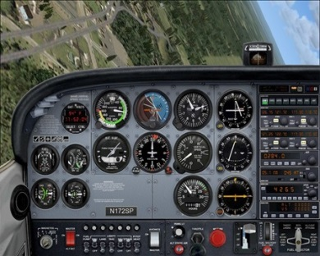
Steep Bank Roll Recovery
Rolling upright (thus orienting the lift vector upward) is a priority in a nose-low, over-banked, unusual attitude
Which way to roll?
Best to roll in the shortest direction to the horizon (step on the sky)
In the case of wake turbulence, if the aircraft is rolling in the vortex or if the roll cannot be arrested early, it is probably prudent to continue the roll in the direction of vortex
Regardless of direction, rolling will result in less altitude lost than pulling
Important to roll using rudder in the direction of roll
It "coordinates" the roll, eliminating adverse yaw, which would otherwise drive the nose downward
Quickens the roll
When applied at bank angles near 90°, it acts like the elevator does to "hold" the nose up
Wait until upright before beginning the dive recovery
Simultaneous application of aileron and elevator results in asymmetric loading or "Gs" and can produce very high, local stresses on the aircraft

Slide 15
Spiral Dive
Recognition
High or increasing airspeed, decreasing altitude, high angle of bank (usually turn coordinator on its stops), high rate of descent, high or increasing G-loads, and increasing rpm.
Any lift deficit will begin a downhill, spiral journey called a spiral dive
Recovery
Close the throttle
Simultaneously level the wings
Slowly pull out of the dive, and check airspeed
When the altimeter stops, check, set cruise power to regain cruise airspeed, hold and adjust (trim if required)
Remember smooth control movements above VA
Once straight and level flight has been regained, return to the original reference heading and altitude

Slide 16
Partial Panel
Use the airspeed indicator and/or the altimeter as the initial guide
Turn coordinator is favored over the AI for bank

Slide 17
Common Errors
Failure to keep the airplane properly trimmed.
A distraction can easily lead to inadvertent entry into unusual attitudes when trim is not proper
Disorganized flight deck. Hunting for charts, logs, computers, etc., can distract attention from flight instruments
Slow cross-check and fixations.
Impulse is to stop and stare when noting an instrument discrepancy
Attempting to recover by sensory sensations other than sight
Poor instrument skills

Slide 19
Disclaimer
Instrument flight can be dangerous. Do not rely solely on this presentation – PROFESSIONAL INSTRUCTION IS REQUIRED
The foregoing material should not be relied upon for flight
ALTHOUGH THE ABOVE INFORMATION IS FROM SOURCES BELIEVED TO BE RELIABLE SUCH INFORMATION HAS NOT BEEN VERIFIED, AND NO EXPRESS REPRESENTATION IS MADE NOR IS ANY TO BE IMPLIED AS TO THE ACCURACY THEREOF, AND IT IS SUBMITTED SUBJECT TO ERRORS, OMISSIONS, CHANGE

