Slide 1
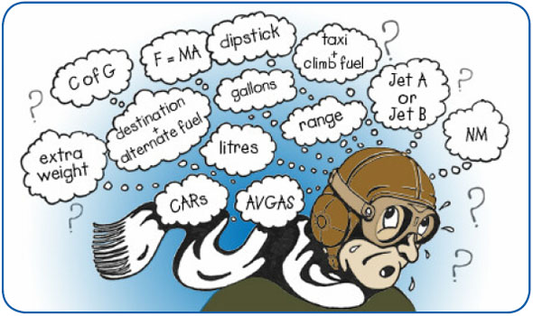
Single Pilot Resource
Management
&
Aeronautical
decision Making
Superior aviation knowledge and decision skills precludes the need to demonstrate superior pilot skills

Slide 2
Single-Pilot Resource Management
Single-Pilot Resource Management (SRM) is defined as managing all the resources (both on-board and outside the aircraft) available to a single-pilot (prior and during flight) to ensure that the successful outcome of the flight is never in doubt
SRM is all about helping pilots learn how to gather information, analyze it, and make decisions
SRM is a set of skill competencies that must be evident in all PTS tasks
A DPE is required to evaluate your ability to use good aeronautical decision-making procedures in order to evaluate risks in scenarios that incorporate as many tasks as possible
Task saturation is often used to evaluate your (i) risk management skills in making safe aeronautical decisions and (ii) ability to utilize all the assets available in making a risk analysis to determine the safest course of action

Slide 3
Single-Pilot Resource Management
The following six areas support the SRM concept:
Aeronautical Decision Making
Risk Management
Task Management
Situational Awareness
CFIT
Automation Management
Neumonic - TRACAS

Slide 4
Single-Pilot Resource Management
Use all available resources to detect changes or expected changes not occurring – provides situational awareness
Use a decision model (ADM) to ascertain the best course of action in response to the input, considering all available resources for best outcome
Evaluate the risk
Evaluate the result– provides situational awareness
Personal risk attitude evaluation
Act on the decision
Risk Management
Stress Management
CFIT
Automation Management
Task Management
© Bob W

Slide 5
Single-Pilot Resource Management Monitoring
Use all available resources to detect changes or expected changes not occurring – to achieve situational awareness
Constantly monitor flight aspects to maintain situational awareness
Can use models such as 5P to assure your monitoring is broadly focused
5P model is based on the idea that pilots have essentially five variables that impact his or her environment and that can cause the pilot to make a single critical decision, or several less critical decisions
Relies on the pilot to adopt a “scheduled” review of the critical variables at points in the flight where decisions are most likely to be effective

Slide 6
Single-Pilot Resource Management Monitoring and the 5P Check
5 Ps are used to evaluate the pilot’s current situation on a schedule at key decision points during the flight, or when an emergency arises
Key decision points include:
Preflight
Pre-takeoff
Hourly or at the midpoint of the flight
Pre-descent
Just prior to the final approach fix or for VFR operations, just prior to entering the traffic pattern.
SRM “FIVE P” Check
The Plan
The Plane
The Pilot
The Passengers
The Programming
Use all available resources to detect changes or expected changes not occurring

Slide 7
Single-Pilot Resource Management Monitoring and the 5P Check
Each of the 5 variables can substantially increase or decrease the risk of the flight and are constantly updated
The Plan – the mission or task, including basic cross country flight planning elements - weather, route, fuel, curent publications, etc.
The Plane
The Pilot
“I’M SAFE” checklist
Proficiency
Currency
The Passengers – In SRM pilot interacts with passengers – good and bad
Can read checklists, verify PIC performance of an action, re-verify that the gear is down and the lights are on, look for other aircraft and even tune radios
The Programming – Automation management –
Can cause task fixation - Automation tends to capture a pilot’s attention and hold it for long periods of time
Plan ahead and know the equipment and buttonology
Use all available resources to detect changes or expected changes not occurring – provides situational awareness

Slide 8
Single-Pilot Resource Management Use of All Resources
Location of resource
Internal to the aircraft
External to the aircraft
Type of Resource
Human resources available include all other groups routinely working with the pilot who are involved in decisions that are required to operate a flight safely.
Including dispatchers, weather briefers, maintenance personnel, passengers, and air traffic controllers
Also includes self – self callout, touching items, etc.
Informational
Includes all of your pre-flight planning, performance data in the POH, checklists, situational awareness during your flight, any information you can get from your human resources, and your knowledge and experience
Equipment
Includes the aircraft and it’s equipment, and all the equipment available to you through the human resources

Slide 9
Single-Pilot Resource Management Use of All Resources
To make informed decisions, a pilot must be aware of the resources in and out of the plane
Useful tools and sources of information may not always be readily apparent, learning to recognize these resources is important
Pilot must also have the skills to evaluate when to use a particular resource and the impact its use has upon the safety of flight

Slide 10
Single Pilot Resource Management Internal Resources
Ability to manage workload is the most valuable resource a pilot has
Passengers even those with no flying experience can help (verbal help, help reading charts, etc)
Verbal communication reinforces an activity - even if talking to yourself. Touching also helps!
Pilots should have a thorough understanding of aircraft equipment and systems to help make good decisions
Checklists
Pilot’s operating handbook (POH)

Slide 11
Single Pilot Resource Management External Resources
ATC – assistance not only decreases pilot workload, but also helps pilots make informed inflight decisions. ATC can provide:
Traffic advisories
Radar vectors
Assistance in emergency situations
Direction finding equipment
Ground speed
Flight Service
En Route Flight Advisory Service (Flight Watch)
Assist lost aircraft and aircraft in emergency situations - DF

Slide 12
Risk Management PTS Requirements
Four fundamental risk elements associated with flight (PAVE)
Pilot
Aircraft
Environment
The operation (the purpose of the flight) or external pressures
Use a tool, such as the PAVE or 5P checklist, to help assess the four risk elements
Use a personal checklist, such as the I’MSAFE checklist, to determine personal risks
Use weather reports and forecasts to determine weather risks associated with the flight
Recognize risks and mitigate those risks throughout the flight

Slide 13
Single-Pilot Resource Management Risk Evaluation
Use all available resources to detect changes or expected changes not occurring – provides situational awareness
Two defining elements of ADM are hazard and risk
A hazard is any source of potential damage, harm or adverse health effects on something or someone
A hazard is a real or perceived condition, event, or circumstance that a pilot encounters
Detected through monitoring
Risk is the probability that a person will be harmed or experience an adverse effect if exposed to a hazard.
When faced with a hazard, make an assessment of that hazard’s potential to impact the flight
Then assign a risk value to the potential hazard.
The result is the pilot’s assessment of the hazard and risk
Different pilots see the same hazard differently based upon skill, knowledge, experience and other factors
Evaluate the risk

Slide 14
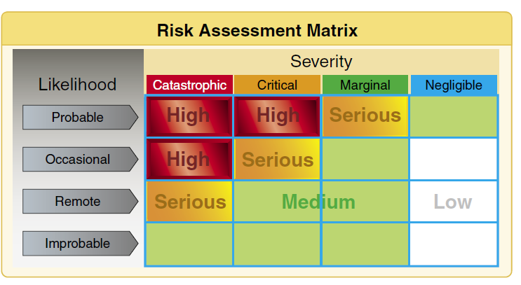
Single-Pilot Resource Management Risk Evaluation
Most basic risk hazard assessment tool is the risk matrix.
It assesses two items:
likelihood of a hazard’s occurrence and
the consequence of the hazard’s occurrence
Probable—an event will occur several times
Occasional—an event will probably occur sometime
Remote—an event is unlikely to occur, but is possible
Improbable—an event is highly unlikely to occur
----------------------------------------------
Catastrophic—results in fatalities, total loss
Critical—severe injury, major damage
Marginal—minor injury, minor damage
Negligible—less than minor injury, less than minor system damage

Slide 15
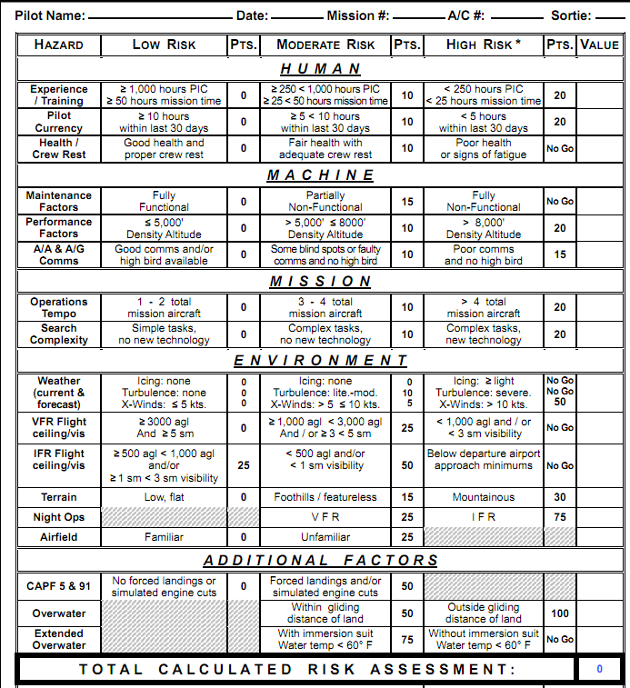
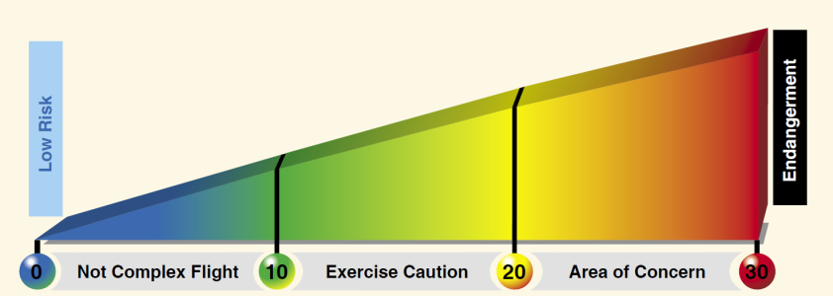
Single-Pilot Resource Management Risk Evaluation
A more aviation specific risk assessment matrix can be used that is tailored to your flying
Includes a wide array of aviation related activities specific to the pilot and assesses health, fatigue, weather, capabilities, etc.
The scores are added and the overall score falls into a range that assists with the evaluation of the risk

Slide 16
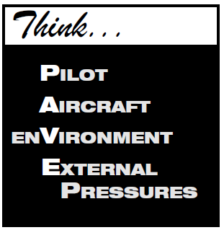
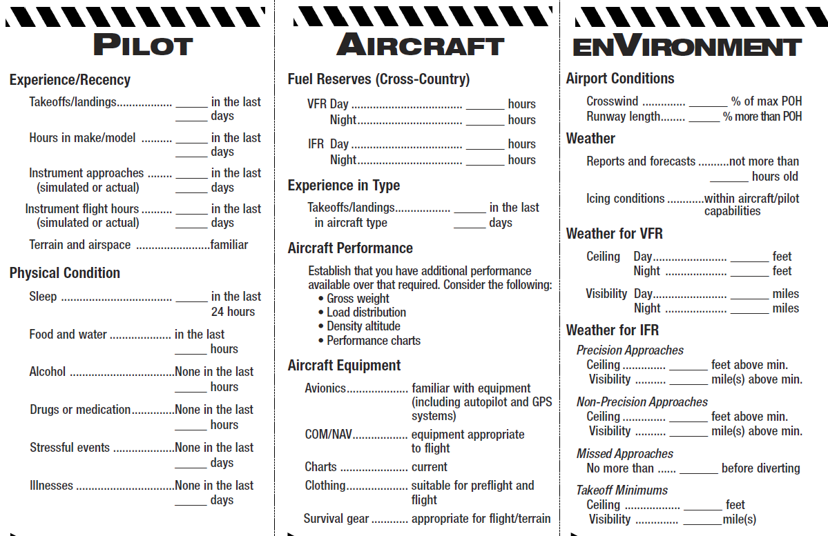
Single-Pilot Resource Management Risk Evaluation
PAVE checklist
simple way to remember each category to examine for risk prior to each flight
E = External Pressures - influences external to the flight that create a sense of pressure to complete a flight—often at the expense of safety. Factors that can be external pressures include the following:
• Someone waiting for the flight’s arrival
• Not disappointing a passenger
• Desire to demonstrate pilot qualifications
• Desire to impress someone. (Probably the two most dangerous words in aviation are “Watch this!”)
• Dsire to satisfy a specific personal goal (“get-home-itis,” “get-there-itis,” and “let’s-go-itis”).
• Pilot’s general goal-completion orientation.

Slide 17
Single-Pilot Resource Management Risk Evaluation
Develop a clear and comprehensive awareness of your particular situation - For each element, ask “what could hurt me, my passengers, or my aircraft”

Slide 18
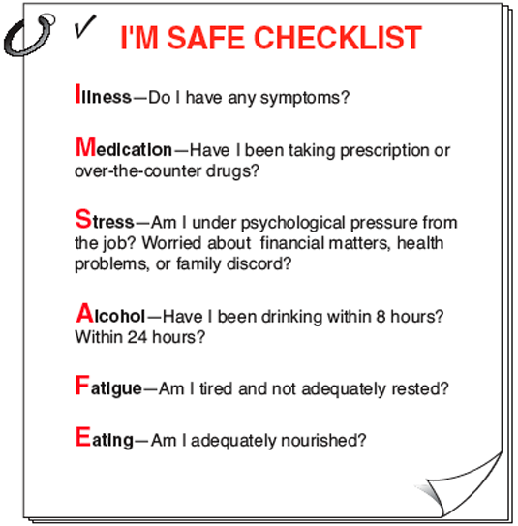
Single-Pilot Resource Management Risk Evaluation
I’M SAFE – Personal fitness for flight risk analysis

Slide 19
Single-Pilot Resource Management Personal Risk Attitudes
Evaluate the risk
Attitude is a predisposition to respond to people, situations, or events in a given manner
Attitude affects the quality of your decisions
Limits freedom of decision
Impacts risk assessment
Studies have identified five hazardous attitudes that can interfere with your ability to make sound decisions and exercise authority properly
anti-authority, impulsivity, invulnerability, macho, and resignation
Recognition of hazardous thoughts is the first step toward neutralizing them
After recognizing a thought as hazardous, you must label the thought as hazardous
The final step is to state the corresponding antidote
Personal risk attitude evaluation

Slide 20
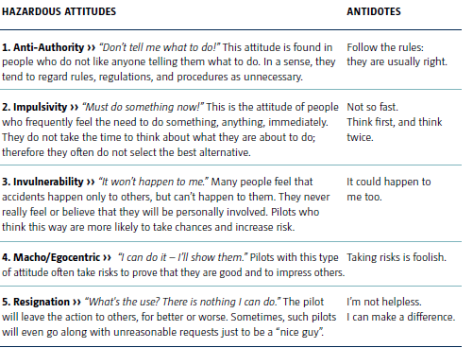
Aeronautical Decision Making Hazardous Attitudes and Antidotes
Hazardous attitudes contribute to poor pilot judgment but can be effectively counteracted by antidotes

Slide 21
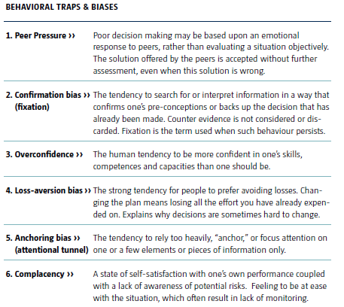
Aeronautical Decision Making Behavioral Traps and Biases

Slide 22
Single-Pilot Resource Management Decision Models
Personal risk attitude evaluation
While some situations, such as engine failure, require an immediate pilot response using established procedures, there is usually time to analyze changes that occur, gather information, and assess risk before making a decision
The process used to reach a decision is critical to the quality of the decision
Several decision models are regularly used in aviation
All start with the inputs of:
Hazards identified
Assessments of the risks
Personal attitude review – how did personal attitudes impact the risk assessment
Use a decision model (ADM) to ascertain the best course of action in response to the input, considering all available resources for best outcome
Act on the decision

Slide 23
Aeronautical Decision Making
Aeronautical decision-making (ADM) is a systematic approach to the mental process used by pilots to consistently determine the best course of action in response to a given set of circumstances (e.g., analyzing (i) changes that occur in flight and (ii) how they may affect a flight’s safe outcome). It is what a pilot intends to do based on the latest information he or she has – See Advisory Circular (AC) 60-22
ADM is a systematic approach to risk assessment and stress management designed to enhance the decision process to decrease the probability of human error
SRM is focused on the effective use of all available resources: human resources, hardware, and information and is the input to ADM to facilitate and improve decision-making

Slide 24
Aeronautical Decision Making
There is no one right answer in ADM, rather you are expected to analyze each situation in light of experience level, personal minimums, and current physical and mental readiness level, and make your own decision
Mentally process information about the circumstances that you have perceived / identified.
The goal is to evaluate the identified factors impact on the safety of your flight, and consider “why must I CARE about these circumstances?”

Slide 25
Aeronautical Decision Making Preliminary Steps
Steps for good decision-making are:
Identifying personal attitudes hazardous to safe flight
Learning behavior modification techniques
Learning how to recognize and cope with stress
Developing risk assessment skills
Using all resources
Evaluating the effectiveness of one’s ADM skills

Slide 26
Aeronautical Decision Making PTS Requirements
You must exhibit sound aeronautical decision making during the planning and execution of a flight through:
Use of a sound decision-making process, such as the DECIDE model, 3P model, or similar process when making critical decisions that will have an effect on the outcome of the flight.
An ability to explain the factors and alternative courses of action that were considered while making a decision
Recognition and explanation any hazardous attitudes that may have influenced a decision
The ability to decide upon and execute an appropriate course of action to properly handle any situation that arises that may cause a change in the original flight plan in such a way that leads to a safe and successful conclusion of the flight
An ability to explain how the elements of risk management, CFIT awareness, overall situational awareness, use of automation, and task management influenced your decisions and the resulting course of action

Slide 27
Aeronautical Decision Making DECIDE Model
Steps | Key Principle
Detect | Recognizing a change occurred or an expected change did not occur. A problem is perceived first by the senses and then distinguished through insight and experience. Objective analysis of all available information, are used to determine the nature and severity of the problem.
Estimate the need to react | In many cases, overreaction and fixation excludes a safe outcome
Choose a course of action | Determine the desirable outcome and choose a course of action
Identify solutions | Identify one or more solutions that will lead to a successful outcome. It important not to become fixated on the process to the exclusion of making a decision
Do the necessary actions | Select and implement the most suitable solution for the situation
Evaluate the effects of the actions | Evaluate the decision; repeat the loop, if needed

Slide 28
Aeronautical Decision Making 3P Model
Perceive, Process and Perform
To use it, the pilot will:
Perceive the given set of circumstances for a flight – develops situational awareness by constant monitoring pilot, plane, environment and external pressures (PAVE)
Process the information by evaluating the hazard’s impact and the severity (risk) on flight safety
Perform by implementing the best course of action to eliminate hazards or mitigate risk
Final step is to evaluate the action taken

Slide 29
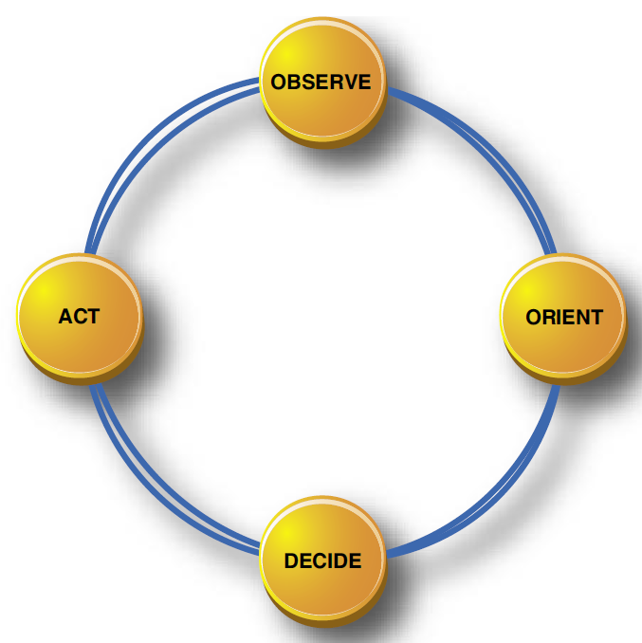
Aeronautical Decision Making OODA Loop
Observation, Orientation, Decision, Action
Observe = situational awareness through continuous monitoring
Orientation – focus the pilot’s attention on the issue
Decision - Decide on the effect to be achieved
Action – implement the decision
Evaluate the action in the observe phase of the next loop and readjust, if needed

Slide 30
Aeronautical Decision Making Time Pressured Decisions
Decision Type | Description
Skill-based | Stick and rudder type of behavior. Behavior that has been learned and ‘compiled’ over time and has thus become relatively fast, unconscious, and automated. Skill-based behavior doesn’t consume much mental resources
Rule-based | “IF this happens THEN I do that” type of behavior. At that level, decisions are based on pattern recognition: IF condition X is met, THEN implement action Y. This type of decision process is quasi-rational (i.e.: some cues can be processed analytically and others in a more automatic manner).
Knowledge-based | Simply called reasoning or problem solving behavior is applied in those situations where rule-based or skill-based answers are simply not available and the decision maker must resort to knowledge or mental models of more theoretical nature. Such situations for which no pre-existing solutions are available are often novel or unexpected. Decisions are based on conscious, analytical thinking and requires a considerable amount of mental resources and time. Under acute stress, knowledge-based decisions and solutions are error prone
Rushed decisions are often called automatic or naturalistic decision making

Slide 31
Aeronautical Decision Making Decision Errors
Situational Factors | The situations are not recognized as requiring a change of course of action, due to the ambiguity of the cues resulting in a poor representation or understanding of the situation (poor situation awareness)
Erroneous risk perception & risk management | Pilots typically under-assess the level of threat or risk associated with the situation, due to risk misperception or tolerance to risk
Goal conflicts | Pilots may be willing to take a safety risk (an unlikely loss) to arrive on time (a sure benefit). Social factors (for instance to please passengers) can also play a role. Peer pressure can encourage risky behavior. Also people seem to disregard risk to avoid losses. An en-route diversion can be seen as a loss
Workload and stress | Workload and stress may overload pilots, deteriorate mental processes (i.e.: tunneling of attention or vision, memory limitation, etc.) and lead to errors. As situations degrade, risk and time pressure may increase up to a point where making correct decisions becomes very difficult.

Slide 32
Aeronautical Decision Making Common Errors in ADM
“Pilot error” is an action or inaction that leads to a deviation from intentions and expectations
Deficiencies in pilot’s ability to control aircraft
Deficiencies in pilot’s "mental airplane" systems knowledge
Decision errors or human limitations
Filtering: Brain's working capacity is limited to about seven chunks, of information at one time, so we filter the flood of information arriving through our senses thus may unconsciously screen out vital information
Filling in the Gaps: When there is more information than the brain can accurately perceive and process, it compensates by filling in the gaps and may produce an interpretation that is not correct
Patterns and Expectations: The brain uses existing knowledge and experience as a shortcut to processing new information. This tendency can be useful, but it can also be dangerous

Slide 33
Aeronautical Decision Making Common Errors in ADM
Confirmation Bias: Human beings also have a tendency to look for information that confirms a decision we have already made. E.g., you might unconsciously give more weight to the information that supports your decision to press ahead
Make a conscious effort to identify your expectations, and then be alert to how reality differs
Framing: When you evaluate options for a decision, be sensitive to how you state, or "frame," your alternatives. If you frame the “continue flight” decision in positive terms you are probably more likely to decide on continuing. If, on the other hand, you frame the decision in negative terms (e.g., “I could get myself in real trouble if I push on”), you are more likely to divert to a safer destination.

Slide 34
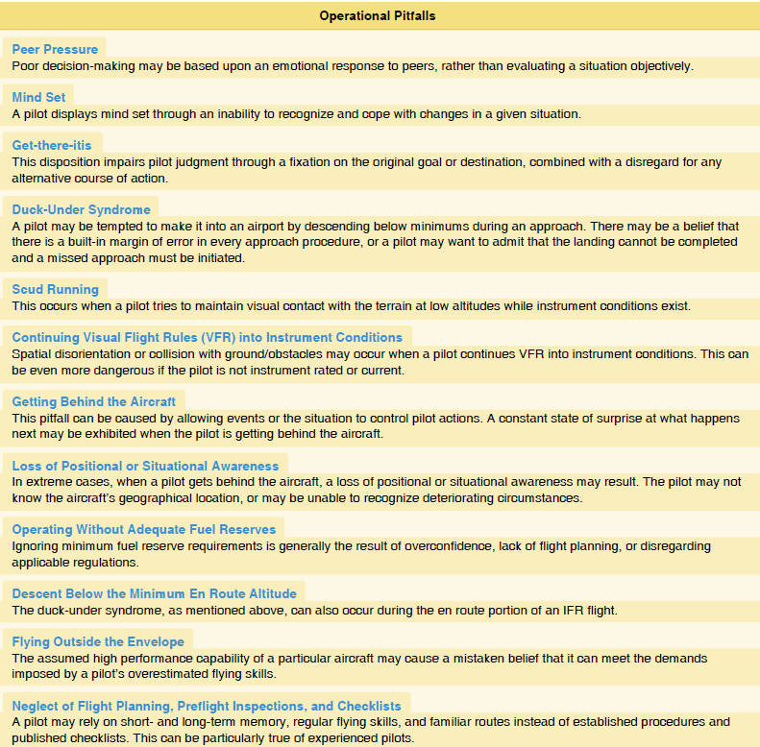
Aeronautical Decision Making Common Decision Pitfalls

Slide 35
Single-Pilot Resource Management Risk Management
Use all available resources to detect changes or expected changes not occurring – provides situational awareness
Determine which risks can be eliminated, reduced or controlled in some manner
Risk controls change a risk by impacting the exposure, severity or the probability of a hazard
Identify and then prioritize risk controls to get the most “bang for your buck”
Select a risk control mechanism
Accept no unnecessary risk
Implement the mechanism
Act on the decision
Risk Management

Slide 36
Aeronautical Decision Making Risk Management
Perceive, Process Perform with CARE and TEAM
Process hazards by using CARE checklist
Consequences
Alternatives
Reality
External factors
Perform risk management using the TEAM checklist
Transfer
Eliminate
Accept
Mitigate

Slide 37
Automation Management PTS Requirements
Explain how to recognize the current mode of operation of the autopilot/FMS
Explain how to recognize anticipated and unanticipated mode or status changes of the autopilot/FMS
State at any time during the flight the current mode or status and what the next anticipated mode or status will be
Use the autopilot/FMS to reduce workload as appropriate for the phase of flight, during emergency or abnormal operations
Recognize unanticipated mode changes in a timely manner and promptly return the automation to the correct mode

Slide 38
Single-Pilot Resource Management Automation Management
Use all available resources to detect changes or expected changes not occurring – provides situational awareness
Automation can be very helpful – but can make some errors more evident, create larger errors and hide other errors
Can be seductive and cause pilot to fixate on the automation or be lulled into complacency by the automation
Can increase workload, especially in terminal areas
Act on the decision
Automation
Management

Slide 39
Single-Pilot Resource Management Automation Management
Use all available resources to detect changes or expected changes not occurring – provides situational awareness
Pilot must know how to manage the course deviation indicator (CDI), navigation source, and the autopilot (including knowing at all times which modes are engaged and which modes are armed to engage)
Must know the peculiarities of the particular automated system being used to ensure you know what to expect, how to monitor for proper operation, and can promptly take appropriate action if the system does not perform as expected
Must have a thorough understanding of how the autopilot interacts with other aircraft systems
Must have a well-planned information management strategy - automation can make it easy for an unwary pilot to slide into the complacent role of passenger in command
Risk is increased when the pilot fails to monitor the systems
Act on the decision
Automation
Management

Slide 40
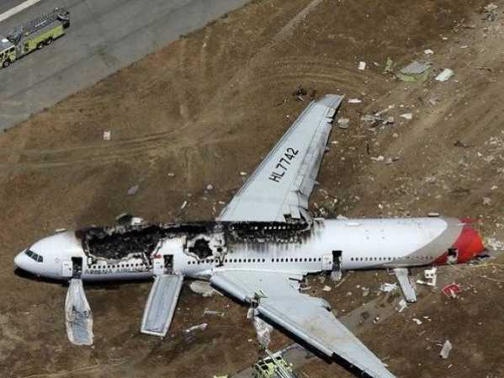
Automation Management Air China - SFO
NTSB faults Asiana pilots for 777 crash - complex automated controls a factor
NTSB - The Asiana flight crew “over-relied on automated systems that they did not fully understand.… As a result, they flew the aircraft too low and too slow and collided with the seawall at the end of the runway.”
The captain flying the plane, who was new to the 777, inadvertently prevented the autothrottle from controlling the plane’s speed. He put the throttle in idle after the plane had unexpectedly climbed too high. He assumed the autothrottle would automatically resume controlling speed, as it is designed to do under most circumstances. But because he turned off the autopilot at the same time, the autothrottle remained on hold at the last selected speed, which was idle.
The NTSB “didn’t say the autothrottle failed to perform as designed, but rather that its design, under certain circumstances, could lead to confusion as to whether it was controlling speed or in an inactive state.”

Slide 41
Single-Pilot Resource Management Automation Management
Maintaining automation situational awareness
Always double check the system and verify data inputs
Conduct verbal callouts
Make use of all onboard navigation equipment. For example, use VOR to back up GPS
Plan a realistic flight route to maintain situational awareness
Avoid an unwarranted overreliance in avionics and aircraft automation
Maintain stick and rudder skills
Fully understand the automation, including understanding the system at a conceptual level to avoid drowning in information
Avoid becoming fixated on the knobs and trying to memorize each and every button sequence
Knowing systems will reduce surprises and allow you to deal with surprises
Manage and prioritize the information flow to accomplish specific tasks
Corral the information flow through option selection (track up / north up)

Slide 42
Task Management PTS Requirements
Explain how to prioritize tasks in such a way to minimize distractions from flying the aircraft
Complete all tasks in a timely manner considering the phase of flight without causing a distraction from flying
Execute all checklists and procedures in a manner that does not increase workload at critical times, such as intercepting the final approach course

Slide 43
Single-Pilot Resource Management Task / Workload Management
Use all available resources to detect changes or expected changes not occurring – provides situational awareness
Take a deep breath
Think
FLY THE PLANE
Aviate - Maintain control of the aircraft
Navigate - Know where you are, where you intend to go and where the cumulo-granite is
Communicate - Let someone know your plans and needs
Act on the decision
Task
Management

Slide 44
Single-Pilot Resource Management Task / Workload Management
Use all available resources to detect changes or expected changes not occurring – provides situational awareness
Task management is defined as prioritizing and selecting the more appropriate tasks (or series of tasks) to ensure successful completion of the flight
Effective task / workload management ensures essential operations are accomplished by planning, prioritizing, and sequencing tasks to avoid work overload
Set radios ahead
Get ATIS early
Have charts ready
Brief approaches before approach
Ensure that attention to non-essential activities do not contribute to loss of situational awareness
Recognizing task overload situations is important – then stop, think, slow down, prioritize
Task management has taken on more importance with the increase in complexity of the avionics
Act on the decision
Task
Management

Slide 45
Single-Pilot Resource Management Task / Workload Management
Use all available resources to detect changes or expected changes not occurring – provides situational awareness
Concurrent task management can be challenging and prone to error
When performing multiple tasks there is a decrease in performance caused by the time required to switch between tasks
Must also recall what other tasks are waiting to be performed or where they left off when returning to an interrupted task
Checklists are critical!
Automation, information, and task management are closely related
“Sterile Cockpit” rule
Act on the decision
Task
Management

Slide 46
Single-Pilot Resource Management Task / Workload Management
Use all available resources to detect changes or expected changes not occurring – provides situational awareness
Avoid task fixation / tunneling – “the allocation of attention to a particular channel of information, diagnostic hypothesis, or task goal, for a duration that is longer than optimal, given the expected cost of neglecting events on other channels, failing to consider other hypotheses, or failing to perform other tasks
The “party” situation provides a good example of tunneling when a person at a loud crowded party listens to one conversation and can easily ignore all others
Task management and prioritization can be affected by fatigue
Act on the decision
Task
Management

Slide 47
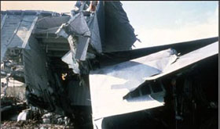
Single-Pilot Resource Management Task / Workload Management
Use all available resources to detect changes or expected changes not occurring – provides situational awareness
Don’t fixate on a single task
Burned out landing gear light kills 99 - Eastern Air Lines Flight 401 crashed into the Everglades in 1972 when the entire flight crew became preoccupied with a burnt-out landing gear light and failed to notice the autopilot had inadvertently been disconnected. As a result, the aircraft gradually lost altitude and eventually crashed while the flight crew was distracted with the indicator problem
Act on the decision
Task
Management

Slide 48
Single-Pilot Resource Management Task / Workload Management
Part of workload management is to determine how to best use resources, such as cockpit automation, to help complete flight tasks
With automation, pilots, for example, pilots must first program the automation and then carefully monitor it to make sure it does what the pilot intended

Slide 49
Stress Management
Certain amount of stress is good
Keeps you alert and prevents complacency
BUT
Effects of stress are cumulative
If you do not cope with the stress in an appropriate way, it can add up to an intolerable burden
Performance generally increases with the onset of stress, peaks, and then begins to fall off rapidly as stress levels exceed a person’s ability to cope
Impairs ability to make good decisions
Increases risk of errors

Slide 50
Stress Management
Stressor | Description
Environmental | Conditions associated with the environment, such as temperature and humidity extremes, noise, vibration, and lack of oxygen.
Psychological | Physical conditions, such as fatigue, lack of physical fitness, sleep loss, missed meals (leading to low blood sugar levels), and illness.
Physiological | Social or emotional factors, such as a death in the family, a divorce, a sick child, or a demotion at work. This type of stress may also be related to mental workload, such as analyzing a problem, navigating an aircraft, or making decisions
Managing stress in the cockpit involves the ability to anticipate, recognize and cope with stress by using one of two strategies: Defense or Coping
Defense strategies involve the alleviation of the symptoms (taking medication, alcohol, etc.) or reduction of the anxiety (i.e. denying to yourself that there is a problem, or blaming someone else)
Coping strategies involve dealing with the source of the stress rather than merely the symptoms (i.e. delegating workload, prioritizing tasks, sorting out the problem). When ‘coping’, the individual either adjusts to the perceived demands of the situation, or changes the situation itself

Slide 51
Situational Awareness PTS Requirements
Explain the concept of situational awareness and associated factors
Explain the dangers associated with becoming fixated on a particular problem to the exclusion of other aspects of the flight
State the current situation at anytime during the flight in such a way that displays an accurate assessment of the current and future status of the flight, including weather, terrain, traffic, ATC situation, fuel status, and aircraft status
Uses the navigation displays, traffic displays, terrain displays, weather displays and other features of the aircraft to maintain a complete and accurate awareness of the current situation and any reasonably anticipated changes that may occur

Slide 52
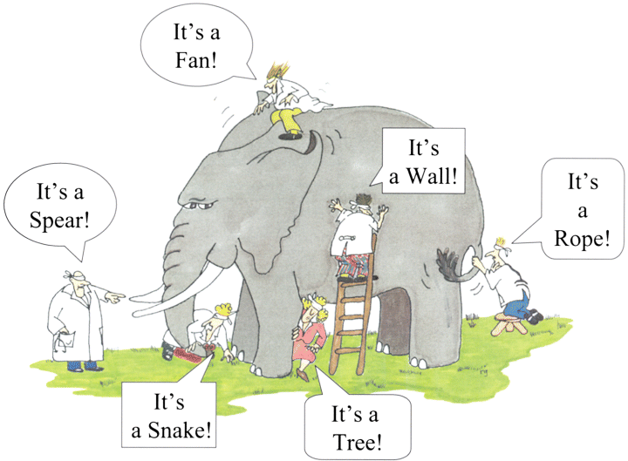
Situational Awareness
Situational awareness is an attention based phenomenon that reflects the flightcrew's knowledge of where the aircraft is in regard to location, air traffic control, weather, regulations, aircraft status, and other factors
Situational awareness is the accurate perception and understanding of all the factors and conditions within the five fundamental risk elements (flight, pilot, aircraft, environment, and type of operation in any given aviation situation) that affect safety before, during, and after the flight
Forming a mental picture of your circumstances – e.g., why is ATC vectoring you
A lack of situational awareness can affect a pilot's ability to perform effectively regarding aircraft handling, aircraft systems, aircraft mode awareness, environmental hazards, standard operating procedures, and attention to required tasks
Cartoon © G. Renee Guzlas, artist

Slide 53
Situational Awareness
When loss of situational awareness occurs, there can be critical consequences, such as missing information from one source when concentrating on another source, altitude or course deviations, dominance of visual cues to the extent that pilots may not hear certain aural warnings, misinterpreting ATC instructions, or experiencing task overload
An individual can lose situational awareness due to attention tunneling and attention to non-essential activities
Attention tunneling occurs when a pilot is absorbed in a task to the exclusion of other visual and aural inputs, and is also a factor in the breakdown of task management
Fatigue, stress, and work overload can cause a pilot to fixate
Distraction danger – landing gear bulb leads to airliner crash

Slide 54
Controlled Flight Into Terrain (CFIT) Awareness - PTS
Use current charts and procedures during the planning of the flight to ensure the intended flight path avoids terrain and obstacles
Be aware of potential terrain and obstacle hazards along the intended route
Explain the terrain display, terrain awareness and warning system (TAWS), and/or ground proximity warning system (GPWS), as installed in the aircraft.
Use the terrain display, TAWS, and/or GPWS of the navigation displays as appropriate to maintain awareness and to avoid terrain and obstacles
Plan departures and arrivals to avoid terrain and obstacles
Visual
ODP - Obstacle departure procedures
Alter flight as necessary to avoid terrain
Plan any course diversion, for whatever reason, in such a way to insure proper terrain and obstruction clearance to the new destination
Explain and understand aircraft performance limitations associated with CFIT accidents
http://www.faa.gov/training_testing/training/media/cfit/volume1/titlepg.pdf

Slide 55
Single-Pilot Resource Management CFIT
Use all available resources to detect changes or expected changes not occurring – provides situational awareness
Controlled flight into Terrain
There is a lot to consider in this area – Please also look at the CFIT slides in the Special Emphasis presentation that is available on the same web page as this PowerPoint - http://captx360.weebly.com/uploads/7/6/9/3/7693240/special_emphasis_areas.pptx
Act on the decision
CFIT

Slide 56
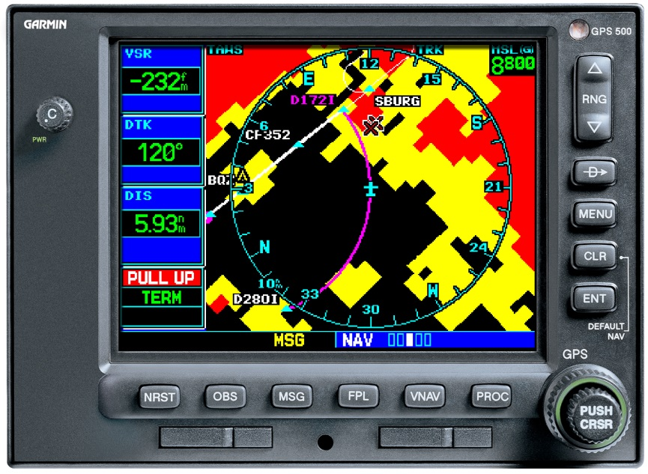
Controlled Flight Into Terrain
TAWS - terrain awareness and warning system. TAWS equipment must provide the following functions:
Forward Looking Terrain Avoidance - looks ahead of the aircraft along and below its lateral and vertical flight path and provides suitable alerts if a potential CFIT threat exists
Premature Descent Alert (PDA) function - uses the aircraft’s current position and flight path information to determine if the aircraft is hazardously below the normal approach path for the nearest runway
Visual and aural discrete signal for both caution and warning alerts
Ground proximity warning system (GPWS) - system that alerts pilots if their aircraft is in immediate danger of flying into the ground or an obstacle (earlier generation system to TAWS)

Slide 57
CFIT Obstacle Departure Procedures
FAA creates an ODP if obstacles require that a climb of more than 200 feet per nm be maintained for terrain separation
ODP often will require that the aircraft be able to maintain a specified climb gradient steeper than the standard 200 feet nm
Aeronautical Information Manual - Pilots are directed to consider the terrain in the vicinity of the airport, and if an ODP is available, determine if it should be flown or if visual obstacle avoidance is possible
Pilots of multiengine aircraft must consider the effect of degraded climb performance and actions to take in the event of an engine loss
ODPs may be flown without ATC clearance, unless an alternate departure procedure or radar vectors specifically have been assigned
Obstacle clearance is not provided by ATC until the controller begins to provide navigational guidance in the form of radar vectors
ODPs are usually depicted in text, not graphic, format and are located in the front of the NACO chart book and on the bottom of the airport information page in Jeppesen plates

Slide 58
CFIT Danger Weather
CFIT is often associated with low visibility, low cloud deck or night flights in mountainous terrain – Don’t forget about downdrafts near mountains
Create a CFIT hazard because pilots often rely on their eyes to identify danger
Approach these conditions with caution
Flying over unlit areas at night should be avoided when possible Otherwise, maintain a higher altitude than normal when flying at night
Thorough planning and weather briefings before flights can prevent encountering hazardous low visibility conditions, day or night
Good situational awareness is key in these conditions
VFR charts can be very helpful

Slide 59
Crew Resource Management
Crew Resource Management (CRM) is the application of team management concepts in the flight deck environment
In an aircraft operation requiring a crew of two, the examiner will evaluate the applicant’s ability throughout the practical test to use good CRM

Slide 61
Disclaimer
Instrument flight can be dangerous. Do not rely solely on this presentation – PROFESSIONAL INSTRUCTION IS REQUIRED
The foregoing material should not be relied upon for flight
ALTHOUGH THE ABOVE INFORMATION IS FROM SOURCES BELIEVED TO BE RELIABLE SUCH INFORMATION HAS NOT BEEN VERIFIED, AND NO EXPRESS REPRESENTATION IS MADE NOR IS ANY TO BE IMPLIED AS TO THE ACCURACY THEREOF, AND IT IS SUBMITTED SUBJECT TO ERRORS, OMISSIONS, CHANGE

