Slide 1
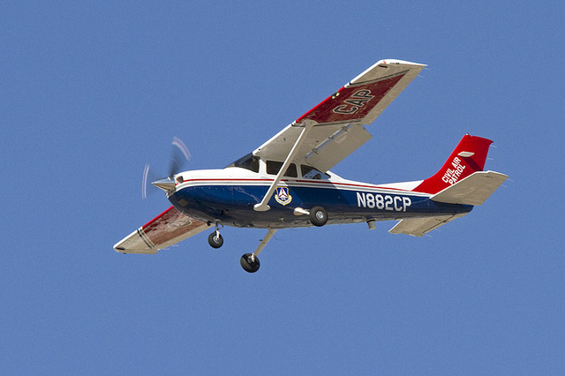
NON-STANDARD APPROACHES

Slide 2
Non-Standard Approaches
Simplified Directional Facility or SDF
Localizer-type Directional Aid or LDA
Airport Surveillance Radar (ASR)
Precision Approach Radar (PAR)
Visual Approach
Contact Approach
Microwave Approach
GLS Approach

Slide 3
Simplified Directional Facility (SDF)
Provides a final approach course similar to that of the ILS localizer – BUT
SDF course may not be aligned with the runway and antenna may be offset from the runway centerline
Course may be wider, resulting in less precision
Either 6° or 12° as necessary for fly-ability and course quality vs which is typically 3 to 6° for an ILS or LDA
Does not provide glide slope information, however
Transmits within the ILS range - 108.10 to 111.95 MHz
Approach techniques and procedures used are essentially the same as those employed in executing a standard localizer approach, except the.

Slide 4
Simplified Directional Facility (SDF)
Usable off-course indications are limited to 35 degrees either side of the course centerline
If the SDF antenna is offset from the runway centerline, the angle of convergence between the final approach course and the runway bearing should be determined by reference to the instrument approach procedure chart
Generally not more than 3 degrees
If the SDF is offset from the centerline, if the approach which is continued beyond the runway threshold, the signal will lead the aircraft to the SDF offset position rather than along the runway centerline

Slide 5
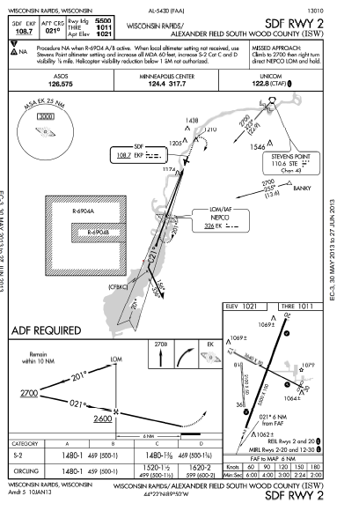
Simplified Directional Facility (SDF)

Slide 6
Localizer-type Directional Aid (LDA)
Comparable to use and accuracy of a localizer but is not part of a complete ILS
Course more precise (3 to 6°) than the SDF (6 to 12°)
The LDA is not aligned with the runway
If the angle of offset is three degrees or less, the facility is classified as an offset localizer. If the offset angle is greater than three degrees, the facility is classified as a localizer-type directional aid (LDA)
Straight-in minimums may be published where alignment does not exceed 30 degrees between the course and runway
Circling minimums only are published where this alignment exceeds 30 degrees
Because the course is not aligned with the runway centerline, additional maneuvering will be required compared to an ILS approach
Minimums, with and without glideslope, is provided on the approach chart as S-LDA/GS and S-LDA.

Slide 7
Localizer-type Directional Aid (LDA)
A very limited number of LDA approaches also have a glideslope.
Annotated in the plan view of the instrument approach chart with a note, “LDA/Glideslope.” If there is a glide slope the approach falls under the newly defined category of approaches called Approach with Vertical Guidance (APV)
Localizer equipment and frequencies identical to an ILS localizer but is a non-precision approach
Very few of these approaches still exist

Slide 8
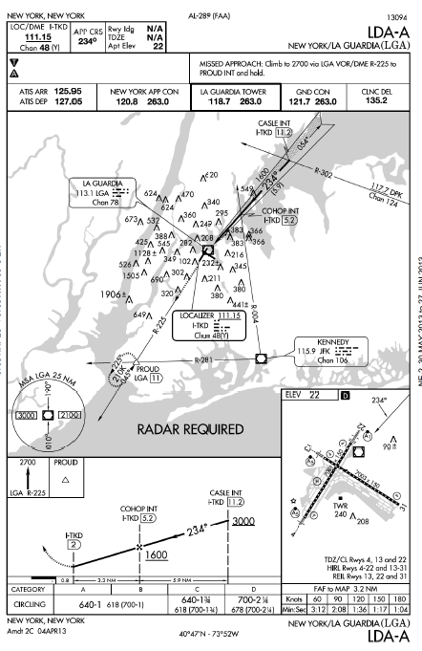
Localizer-type Directional Aid (LDA)

Slide 9
Ground Controlled Approaches (GCA)
Two basic types of GCA approaches
Airport Surveillance Radar (ASR); and
Precision Approach Radar (PAR)
These approaches are essentially a verbal VOR or ILS approach
Mostly used at military airfields, but are available at a few civilian fields, mostly ASR approaches

Slide 10
Precision Approach Radar (PAR)
PAR provides course and range information as well as glide path information, thus making it a precision approach
PAR are certified down to 100' and 1/4 mile, more accurate than the ILS (Cat 1) 200' and 1/2
PARs have an accuracy of bringing the pilot within 25 feet of either side of the runway centerline
The PAR approach is a special instrument approach procedure and is not described in the approach plates
PAR is a straight-in procedure only. No circling minima are published

Slide 11
Airport Surveillance Radar (ASR)
Non­-precision approach in which the controller provides navigational guidance in azimuth only, e.g., course and range information
Surveillance radar doesn’t provide altitude data
Uses the controller's normal radar, whereas PAR utilizes a radar system separate from the ATC radar
The ASR is a special instrument approach procedure and is not be described in the approach plates
Airport surveillance radar is less precise than precision radar
ASR has higher minimums than PAR approaches
Good practice to "back up" any Radar approach with a published non-­precision approach if possible.

Slide 12
Airport Surveillance Radar (ASR)
The final controller will, on request, provide recommended altitudes on final to the last whole mile that is at-or-above the published MDA
Recommended altitudes are computed from the start of descent point to the threshold of the runway
ASRs have an accuracy of bringing the pilot within 500 feet of either runway edge, while PARs are accurate to within 25 feet either side of runway centerline.

Slide 13
Radar Approach Planning
Have a back-up approach (compatible with existing weather and aircraft capabilities) to use if controller radar or communications are lost during the approach
The Back-up plan is critical as these radar approaches are highly communication dependent

Slide 14
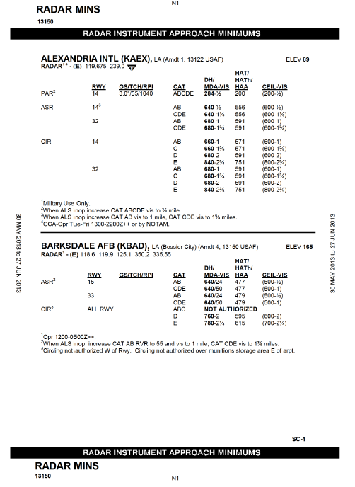
Radar Approach “Plate”
Airport
Glide slope and threshold crossing height
Radar approach type
Decision height / Minimum descent Altitude / Visibility minimums
Runways served
Radar approach data is published in tabular form in the front of the Terminal procedures Pub. And are listed by specific airport

Slide 15
Radar Approach Procedures
Communication Verification
To insure you have not lost communications, you should attempt contact with ATC if no transmissions are heard for:
1 minute while being vectored in the radar pattern
15 seconds while on ASR final
5 seconds while on PAR final
Lost Comms Procedure
If communication is lost, you are deemed cleared to fly any published approach, unless ATC previously issued a specific IAP to fly in the event of lost communications
If communication is lost (or if radar is lost with ATC communication) and you're unable to maintain VFR, transition to your back-up approach
Intercept the back-up approach at the nearest point that will allow for a normal descent rate and not compromise safety
Maintain the last assigned altitude or MSA/ESA, whichever is higher, until established on a segment of the back-up published approach
If no back-up approach is available that's compatible with your aircraft or with the existing weather, advise ATC upon initial contact of your intentions in the event of lost communications

Slide 16
Radar Approach Procedures
The pilot should repeat all headings, altitudes (departing and assigned), and altimeter settings as normal, until the final controller advises "do not acknowledge further transmissions“ to keep the frequency clear for the controller’s directional transmissions
After the do not acknowledge instruction, the controller will query you if he needs or wants a reply, such as acknowledging a landing clearance
Your job is to monitor the approach (altitude, course control, airspeed, etc.), as the controller will issue precision glideslope for a PAR and course information for an ASR or PAR approach in a running commentary fashion

Slide 17
Radar Approach Procedures
ATC will vector you to the final segment of the approach and then hand you off to the final controller
The vector to “dogleg” final (transition to final) encompasses all maneuvering up to a point where the aircraft is approximately 8 NM from touchdown and inbound
ATC will provide the pilot with position information at least once prior to handoff to the final controller
Each radar approach is on it's own discreet frequency. This precludes delays or interference by other transmissions
Only you and the final controller will be on this frequency
Prior to handoff to the final controller, all approach / landing checks should have been accomplished
You should have a descent rate determined. (e.g., if the glide path is known to be 3 degrees, and your final approach groundspeed is 120 kts, then your initial descent rate plan should be 600 fpm)

Slide 18
PAR Final Segment
PAR final approach starts when the aircraft is within the range of the PAR radar, which is separate from the normal ATC radar
Normally about 8 NM from touchdown point
Upon switching to the final controller, and approximately 10-30 seconds prior to reaching the descent point, the final controller will usually ask what the aircraft's heading is to use as a baseline for corrections compared to what appears on the radar screen
Final controller will then advise the pilot that he's approaching the glide path
Upon reaching the descent point, the final controller will advise "begin descent" then begin the azimuth and elevation corrections about every 5 seconds
The pilot should Establish the predetermined rate of descent, and utilize power or drag devices as required to maintain desired airspeed or AOA
When airspeed and glide path are stabilized, note the power, attitude and VSI, and utilize these indications as a baseline for corrections for the remainder of the approach
ATC will issue course and glide path guidance and will provide corrections along with trend information

Slide 19
PAR Final Segment
Position information for course will be stated as slightly / well left / right of course
Course corrections from ATC won't be much more than 3-5 degrees
Heading corrections should also not be made with more than (i) an angle of bank more than the correction to be made or (ii) 1/2 standard rate turn, to avoid overshooting the course
Position information for glide path will be stated as slightly / well above, slightly / well / dangerously below
Pitch changes of no more than 1 degree are normally sufficient
Trend information will also be given - such as "going further below", etc
Follow corrections as soon as ATC gives them
After a correction is issued, the controller will assume that corrected heading is being maintained. Additional corrections will be made based on the last heading given.
As with an ILS approach, make all turns within the "heading bars" on the HSI.

Slide 20
PAR Final Segment
The final controller will advise the pilot when he's reached the published DH
Pilot determines DH when (i) read on the altimeter, or (ii) advised by the controller, whichever occurs first
The final controller will continue to provide advisory course and glide path guidance until the aircraft passes over the approach landing threshold at which time the controller will advise "over the landing threshold“
If at the DH you need to commence a missed approach
Advise the controller and the procedures are the same as with an ASR approach, as discussed below
If landing, advise the final controller when you have the runway in sight with landing assured
On rollout, contact / switch to tower and advise them of your status

Slide 21
No Gyro Radar Approach
If you have lost your HSI or DG, advise ATC and request a No-Gyro approach
A no gyro approach can be made with either an ASR or PAR approach
In a no-gyro approach
Perform turns during transition to final by establishing an angle of bank that will approximate a standard rate turn, not to exceed 30 degrees
Perform turns on the final segment by establishing an angle of bank on the attitude indicator that will approximate a 1/2 standard rate turn
Do not begin using half-standard rate turns until advised to do so by ATC. ATC may want to continue standard rate turns even on final if abnormal conditions exist such as strong crosswinds or turbulence
If unable to comply with this, advise the final controller so he can manually determine lead-points for turn and heading corrections
Initiate turns immediately upon hearing "turn left/right"
Stop turns when hearing "stop turn“
Acknowledge these commands until advised by the final controller to no longer acknowledge further transmissions

Slide 22
ASR Final Segment
Final controller will inform the pilot of the runway to which the approach will be made, the straight-in MDA (if a straight-in), the MAP location, and notice of where the descent to MDA will begin.
If terminating an ASR to a circling approach, the pilot must furnish the aircraft's approach category to the final controller, the final controller will then issue the circling MDA appropriate to the runway the pilot is circling to and the aircraft's category, as applicable.
Prior to reaching the descent point, the controller will provide missed approach instructions and instructions concerning what to do in the event of lost communications
The pilot will be given a warning when approaching the ‘begin descent’ point
Upon reaching the descent point, the final controller will advise the pilot to "begin descent," advising the pilot of any descent restrictions that may exist
Use normal non-precision descent rates to arrive at MDA with time to acquire the runway environment and make a normal descent to landing
Upon request, the controller will provide recommended altitudes on final at each mile to the last whole mile that is at or above the published MDA

Slide 23
ASR Final Segment
The final controller will issue course guidance when required and will give you range information each mile while on final
This guidance will be provided until the aircraft is over the MAP, unless the pilot requests discontinuation of guidance
Controller will advise you when you're at the MAP
The controller will also, during the descent on final, issue the landing clearance to the pilot. The final controller will coordinate the clearance with the tower.
Radar approaches do not utilize frequency changes after switching to the final controller, since the final controller will also initially work your missed approach, were you to do one.

Slide 24
ASR Final Segment
At the MAP, the pilot must advise the controller either
"Runway in sight, landing assured"; or
"Executing missed approach" stating the reason for the missed approach, at which point ATC will issue missed approach instructions (In the event of lost communications, follow the lost communications instructions / procedures)
On landing rollout, switch to the tower frequency and advise the tower you're on frequency

Slide 25
ASR Communications
Final controller communications will sound like this:
Do not acknowledge further communications
__ miles from touchdown, slightly left of course, turn right heading ___°, begin descent
__ miles from touchdown, turn left heading ___°, recommended altitude ______ (assuming you requested recommended altitudes)
On course
__ miles from touchdown, on course, recommended altitude _____
and so on.....

Slide 26
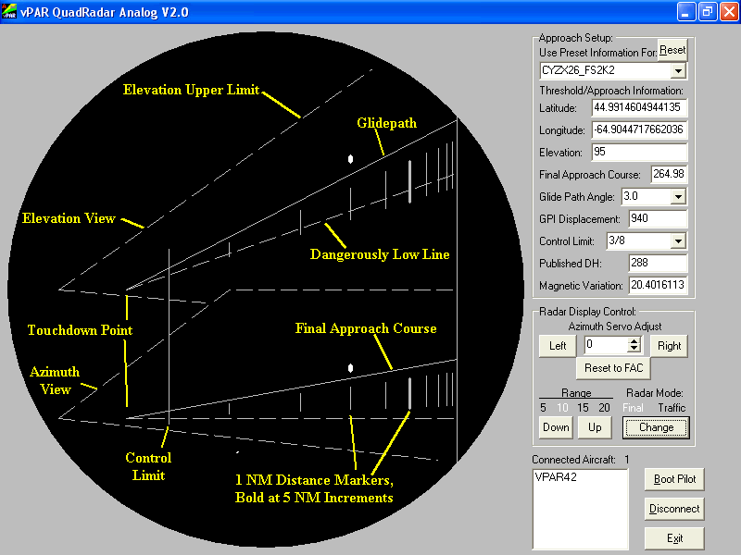
Controller’s View of the GCA Approach

Slide 27
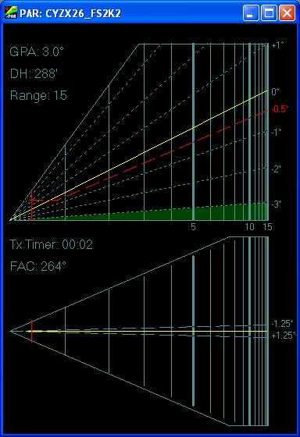
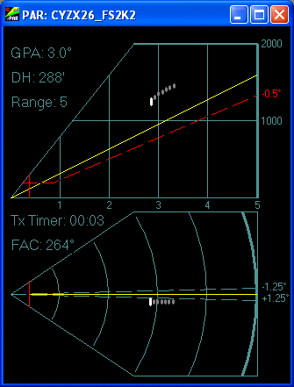
Controller’s View of the GCA Approach
Aircraft above (white bars) is left of course and well above the glide slope

Slide 28
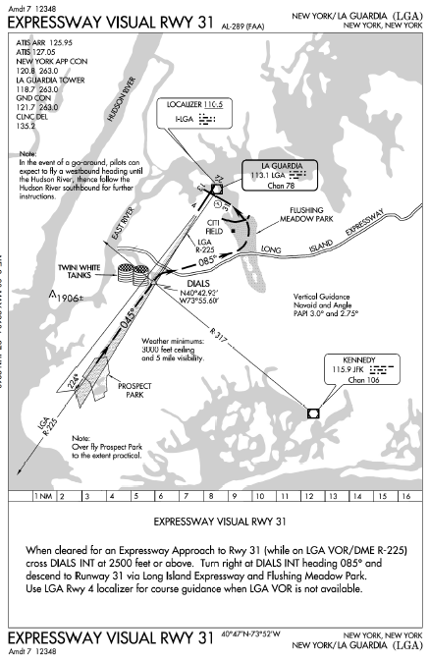
Visual Approach
Two types
Published
Verbal

Slide 29
Visual Approach
The FAA defines a visual approach as one conducted under instrument flight rules (IFR), which authorizes the pilot to proceed visually and clear of clouds to the airport
Allows you to fly to the runway without having to perform a formal instrument approach
It is not an instrument approach procedure
There is no missed approach segment- If you are unable to complete a visual approach, the miss is handled as any go-around and appropriate separation must be provided by ATC
The pilot must, at all times, have either the airport or the preceding aircraft in sight
This approach must be authorized and under the control of the appropriate air traffic control (ATC) facility
Reported weather at the airport must be ceiling at or above 1,000 feet and visibility of 3-miles or greater
Pilot assumes the responsibility to "see and avoid" other traffic.

Slide 30
The "Dark" Side of Visual Approaches
Can land at the wrong airport or runway
Traffic to be followed cannot be identified or is lost through distraction or other problems
Misidentification of traffic to be followed is also a problem, particularly at busier airports
Most incidents of landing without clearance reported to ASRS are out of visual approaches
Can lead to more visual illusions at night

Slide 31
Visual Approach
Controllers may initiate, or pilots may request, a visual approach
An aircraft may be cleared for a visual approach when:
The aircraft is number one in the approach sequence,
The aircraft is to follow a preceding aircraft and the pilot reports the preceding aircraft in sight and is instructed to follow it
The pilot need not report the airport/runway in sight.
If the pilot reports the airport or runway in sight but not the preceding aircraft. Radar separation will be provided until visual separation is provided

Slide 32
CHARTED VISUAL FLIGHT PROCEDURES (CVFP)
An aircraft will be cleared for a CVFP only when the following conditions are met:
There is an operating control tower
The published name of the CVFP and the landing runway are specified in the approach clearance
The reported ceiling at the airport of intended landing is at least 500 feet above the MVA/MIA (Minimum Vectoring Altitude / Minimum IFR Altitude), and the visibility is 3 miles or more, unless higher minimums are published for the particular CVFP
An aircraft not following another aircraft on the approach reports sighting a charted visual landmark, or reports sighting a preceding aircraft landing on the same runway and has been instructed to follow that aircraft
Phraseology-
Skyhawk _____ CLEARED (name of CVFP) APPROACH.

Slide 33
Contact Approach
A contact approach is a visual (not instrument) approach that can only be requested by the pilot and permits a visual approach when the conditions are below those required for a visual (as discussed above) approach
The pilot is responsible for maintaining the required flight visibility, cloud clearance, and terrain/obstruction clearance.
Unless otherwise restricted, the pilot may find it necessary to descend, climb, and/or fly a circuitous route to the airport to maintain cloud clearance and/or terrain/obstruction clearance
The following must exist for a contact approach:
The reported ground visibility must be at least 1 statute mile.
A standard or special instrument approach procedure has been published and is functioning for the airport
separation is applied between the aircraft and other IFR or SVFR traffic
ATC will not assign a fixed altitude but will clear the aircraft to be at or below an altitude which is at least 1,000 feet below any IFR traffic but not below the minimum safe altitude
Phraseology-
CLEARED CONTACT APPROACH,
And if required, AT OR BELOW (altitude) (routing).

Slide 34
Microwave Landing System (MLS)
MLS provides precision navigation guidance for exact alignment and descent of aircraft on approach to a runway. It provides azimuth, elevation, and distance
Requires specialized equipment
MLS supplements the ILS as the standard landing system
Greatly expanded navigation and data capabilities

Slide 35
Global Positioning Landing System (GLS)
The Ground Based Augmentation System (GBAS) is a satellite navigation system that uses GPS signals to develop an extremely accurate navigation signal that focuses its service on the airport area (approximately a 20-30 mile radius)
With WAAS, GPS-corrected navigation signals are broadcast by satellites. With GBAS, the GPS-corrected navigation signal is broadcast from a GBAS VHF data broadcast transmitter at or near the airport
New system just coming operational in the US - Houston George Bush Intercontinental became operational in 2013 – Not yet in GA aircraft
GBAS enables curved and segmented approach paths

Slide 36
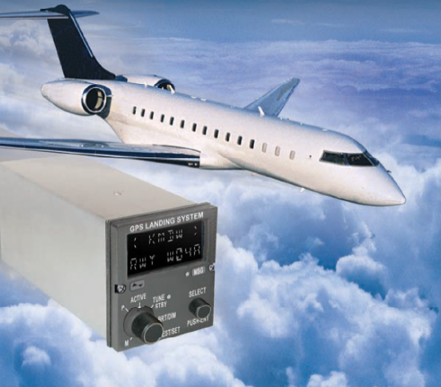
Global Positioning Landing System (GLS)
GBAS will complement WAAS by providing GNSS Landing System (GLS) landing service for Category II/III precision approach operations
GBAS will also provide GLS Category-I capability at locations where WAAS service may not be available

Slide 37
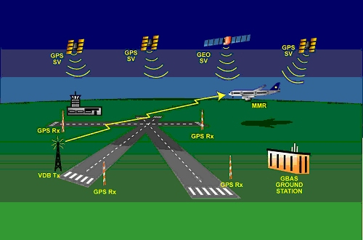
Global Positioning Landing System (GLS)
GRS stations receive satellite signals and transmit them to the ground processing station that calculates a correction and transmits it to aircraft through the VHF transmitter
GBAS ground processing station
VHF correction signal transmitter
Ground reference stations (GRS)

Slide 38
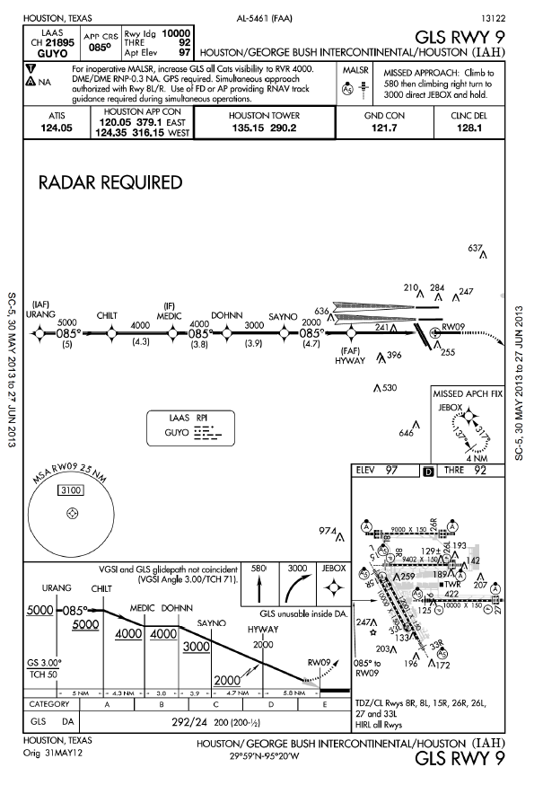
Global Positioning Landing System (GLS)

Slide 39
Questions

