Slide 1
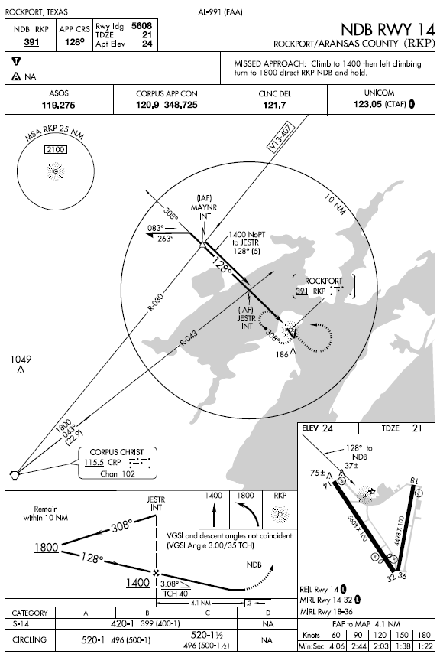
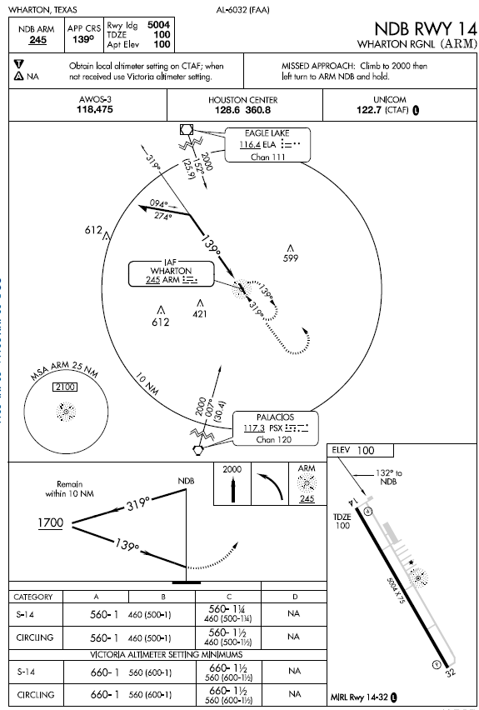
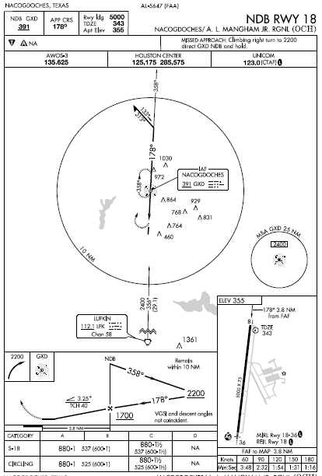
NDB
Approaches

Slide 2
NDB Approach Background
One of the oldest and most disliked approaches
Can use NDBs both on and off of the destination airport
NDB approaches can be on the TO or FROM side of an NDB; some use both the TO and FROM sides – Navigation is based upon a specific bearing
NDB approach may or may not have a final approach fix –
  off airport NDB usually the final approach fix
  On airport NDB – usually has no depicted FAF
NDB is normally the IAF – but can have others or none with radar
It is a non-precision approach as there is no vertical guidance
Requires situational awareness and subtle use of geometry
  MH + RB = MB

Slide 3
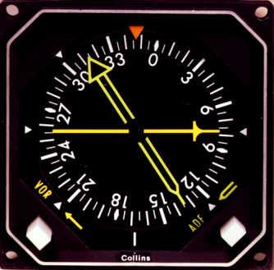
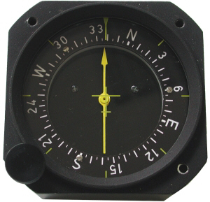

NDB Equipment
ADF receiver and ADF radio bearing indicator (RBI) or radio magnetic indicator (RMI)
Some approaches also require a VOR NAV receiver

Slide 4
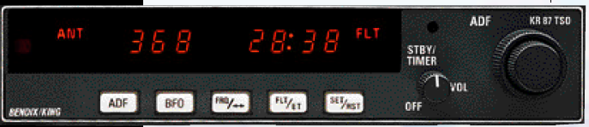
NDB Receiver
Power / identification volume control
Frequency
Flight timer
Tuning knob
Beat frequency oscillator (generates an audio tone to let you identify unmodulated NDBs that identify themselves using interrupted-carrier keying - seldom used in the United States)
ADF function button
Flight timer or elapsed timer and reset button

Slide 5
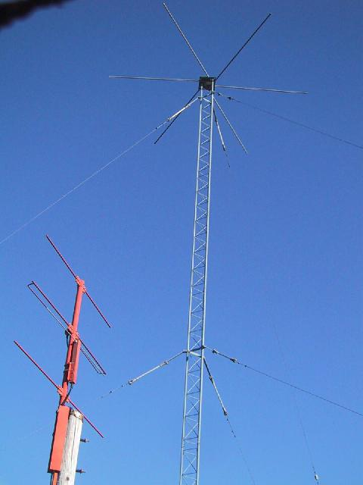
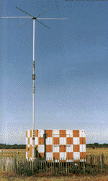
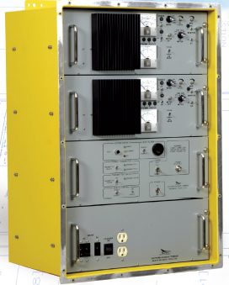
NDB Ground Station

Slide 6
Understanding the Signals
Tune the NDB frequency
Morse code identifier – identify and keep it on in the background – No other definitive evidence of signal loss (NDB – 3 letters; LOM – 2 letters)
If equipped, press the test button to check equipment
Indicator / Signal Errors
  Night effect: radio waves reflected back by the ionosphere can cause signal strength fluctuations 30 to 60 nautical miles from the transmitter, especially just before sunrise and just after sunset (more common on frequencies above 350 kHz)
  Terrain / mountain effect: high terrain like mountains and cliffs can reflect radio waves, giving erroneous readings; magnetic deposits can also cause erroneous readings
  Electrical effect: electrical storms, and sometimes also electrical interference (from a ground-based source or from a source within the aircraft) can cause the ADF needle to deflect towards the electrical source
  Shoreline effect: low-frequency radio waves will refract or bend near a shoreline, especially if they are close to parallel to it
  Bank effect: when the aircraft is banked, the needle reading will be offset
  Quadrantal Error - Signal is bent by aircraft metal; quadrantal effect is minimal at the cardinal points (nose, tail and wing tips), and greater in the intermediate bearings;
  Needle Oscillation - Needle oscillates in conditions of static (rainfall and thunderstorms) and weak transmissions;
  Ore Deposits - Can cause needle deflections

Slide 7
Using the Radio Bearing Indicator (RBI)
ADF indicator is a performance instrument – Keep it in the scan
Set the card to the course, if the RBI has a movable card
Look at indicator for needle location and trend; BUT FLY THE ATTITUDE INDICATOR / DG – don’t chase the RBI
Initially steer desired radial +/- wind correction
Make corrections with gentle coordinated turns to reference headings on the DG using bracketing
Make corrections early and often to avoid the need for large corrections
Card
Card adjuster knob

Slide 8
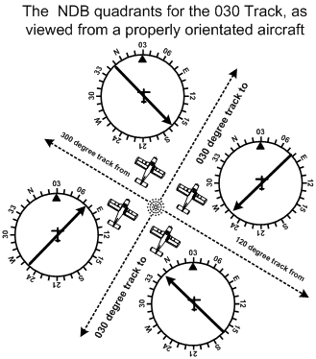
RBI Indications

Slide 9
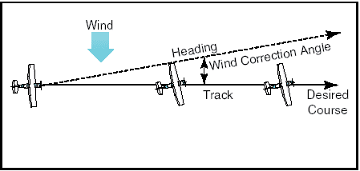
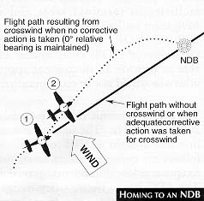
Homing vs Flying a Course

Slide 10
Homing vs Flying a Course
To “home” to a station using ADF:
  note the relative bearing to the NDB and turn the aircraft so that the relative bearing is on the aircraft’s nose (i.e., the magnetic heading of the aircraft equals the magnetic bearing to the NDB);
  maintain a relative bearing of 360° (on the nose).
To intercept a pre-determined track using ADF:
  orient the aircraft so that the aircraft’s heading is the same as the desired track to or from the NDB (paralleling the track);
  note whether the indicator needle is indicating right or left of the longitudinal axis of the aircraft;
    if the bearing indicator points to the right of the aircraft’s nose, add the desired intercept angle to the current orientated heading and fly the intercept; if the bearing indicator points to the left of longitudinal axis, subtract the desired intercept angle;
  if you are intercepting a track from the NDB, you slowly “pull the tail” of the RBI needle to match the intercept angle (turn toward where you want the TAIL of the needle to be) —when the tail “opens” to match your intercept angle, you are “on track”;
  if you are intercepting a track to the NDB, you slowly “push the head” of the bearing indictor to match the intercept angle (turn toward where you want the HEAD of the needle to be) —when the head matches the intercept angle, you are “on track.” Now turn on course.

Slide 11
Let’s Fly - IAF
Starting the Approach
Approach starts at the initial approach fix (IAF) – There can be several IAF’s – IAFS join at one or more common intermediate segments
You will reach the IAF from a “feeder route” which can be a radar vector
Must fly the entire procedure unless otherwise advised by ATC

Slide 12
Let’s Fly - IAF
Starting the Approach
IAF is where the initial approach segment begins.
  Purpose is to align the aircraft with the intermediate or final approach segment
  Accomplished by using a course reversal, such as a procedure turn or holding pattern, or straight in route
  IAF is usually a designated intersection, VOR, NDB, or DME fix
IAF may be collocated with the intermediate fix of the instrument approach. In that case there is no initial approach segment
Segment usually ends at the intermediate approach segment or at an Intermediate Fix (IF)

Slide 13
Let’s Fly – Intermediate Segment
Starting the Approach
Intermediate segment positions the aircraft for the final descent to the airport
Normally aligned within 30° of the final approach course
Segment begins when
  you are proceeding inbound to the FAF,
  are properly aligned with the final approach course, and
  are located within the prescribed distance before the FAF
May not be charted –
  Approach with a procedure turn is the most common example of an uncharted IF
    intermediate segment begins when you intercept the inbound course after completing the procedure turn
Ends at beginning of Final approach

Slide 14
Let’s Fly – Final Segment
Starting the Approach
Final approach segment begins at a designated FAF, depicted as a Maltese cross (X) on the profile view, or at the point where the aircraft is established inbound on the final approach course
Mandatory ATC report
  When leaving the FAF
  When you go missed in non-radar environment

Slide 15
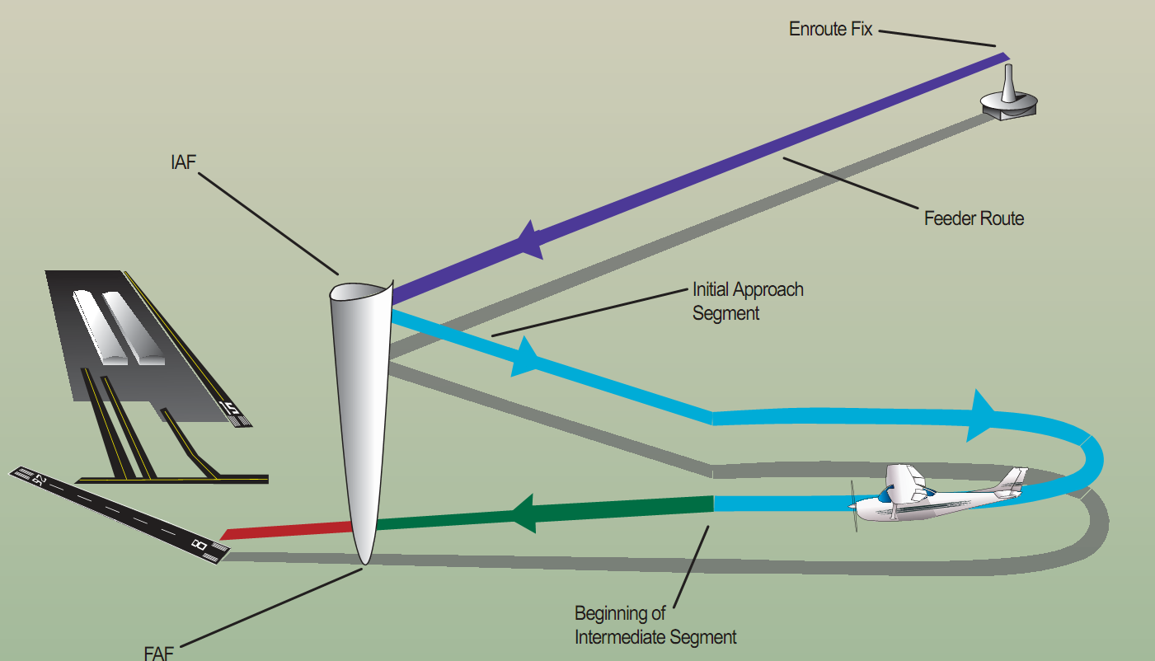
Let’s Fly Approach Segments
Outer marker or other fix

Slide 16
Before the Initial Segment
Preflight – Plan the approach – Must be familiar with “all available information concerning a flight” prior to departure and FDC Notams
Enroute – Get weather (ATIS, FSS information, etc.) to help determine likely approaches and review
Calculate / review performance data, approach speeds, and power settings – confirm aircraft and weather are appropriate for the ILS procedure for aircraft’s certified category or, if higher, the actual speed to be flown
Set navigation / communication and automation - The navigation equipment required for an approach is generally indicated by the title of the procedure and chart notes

Slide 17
Before the Initial Segment
Review and brief the approach – Don’t forget to brief the missed approach
  Commit to memory
    Altitude step downs
    MDA
    Time from FAF to MAP or DME
    Visibility minimums
    Missed approach procedure (at least initial steps)
Begin reducing speed
Obtain ASOS/ATIS/AWOS on comm 2 – listen in the background
Note the time you cross the IAF

Slide 18
Initial Segment
Complete briefing the approach
Begin landing checklist – complete before final segment
Reset comm and nav radios with required frequencies
Comply with the clearance and approach
Finish reducing power to approach settings (consider wind gusts, shear and turbulence)
Configure aircraft for landing – Flaps
Fuel related items set for landing (pumps, mixture, selectors)

Slide 19
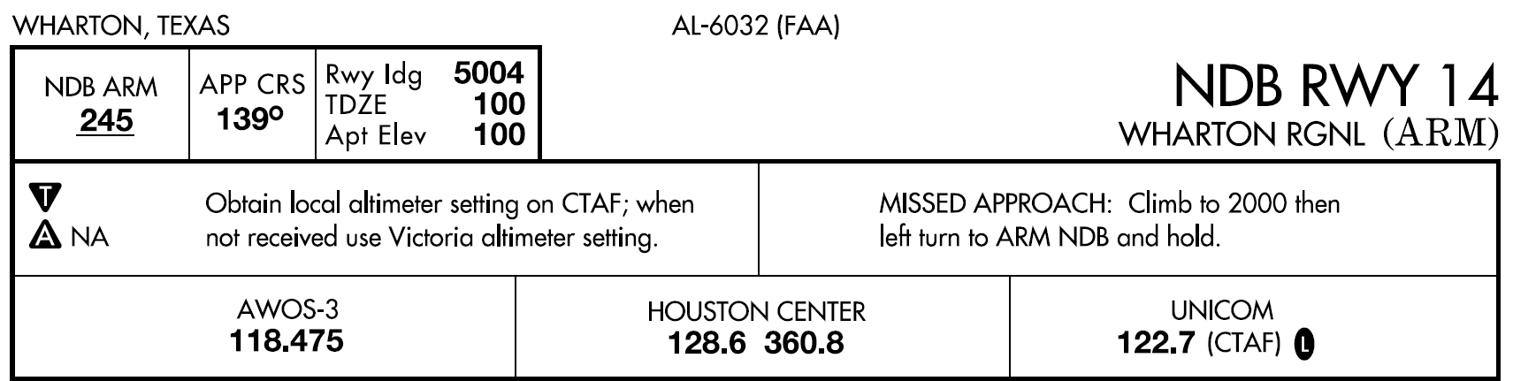
Initial Segment - Briefing
Brief and review approach to assure you can execute it - Complete before end of segment
Runway length, Touchdown Zone elevation and airport elevation
NDB identifier and frequency
Final approach course
Approach name
Takeoff minimums / procedures – non-standard
Missed approach information
Special notes – often important!
Frequencies
Minimums for use as an alternate –> non-standard - - Can’t be used as a legal alternate
Dark = pilot controlled lighting;

Slide 20
Initial Segment - Briefing
Plan view – mentally run through the approach
Procedure turn headings
Heading for segment
IAF with procedure turn
Obstruction (highest)
Distance and center identifier
Holding course – in and outbound
Sector minimum safe altitude
Initial missed
approach
course
Center of MSA
Feeder route

Slide 21
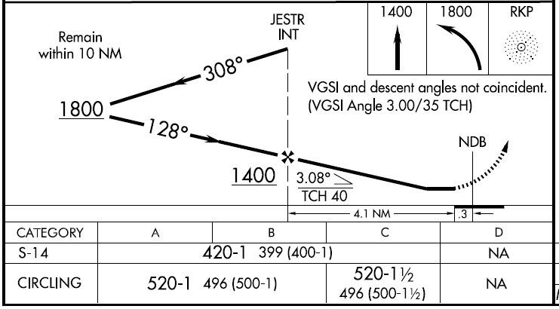
Initial Segment - Briefing
Profile view – mentally run through the approach
Procedure turn notes
Graphical missed approach information
FAF
Descent angle notes
Outbound course
Non-precision FAF (point to begin MAP timing)
Procedure turn altitude
Runway
Minimums
Aircraft category
A <= 90
B < 121
C < 141
Mileage to threshold
Mileage from threshold to NDB
Descent angle and threshold crossing height
Inbound course
FAF altitude

Slide 22
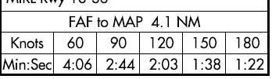
Segment - Briefing
Missed Approach Timing Information (if ground speed information is unavailable – estimate from airspeed)
  Add tailwind to airspeed (1/2 wind speed for quartering winds)
  Subtract headwind from airspeed (1/2 wind speed for quartering winds)
Begin timing point
MAP

Slide 23
Let’s Fly – The Initial Segment
Radios tuned to NDB to 245
Confirm Morse code and leave on in the background
Reduce power to approach setting
Proceed on feeder at 2,000 feet
Proceed outbound from the NDB to the procedure turn (1 – 4 minutes depending upon speed and NDB location)
One minute outbound on procedure turn; Then turn inbound
As the NDB needle begins to move towards 45 degree intercept angle (note the rate of movement) turn inbound on course (139°) – determine heading to hold with the wind correction angle

Slide 24
NDB Procedures
On-Airport NDB
You can tell NDB is on the airport from the approach chart profile view
Generally an on airport NDB approach will have no depicted final approach fix. In which case, the final approach segment begins at the final approach point (FAP).
The FAP is the point where you are established in-bound on the final approach course from the procedure turn/radar vector and can begin the final approach descent
For a procedure turn fly out 3 to 4 minutes before the procedure turn to assure adequate distance to become established inbound
The NDB is the MAP – when the needle swings 180° – no timing

Slide 25
Let’s Fly – The Intermediate Segment
Switch to local frequency WHEN INSTRUCTED
Complete landing checklist as much as possible
You are now at the final segment!

Slide 26
Let’s Fly – The Final Segment
At FAF (JESTR) start timing for missed approach (timing is based upon ground speed)
Expeditious but safe descent (gen <700 ft min @ 90 kts) – However, if there is an angle of descent, you should calculate the corresponding rate of descent (inside back cover of TERPS)
Maintain a constant speed – level and descending
FAF inbound report to ATC required in non-radar environment
Likely to be told to switch to local frequency – swap comm
Confirm gear down
Second notch flaps – Check in white arc

Slide 27

Rate of Descent Table

Slide 28
Let’s Fly – The Final Segment
Final speed reduction
Glance out the window to look for the runway environment
Begin level off about 100’ before you reach the MDA 420’
Airport Communications
  Tower
  Non-towered airport – Broadcast your intentions on the CTAF
    Approach you are executing
    Your position (every mile for last 5 miles)
    Arrival over the FAF inbound
    Missed approach

Slide 29
Let’s Fly – The Final Segment
  If you now have an identifiable segment of the approach environment unmistakably visible and identifiable you may continue the approach if:
    Visibility is above the minimums for approach category
    You are in a position to make a normal descent to the intended runway using normal maneuvers
    FAR 91.175
  If not, commence missed approach turn - do not turn out early
  MAP identified by
    Needle swing 180°
    Time from NDB
    Other – e.g. cross radial

Slide 30
Let’s Fly – The Final Segment
Commence circle to land
When aligned with final, drop full flaps and land
At MAP:
    Runway environment in sight
    Visibility above minimums
    Able to make a normal descent to intended runway

Slide 31
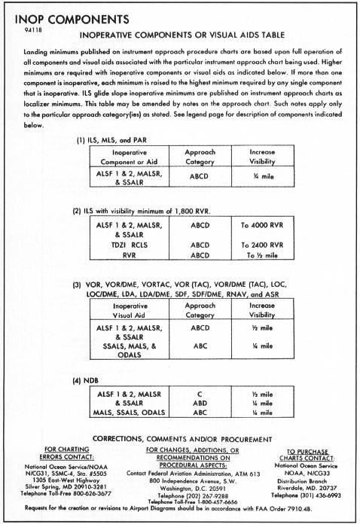
NDB Approach Problems
Report any instrument or communication malfunctions to ATC
If signal loss or interference at any time, go missed but follow the course - do not turn out early
Inoperative components
  No change in MDA
  Increase visibility requirements – ¼ to ½ sm

Slide 32
Considerations
If you are low generally do NOT climb – level off and re-intercept
Make small adjustments – see what happens and readjust
Remember sensitivity increases as you get near the NDB
DO NOT FLY NDB needle – bad things will happen! FLY the DG and AI
With aircraft properly trimmed small changes in power will cause a pitch change and allow you to maintain airspeed
Must execute missed after the MAP if you lose sighting of the runway environment
Runway environment
  Approach lighting system – not below 100’ AGL until you see red side lights or red terminating bar
  Runway or runway markings or lights
  Threshold, threshold markings or lighting
  REILS
  VASI
  Touchdown zone or markings or lighting
Know for the approach
  IAF and how to arrive at the FAF
  Minimum altitudes for each segment and MDA
  Missed approach procedure

Slide 33
Common Errors
Failure to have essential approach information in memory
  IAF
  FAF
  Altitudes, including MDA
  MAP
Poor communications
Failure to complete checklist items or use checklist
Descent below altitudes (keep a cushion on checkride)

Slide 34

QUESTIONS

