Slide 1
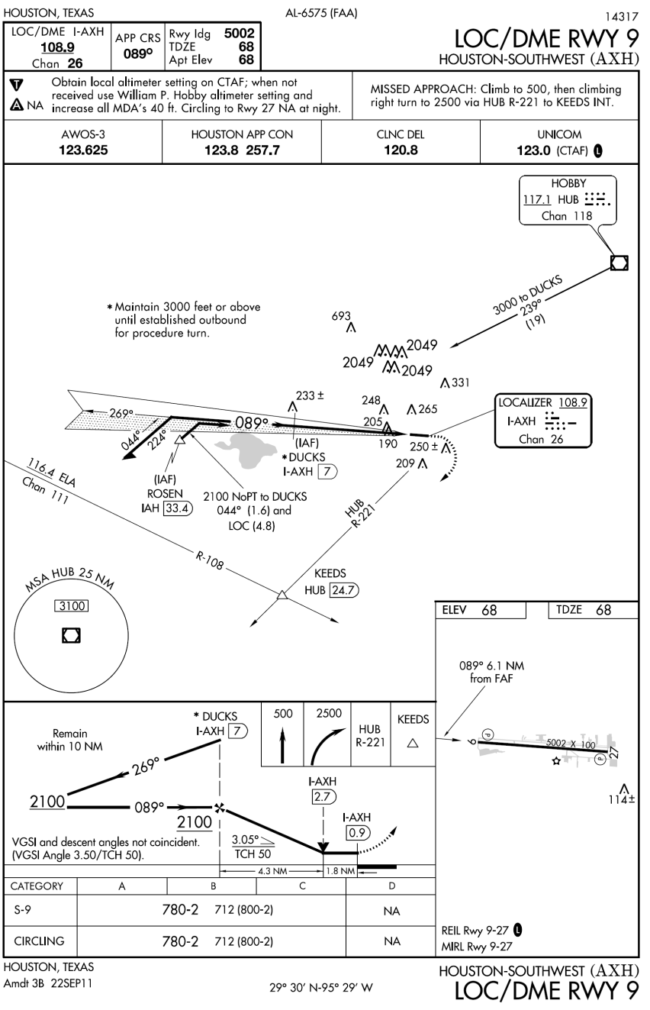
Localizer Approaches
This presentation assumes you have reviewed the ILS presentation first

Slide 2
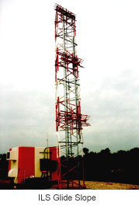
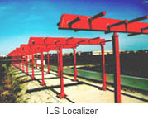
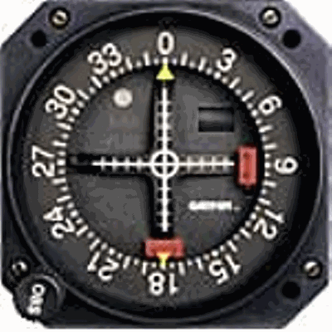
Localizer Signal
Localizer – Provides "left/right" azimuth guidance. Think of it as the same as the VOR needle - just more sensitive (3°- 6° vs 10°). The closer you get to the runway, the more sensitive it is.
Glide Slope needle provides no guidance with a localizer approach
Alarm flags

Slide 3
Localizer Signals
Tune the localizer frequency (108.1 – 111.95) – first digit after the “.” is always an odd #
Morse code identifier – identify it. Good idea to keep it on in the background
Goal - Keep the needle centered

Slide 4
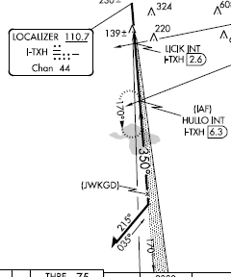
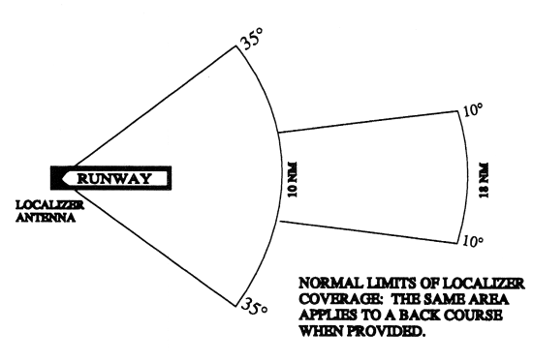
Localizer
Localizer course width is 3° to 6° (full scale – one side to the other)
  Actual width varies to assure 700 feet full scale course width at runway approach threshold - based upon runway length and localizer antenna location (e.g. a short runway will have a wider angle)
- Localizer is always aligned with the runway
Near the outer marker, a one-dot deviation puts you about 500 ft. from the centerline. Near the Middle Marker, one dot means you're off course by 150 ft.
Localizer identifier is a three-letter identifier preceded by the letter I-
CDI works by comparing strength of blue and yellow signals (90 and 150 Hz signals).
Blue Sector 150 Hz signal
Localizer signal is normally usable up to 18 NM from the field with a course width of 14° from 10 to 18nm. Course width is up to 35° from 10nm to the runway
Yellow Sector 90 Hz signal

Slide 5
Localizer-Type Directional Aid / Simplified Directional Facility
LDA – comparable to a localizer but is NOT aligned with the runway.
  Straight in approach may have an angle up to 30°
  No glide slope
SDF
  Course width 6° to 12° vs. 3° to 6° for LOC and LDA
  May be offset from runway centerline, but will be noted on the approach plate

Slide 6
Flying a Localizer
Similar to an ILS without vertical guidance
Localizer minimums – NOT A DH, rather it is an MDA
Use DME or timing - not altitude - to ascertain missed approach point
May have alternative minimums and/or step downs

Slide 7
Sugar Land LOC 35
Localizer minimums are higher than ILS minimums
Note timing tables - may need to interpolate

Slide 8
Descent Planning
Descent styles
  Dive and drive
    Levelling off at the MDA can be problematic with distractions or turbulence
    Unstable approach
  Continuous descent final approach descent
    FAA recommends CDFA for most non-precision approaches with a vertical descent angle (VDA) or glideslope (GS) published
Continuous descent
Dive and drive
MDA

Slide 9
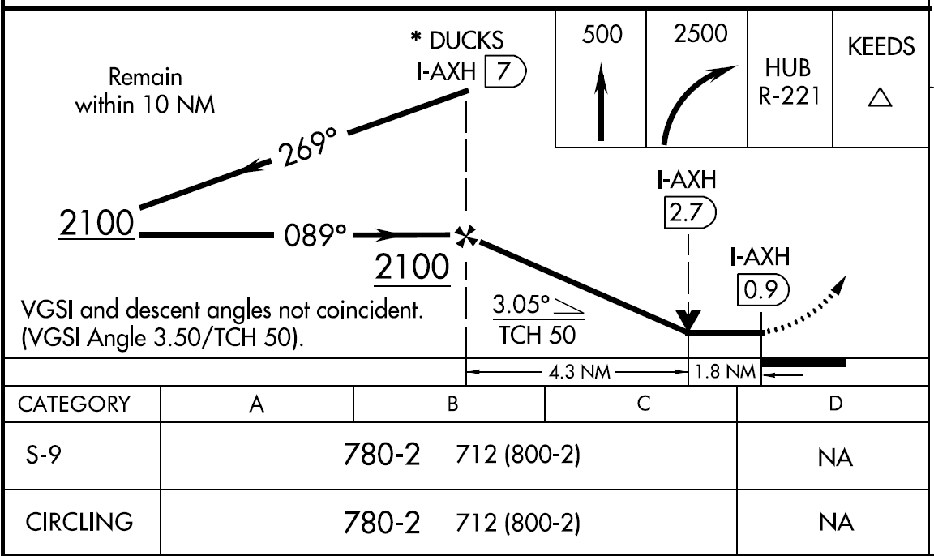
Descent Planning
Should reach the MDA ideally at the MAP in a continuous descent
Dive and drive – You should be at the MDA before the MAP to have the maximum opportunity to see the runway
  On a bad day you get to MAP before the MDA potentially blowing the approach because you didn't get out of the clouds in time
After Ducks – Dive and drive - descend to 780’ promptly to be at 780’ before the MAP (I-AXH 0.9)
- Continuous descent chose a rate of descent based upon 3.05 descent angle – use rate of climb / descent tables in TERPS

Slide 10
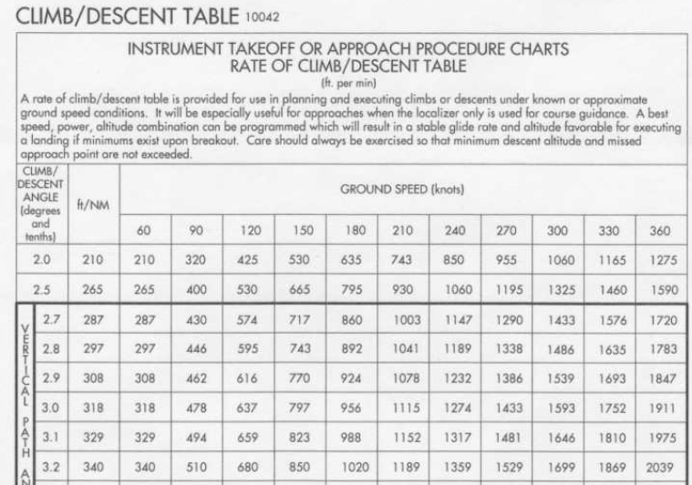
Continuous Descent Planning
Vertical descent angle
3.1° @ 90 kts = 494
3.0° @ 90 kts = 478
------------------------------
3.05 °= 486 kts
Can also interpolate for speed – e.g. at 80 kts 3.05°= 432kts (60 kts=323.5; 90kts=486)

Slide 11
Descent Planning
Reduce power smoothly to descend to the published MDA
Maintain applicable speed
  Speed should be accurately controlled, especially if you MAP is based on ground speed
  Upon reaching the MDA be sure to add power to maintain the required speed
Descent should be stabilized – put the bars on the attitude indicator at a point where it will give you the required descent rate (usually a bar width or so)
As you cross each fix on the localizer, descend to the next published altitude
  Even in a continuous descent can not go below the steps, but the descent should keep you above the steps in most cases

Slide 12
Descent Planning
G1000 and FMS systems will, if properly programmed, compute and reflect the continuous descent path
  Direct-To VNAV
  Flight Plan VNAV

Slide 13
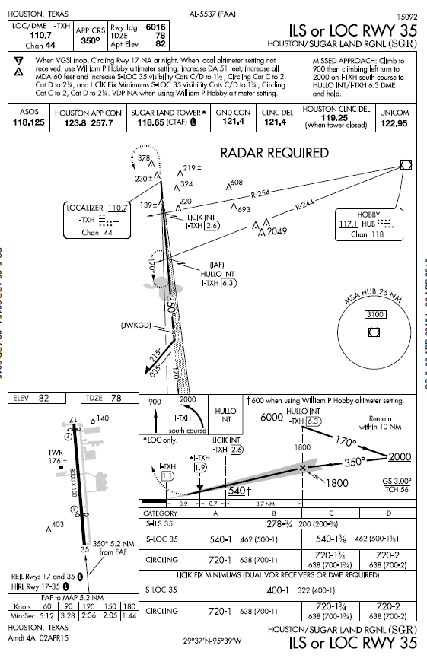
Visual Descent Point
Visual Descent Points (VDPs) are points on a nonprecision straight-in approach from which normal descent from the MDA to the runway touchdown point may be commenced if required visuals are present. See §91.175(c)(3)
The VDP will normally be identified by DME on VOR and localizer procedures and by along-track distance to the next waypoint for RNAV procedures
VDP is identified on the profile view of the approach chart by a “V”
No special technique is required to fly a procedure with a VDP – just don’t descend below the MDA prior to reaching the VDP and acquiring the necessary visual reference.
If aircraft is not equipped to receive the VDP - fly the approach as if no VDP was provided

Slide 14
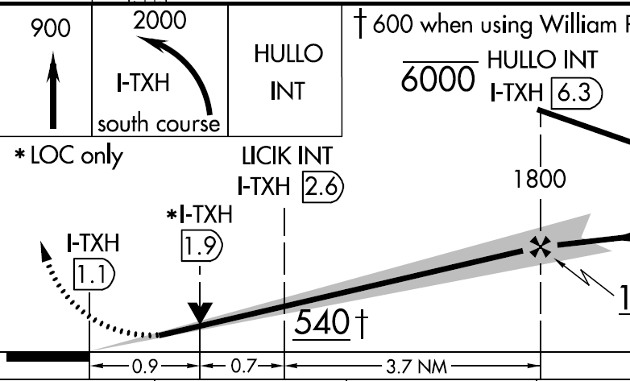
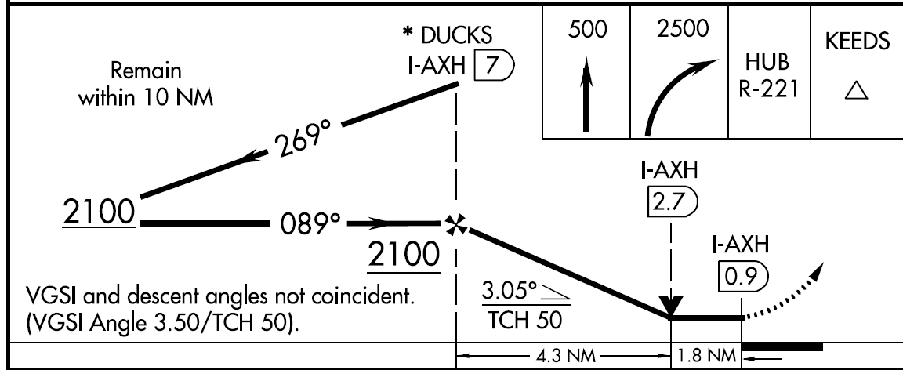
Visual Descent Point
If the visual segment area below the minimum altitude is clear of obstacles on a 34:1 slope (3 degree glide slope) there will be a gray shaded area extending from the VDP to the runway
If the shaded arrow is not on the approach plate, however, you will still fly to the minimum descent altitude (MDA) and continue if the runway is in sight
Without the shaded arrow on the approach plate, though, there is no assured clear slope, and no assurance that the path is clear of obstacles

Slide 15
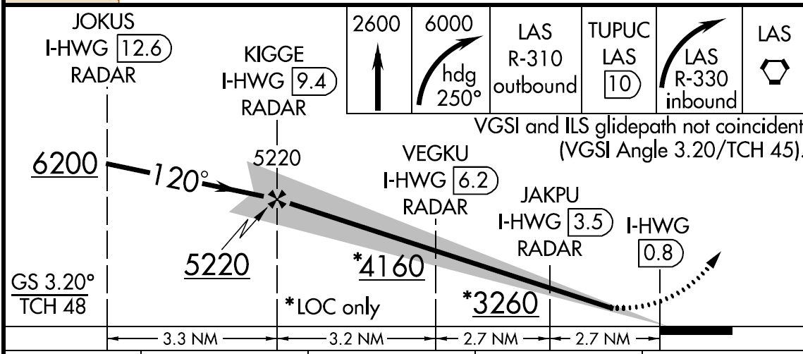
No Visual Descent Point
ILS / LOC with no VDP – note the missing “V”

Slide 16
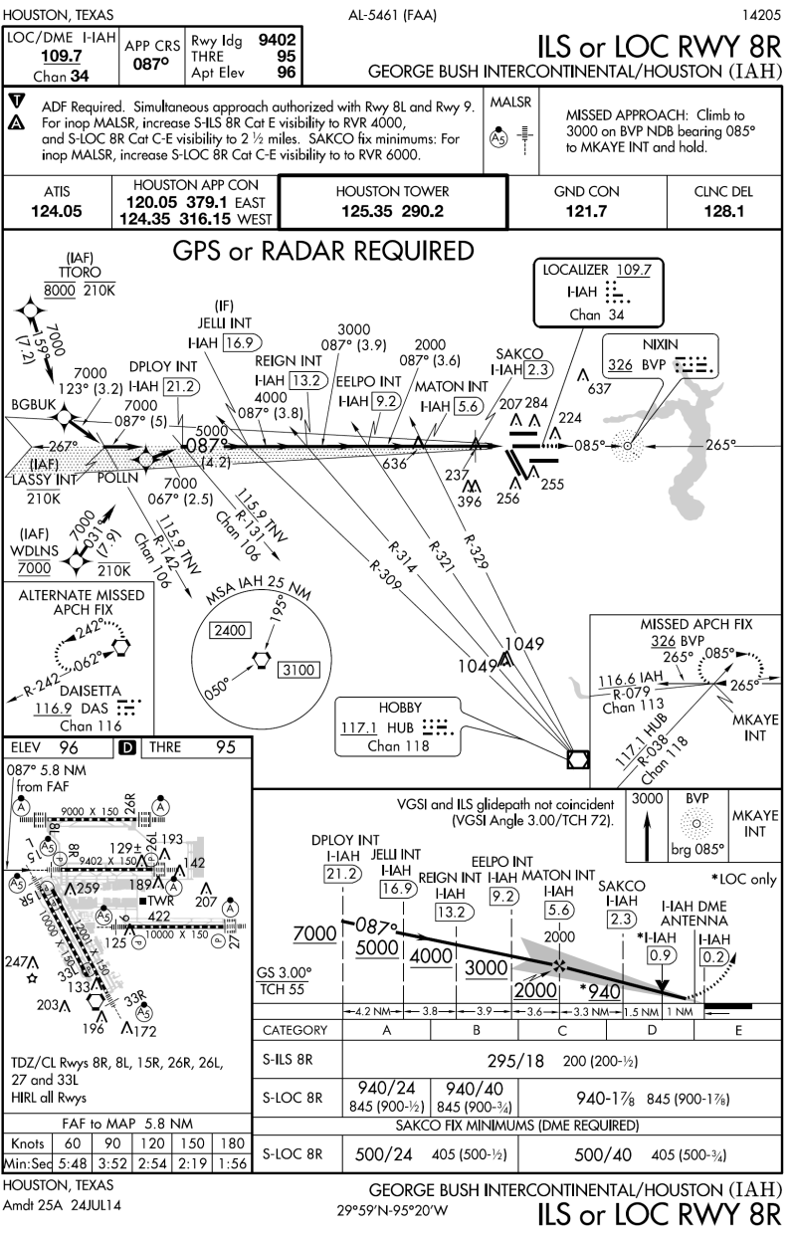
More Complicated LOC - IAH
Special inoperative equipment requirements
Simultaneous approaches
Additional equipment required
Step downs based upon multiple VORs
Multiple step downs
Multiple minimums

Slide 17

QUESTIONS

Slide 18
Disclaimer
Instrument flight can be dangerous. Do not rely solely on this presentation – PROFESSIONAL INSTRUCTION IS REQUIRED
The foregoing material should not be relied upon for flight
ALTHOUGH THE ABOVE INFORMATION IS FROM SOURCES BELIEVED TO BE RELIABLE SUCH INFORMATION HAS NOT BEEN VERIFIED, AND NO EXPRESS REPRESENTATION IS MADE NOR IS ANY TO BE IMPLIED AS TO THE ACCURACY THEREOF, AND IT IS SUBMITTED SUBJECT TO ERRORS, OMISSIONS, CHANGE

