Slide 1
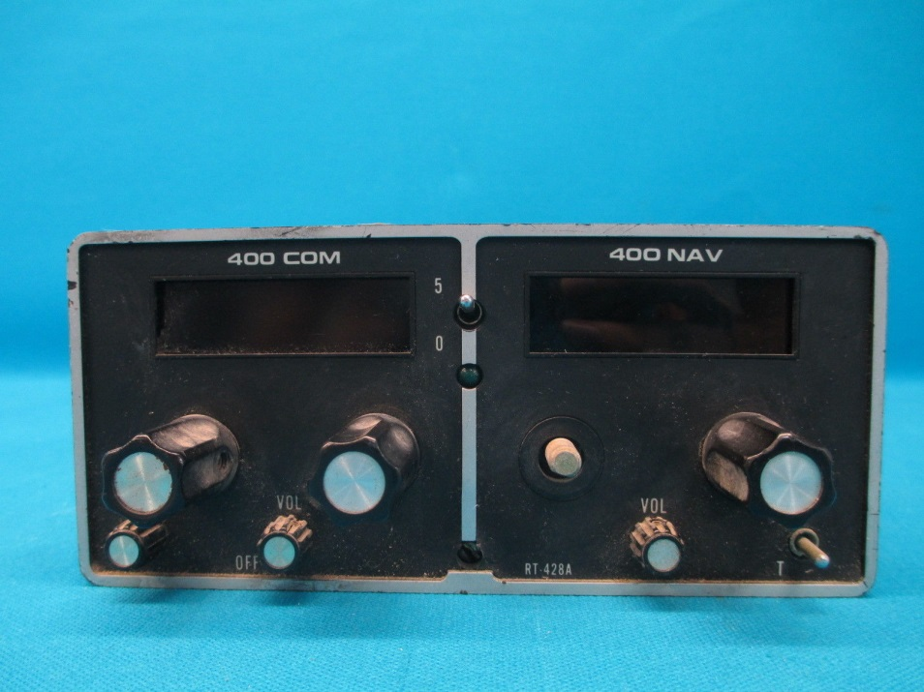
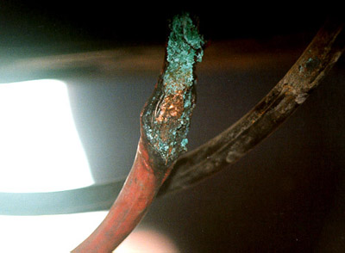
IFR Lost Communications I Can’t Hear You Procedures

Slide 2
Lost Communications
Preflight plan for lost communications
Where are the cloud tops and which way to nearest VFR
What is destination weather and alternate
Trouble shoot com problem BUT don’t forget to fly the plane
Stuck microphone
Unplug mic and adjust squelch
Check audio selector
Confirm frequency
Try another radio
Check power / circuit breaker / avionics switch
Reduce electrical load, if appropriate
Squawk 7600

Slide 3
Flying the Lost Comm Plan FAR §91.185
VMC - If the failure occurs in VFR conditions, or if VFR conditions are encountered after the failure, you must continue the flight under VFR and land as soon as practicable and notify ATC
Not intended that the requirement to "land as soon as practicable" be construed to mean "as soon as possible“
Primary objective is to preclude extended NORDO IFR operations in VMC

Slide 4
Flying the Lost Comm Plan - Route FAR §91.185
IMC – Continue in accordance with the following:
Route – in this order
By the route assigned in the last ATC clearance received
If being radar vectored, by the direct route from the point of radio failure to the fix, route, or airway specified in the vector clearance
In the absence of an assigned route, by the route that ATC has advised may be expected in a further clearance; or
In the absence of an assigned route or a route that ATC has advised may be expected in a further clearance, by the route filed in the flight plan
as Assigned
as Vectored
as Expected
as Filed.

Slide 5
Flying the Lost Comm Plan - Altitude FAR §91.185
IMC – Continue in accordance with the following:
Altitude - At the highest of the following altitudes or flight levels for the route segment being flown:
The altitude or fight level assigned in the last ATC clearance received;
The minimum altitude for IFR operations; or
The altitude or flight level ATC has advised may be expected in a further clearance

Slide 6
Flying the Lost Comm Plan – Altitude Up and Down
Comms lost
Fly 2,000 – as assigned and MEA
Climb to 3,000 after 10 minutes
Climb to 4,000 for higher MEA
Descend to 3,000 – for expected altitude
Climb to 5,000 for higher MEA
2000
10 mins
4000
5000
2000
Cessna 1472F cleared to Sugar Land airport, climb and maintain 2000, expect 3,000 ten minutes after departure, departure frequency is …..

Slide 7
Flying the Lost Comm Plan Off-Route Altitudes
If off-route - Maintain the last assigned altitude or the minimum safe/sector altitude (emergency safe altitude if more than 25 NM from the facility), whichever is higher, until established on a segment of the published approach

Slide 8
Flying the Lost Comm Plan Leaving a Clearance Limit
When the clearance limit is a fix from which an approach begins, commence descent or descent and approach as close as possible to the expect-further-clearance time if one has been received, or if one has not been received, as close as possible to the estimated time of arrival as calculated from the filed or amended (with ATC) estimated time en route.
If the clearance limit is not a fix from which an approach begins, leave the clearance limit at the expect-further-clearance time if one has been received, or if none has been received, upon arrival over the clearance limit, and proceed to a fix from which an approach begins
Commence descent or descent and approach as close as possible to the estimated time of arrival as calculated from the filed or amended (with ATC) estimated time en route.

Slide 9
Lost Communications
Lost communications is an emergency under IFR conditions. You can deviate as necessary to resolve the problem
During radio failure, when confronted with a situation not covered in the regulation, pilots are expected to exercise good judgment in their actions
Set transponder to 7600
Expect ATC to attempt to communicate with you by transmitting on guard frequencies and available frequencies of navaids
ATC may ask you to acknowledge communications by pressing ident on transponder

Slide 11
Disclaimer
Instrument flight can be dangerous. Do not rely solely on this presentation – PROFESSIONAL INSTRUCTION IS REQUIRED
The foregoing material should not be relied upon for flight
ALTHOUGH THE ABOVE INFORMATION IS FROM SOURCES BELIEVED TO BE RELIABLE SUCH INFORMATION HAS NOT BEEN VERIFIED, AND NO EXPRESS REPRESENTATION IS MADE NOR IS ANY TO BE IMPLIED AS TO THE ACCURACY THEREOF, AND IT IS SUBMITTED SUBJECT TO ERRORS, OMISSIONS, CHANGE

