Slide 1
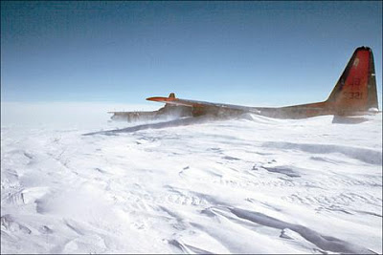
Aircraft Icing

Slide 2
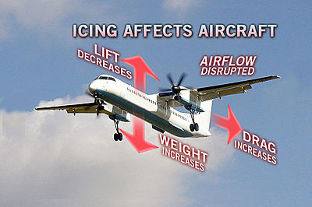

Slide 3
Icing Factors
Liquid water content
Temperature
Droplet size
Cloud type
Airfoil geometry
Airspeed
Duration of exposure

Slide 4
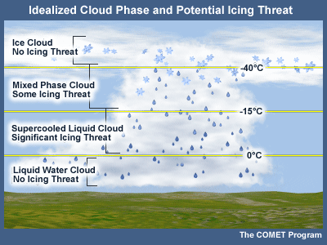
Where Icing is Likely to Occur

Slide 5
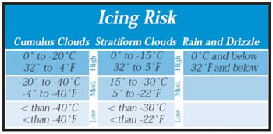
Icing Risk
Most icing tends to occur at temperatures between 0°and -20°C
– More than 50% of those occur between -8 and -12°C
- Heaviest icing usually will be found at or slightly above the freezing
level

Slide 6
Causation of Icing
NOT caused by ICE in clouds.
Caused by “Super-cooled” liquid water droplets
Strike the leading edge of an airfoil
Freeze on impact
For icing to occur –
the aircraft must be flying through visible water such as rain or cloud droplets, and
the temperature at the point where the moisture strikes the aircraft must be 0° C or colder.
Aerodynamic cooling can lower temperature of an airfoil to 0° C even though the ambient temperature is a few degrees warmer

Slide 7
Icing Type Classification
Types
Clear
Rime
Mixed
Classified based on the structure and appearance of the ice
Type of ice varies based on the atmospheric and flight conditions in which it forms

Slide 8
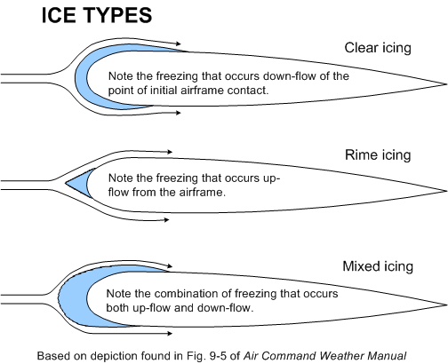

Slide 9
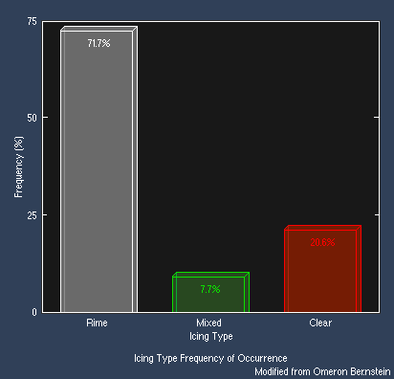
Frequency of Icing Types

Slide 10
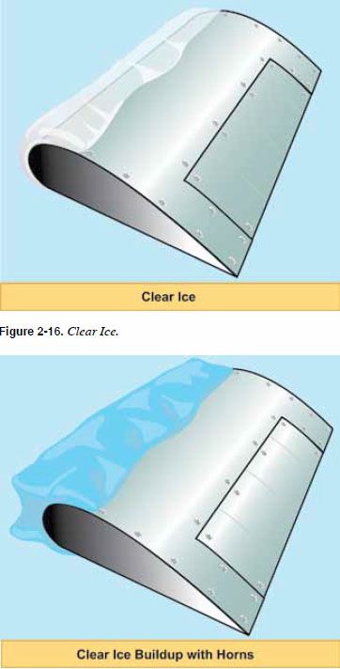
Clear Ice
Glossy, transparent ice formed by the relatively slow freezing of super cooled water
Often contains some air pockets that result in a lumpy translucent appearance
Clear ice is denser, harder, and sometimes more transparent than rime ice
With larger accumulations, clear ice may form “horns.”
Forms when
Temperatures are close to freezing
Large amounts of liquid water are present
High aircraft velocity
Large droplets are present
Clear icing most likely in building Cumulus
Removal of clear ice by deicing equipment is especially difficult

Slide 11
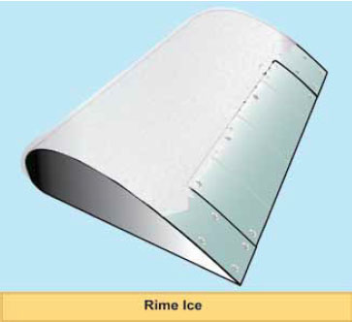
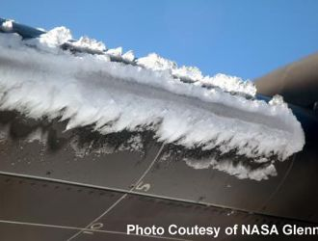
Rime Ice
Rough, milky, opaque ice
Formed by the instantaneous or very rapid freezing of super cooled droplets as they strike the surface
Freezes before the drop has time to spread
Rapid freezing results in the formation of air pockets in the ice, giving it an opaque appearance and making it porous and brittle
For larger accretions, rime ice may form a streamlined extension of the wing
Forms when:
Temperatures are low
Lower amounts of liquid water present
Low velocity
Small droplets are present
Irregular shape and rough surface make it very effective in decreasing aerodynamic efficiency, but it is lighter than clear ice

Slide 12
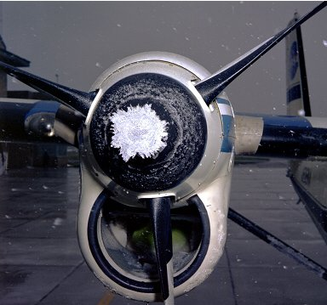
Mixed Ice
Mixed ice is a combination of clear and rime ice
Shape and roughness of the ice is the most important aspect from an aerodynamic point of view.

Slide 13
Icing Severity Accumulation Rate
Description to Report to ATC | Condition of Ice Accumulation | Pilot Action
Trace | Ice becomes perceptible. Rate of accumulation slightly greater than rate of sublimation. It is not hazardous even though deicing/anti-icing equipment is not utilized, unless encountered for an extended period of time - over one hour. | Unless encountered for one hour or more, deicing/anti-icing equipment and/or heading or altitude change not usually required.
Light | The rate of accumulation may create a problem if flight is prolonged in this environment (over one hour). Occasional use of deicing/anti-icing equipment removes/prevents accumulation. It does not present a problem if the deicing/anti-icing equipment is used. | Deicing/anti-icing required occasionally to prevent accumulation and/or heading or altitude change required.
Moderate | The rate of accumulation is such that even short encounters become potentially hazardous and use of deicing/anti-icing equipment or diversion is necessary. | Deicing/anti-icing required or heading or altitude change required.
Severe | The rate of accumulation is such that deicing/anti-icing equipment fails to reduce or control the hazard. Immediate diversion is necessary. | Immediate heading or altitude change required.

Slide 14
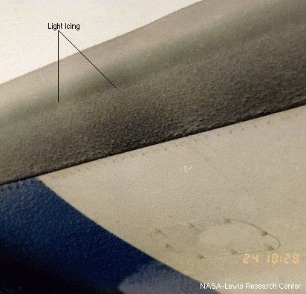
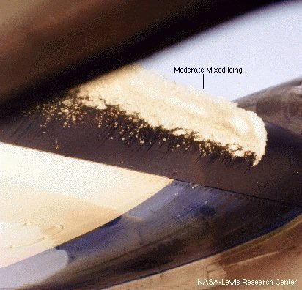
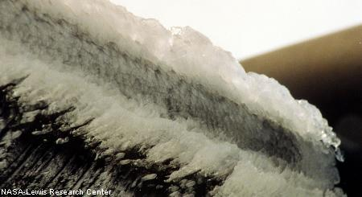
Icing Severity Accumulation Rate
Light
Moderate
Severe

Slide 15
Freezing Rain
Heavy icing in short time
Warm air/moisture over-running Cold air
Begins as rain,
Then falls through cold air
Becomes super cooled water
Freezes on impact
Best maneuver maybe to gain altitude
Check with a weather briefer first!

Slide 16
Cloud Type and Icing
Stratus clouds
Typically contain lower amounts of liquid water than cumulus clouds
Thickness can go to several thousands of feet; however, the vertical exent of an icing layer in a stratus cloud usually does not exceed 3,000 feet
Icing in stratiform clouds is usually found in the higher temperature mid-to low-level clouds below 15,000 feet AGL
Immediately activate ice protection systems. Monitor closely, and change altitude by at least 3,000 feet to avoid prolonged icing exposure
Cumulus clouds
Vertical development can cause the range of icing to cover many thousands of feet
Often contain high amounts of liquid water and larger droplet sizes
Icing is most intense in the updrafts that have high liquid water content, which sometimes support Super large droplets
Icing usually found below 27,000 feet at temperatures between +2° and -20°C.
Icing is usually of short in duration, but can be severe in intensity
Attempt to maintain visual separation from the clouds
Icing risk can increase near large bodies of water, since moisture added to overlying air masses increases water content

Slide 17
Known Icing
Generally known icing conditions exist when visible moisture or high relative humidity combines with temperatures near or below freezing
Since clouds are a form of visible moisture, flying through clouds at an altitude that is near or below freezing would constitute flight into known icing conditions
It doesn't matter whether there are any reports or forecasts of icing conditions at any altitude anywhere near the route of flight – determination of known icing is based upon temperature and moisture
The threat of ice need not cover an entire area at all altitudes for the threat to be known or dangerous

Slide 18
Aircraft Certification
Aircraft are either FAA approved for flight in icing conditions or not
Icing approval involves significant testing
Few light aircraft are approved for flight in icing
Aircraft that do not have all required ice protection equipment installed and functional are prohibited from venturing into an area with known icing conditions
Limited anti/de-icing equipment, such as a heated propeller or windshield, does not prepare an aircraft for flight in icing conditions
Only makes escape from an inadvertent encounter a little easier
Flight into known icing conditions when the airplane flight manual or pilot operating handbook prohibits such flight would constitute a violation whether the aircraft accretes ice or not

Slide 19
Types of Icing
Structural Icing
Accumulation of ice on the exterior of the aircraft
Forms on aircraft structures and surfaces when super-cooled droplets land on them and freeze
Small and/or narrow parts rapidly collect droplets and ice up most rapidly
This is why a small protuberance within the pilot’s vision can be used as an “ice evidence probe” It is generally one of the first parts of the airplane on which an appreciable amount of ice forms
Tailplane is a better collector than wings, because the tailplane presents a thinner surface to the airstream
Structural icing can cause significant aircraft control and performance degradation

Slide 20
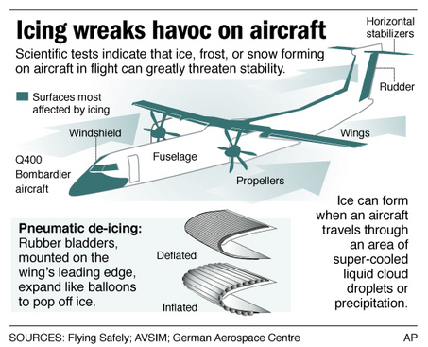
Where Ice Forms

Slide 21
Structural Icing
Thin wings are more critical with ice on them than thick wings
Tail Stall
If the tail stalls due to ice and the airflow disruption it causes, recovery is unlikely at low altitudes
Less familiar to many pilots
Wing stall
Much more common threat
Important to distinguish between tail stall and wing stall, since the required actions are roughly opposite

Slide 22
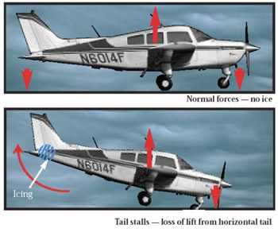
Tail Stall
What Is a Tail Stall?
Horizontal stabilizer balances the tendency of the nose to pitch down by generating downward lift on the tail of the aircraft to counter CG being forward of CP
When the tail stalls, this downward force is lessened or removed, and the nose of the airplane can severely pitch down
Because the tail has a smaller leading edge radius and chord length than the wings, it collects two to three times more ice than the wings
Tail ice accumulation is often not seen by the pilot

Slide 23
Tail Stall
Tailplane stall often worsens with increased airspeed and may worsen with increased power settings at the same flap setting
Airspeed, at any flap setting, in excess of the airplane manufacturer’s recommendations, with ice on the tailplane may cause a tailplane stall and uncommanded pitch down from which recovery may not be possible
Tailplane stall may occur at speeds less than the maximum flap extended speed (VFE)
High engine power settings may adversely impact response to tailplane stall conditions at high airspeed in some aircraft designs
Follow the manufacturer’s recommendations regarding power

Slide 24
Tail Stall Recognition
Tail stall Indications
When flaps are extended to any setting, the pitch control forces become abnormal or erratic
Buffet in the control column (not the airframe)
Elevator control pulsing, oscillations, or vibrations
Abnormal nose-down trim change
Any other unusual or abnormal pitch anomalies (possibly resulting in pilot induced oscillations)
Reduction or loss of elevator effectiveness
Sudden change in elevator force (control would move nose-down if unrestrained)
Sudden uncommanded nose-down pitch
Recovery from a tail stall is exactly opposite that for a wing stall recovery
In a tail stall recovery air flow must be restored to the tail's lower airfoil surface, and in a wing stall recovery air flow must be restored to the wing's upper airfoil surface

Slide 25
Tail Stall Recovery
Immediately raise flaps to the previous setting
Apply appropriate nose-up elevator pressure
Reduce power if altitude permits; otherwise maintain power
May need power increase if flaps are retracted, however
Do not increase airspeed unless it is necessary to avoid a wing stall
Make nose-down pitch changes slowly, even in gusting conditions, if circumstances allow

Slide 26
Wing Icing
Ice can distort the flow of air over the wing
Diminishes the wing's maximum lift
Reduces the angle of attack for maximum lift
Adversely affects airplane handling qualities
Significantly increases drag
Will ordinarily stall at a lower angle of attack, and thus a higher airspeed
Small amounts of ice will have an effect, and if the ice is rough, it can be a large effect
Frost, snow, and ice accumulations (on the leading edge or upper surface of the wing) no thicker or rougher than a piece of coarse sandpaper can reduce lift by 30 percent and increase drag up to 40 percent
Larger accretions can reduce lift even more and can increase drag by 80 percent or more

Slide 27
Wing Icing
Increased approach speed is advisable if ice is on the wings
How much of an increase depends on both the aircraft type and amount of ice – Refer to the POH
Stall characteristics of an aircraft with ice-covered wings will be degraded
Ice accretion may be asymmetric between the two wings
Outer part of a wing, which is ordinarily thinner and thus a better collector of ice, may stall first rather than last

Slide 28
Detecting Wing and Airframe Icing
Most obvious early symptom of airframe / wing icing in flight will be a decrease in airspeed
May also see ice on small narrow areas around the windshield and on struts
Visual inspection on the ground and inflight
Use of a flashlight can be very helpful
Ice is often difficult to see and in many instances cannot be detected other than by touch with the bare hand so should conduct visual and tactile inspections
inspections of airplane wing upper surfaces
May make the aircraft’s critical surfaces appear to be wet or the same color as the wing
During night operations, adequate illumination should be used to observe ice on the ground and in flight
Some aircraft have electronic ice detectors

Slide 29
Icing Impact on Roll Control
Ice on the wings forward of the ailerons can affect roll control
Serious roll control problems are not unusual
Possible for uncommanded and uncontrolled rolls to occur
Roll upset may be caused by airflow separation (aerodynamic stall), which induces self-deflection of the ailerons and loss of or degraded roll handling characteristics
Wings on GA aircraft are designed so that stall starts near the root of the wing and progresses outward, so the stall does not interfere with roll control of the ailerons
Since wing tips are thinner and most efficiently collect ice - can lead to a partial stall of the wings at the tips, which can affect the ailerons and thus roll control
If ice accumulates in a ridge aft of the boots but forward of the ailerons, this can affect the airflow and interfere with proper functioning of the ailerons
If aileron function is impaired due to ice, slight forward pressure on the elevator may help to reattach airflow to the aileron

Slide 30
Pitot Tube / Static Port Icing
A completely blocked pitot tube (e.g., due to an inoperative heater) will cause the airspeed indicator to function like an altimeter
As the aircraft climbs, so does the airspeed. As the aircraft descends, so does the airspeed indication
Various instruments (e.g., airspeed indicator, altimeter, and VSI) utilize pressures sensed by the pitot tube and static port
When iced these instruments display incorrect information

Slide 31
Propeller Icing
Ice buildup on propeller blades reduces thrust
The greatest quantity of ice normally collects on the spinner and inner radius of the propeller
Propeller areas on which ice may accumulate and be ingested into the engine normally are anti-iced rather than deiced to reduce the probability of ice being shed into the engine

Slide 32
Stall Warning Systems
Icing may result in the possible loss of stall warning system effectiveness
Exacerbates an already hazardous situation
Even if the stall warning system is operational, it may be ineffective because the wing stalls at a lower angle of attack due to ice on the wing

Slide 33
Other Icing Impacts
In certain icing conditions, control surfaces may bind or jam as a result of icing
Some approved aircraft have space around the edges of control surfaces to allow ice to build up without interfering with their movement
Unheated fuel vents can become blocked, which may lead to fuel starvation
Fuel tanks, especially bladder types, may collapse because air is unavailable to replace the used fuel
Limited vision
Icing may block windscreen blocking enough forward vision to see ahead enough to land

Slide 34
Communications
Because of their small size and shape, antennas that do not lay flush with the aircraft’s skin tend to accumulate ice rapidly
Ice accumulations may cause:
Antenna to vibrate
Radio signals to become distorted
Damage to the antenna
If a frozen antenna breaks off, it can damage other areas of the aircraft in addition to causing a communication or navigation system failure

Slide 35
Ice Weight Impact
Weight of ice may prevent an aircraft from:
Taking off
Maintaining altitude
Significantly alter CG
How much ice can a non-approved aircraft can carry?
It is unknown – It was never determined through testing

Slide 36
Fuel System Icing
Ice formation in fuel systems results from dissolved and undissolved water in the fuel
Dissolved water in solution with fuels constitutes a relatively small part of the total water potential in a fuel system. Water strictly in solution is not a serious problem in aviation fuel so long as it remains in solution.
Undissolved water is entrained water, such as water particles, suspended in the fuel as a result:
Mechanical agitation of free water
Conversion of dissolved water through temperature reduction
May be introduced as a result of refueling or the settling of entrained water which collects at the bottom of a fuel
May also be introduced as a result of condensation from air entering a fuel tank through the vent system
Entrained and free water are the most dangerous because of the potential of freezing on the surfaces of the fuel system
Free water can be drained from a fuel tank if low point drain provisions are adequate. Removal of such water can reduce or eliminate the potential for icing problems

Slide 37
Fuel System Icing
During flight, the temperature of the fuel in the tanks decreases, due to the decreasing temperatures at altitude
Temperature decrease causes precipitation of the dissolved water from the fuel
Separated water then drops to the bottom of the tank, because it is denser than the fuel.
Since the water is no longer in solution, it can freeze, blocking fuel inlet pipes
The entrained water will freeze in cold fuel and tend to stay in solution longer since the specific gravity of ice is approximately the same as that of aircraft fuel
Ice crystals begin to form in entrained water in the fuel as the temperature nears the freeze point of water
Due to impurities in the water, this normally takes place at slightly lower temperatures (27 to 31 °F) (-3 to -1 °C)
As the temperature decreases further, the ice crystals begin to adhere to their surroundings in the form of ice. This is known as the critical icing temperature and occurs at about 12 to 15 °F (-11 to -9 °C)
At temperatures below 0 °F (-18 °C), ice crystals tend to become larger and can plug small openings such as screens, filters, and orifices

Slide 38
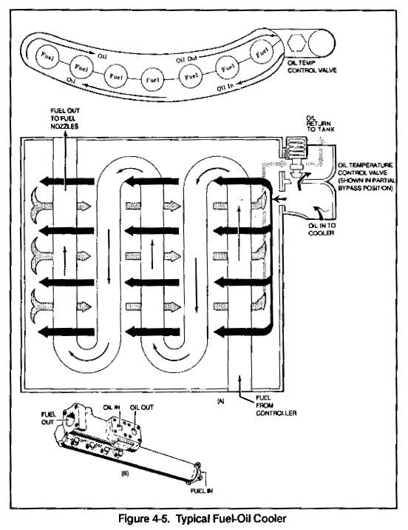
Fuel System Icing
Anti icing agents
Fuel System Icing Inhibitors (FSII) help to prevent the formation of ice crystals
Typically an Ethylene Glycol mixture
FSII dissolves in more easily in water then fuel. Any water present will extract FSII from the fuel; the additive then acts to reduce the freeze point of the free water, preventing the formation of ice crystals
FSII must be distributed evenly throughout the fuel – can’t just pour in the tank
FSII depresses the freezing point of the water to -43°C.
Some FSII formulations are highly toxic and must be stored properly in dry conditions
Normally prepared for jet fuel, but some brands are good with 100LL – Check the label
Fuel Heaters
Operate using the principle of heat exchange to warm the fuel
Can use engine bleed air, an air-to-liquid exchanger, or engine lubricating oil, a liquid-to-liquid exchanger, as a source of heat.
Protects the engine fuel system from ice formation and can also be used to thaw ice
In some cases the fuel filter is fitted with a pressure-drop warning switch which illuminates a warning light if ice collects on the filter surface
Fuel deicing systems are designed to be used intermittently
Controlled manually by a switch in the cockpit or automatically using a thermostat

Slide 39
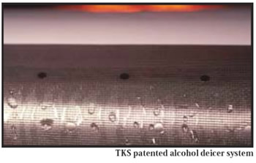
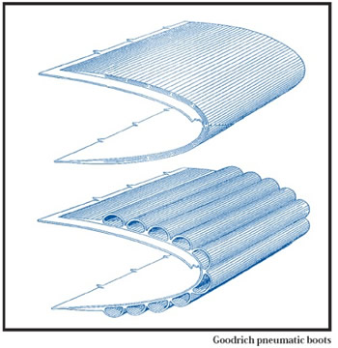
Deicing and Anti-Icing Equipment
Anti-icing equipment is turned on and used before entering icing conditions
Includes carburetor heat, prop heat, pitot heat, fuel vent heat, windshield heat, and fluid surface deicers (in some cases).
Deicing is used after ice has built up to an appreciable amount. Typically this includes surface deice equipment – e.g. boots
Propeller
Ice often forms on the propeller before it is visible on the wing
Deicing fluid can be applied by slinger rings on the prop hub
Propeller can be de-iced by electrically heated elements on the leading edges
Wing
Boots are de-icing devices – most common system
Boots are inflatable rubber strips attached to the leading edge of the wing and tail surfaces. When inflated they expand, breaking ice off the boot surfaces. Following inflation, suction is applied to the boots and they return to their original shape
Two types of anti-icing systems
Weeping wing systems (fluid deice systems) - pump fluid from a reservoir through a mesh screen embedded in the wing’s leading edge
Heated wing - typically found on jets

Slide 40
Deicing and Anti-Icing Equipment
Windshield - two systems used in light aircraft
Electrically heated windshield, or plate
Fluid de-icing spray onto the windshield
Icing can also be controlled to a very limited extent with the windshield defroster
Never acceptable by itself
On many aircraft it is the only source of windshield ice prevention

Slide 41
Deicing and Anti-Icing Equipment
Unprotected areas of an aircraft with anti / de-icing equipment can still have a significant performance impact, even after use of the equipment
Close to 30 percent of the total drag associated with an ice encounter remained after all the protected surfaces were cleared
Non-protected surfaces may include antennas, flap hinges, control horns, fuselage frontal area, windshield wipers, wing struts, fixed landing gear, etc.

Slide 42
What about Using Anti-Icing Fluid
Consult your Pilot Operating Handbook (POH) for specific information
General guidance
Key factor is rotation speed
Rotation speed of <60 knots, normally only consider Type I fluid
Type I fluid is orange in color and mostly glycol
Protection time is limited - five minutes or less
Rotation speed is 60 knots or more, may be able to use Type III fluid, if approved by the airframe manufacturer
Only if rotation speed is 110 knots or more, should you consider using Type II or IV fluid—and then only if approved by the airframe manufacturer

Slide 43
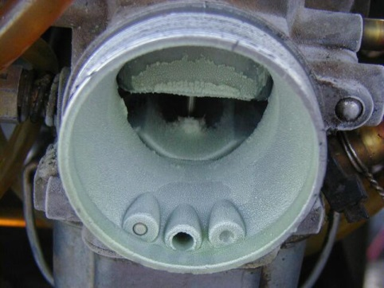
Induction Icing
Ice in the induction system reduces the amount of air available for combustion
Induction icing accidents is the number one cause of icing accidents – 52%
Carburetor ice
Occurs when moist air passes through a carburetor venturi and is cooled
Carburetion process can lower the temperature of the incoming air as much as 60 degrees F
Ice may, as a result, form on the venturi walls and throttle plate, restricting airflow to the engine
Generally occurs at temperatures between 20° F (-7° C) and 70° F (21° C)
Can form even when the skies are clear and the outside air temperature is as high as 90 degrees
Indicated by reduced rpm with a fixed-pitch propeller and a loss of manifold pressure with a constant speed propeller, and may make the engine run rough
Remedied by applying carburetor heat, which uses exhaust as a heat source to melt the ice or prevent its formation

Slide 44
Induction Icing
At the first indication of carburetor ice
Apply full carburetor heat and leave it on
Engine may run rougher as the ice melts and goes through it, but it will smooth out
When the engine runs smoothly, turn off the carb heat
If you shut off the carburetor heat prematurely, the engine will build more ice—and probably quit because of air starvation.
The engine rpm should return to its original power setting. If the rpm drops again, fly with the carb heat on
Do not use partial heat – it will make the icing worse
With carburetor heat on, the hot air is less dense, so the mixture becomes richer, and as a result, the rpm will drop a bit further. Lean the mixture, and most of the rpm loss should return.

Slide 45
Induction Icing
Fuel-injected aircraft induction icing
Engines are less vulnerable to icing
Can be affected if the engine’s air source (air filter and intake passages) becomes blocked with ice
Manufacturers provide an alternate air source to remedy the situation
At the first indication of induction icing
Activate the alternate induction air door or doors
When these doors open, intake air routes through them, bypassing the ice blocked normal induction air pathway
Some alternate induction air systems activate automatically using spring-loaded doors
Check the POH to ascertain how and when to use this system

Slide 46
Induction Icing
Jet aircraft
Air that is drawn into the engines creates an area of reduced pressure at the inlet, which lowers the temperature below that of the surrounding air. This reduction in temperature may be sufficient to cause ice to form on the engine inlet, disrupting the airflow into the engine
Hazard may also occur when ice breaks off and is ingested into a running engine, which can cause damage to fan blades, engine compressor stall, or combustor flameout
When anti-icing systems are used, runback water also can refreeze on unprotected surfaces of the inlet and, if excessive, reduce airflow into the engine or distort the airflow pattern in such a manner as to cause compressor or fan blades to vibrate, possibly damaging the engine
Icing of engine probes used to set power levels (for example, engine inlet temperature or engine pressure ratio (EPR) probes), can lead to erroneous readings of engine performance, reduced power or total power loss.
The type of ice that forms can be classified as clear, rime, or mixed, based on the structure and appearance of the ice. The type of ice that forms varies depending on the atmospheric and flight conditions in which it forms. Significant structural icing on an aircraft can cause serious aircraft control and performance problems.

Slide 47
Ice Avoidance flight plan
Fairly easy to predict where large areas of icing potential exist
Accurate prediction of specific icing areas and altitudes is much harder
All clouds are not alike. There are dry clouds and wet clouds
Fronts and low-pressure areas are the biggest ice producers, but isolated air mass instability with plenty of moisture can produce significant icing
Freezing rain and drizzle are very dangerous

Slide 48
Ice Avoidance flight plan
For VFR flights, with the exceptions of freezing rain, freezing drizzle, and carburetor icing, staying clear of clouds by a safe margin generally will prevent ice formation
For IFR Flights
Get a good briefing – use all resources
Know the big picture because most ice is in fronts and low-pressure centers
Cloud tops and bases
Temperatures
Look at alternate routes
Have an escape route - could be a climb, descent, 180-degree turn, or immediate landing at a nearby airport
Request Pireps pre-flight and enroute
Type of aircraft making the pirep is important
Single reports not always accurate
Provide Pireps for others

Slide 49
Ice Pre-Flight Actions
Carry extra fuel. In icing conditions, extra power is needed because of increased aerodynamic drag and/or because carburetor heat is used. Fuel consumption will increase
Remove all frost, snow, or ice from the wings - Don't count on blowing snow off when taking off. There could be some nasty sticky stuff underneath the snow
Check for ice and snow elsewhere
Propeller dry and clean
Check controls to be sure there is full freedom of movement in all directions
Check the landing gear and clean off all accumulated slush
Wheelpants on fixed-gear aircraft should be removed in winter operations because they are slush collectors
Check wheel wells for ice accumulation
Be sure that deice and anti-ice equipment works. When was the last time you actually checked the pitot heat for proper functioning

Slide 50
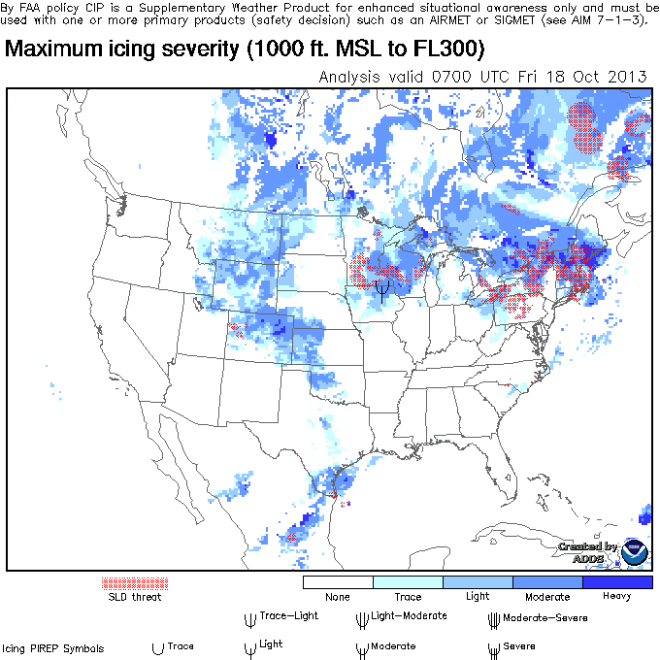
Weather Products
Current Icing Potential (CIP)
Shows expected potential for icing, but does not yet show severity
Gives icing potential information for particular altitudes and geographic locations, but should be used as a supplement to an official weather briefing
Forecast Icing Potential (FIP)

Slide 51
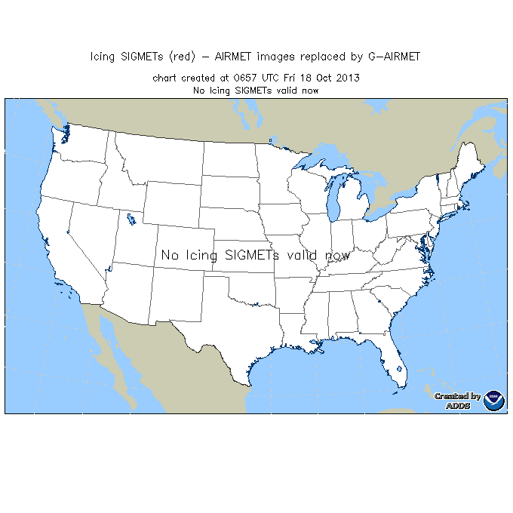
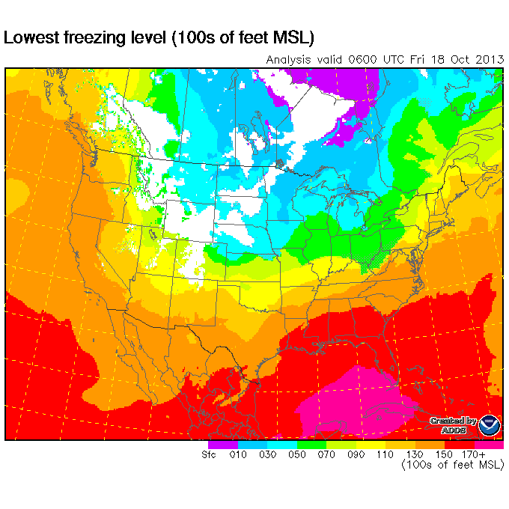
Weather Products
Icing sigmets
Issued for severe icing (not associated with thunderstorms -- otherwise, it is a convective sigmet)
AIRMET Zulu
Describes moderate icing and provides freezing-level heights
Freezing level graphics

Slide 52
Departures in Icing Conditions
Taxi slowly on icy taxiways
Be careful on run-up – aircraft may slide
Know where the cloud bases and the tops are
If you encounter icing conditions, have a plan either to return to the airport or climb above the ice
Consider cycling the gear after takeoff to help shed ice from the landing gear
Do not climb too steeply as it may cause ice to form on the underside of the wing behind the boots
Ice on the underside of the wing increases drag, sometimes dramatically

Slide 53
Enroute
Airspeed is a key to measuring ice accumulation.
If normal cruise drops, it's time to exit immediately
If you can't climb or descend, then a 180-degree turn is the only option, and that will result in a loss of at least another 10 KIAS until you're out of the ice
A 20-knot drop in airspeed is plenty. Add power to increase airspeed, since stall speed margins shrink with speed loss
Speed discipline is key in icing conditions
Aircraft not certified for flight into icing conditions should start getting out of icing conditions at the first sign of ice.
At the first sign of ice accumulation, decide what action you need to take and advise ATC
Do you know where warmer air or a cloud-free altitude is
If you need to modify your route to avoid ice, be firm with ATC about the need to change altitude or direction as soon as possible
Requesting an immediate climb, descent, or turn lets the controller know that unless the request is handled quickly an emergency situation will likely develop
Don't wait until the situation deteriorates
Declare an emergency if necessary to solve the problem

Slide 54
Enroute
If you're on top of a cloud layer and can stay on top, ask ATC for a climb well before getting into the clouds
Icing is much worse in the tops of the clouds
If you're in the clouds and the temperature is close to freezing, ask for a top report ahead
Can tell you whether going up is a better option than descending
Around mountains be extra cautious
The air being lifted up the mountain slopes by the wind (orographic lifting) produces moderate to severe icing

Slide 55
Autopilot
Do not use the autopilot in icing conditions
Masks the aerodynamic effects of the ice and may bring the aircraft into a stall or cause control problems
Situation can degrade to the point that autopilot servo control power is exceeded, disconnecting the autopilot
Pilot is then faced with an immediate control deflection for which there was no warning or preparation

Slide 56
Approach and Landing With Ice
Most icing accidents occur in the approach and landing phases of flight
If on top of ice-laden clouds, request ATC's permission to stay on top as long as possible
When carrying ice do not lower the flaps
The airflow change resulting from lowering the flaps may cause a tail with ice to stall
Carry extra power and speed on final approach — at least 10 to 20 knots
Stall speed is increased when carrying Ice
Many icing accidents occur when the aircraft is maneuvering to land
Shallow bank turns should be used as the stall potential is high
Use the longest runway possible
Because of increased airspeed and the no-flap configuration
May also be ice on the runway
Turn the defroster on high to possibly help keep a portion of the windshield clear
Turn off the cabin heat if that will provide more heat to the windshield.
If the windshield is badly iced, open the side window and attempt to scrape away a small hole using an automotive windshield ice scraper, credit card, or other suitable object
Be careful not to lose control of the aircraft when removing ice from the windshield

Slide 57
Also Look at the FAA’s Pilot’s Guide to Flight in Icing Conditions for more detail –
http://rgl.faa.gov/Regulatory_and_Guidance_Library/rgAdvisoryCircular.nsf/list/AC%2091-74/$FILE/AC91-74.pdf

Slide 58
Disclaimer
Instrument flight can be dangerous. Do not rely solely on this presentation – PROFESSIONAL INSTRUCTION IS REQUIRED
The foregoing material should not be relied upon for flight
ALTHOUGH THE ABOVE INFORMATION IS FROM SOURCES BELIEVED TO BE RELIABLE SUCH INFORMATION HAS NOT BEEN VERIFIED, AND NO EXPRESS REPRESENTATION IS MADE NOR IS ANY TO BE IMPLIED AS TO THE ACCURACY THEREOF, AND IT IS SUBMITTED SUBJECT TO ERRORS, OMISSIONS, CHANGE

