Slide 1
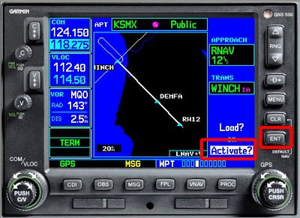
GPS Approaches

Slide 2
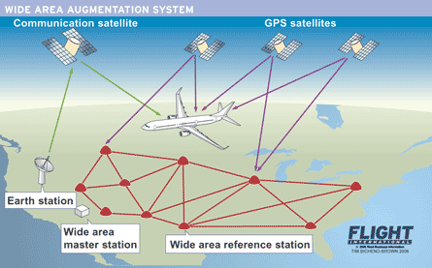
GPS Terminology
Receiver Autonomous Integrity Monitoring (RAIM) – Process used by a GPS receiver to determine the integrity of the GPS’ position using only GPS signals
Wide Area Augmentation System (WAAS) – Ground based signal that augments satellite GPS signals, to improve the GPS’ accuracy, integrity, and availability
WAAS uses a network of ground-based reference stations to measure small variations in GPS signals. The measurements are then routed to master stations, which compute the Deviation Correction (DC) and send correction messages to WAAS satellites every 5 seconds or better
Provides position accuracy of 25 ft or better for both lateral and vertical measurements

Slide 3
GPS Terminology
Track (TRK or TK) – provides aircraft's precise track along the ground
This isn't heading – it is the actual direction the aircraft is moving, corrected for wind, deviation, and variation
Desired Track (DTK) - course to the next waypoint
Bearing (BRG) - direction you need to go to get to the waypoint from your present position

Slide 4
GPS Terminology
Distance – Unlike DME, distances are not based on slant distance
Non-Sequential Mode (Susp or OBS button) –
When you enter a series of waypoints in the GPS, it assumes that, as you cross each one, it should automatically switch to the next waypoint
Sequencing is useful, unless you need to do something different like a hold or a procedure turn. In these instances, you may cross a particular waypoint more than once before you want to activate the next waypoint. As a result, every GPS allows you to turn off the auto-sequencing function (Suspend) and does so after the MAP is passed
Moving Map
Track-Up - display rotates the map around to your direction of flight
Desired Track Up - display will put the direction you're supposed to go at the top of the map - can be dangerous, since you could go off course enough to depart the map display
North-Up display - places north at the top of the map – more like a paper chart

Slide 5
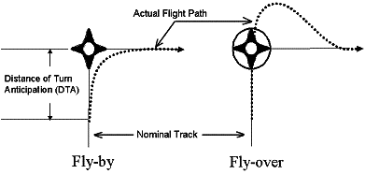
GPS Terminology
Waypoints
GPS approaches make use of both fly-over and fly-by waypoints
Fly-by waypoints are used when an aircraft should begin a turn prior to reaching the waypoint separating the two route segments. This is known as turn anticipation
Approach waypoints, except for the missed approach waypoint and the missed approach holding waypoint (MAHWP), are normally fly-by waypoints
Fly-over waypoints are used when the aircraft must fly over the point prior to starting a turn
Approach charts depict fly-over waypoints as a circled waypoint symbol
You should understand the bank angle and rate of turn that your GPS uses and whether your GPS considers wind and airspeed for turn anticipation. Over/under banking can prove troublesome on approaches

Slide 6
How it Works
GPS is based on the concept of ranging and triangulation from a minimum of four satellites above the mask angle (lowest usable signal angle above the horizon)
Each satellite transmits a specific course/acquisition (CA) code containing the:
Satellite's ephemeris (exact position in space)
GPS system time
Health and accuracy of the data
Accuracy +/- 50’ horizontally, 10’ with WAAS
Do not use non-WASS GPS altitude information – error can be up to 500 meters (1600’)
Pseudo-range (distance from the satellite determined by time measurement) is computed by your GPS receiver/processor
Using pseudo-range and position information from at least four satellites, the GPS receiver computes, by triangulation, a three-dimensional aircraft position (latitude, longitude, altitude) and time solution
Navigational values are computed by the GPS using the position/time solution described above and its built-in database

Slide 7
Potential Errors
Loss of signals due to antenna position or higher terrain
Signal interference / jamming
Harmonic interference from UHF transmission
Multipath – reflected signals
Satellite transmission errors
Selective availability (DoD can turn GPS service off)

Slide 8
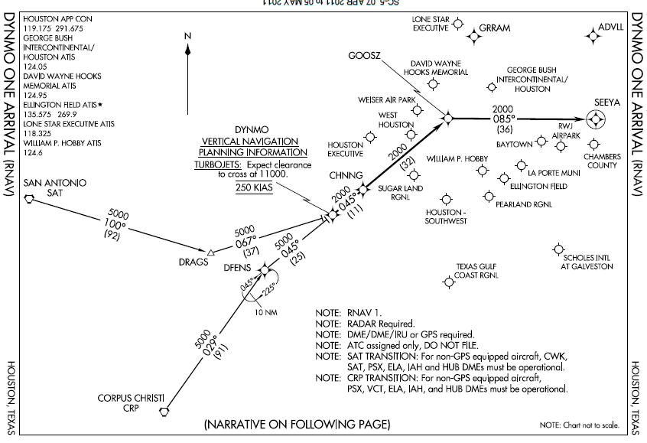
Approach Sensitivity
GPS is different than other avionics – Sensitivity must be sequenced by the GPS for enroute, terminal and approach segments

Slide 9
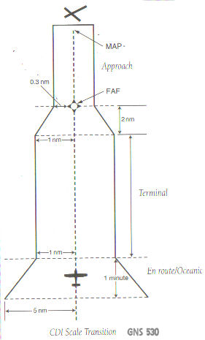
GPS Variable CDI Sensitivity
Enroute – 5 nm (>30 nm from destination)
Terminal – 1.0 nm (.2nm dot) (from 30 nm to 2 nm from destination)
Approach - .3 nm (360’ per dot)(<2nm)
CDI progressively steps up sensitivity – can be deceptive as to off course distance
Approach mode should be armed before the airplane is within 2 miles of the final approach fix
Arming the approach mode activates sequencing of CDI sensitivity - this change in CDI sensitivity is why you must "load" and "activate" an approach rather than flying “direct to” each of the approach fixes

Slide 10
General GPS Approach Categories
GPS overlay procedure – Procedure allows pilots to use GPS to fly an existing non-precision instrument approach based on the location of conventional ground navaids
A Phase III GPS overlay procedure is published with “or GPS“ in addition to the ground based procedure designation. Phase II GPS approaches have no GPS reference in the title
GPS stand-alone procedure - An instrument approach procedure based solely on GPS without reference to conventional ground navaids
Identified as “RNAV (GPS) procedure name”
RAIM or equivalent monitoring functions must be available
Most use “T” format Terminal Arrival Area design

Slide 11
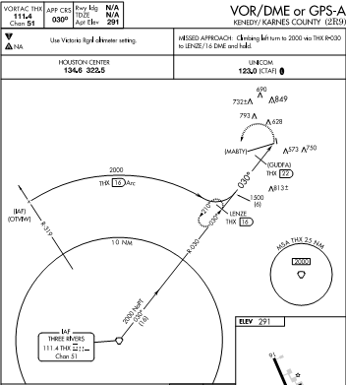
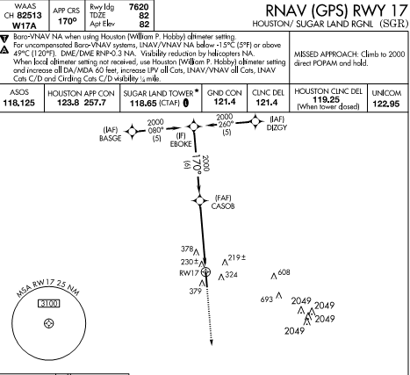
Approach Categories
Overlay
Stand-alone

Slide 12
Using GPS for DME or Overlay Approaches
GPS receivers may be used to fly all non-precision approaches that can be retrieved from the GPS’ database, except localizer, localizer directional aid (LDA), and simplified directional facility (SDF) approaches
Approach overlay program has three phases
Phase I ended in 1994
Phase II - GPS can be used as the primary guidance to fly an overlay to an existing non-precision approach without actively monitoring the applicable NAVAID. Ground-based NAVAID(s) must be operational and the aircraft’s avionics must be operational to use the overlay approach. Avionics need not be operating if RAIM is available
Pilots can tell Phase II approach - "GPS" is not included in the title of the approach

Slide 13
Using GPS for DME or Overlay Approaches
Phase III approaches include "or GPS" in the title of the procedure. Neither traditional avionics nor ground based NAVAIDs need be installed, operational, or monitored. However, if the GPS does not use RAIM, the ground-based NAVAIDs and traditional avionics must be installed and operating
Mixture of nonprecision Phase II, Phase III, and GPS stand alone approaches will exist for some time
Most nonprecision instrument approaches (except localizer, LDA, and SDF) are available under Phase II. Eventually, these approaches will become Phase III approaches
FAA continues to develop stand alone GPS approaches

Slide 14
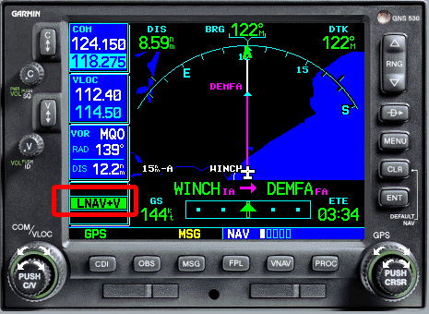
Types of Approaches LNAV / VNAV / LPV
If your GPS is non-WAAS (TSO C129), then you only get lateral guidance and you can fly a GPS approach like any other non-precision approach, descending as indicated on the profile view on the approach chart
With a WAAS GPS receiver, the approach minimums you use depend on the course sensitivity the GPS displays when you are flying the approach
The GPS will display the sensitivity level a few miles outside the FAF
Course sensitivity depends on WAAS signal integrity and may vary from day to day and hour to hour

Slide 15
Types of Approaches
 | LNAV | LNAV/VNAV | LP | LPV
Lateral Navigation | X | X | X – Equivalent to localizer precision | X – Equivalent to localizer precision
Vertical Guidance | Descend incrementally based upon fixes - MDA | X – Internally generated descent path - average DH of 350 feet – vertical accuracy of 20-50 meters - DA | Descend incrementally based upon fixes - MDA | X – Equivalent to glideslope precision - DA
Type of Approach | Non-precision approach | Precision | Non-precision approach | Precision
Equipment requirements |  | Flown with barometric vertical navigation or WAAS |  | WAAS generated vertical guidance - equivalent to localizer

Slide 16
Types of Approaches LPV / LNAV - The Extremes
LNAV - lateral navigation only, no descent guidance
LPV (localizer performance with vertical navigation) – An approach with WAAS generated vertical guidance to a Decision Altitude (DA)
Provides lateral and vertical guidance similar in precision to an ILS – triangular increasing precision
Usually to a DA no lower than 250 HAT and no less than 1/2 mile visibility
VNAV sensitivity will be annunciated at the last fix before the final approach fix

Slide 17
Types of Approaches LP
Localizer performance
Lateral guidance is angular, with needle sensitivity increasing as you get closer to the missed approach point (similar to the localizer triangle)
By contrast, LNAV approach CDI sensitivity is the same from the final approach fix to the MAP (e.g. a rectangle)
Unlike an ILS or LPV approach, there is no glideslope on an LP approach
No advisory glideslope. Serious drawback for only 60 ft in lower minima (on average) than a basic LNAV
WAAS approach like the LPV

Slide 18
Types of Approaches LNAV/VNAV
Provides lateral and vertical navigation
Final approach segment's obstacle environment surfaces are treated somewhat like an ILS but without the precise measurements of the curvature of the earth or other precise anchor points that an LPV approach uses
The WAAS G/S is in essence emulating a barometric VNAV glide slope without the temperature errors
There is no taper down of lateral obstacle clearance
You probably don’t have one

Slide 19
Types of Approaches LNAV/VNAV
Vertical Navigation (VNAV) utilizes an internally generated glideslope based on
WAAS or
Baro-VNAV systems
May have approach restrictions as a result of temperature limitations and must check predictive RAIM
Minimums are published as a DA

Slide 20
Types of Approaches LNAV+V - lateral navigation with advisory descent guidance
Provides only advisory guidance and is considered a non-precision approach –
There is no vertical guidance provided for in the FAA procedure
It is strictly a Jeppesen add on, and if done correctly, will allow you to fly the approach without violating any stepdown fixes in the final approach segment
Do not descend below any step-down altitude listed on the approach chart's profile view
You may see LNAV+V on some RNAV approach charts that only have LNAV minima, but you may also see it on an RNAV approach where the required signal integrity for LPV is unavailable
RNAV approaches with only circling minima and with an approach course that is more than 30 degrees out of alignment with any runway will not display advisory guidance
The advisory vertical guidance should be the constant glide angle required to get you to MDA a just before the missed approach point

Slide 21
Vertical Guidance Types
Approved Vertical Guidance – provides glide path information to meet altitude approach restrictions for LPV, LNAV/VNAV, and ILS lines of minima.
LPV approach can provide WAAS vertical guidance as low as 200 feet AGL
LNAV/VNAV - Barometric altimeter information remains the primary altitude reference
Barometric Aiding (Baro-Aiding) - augmentation that allows a GPS system to use the aircraft static system to provide vertical reference and reduces the number of required satellites from five to four
Baro-aiding satisfies the RAIM requirement in lieu of a fifth satellite
Barometric Vertical Navigation (Baro-VNAV) - barometric altitude information from the aircraft’s static system to compute vertical guidance
Vertical path is typically computed between two waypoints or an angle from a single way point.
Check for any temperature limitations resulting in approach restrictions

Slide 22
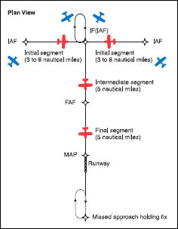
Stand Alone Approach Basic “T” Design of Terminal Arrival Area (TAA)
3 segments as with other approaches
Eliminates or reduces the need for feeder routes, departure extensions, and procedure turns or course reversal
Standard TAA has three IAFs: straight-in, left base, and right base with NoPT
The arc boundaries of the three areas of the TAA are published portions of the approach and allow aircraft to transition from the en route structure directly to the nearest IAF BUT in all cases you have the option to go directly to the holding pattern
Aligns the procedure on the runway centerline
Missed approach point is located at the threshold
The FAF is 5 NM from the threshold, and the intermediate fix (IF) is 5 NM from the FAF

Slide 23
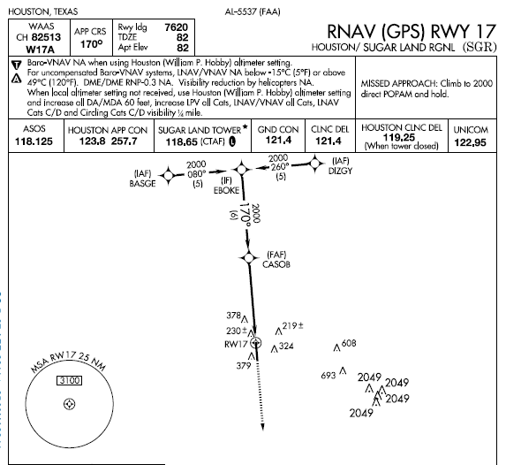
Stand Alone Basic “T” Design of Terminal Arrival Area (TAA)
IAFs
FAF
MAP
Initial segments
Intermediate segment
Final segment
TAA approach enables simple transitions to avoid inaccurate & disorienting procedure turns

Slide 24
Stand Alone Approach Improved MAP’s
Significantly safer Missed Approach Climb Procedures
Focus on Straight Ahead Navigation
Plenty of time between course changes
Realistic expectation of ATC intervention prior to hold entry
Alternate MAP’s offer non-GPS dependent version

Slide 25
GPS A, etc.
Just like that old VOR-A
Final Approach Course more than 30˚ misaligned from the runway centerline
For various reasons, the FAA uses GPS approaches the same way
Terrain
Traffic & Airspace
Multiple “off-centerline” approaches work down the alphabet

Slide 26
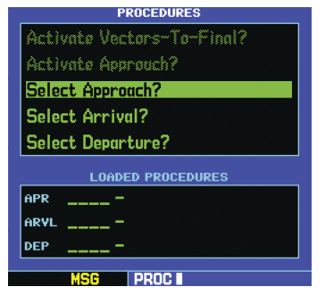
Loading the STAR to Get to the Approach
Select arrival and then enter the name of the arrival
The GPS will then ask for the transition to be used
When an approach has been loaded in the flight plan, GPS receivers will give an “arm” annunciation (generally 30 NM straight line distance from the airport)
You need to know how to operate your GPS – all of them are different

Slide 27
Which Transition?
If you are on the “approach side” of the “T-arms”
Select the closest arm as a transition
Can select the center of the arms, but may require you fly the depicted hold in lieu of a procedure turn
If you are “outside” of the “T-arms”
You may fly directly (when cleared) to the center of the “T arms” & disregard the hold
You may not fly directly to the FAF

Slide 28
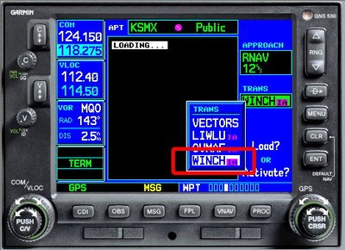
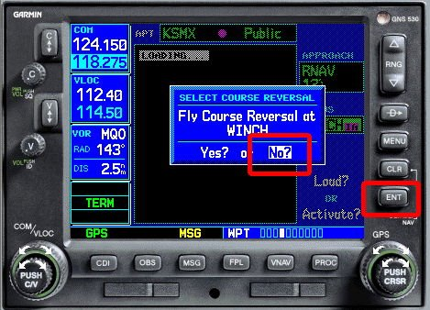
Stand Alone Basic “T” Design of Terminal Arrival Area (TAA)
Load the approach
Select the IAF transition
Select hold or no – hold – most often no course reversal
ACTIVATE the approach

Slide 29
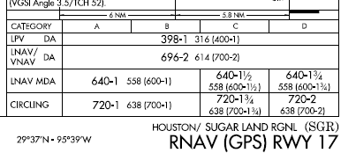
Stand Alone Basic “T” Design of Terminal Arrival Area (TAA)
T Design approaches generally support the 3 levels of GPS approach precision
Which one used depends on the type of GPS equipment being used and signal sensitivity available

Slide 30
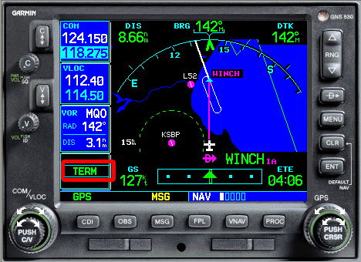
Stand Alone Basic “T” Design of Terminal Arrival Area (TAA)
Follow the magenta brick road
Note that before the FAF, usually at the last intermediate fix before the FAF, the GPS sensitivity will change from Term to either LNAV, LNAV+V, L/VNAV, or LPV

Slide 31
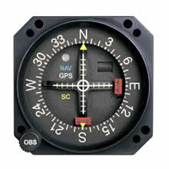
GPS CDI
Fly the CDI the same as you fly an ILS for vertical guidance or a VOR if LNAV only
Indicators
LNAV Flag
VNAV Flag
GPS / NAV indicator (VLOC) – CDI switch
OBS Ring generally has no effect
Measures distance off course – not degrees off course!!
Enroute - dot = 1 NM
Terminal - dot = .2 NM
Approach - dot = 365’

Slide 32
Before the Initial Segment
Preflight – Plan the approach – Must be familiar with “all available information concerning a flight” prior to departure and FDC Notams
Enroute – Get weather (ATIS, FSS information, etc.) to help determine likely approaches and review
Calculate / review performance data, approach speeds, and power settings – confirm aircraft and weather are appropriate for the ILS procedure for aircraft’s certified category or, if higher, the actual speed to be flown
Set navigation / communication and automation - The navigation equipment required for an approach is generally indicated by the title of the procedure and chart notes

Slide 33
Before the Initial Segment
Review and brief the approach – Don’t forget to brief the missed approach
You are not required to carry paper charts, BUT putting all your eggs in the GPS and its database with no backup may not be a good idea
Not all GPS’ display all required information – e.g. LNAV / LP step down altitudes
Begin reducing speed
Obtain ASOS/ATIS/AWOS on comm 2 – listen in the background

Slide 34
NOTAMS
Prior to any GPS IFR operation, the pilot must review appropriate NOTAMs and aeronautical information
UNRELIABLE is an advisory to pilots indicating the expected level of service may not be available

Slide 35
NOTAMS
Satellite out of service NOTAM
Satellite OOS - GPS 07/009 GPS PRN [pseudo random noise signal] 3 OTS WEF [with effect from] 0607171600-0607172230
Degraded WAAS NOTAM
APC 07/034 APC WAAS LNAV/VNAV AND LPV MNM UNREL WEF 0607180554-0607180609
IKFDC KFDC WAAS ATLANTIC SATELLITE UNAVBL, WAAS LPV AND LNAV/VNAV MNM UNAVBL EAST OF 110 DEGREE WEST LONGITUDE FOR CONUS AND PUERTO RICO WEF 0709241600
Unreliable GPS
KZFW FORT WORTH (ARTCC),TX. [Back to Top] 03/014 - NAV GPS IS UNRELIABLE AND MAY BE UNAVAILABLE WITHIN A CIRCLE WITH A RADIUS OF 365 NM AND CENTERED AT 331127N/1063447W OR THE LOCATION ALSO KNOWN AS 98.7 DEGREES AND 35.6 NM FROM THE TRUTH OR CONSEQUENCES /TCS/ VOR AT FL400; DECREASING IN AREA WITHA DECREASE IN ALTITUDE TO A CIRCLE WITH A RADIUS OF 310NM AT FL250; A CIRCLE WITH A RADIUS OF 235NM AT 10,000FT MSL AND A CIRCLE WITH A RADIUS OF 245NM AT 4000FT AGL.THE IMPACT AREA ALSO EXTENDS INTO THE MEXICAN FIR. 0200-1000 DLY. 29 MAR 02:00 2011 UNTIL 02 APR 10:00 2011. CREATED:27 MAR 13:17 2011
In order for a GPS receiver to perform RAIM, a minimum of five satellites with satisfactory geometry must be visible. RAIM is not available 100% of the time, even when all GPS satellites are operational. Also, satellites occasionally need to be taken out of service for maintenance, further reducing the availability of RAIM
Ground based transceiver OOS NOTAM
!ANI ANI NAV GBT OTS WEF 0709211600-0709211900

Slide 36
Vectors-to-Final
Use caution - generally not as useful as it may seem
Remember GPS is point to point – Direct to won’t put you on the approach course or provide approach course guidance
When you choose vectors-to-final, the GPS typically erases all fixes except the FAF and the MAP – hence less situational awareness
Typically just an extended centerline
Using vectors-to-final may also require reloading / re-executing the approach if ATC changes your clearance to an IAF or IF instead of setting you up to intercept the extended centerline provided by vectors-to-final

Slide 37
ATC Vectors A Better Option
Load the procedure and choose an IAF or other fix based on your position relative to the airport, and then, when appropriate, activate a leg of the procedure or fly direct to a fix, as cleared by ATC
Rule of thumb if you are receiving vectors or cleared to the initial fix - activate or execute the approach
Once the approach is activated, the GPS will treat the IAF selected as the next waypoint in the flight plan
Ignore the fact that that you’re not going to go to the IAF or other fix you have selected
Eventually, ATC will put you on a heading that intercepts the leg between IAF and the IF or another location
Then select “Fly this Leg” or similar wording on your GPS

Slide 38
Vectors to Final
ATC is generally restricted from clearing you direct to any waypoint inside the Intermediate Fix (IF) or vectoring you any closer than 3 miles from the FAF on an RNAV approach
When receiving vectors to final, some receiver operating manuals suggest placing the receiver in the nonsequencing (susp) mode on the FAWP and manually setting the course
This provides an extended final approach course in cases where the aircraft is vectored onto the final approach course outside of any existing segment which is aligned with the runway

Slide 39
Vectors – No Do It Yourself Approaches
You can’t make up your own approaches
You cannot edit the approaches in the database
Approach procedure you want to fly must be retrievable from the navigation database

Slide 40
Initial Segment
Complete brief of the approach
Begin landing checklist – complete before final segment
Reset comm with required frequencies and complete GPS programming (should already be done)
Comply with the clearance and approach
Finish reducing power to approach settings
Configure aircraft for landing - Flaps

Slide 41
Initial Segment - Briefing
Brief and review approach to assure you can execute it - Complete before end of segment
Runway length, Touchdown Zone elevation and airport elevation
WAAS
frequency
Final approach course
Approach name
Non- continuous operation
Takeoff minimums / procedures – non-standard
Missed approach information
Special notes – often important!
Frequencies
Minimums for use as an alternate –> non-standard - - Can’t be used as a legal alternate
"L" in the black oval indicates that the airport lights can be turned on by the aircraft radio

Slide 42
WAAS Warning
A WAAS approach plate may have a white-on-black rectangular “W” symbol annotation to warn you that vertical guidance may or not be available because the airport is at the edge of WAAS coverage

Slide 43
Initial Segment - Briefing
Plan view – mentally run through the approach
IAF
Altitude and heading and distance
for segment
Intermediate fix
Final approach fix
Missed approach point
at the runway
Towers
Sector minimum safe altitude

Slide 44
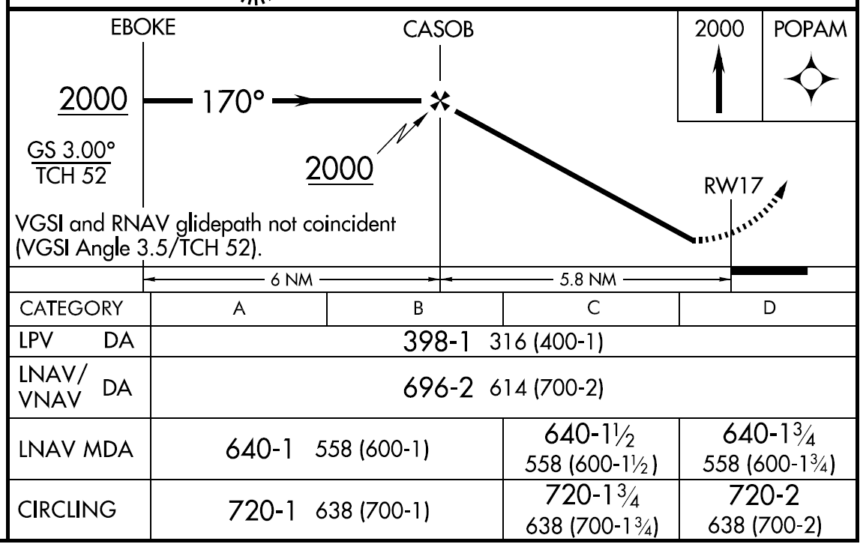
Initial Segment - Briefing
Profile view – mentally run through the approach
Final approach fix intercept
Minimum altitude
Heading
Graphical missed approach information
Intermediate fix
Glide slope
Distance to runway
Threshold crossing height
Distance to FAF
Limiting notes
Aircraft category
A <= 90
B < 121
C < 141
Types of approaches
And minimums

Slide 45
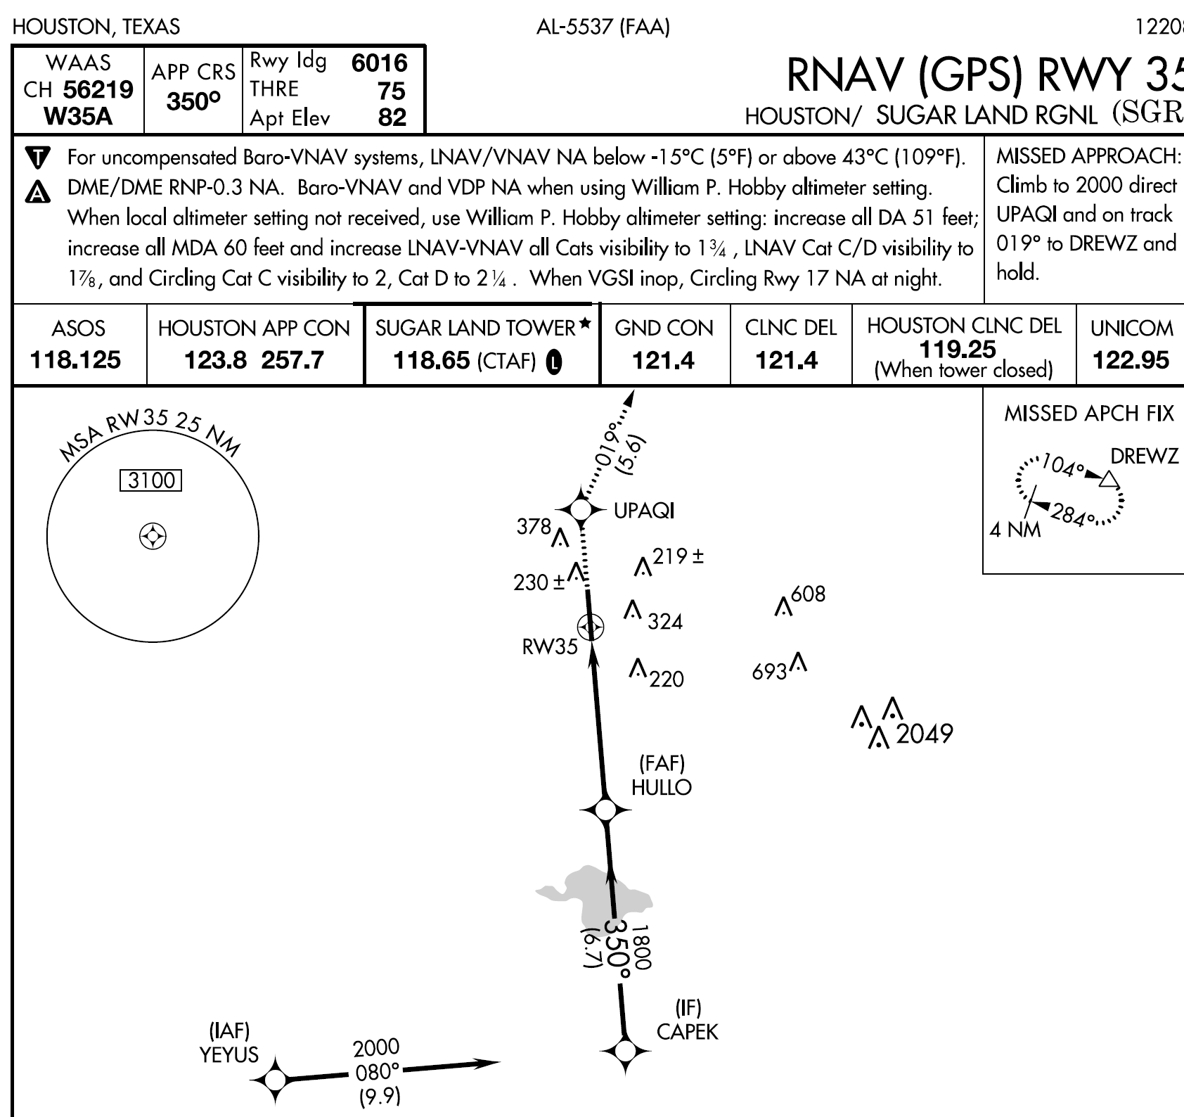
Missed Approach Briefing
Location of the MAP
Direction of the MAPHP

Slide 46
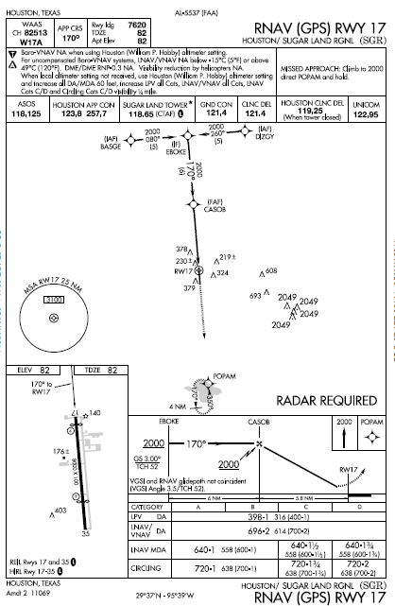
Let’s Fly – The Initial Segment
GPS loaded and activated – Note you can review the approach in the GPS (Garmin press FPL key)
If approach is not activated before 2 nm of MAWP, approach mode will not become active timely
Radios tuned to Approach / Tower
Confirm CDI is set for GPS (not VLOC)!
Reduce power to approach setting
Cross over IAF at 2,000 feet – segment should turn magenta
Turn to track towards IF either (80 / 260 degrees)
Be sure to turn the OBS ring with each directional change to match the course as a reminder, although it won’t impact the CDI indication
Before IF begin turn inbound on 170° based on turn anticipation
Intermediate segment should become active - magenta

Slide 47
Flying the Approach
Intermediate Segment
Intermediate segment positions the aircraft for the final descent to the airport
normally aligned within 30° of the final approach course
Segment begins when
you are proceeding inbound to the FAF
are properly aligned with the final approach course
May not be charted on some non TAA approaches
Approach with a procedure turn is the most common example of an uncharted IF
intermediate segment begins when you intercept the inbound course after completing the procedure turn
Ends at final approach fix

Slide 48
Let’s Fly – The Intermediate Segment
Inbound on 170°
Verify power settings for the approach and drop first notch of flaps
Remain at 2000 feet
Glide Slope needle should start to come down from the top of the CDI/HSI
When the glide slope needle reaches the middle of the CDI/HSI, drop the gear (some wait to FAF)
Likely to be told to switch to local / tower frequency
Complete landing checklist (try to complete as much as possible before intermediate segment)
You are now at the final segment!

Slide 49
Let’s Fly – The Intermediate Segment
If you are vectored onto the intermediate segment
Execute “fly this Leg” or “vectors to final” to assure approach is executed

Slide 50
Flying the Approach
Final Approach Segment
Final approach segment begins at the final approach fix shown on the chart
Ends at MAWP

Slide 51
Let’s Fly – The Final Segment
Confirm gear down
Second notch flaps – Check in white arc
Final speed reduction
Glance out the window to look for the runway environment
You reach the MAWP (Should be at DA 398’ (DA is MSL – DH is AGL) MAP not DA is guide to missed approach) with LPV or LNAV/VNAV – MDA with LNAV
If you now have an identifiable segment of the approach environment unmistakably visible and identifiable you may continue the approach if (FAR 91.175):
Visibility is above the minimums for approach category
You are in a position to make a normal descent to the intended runway using normal maneuvers

Slide 52
Let’s Fly – The Final Segment
If not, commence missed approach turn - do not turn out early (e.g. if full needle deflection)
Don’t level off and look for the runway environment
Drop full flaps and land
If using circling approach level off at 720’ and continue to MAWP
At MAWP:
Runway environment in sight
Visibility above minimums
Able to make a normal descent to intended runway

Slide 53
Overlay Approach
Generally more complicated than a stand alone approach
GPS provides course guidance for each segment up to the MAWP
Procedure turns are generally stored as a leg of the approach – However, some GPS’ require the pilot to enter the susp / obs mode. GPS may give you a message to start procedure turn
Often no guidance is provided within the procedure turn – guidance only for entry and exit points
Select and load the approach as with stand-alone approaches – then activate when ready
Be sure you know where you are in the approach as the same waypoint can appear more than once

Slide 54
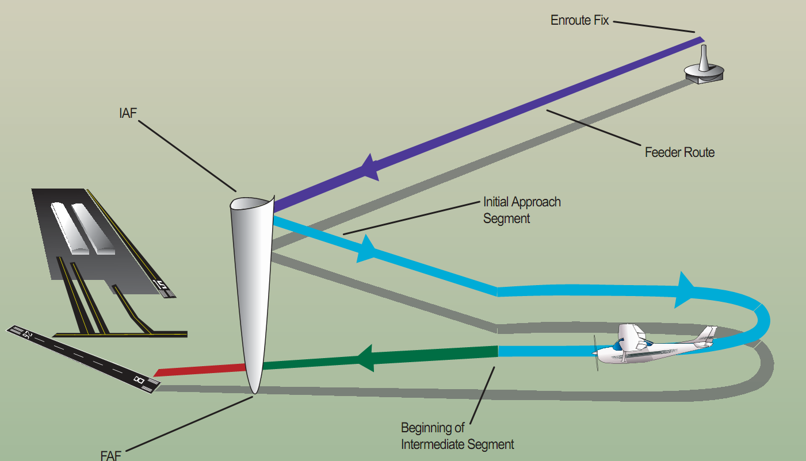
Overlay Approach Segments
Outer marker or other fix
Decision height on glideslope

Slide 55
Overlay Approach Differences from Underlying Approach
If no pronounceable 5 letter name is assigned to a waypoint or fix, it is given a database alphanumeric identifier – these points are in the database, but may not appear on the chart
Procedures without a FAF (e.g., VOR or NDB on airport) will have a FAWP added to the database at least 4 nm prior to the MAWP to allow the GPS receiver to transition to approach mode
May also have an added database point when the MAWP and the MAHWP are the same
DME arcs and radial approaches may also have additional non-charted waypoints

Slide 56
Overlay Approach Differences from Underlying Approach
A DME identified fix will not be in the waypoint sequence on the GPS receiver unless a name is assigned
When a name is assigned to a DME fix, the along track distance may be zero rather than the DME listed on the approach plate – Be alert for this discrepancy

Slide 57
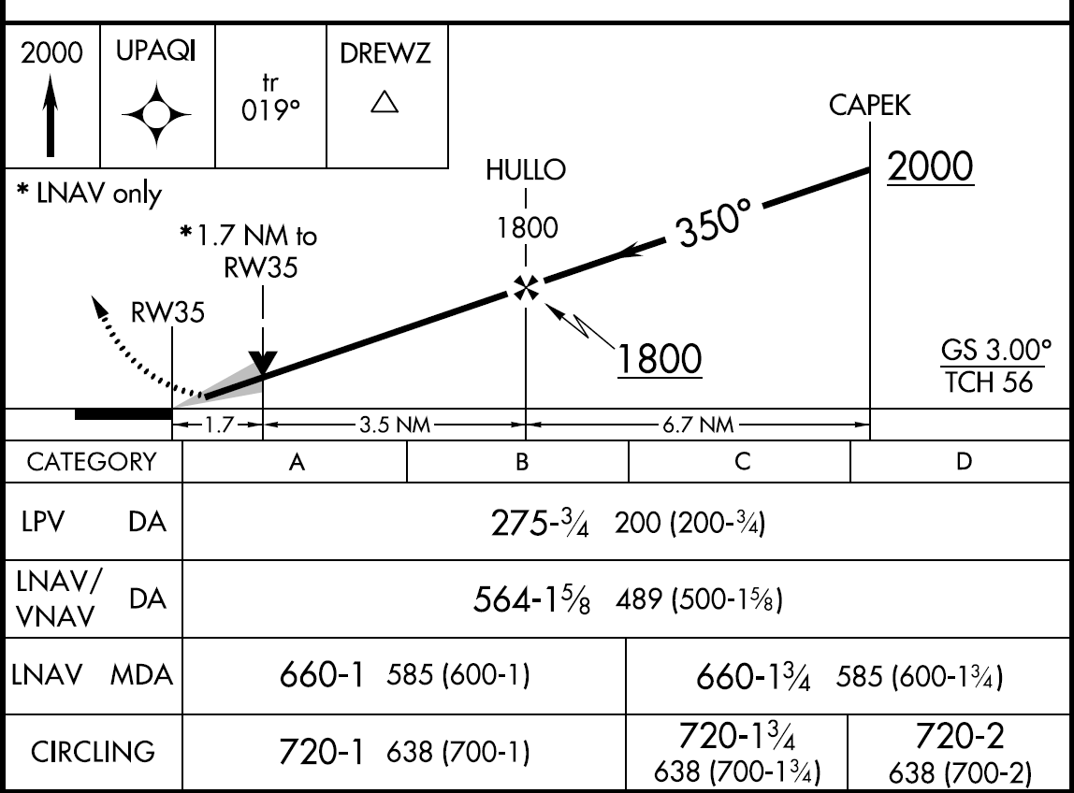
Visual Descent Point
If a visual descent point (VDP) is published, it will not be included in the DB waypoints
Visual Descent Points (VDPs) are points from which a normal descent from the MDA to the runway touchdown point may be commenced if required visuals are present. See §91.175(c)(3)
The VDP will normally be identified by along-track distance to the next waypoint for RNAV procedures
VDP is identified on the profile view of the approach chart by a “V”
No special technique is required to fly a procedure with a VDP – just don’t descend below the MDA prior to reaching the VDP and acquiring the necessary visual reference.

Slide 58
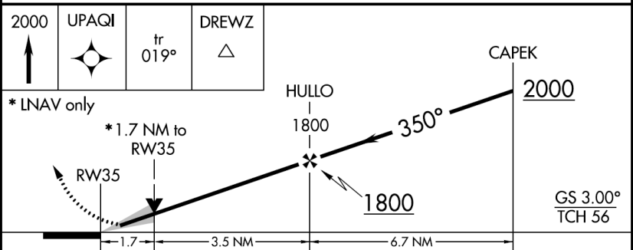
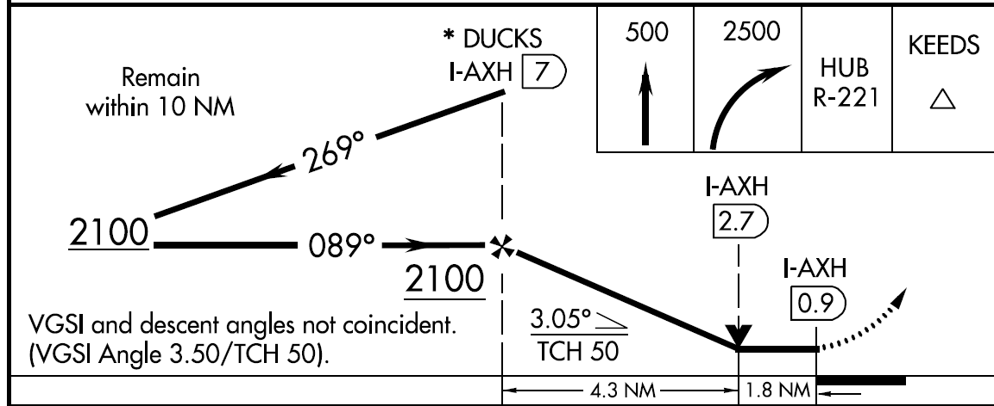
Visual Descent Point
If the visual segment area below the minimum altitude is clear of obstacles on a 34:1 slope (3 degree glide slope) there will be a gray shaded area extending from the VDP to the runway
If the shaded arrow is not on the approach plate, however, you will still fly to the minimum descent altitude (MDA) and continue if the runway is in sight
Without the shaded arrow on the approach plate, though, there is no assured clear slope, and no assurance that the path is clear of obstacles

Slide 59
Alternates – NON WAAS GPS
GPA approaches can be planned at either your destination or alternate, but not at both
Upon arrival at alternate you can fly a GPS approach
If the non-GPS approaches require DME or ADF, the aircraft must be equipped with DME or ADF avionics as appropriate – Can’t rely on GPS distances

Slide 60
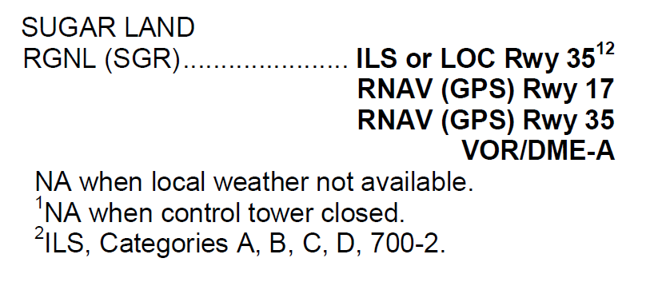
Alternates –WAAS GPS
Aircraft with WAAS GPS can plan GPS approaches for both the destination and alternate
Must flight plan for an LNAV approach or a conventional procedure that says “or GPS” in title
But can use approach with vertical guidance when you are landing at the alternate, if available
Standard non-precision alternate or non-standard approach-specific minimums still apply

Slide 61
Missed Approach
Must go missed at MAWP if:
you do not see the runway environment
Approach lighting system – not below 100’ AGL until you see red side lights or red terminating bar
Runway or runway markings or lights
Threshold, threshold markings or lighting
REILS
VASI
Touchdown zone or markings or lighting
Have visibility minimums
You are not in a position to make a normal descent to the runway

Slide 62
Missed Approach Point
After crossing the MAWP some WAAS receivers automatically transition to the missed approach procedure, while non-WAAS units will give you a Susp message indicating that waypoint sequencing has been suspended and pilot input is required (e.g., push Susp button)
A from indication will appear on the CDI
Until the missed approach function is activated, the GPS will display an extension of the inbound final approach course and the distance will increase from the MAWP until it is manually sequenced after crossing the MAWP

Slide 63
Missed Approach Actions Non-WAAS
A non-WAAS GPS missed approach requires pilot action to sequence the receiver past the MAWP to the missed approach portion of the procedure
Pilot must:
Be thoroughly familiar with the activation procedure
Initiate appropriate action after the MAWP
Activating the missed approach prior to the MAWP
Will cause CDI sensitivity to immediately change to terminal (± 1 NM) sensitivity
Will cause the GPS to continue to navigate to the MAWP – may not be the published course
The receiver will not sequence past the MAWP
Turns should not begin prior to the MAWP

Slide 64
Missed Approach
If the receiver does not sequence into the approach mode or a RAIM failure/status annunciation occurs prior to the FAWP, the pilot should not descend to Minimum Descent Altitude (MDA), but should proceed to the missed approach waypoint
Non-WAAS IFR GPS receivers conduct a RAIM check at least two miles before reaching the final approach waypoint
GPS receiver will not automatically sequence past the MAP to the missed-approach segment without user intervention
Take the GPS out of the OBS mode and putting it back into sequencing mode – in some cases you will have to manually alter the flight plan to go to the next waypoint
Low, slow, and busy is not a good time to be giving all of your attention to the GPS. Point yourself in the right direction, start climbing, clean it up, do anything else you need to do, and then worry about sequencing the GPS

Slide 65
Missed Approach Actions
Missed approach routings in which the first track is via a course rather than direct to the next waypoint require the pilot to set the course in non-WAAS receivers
Being familiar with all of the inputs required is especially critical during this phase of flight
Overriding an automatically selected sensitivity during an approach will cancel the approach mode annunciation. The RAIM and CDI sensitivity will not ramp down, and the pilot should not descend to MDA, but fly to the MAWP and execute a missed approach

Slide 66
SID
The GPS receiver must be set to terminal (± 1 NM) CDI sensitivity (should be automatic)
The navigation routes must be contained in the data base in order to fly published IFR charted departures and DP's
Terminal RAIM, however, may not be available unless the waypoints are part of the active flight plan rather than proceeding direct to the first destination
Certain segments of a DP may require manual intervention, especially when radar vectored to a course or required to intercept a specific course to a waypoint
The data base may not contain all of the transitions or departures from all runways
Some GPS receivers do not contain DP's in the data base

Slide 67
Equipment Failure
If GPS avionics become inoperative, the pilot should advise ATC and amend the equipment suffix
WAAS receivers do not “fail down” to lower levels of service once the approach has been activated
If WAAS fails during the approach, the vertical flag will appear
May use higher LNAV minima, in the same way you use localizer with a glide slope failure on an ILS
If the lateral integrity limit is exceeded, a missed approach must be executed since there is no way to reset the lateral alarm limit

Slide 68
RAIM
If, at any point during the approach, you lose RAIM then you can not descend to the MDA for the approach
If you already have started down, you should execute a missed approach immediately. (overfly the MAWP to guarantee clearance with obstacles, but begin your climb immediately)
Once the approach has begun the GPS receiver will go up to five minutes without the necessary satellites before giving an annunciation, to give itself the opportunity to reestablish communication – hence, if a warning pops up, you could already be considerably off course

Slide 69
Alternate Equipment Requirements
Aircraft using non-WAAS GPS navigation equipment under IFR must be equipped with non-GPS alternate navigation equipment appropriate to the flight
WAAS equipped aircraft need not have alternate navigation equipment
Active monitoring of alternative navigation equipment is not required if the GPS receiver uses RAIM for integrity monitoring
Active monitoring of an alternate means of navigation is required when the RAIM capability of the GPS equipment is lost

Slide 70
RAIM
Procedures must be established if the loss of RAIM capability is predicted to occur. In situations where this is encountered, the flight must rely on other approved equipment, delay departure, or cancel the flight

Slide 71
Fault Detection and Exclusion
Fault Detection and Exclusion (FDE) is the RAIM equivalent for WAAS units
FDE prediction is only required for:
Oceanic or
remote operation where GPS will be the primary source of navigation

Slide 72
QUESTIONS

Slide 73
Disclaimer
Instrument flight can be dangerous. Do not rely solely on this presentation – PROFESSIONAL INSTRUCTION IS REQUIRED
The foregoing material should not be relied upon for flight
ALTHOUGH THE ABOVE INFORMATION IS FROM SOURCES BELIEVED TO BE RELIABLE SUCH INFORMATION HAS NOT BEEN VERIFIED, AND NO EXPRESS REPRESENTATION IS MADE NOR IS ANY TO BE IMPLIED AS TO THE ACCURACY THEREOF, AND IT IS SUBMITTED SUBJECT TO ERRORS, OMISSIONS, CHANGE

