Slide 1
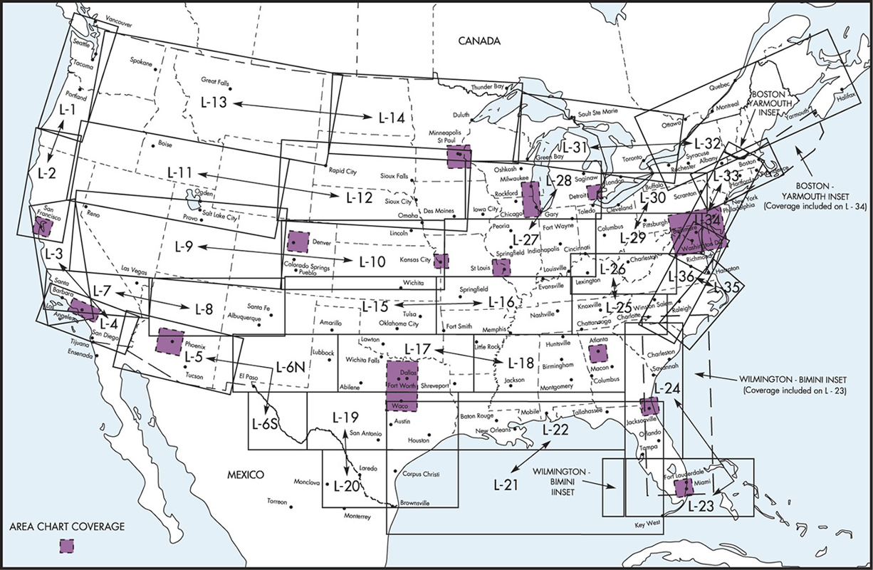
Enroute IFR Low Charts

Slide 2
IFR Charts
IFR Low
IFR High (above 18,000)
Multiple charts cover the country
Not all cover the same amount of area and are oriented in different directions

Slide 3
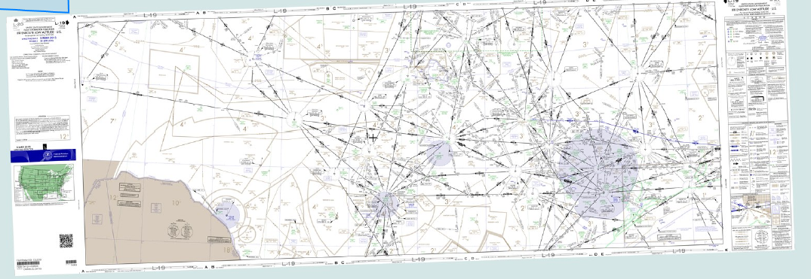
IFR Low Chart
Houston

Slide 4
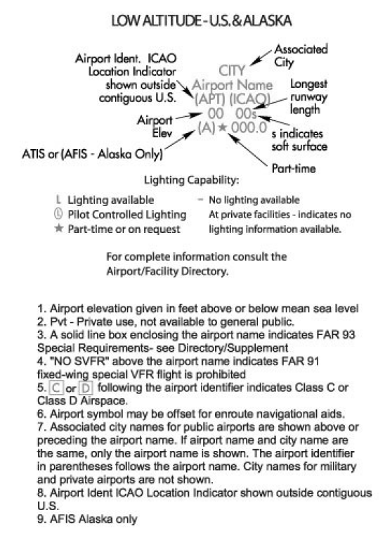
Airport Information
Airport data is shown in a uniform manner
Green - Instrument approach
Brown – No instrument approach
Blue – Military airport

Slide 5
IFR Low Chart Symbols
See FAA Aeronautical Chart User's Guide - https://www.faa.gov/air_traffic/flight_info/aeronav/digital_products/aero_guide/
See front flap of chart

Slide 6
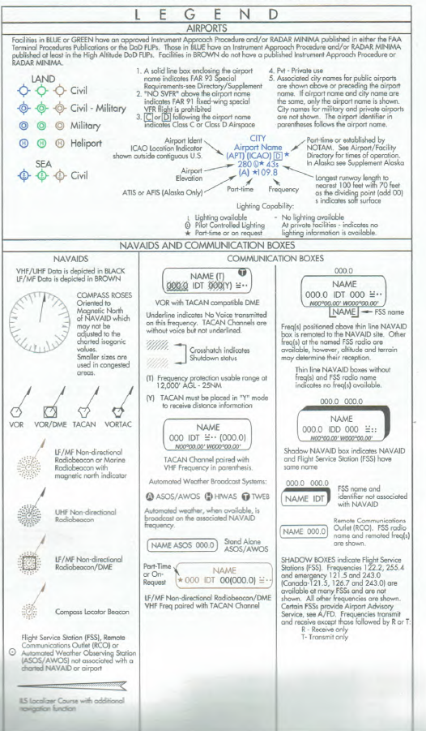
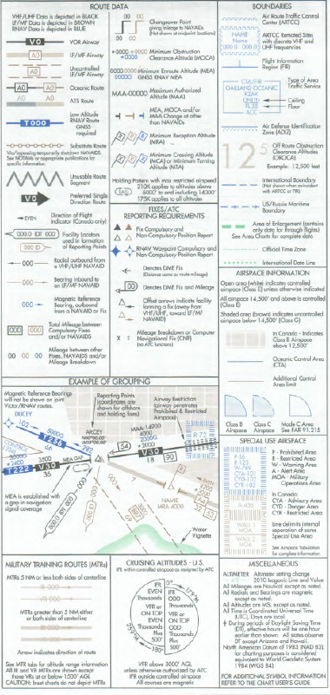
IFR Low Chart Symbols

Slide 7
IFR Low Chart Data Page
Military training routes – ID and altitude
Special use airspace
MOAS
Airport grid locations

Slide 8
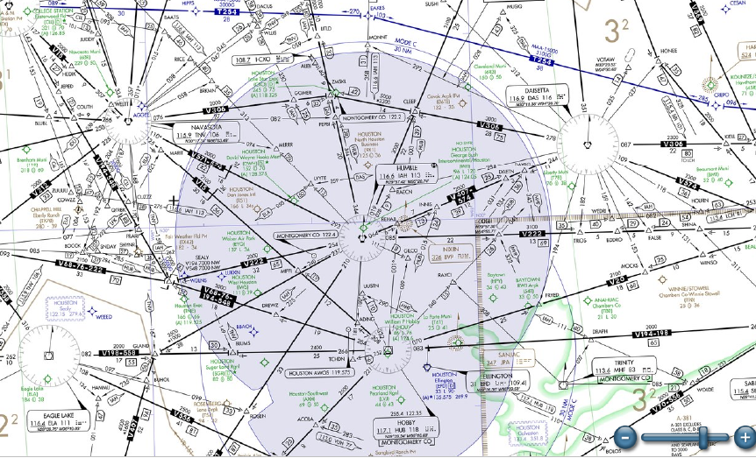
IFR Low Chart
HIWAS
MEA
Sector Min Alt
RCO
GPS route
Victor route
Navaid DME total
NDB
Segment DME
Max Alt
Mode C
Veil
Gps
WPT
Class B
Chng over
Point
Cum DME
Total
Min
Cross
Alt
No Appch airport
CNTR
Freq
Appch
Apt
Route ID
Heading (mag)
VOR info
Intersection
No voice

Slide 9
Questions
Best to get the
Chart and study it

Slide 10
Disclaimer
Instrument flight can be dangerous. Do not rely solely on this presentation – PROFESSIONAL INSTRUCTION IS REQUIRED
The foregoing material should not be relied upon for flight.
ALTHOUGH THE ABOVE INFORMATION IS FROM SOURCES BELIEVED TO BE RELIABLE SUCH INFORMATION HAS NOT BEEN VERIFIED, AND NO EXPRESS REPRESENTATION IS MADE NOR IS ANY TO BE IMPLIED AS TO THE ACCURACY THEREOF, AND IT IS SUBMITTED SUBJECT TO ERRORS, OMISSIONS, CHANGE.

