Slide 1
Circle to Land

Slide 2
The Maneuver
A circling approach is a maneuver used to align the aircraft with a runway for landing when a straight-in landing from an instrument approach is not possible or desirable.
Two times where this occurs
Runway not aligned with the approach
Runway aligned with the approach, but not the runway you want to land on
Circling to land is a relatively dangerous maneuver. It contains the worst elements of IFR flight
Minimum obstruction clearance
Limited space in which to maneuver
Slow speed
Continuous turns
Absence of visual reference, and trying to keep the runway in sight while preparing to land
At night the maneuver is a quite a bit more dangerous
Every circle-to-land approach is a non-precision approach

Slide 3
Suggested Circle to Land Patterns Some Conflict
Regulation - 91.126 - Operating on or in the vicinity of an airport in Class G airspace.
(a) General. Unless otherwise authorized or required, each person operating an aircraft on or in the vicinity of an airport in a Class G airspace area must comply with the requirements of this section.
(b) Direction of turns. When approaching to land at an airport without an operating control tower in Class G airspace—
(1) Each pilot of an airplane must make all turns of that airplane to the left unless the airport displays approved light signals or visual markings indicating that turns should be made to the right, in which case the pilot must make all turns to the right
AIM - 5-4-20 - f. Circling Minimums
Pilots must use sound judgment, have an in-depth knowledge of their capabilities, and fully understand the aircraft performance to determine the exact circling maneuver since weather, unique airport design, and the aircraft position, altitude, and airspeed must all be considered. The following basic rules apply:
1. Maneuver the shortest path to the base or downwind leg, as appropriate, considering existing weather conditions. There is no restriction from passing over the airport or other runways.
2. It should be recognized that circling maneuvers may be made while VFR or other flying is in progress at the airport. Standard left turns or specific instruction from the controller for maneuvering must be considered when circling to land.

Slide 4
Circling Pattern – Bottom Line
Passing over runways is not required nor necessarily advisable
Based on the AIM, it appears that a right base can be flown. However, considering § 91.126, if it is possible to safely enter a left downwind, then one should probably do so

Slide 5
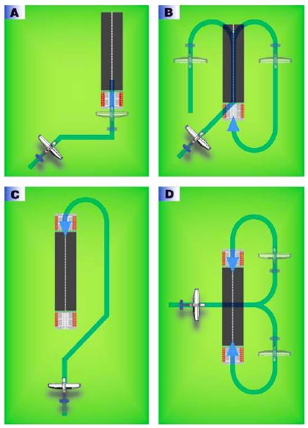
Recommended Entry
Use A when <90° intersection angle with desired runway and sufficient time. If you sight runway too late use B
Use C when you desire to land on the reciprocal runway and you have sufficient time. If you sight the runway too late, use B with left turns
Use D for runway >90° runway intersection angle

Slide 6
When to Begin the Circle to Land
When can you depart the electronic final approach, but remain at or above the MDA, for a circle-to-land approach
FAR 91.175(e)(2) requires a missed approach if visual contact with the airport is lost. Hence, an identifiable part of the airport must be sighted prior to departing the approach procedure’s electronic guidance
The circling approach cannot be done below the circling MDA until at least one of the runway-specific cues associated with the landing runway is in view and the aircraft is in a position to make a normal descent to landing
A circling approach cannot be made if a straight-in descent has gone below circling minimums
One way to fly circling minimums is to fly the straight in approach guidance down to the published circling minimums and then proceed at the circling MDA on the localizer / VOR, etc. by timing or DME if authorized to the missed approach point, if the airport is not sighted before

Slide 7
AIM 5-4-20 - f. Circling Minimums
Published circling minimums provide 300’ obstacle clearance when pilots remain within the appropriate area of protection
Pilots should remain at or above the circling altitude until the aircraft is continuously in a position from which a descent to a landing on the intended runway can be made at a normal rate of descent using normal maneuvers
Circling may require maneuvers at low altitude, at low airspeed, and in marginal weather conditions – exercise caution

Slide 8
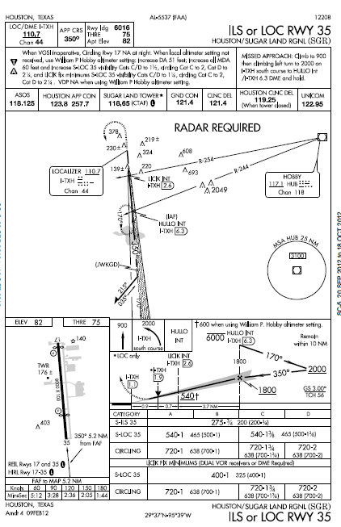
Circling Minimums
Published circling minimum
In some busy terminal areas, ATC may not allow circling and circling minimums will not be published.

Slide 9
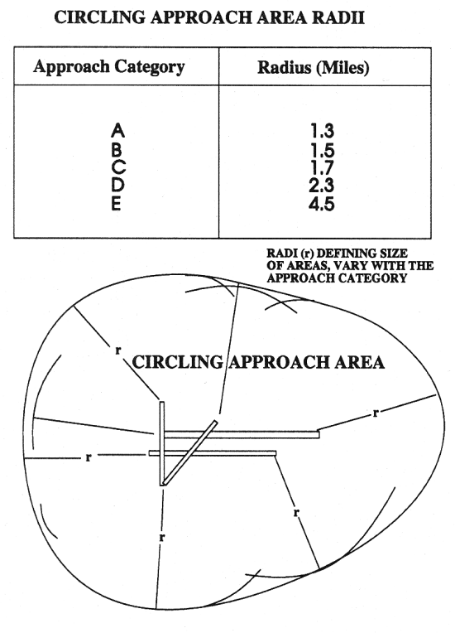
Area of Protection
Must remain within the area of protection
Must remain within the published visibility criteria
Circling area may be limited – check notes

Slide 10
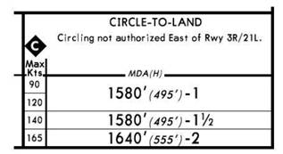
Revised Area of Protection
FAA expanded airspace for airport circle-to-land approaches
Aeronautical charts show approaches with the new circle-to-land minima criteria with a "Inverse C" circle icon (white “C” surrounded by a black background). Jeppesen uses an "Inverse C" diamond icon
Circling MDA in feet MSL | Approach Category and Circling Radius (NM)
 | CAT A | CAT B | CAT C | CAT D | CAT E
1000 or less | 1.3 | 1.7 | 2.7 | 3.6 | 4.5
1001-3000 | 1.3 | 1.8 | 2.8 | 3.7 | 4.6
3001-5000 | 1.3 | 1.8 | 2.9 | 3.8 | 4.8
5001-7000 | 1.3 | 1.9 | 3.0 | 4.0 | 5.0
7001-9000 | 1.4 | 2.0 | 3.2 | 4.2 | 5.3
9001 and above | 1.4 | 2.1 | 3.3 | 4.4 | 5.5

Slide 11
Approach Category
Approach category is always based on the aircraft’s maximum certified landing weight
You cannot use a lower approach category based on the aircraft's actual landing weight
Non-standard landing configuration or higher approach speeds may result in the need to use minima associated with a higher approach category

Slide 12
No Published Circling Minimums
If no circling minimums are published, then you may not execute a circle to land approach
However, if authorized, by ATC you can circle provided you have basic VFR (1000-3)

Slide 13
Controller Communication
Approach clearance instructions to circle will include
The runway in use, if landing will be made on a runway other than that aligned with the direction of instrument approach
When a specific direction for the circling maneuver in relation to the airport/runway is required, the direction (eight cardinal compass points) will be stated along with a left or right base/downwind leg as appropriate
PHRASEOLOGY-
CIRCLE TO RUNWAY (number), or CIRCLE (direction using eight cardinal compass points) OF THE AIRPORT/RUNWAY FOR A LEFT/RIGHT BASE/DOWNWIND TO RUNWAY (number).
ATC should not issue clearances, such as “extend downwind leg,” which might cause an aircraft to exceed the protected circling approach area

Slide 14
Side-Step Maneuver
ATC may authorize a side-step maneuver to either one of two parallel runways that are separated by 1,200 feet or less, followed by a straight-in landing on the adjacent runway
Aircraft executing a side-step maneuver will be cleared for a specified non-precision approach and landing on the adjacent parallel runway
For example, "Cleared ILS runway 17 left approach, side-step to runway 17 right."
Pilots are expected to commence the side-step maneuver as soon as possible after the runway or runway environment is in sight
Landing minimums to the adjacent runway will be based on non precision criteria and therefore higher than the precision minimums to the primary runway, but will normally be lower than the published circling minimums
Side-step maneuver’s higher weather minima / MDA will be published on the instrument approach chart
However, when in doubt, use circling minimums.

Slide 15
Missed Approach
While circling, if at any time you lose visual contact with the runway (excepting wing blocking during turns), you must fly the missed approach
Because the runway on which the aircraft makes the instrument approach is not the runway to which it is circling, the missed approach procedure becomes more complex
The missed approach specified for the instrument approach being flown must be followed – rather than a missed approach procedure for the landing runway
The transition from the circling approach to the missed approach should be initiated by a climbing turn, within the circling area, towards the landing runway, to return to the circling altitude or higher
Continue the turn until you intercept and are established on the missed approach course
Then continue execution of the missed approach procedure
The goal of the turn towards the runway is to keep clear of all obstructions
Pre plan your circle to land pattern and missed approach options using the plan view diagram of the airport before you start the approach

Slide 16
PTS Standard Area of Operation VI. D.
Exhibits adequate knowledge of the elements related to a circling approach procedure
Selects and complies with the appropriate circling approach procedure considering turbulence and wind shear and considering the maneuvering capabilities of the aircraft
Confirms the direction of traffic and adheres to all restrictions and instructions issued by ATC and the examiner
Does not exceed the visibility criteria or descend below the appropriate circling altitude until in a position from which a descent to a normal landing can be made
Maneuvers the aircraft, after reaching the authorized MDA and maintains that altitude within +100 feet, −0 feet and a flight path that permits a normal landing on a runway
Runway selected must be such that it requires at least a 90° change of direction, from the final approach course, to align the aircraft for landing
Demonstrates an appropriate level of single-pilot resource management skills.

Slide 17
Questions

Slide 18
Disclaimer
Instrument flight can be dangerous. Do not rely solely on this presentation – PROFESSIONAL INSTRUCTION IS REQUIRED
The foregoing material should not be relied upon for flight
ALTHOUGH THE ABOVE INFORMATION IS FROM SOURCES BELIEVED TO BE RELIABLE SUCH INFORMATION HAS NOT BEEN VERIFIED, AND NO EXPRESS REPRESENTATION IS MADE NOR IS ANY TO BE IMPLIED AS TO THE ACCURACY THEREOF, AND IT IS SUBMITTED SUBJECT TO ERRORS, OMISSIONS, CHANGE

