Slide 1
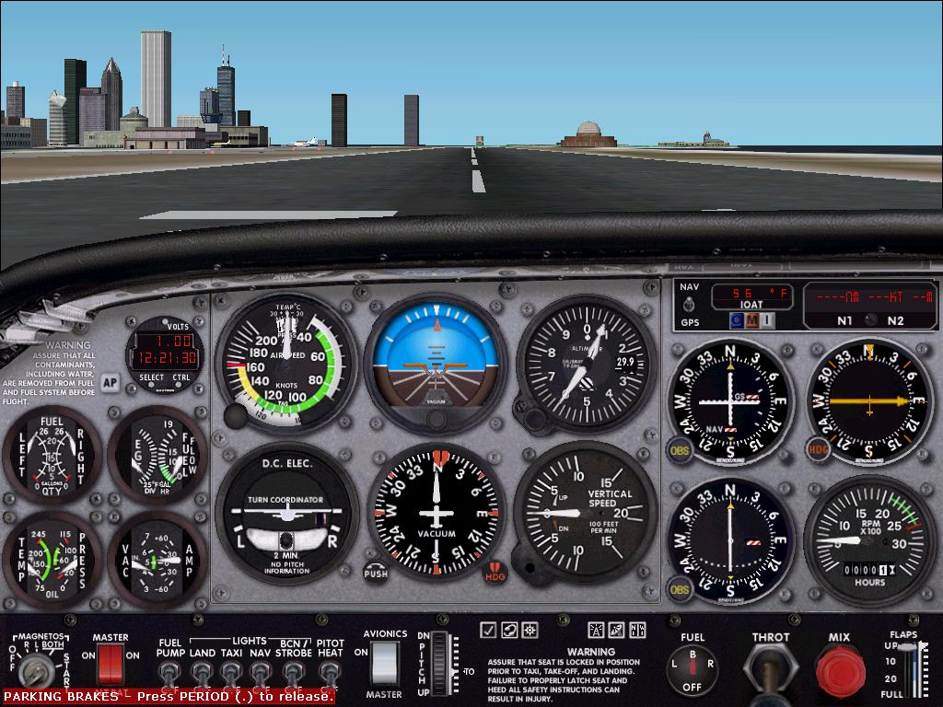
Attitude Instrument Flight

Slide 2
Attitude Instrument Flying
Attitude Instrument flying involves aircraft control by reference to its instruments rather than outside visual references

Slide 3
Three Fundamental Skills
Skills
Instrument cross-check
Instrument interpretation
Aircraft Control
All three skills are used in all instrument flight maneuvers
Skills must be integrated into unified, smooth, positive aircraft control inputs

Slide 4
Instrument Cross-Check SCAN
Instrument scan is critical
Slow methodical eye movements
Know when and where to look for the task at hand
Be relaxed
Create time for proper aircraft management
Continuous systemic focus on specific aircraft instruments for attitude and performance information
Doesn’t mean that eyes are moving like spinning slot machine reels

Slide 5
Instrument Cross-Check SCAN
Instrument cross-check (aka - scan)
Scan patterns
Inverted V
Radial
Rectangular or oval
Instrument focus
Two basic methods
Control and performance
Primary and supporting
Similar, but differ in their reliance on the attitude indicator and the role of other instruments in controlling the aircraft
Make appropriate changes based upon instrument observation

Slide 6
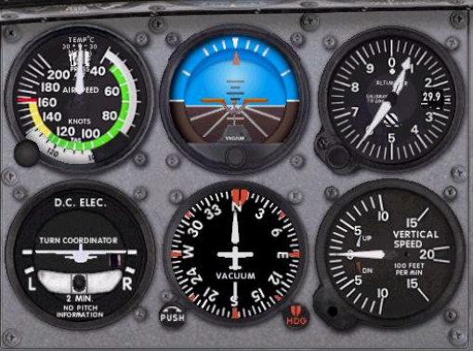
Cross-Checking / Scanning Inverted V
Initial scan generally should be from the attitude indicator down to the turn coordinator, up to the attitude indicator, down to the VSI, and then back up to the attitude indicator

Slide 7
Cross-Checking / Scanning Inverted V
Inverted V Scan is the initial scan
Step One - set a reasonable attitude and power setting for the desired maneuver
Remember the basic axiom of flight:
Attitude + power = performance
Concentrate on the attitude indicator, set engine power by sound, and then glance at the engine's tachometer or manifold pressure gauge to fine-tune your power setting
Adjust the elevator trim coarsely if pressures become excessive.

Slide 8
Cross-Checking / Scanning Inverted V
Step Two - Scan the turn coordinator (TC) and the vertical speed indicator (VSI) from the AI in an inverted V pattern
The TC and VSI are fine-tuners because of their sensitivity
TC will show a turn before the heading indicator
VSI will show a climb or descent before the altimeter
The scan should move at a slow speech rate - "and one and two, and one and two, and..."- e.g., that's how fast your eyes should move
When you say "and," look at the AI; when you say "one," look at the TC; when you say "two," look at the VSI
Key information while using the inverted-V scan is trend of motion information, rather than the specific numbers
Is the airplane doing what you want it to do - turning, flying level, climbing, or descending?

Slide 9
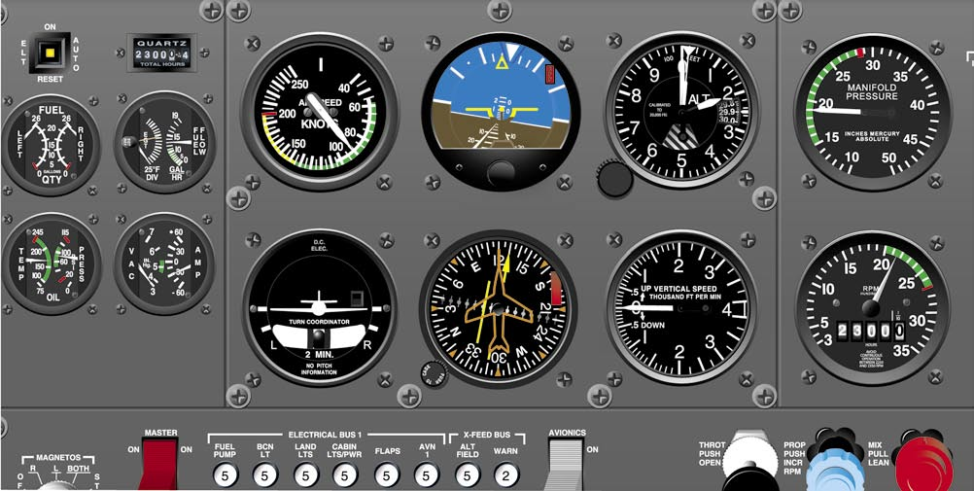
Cross-Checking / Scanning Validating Instruments
Second priority is to validate the AI
Think in terms of aircraft systems
You are comparing electrical (TC) and vacuum bank information (AI), and you are comparing static-air (VSI) and vacuum pitch information (AI)
If a bank or pitch disagreement exists, look to an independent bank or pitch system in order to resolve the conflict
To resolve bank conflicts, use the magnetic compass. It will agree with either the AI or the TC
The instrument that disagrees is the problem.
You cannot use the heading indicator unless you check the suction gauge and confirm proper operation of the vacuum system
To resolve pitch conflicts, use the alternate static air system, air speed indicator and the altimeter
Pitch will agree with either the AI or the VSI
The instrument that disagrees is not reliable
If static problem - you can’t use the altimeter or airspeed indicator, unless you replace the normal static-air system with the alternate static-air system if you have one, as it feeds from the same source
When a pitch or bank conflict develops, stop for a few seconds, and use system analysis to resolve the problem
False assumptions can result in loss of control
Pitch conflict
Bank conflict

Slide 10
Cross-Checking / Scanning
Cover the face of an erroneous instrument (carry post it notes in your flight bag) so that you aren't distracted by the incorrect information
Poor man’s
instrument cover

Slide 11
Radial Scan
Step Three - Scan the other “six-pack” instruments
These are the tertiary instruments
Scan using the same slow eye movement as in the inverted V scan
Scan the instruments that have the numbers that you are trying to maintain –
Focus is on the important numbers – the quantitative information
Are you complying with ATC, your intentions / desires, what the nav charts require?
If you do not like what you see,
Return to Step One and change attitude and /or power
Return to Step Two for trend of motion and for AI validation
Return to the radial scan (Step Three) for the numbers

Slide 12
Cross-Checking / Scanning Radial
In the radial scan you will spend 80 to 90% of the time looking at the attitude indicator with only quick glances at one of the other flight instruments
Your eyes always go from the AI to another flight instrument and never directly between the other flight instruments
The maneuver being performed at any given time determines which instruments are included in the scan pattern

Slide 13
Cross-Checking / Scanning Radial
Flight Regime | Primary | Primary Radial Instruments
Straight-And-Level | AI | AL / DG
Constant Airspeed Climb/Descent | AI | ASI (until 100’ to go – then use the ALT) /DG
Constant Rate Climb/Descent | AI | VSI / ASI (until 100’ to go – then use the ALT) / DG
Standard Rate Turn | AI | AL/TC

Slide 14
Cross-Checking / Scanning Rectangular or Oval
Step Four
Transition from a radial scan to a circular scan and fine-trim the elevator and rudder trim
Imagine a rectangular pattern flowing over all six primary flight instruments
Used because the radial scan is very fatiguing
Radial scan is used only when you are redirecting the airplane - changing attitude and/or power
Rectangular scan is more relaxing, and allows for small corrections as you evaluate the instruments
Use the rectangular scan pattern whenever the airplane is in stabilized, straight-and-level flight

Slide 15
Cross-Checking / Scanning Rectangular
Rectangular scan covers all instruments equally, regardless of its importance to the maneuver being performed
Lengthens the time it takes for you to return to the critical instruments for a maneuver

Slide 16
Common Cross-Check Errors
Fixation - staring at a single instrument
Omission of an instrument from your scan
Emphasis on a single instrument rather than the necessary combination of instruments

Slide 17
Control and Performance Method
Aircraft is controlled through the aircraft’s attitude and power
Based on precept of Attitude + Power = Performance
Instrument categories
Control
Performance
Navigation instruments
Control Instruments
Display direct and immediate attitude and power indications
Permit precise attitude and power adjustments
Control instruments are the attitude indicator and power indicators
Power indicators include tachometer, manifold pressure, etc.

Slide 18
Control and Performance Method
Performance Instruments
Indicate the aircraft’s actual performance
Performance instruments include
Altimeter
Airspeed indicator
VSI
Heading indicator
Turn-and-bank indicator
Navigation Instruments
Indicate the aircraft’s position
Navigation instruments include
CDI
HSI
Glide slope indicators
Bearing pointers
GPS displays

Slide 19
Control and Performance Method
Establish Rough Settings
Set your attitude and a power setting with the control instruments (AI and tach/MP gauge) that will produce the approximate performance desired
Known attitudes and approximate power settings will reduce workloads
Trim
Trim to relieve control pressures
Essential for smooth, precise aircraft control and allows you to divert attention to other things with minimized changes to aircraft attitude
Cross-check
Cross-check performance instruments to determine if the rough settings are providing the desired performance
Involves both seeing and interpreting the instruments
If a deviation is noted, determine the magnitude and direction of adjustment required
Correct
Make any necessary attitude or power setting changes using the control instruments as necessary
Cross check performance instruments

Slide 20
Control and Performance Method
Attitude Control
Must maintain a constant attitude, and know when and by how much to change the attitude
Smoothly change attitude by precise amounts, when required
Accomplished by using the attitude indicator which provides an immediate, direct indication of any change in aircraft pitch or bank.
Pitch Control
Observe changes to the “pitch attitude” on the AI in relation to the horizon
Know indicator gradients 2.5, 5 and 10 degree lines / estimate bar widths
Bank Control
Observe changes to the “bank attitude” or bank pointers on the edge of the AI
Bank scale is normally referenced marked at 0°, 10°, 20°, 30°, 60°, and 90°
AI vs ADI (sky pointer)
Normally, use a bank angle that approximates the degrees to turn, not to exceed 30°

Slide 21
Control and Performance Method
Power Control
Establish or maintain desired airspeeds in coordination with attitude changes through power / throttle adjustments
Refer to the power indicators (Tach and MP gauges)
Learn approximate power settings by sight, sound and feel and then cross-check the power indicators (MP / Tach) to establish a more precise setting

Slide 22
Primary and Supporting Instrument FAA Method
Attitude control can be thought of in terms of pitch, bank, power, and trim control, as all maneuvers involve motion about all 3 axes - lateral (pitch), longitudinal (bank/roll), and vertical (yaw)
Instruments are grouped as they relate to control function and aircraft performance as follows:
Pitch Instruments
Attitude indicator, altimeter, airspeed indicator, VSI
Bank Instruments
Attitude indicator, heading indicator, magnetic compass, turn coordinator
Power Instruments
Airspeed indicator. engine instruments, manifold pressure gauge, tachometer/RPM
Certain instruments are key in each maneuver or condition of flight
Primary instruments provide the most pertinent and essential information.
Supporting instruments back up and supplement the information shown on the primary instruments

Slide 23
Primary and Supporting Instrument Method
Flight Regime | Primary Pitch | Supporting Pitch | Primary Bank | Supporting Bank | Primary Power | Supporting Power
Straight-And-Level | ALT | AI/VSI | DG | AI/TC | ASI | MP/Tach
Constant Airspeed Climb/Descent | ASI | AI/VSI | DG | AI/TC | MP/Tach | ASI
Constant Rate Climb/ Descent | VSI | AI | DG | AI/TC | MP/Tach | ASI
Standard Rate Turn | ALT | AI/VSI | TC | AI | ASI (MP/Tach initially primary if speed is changing) | MP/Tach

Slide 24
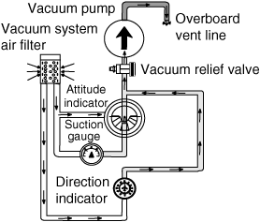
Partial Panel Scan Technique Loss of Vacuum
Turn coordinator becomes the master instrument
Roll and balance information from the T/C
Pitch information from the AI is lost – Get pitch information indirectly from the remaining instruments, namely the ASI, ALT and VSI
Use a rectangular scan originating from the T/C

Slide 25
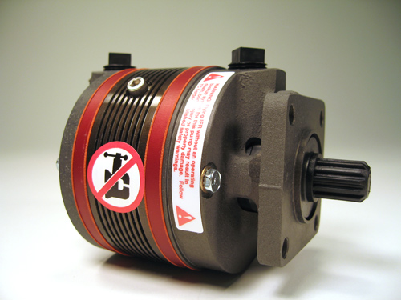
Partial Panel Scan Technique Loss of Vacuum
Climbing
Set climb power
Gentle pitch movements until the desired air speed is obtained then trim
Descending
Reduce power, allowing the pitch to naturally change, until the required rate of descent is achieved
No change in trim should be required, unless a specific airspeed is required for the descent, in which case reduce power, hold attitude for required speed, then descent in a trimmed condition

Slide 26
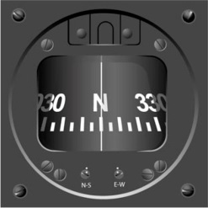
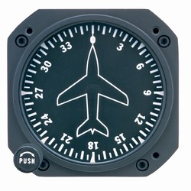
Partial Panel Scan Technique Loss of Vacuum
330° to the left
Turning
Will need to rely on turn coordinator and compass
Remember compass errors during turns
Turn coordinator is primary bank instrument
The compass also reads in the reverse sense to the DG (Look at the VOR or GPS to decide which direction to turn)
Use standard rate turns on TC and time for 3 degrees per second to come out at approximately the correct heading
Turn Procedure
Check current heading on the compass
Calculate the number of seconds for the turn (max 60 seconds), and establish the direction of the turn
Establish standard rate turn, start timing and maintain turn rate
Roll wings level when the time is complete
Fly straight and level for a couple of seconds to allow the compass to settle
Check correct heading has been achieved. Repeat if necessary to fine tune heading
330° to
the right

Slide 27
Partial Panel Scan Technique Loss of Vacuum
Approach
On partial panel use 1/2 standard rate turns on approach
Request a No-Gyro Approach
ATC will instruct you to turn left or right. Use the turn coordinator to guide the turn. ATC will tell you when to stop the turn.
ATC will expect you to make standard rate turns and to start and stop turns as soon as you are instructed.
ATC will notify you when you are on final approach and you will be expected to make 1/2 standard rate turns.
Use GPS as an alternative to the compass
Movements on partial panel should be smooth and gradual

Slide 28
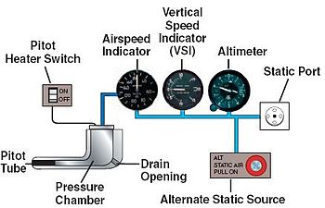
Pitot / Static System Failure
Pitot / static system failure may cause erratic and unreliable AI, ASI and VSI instrument indications
Procedure
Consider pitot heat
Select alternate static source
In the absence of an alternate static source, in an unpressurized aircraft, you can break the glass on the VSI
Breaking the VSI glass provides an alternate source of static pressure to the altimeter and airspeed indicator
May cause some errors and VSI will be unusable

Slide 29
Pitot / Static System Failure
ASI uses inputs from both pitot and static system and therefore will be affected by a failure in either system
If the pitot tube is blocked (along with its drain hole) — by ice, an insect or some other foreign material
Likely not to be noticed in level flight
In a climb or a descent, however, the ASI will act like an altimeter
If only the pitot tube (but NOT the drain) is blocked the airspeed will decrease, likely to near zero
Since the altimeter and VSI rely only on static pressure input, they won't be affected by blockages of the pitot tube

Slide 30
Pitot / Static System Failure
A blocked static port will cause varying symptoms depending upon how much blockage there is and the altitude at which it occurs
Generally, will cause the airspeed indicator to increase with decreasing altitudes and decrease during a climb – a reverse altimeter effect
If the static port is blocked at a relatively high altitude there will be an increasing difference between static and pitot pressure as the airplane descends – Lower altitudes shows high erroneous airspeed
An altimeter affected by a blocked static system will continue to show the same reading it had when the blockage occurred regardless of actual altitude
Likewise the VSI will usually not change with a blocked static system

Slide 31
Pitot / Static System Failure
Remember attitude + power = performance
Use the AI, as long as you have vacuum, to keep the airplane level. Set pitch and power
Consider backup altimeter
GPS
Altimeter watches, sky diving altimeters, etc.
Don’t allow your attention to become fixated on any one instrument or system

Slide 32
Aircraft Control
Maintain aircraft attitude or change it by moving the appropriate controls
Aircraft control is composed of four aspects:
Pitch - elevators
Bank - ailerons
Power
Trim - relieves control pressures to eliminate constant control pressures which produces tension, distracts the pilot’s attention from cross-checking, and contributes to abrupt and erratic attitude control

Slide 33
Aircraft Control Errors
Improper instrument interpretation
Improper control application
Failure to establish proper attitude / performance
Improper entry or level off technique
Don’t chase the needles – USE THE AI
Failure to anticipate required power changes
Watch for ballooning on level off
Failure to use an accelerated cross check as the maneuver begins and ends
Failure to trim or poor trim technique
Failure to relax rudder pressure / tension - excessively strong grip on the control column resulting in an over-control situation

Slide 34
PTS Basic Instrument Flight Skills
Exhibits adequate knowledge of the elements related to attitude instrument flying during straight-and-level flight, climbs, turns, and descents while conducting various instrument flight procedures.
Maintains altitude within ±100 feet during level flight, headings within ±10°, airspeed within ±10 knots, and bank angles within ±5° during turns.
Uses proper instrument crosscheck and interpretation, and apply the appropriate pitch, bank, power, and trim corrections when applicable.

Slide 35
PTS Partial Panel
Exhibits adequate knowledge of the elements relating to recognizing if primary flight instruments are inaccurate or inoperative, and advises ATC or the examiner
Advises ATC or examiner anytime that the aircraft is unable to comply with a clearance
Demonstrates a nonprecision instrument approach without the use of the primary flight instrument using the objectives of the nonprecision approach
Demonstrates an appropriate level of single-pilot resource management skills

Slide 36
Questions

Slide 37
Disclaimer
Instrument flight can be dangerous. Do not rely solely on this presentation – PROFESSIONAL INSTRUCTION IS REQUIRED
The foregoing material should not be relied upon for flight
ALTHOUGH THE ABOVE INFORMATION IS FROM SOURCES BELIEVED TO BE RELIABLE SUCH INFORMATION HAS NOT BEEN VERIFIED, AND NO EXPRESS REPRESENTATION IS MADE NOR IS ANY TO BE IMPLIED AS TO THE ACCURACY THEREOF, AND IT IS SUBMITTED SUBJECT TO ERRORS, OMISSIONS, CHANGE

