Slide 1
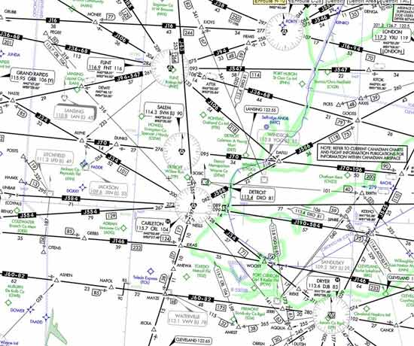
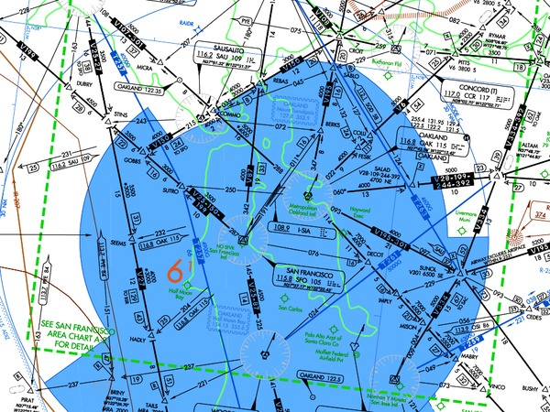
AIR TRAFFIC ROUTES

Slide 2
Air Traffic Service (ATS) routes
Route designed for the management of air traffic or for the provision of air traffic services
An ATS route may be a
low/medium frequency (L/MF) route (e.g., colored airways)
VOR (victor) airways (Vxxx)
Jet routes (Jxxx)
Area navigation (RNAV) routes
“T" will prefix RNAV routes below FL 180
“Q" will prefix RNAV routes FL 180 and above
Routes are only established in controlled airspace
Numbering
Even numbers for ATS routes that are east and west oriented
Odd numbers for ATS routes that are north and south oriented

Slide 3
Low Altitude Airways
Victor airways are low-altitude airways
Low altitude airways are designated as Class E, airspace
Extend from 1,200 feet AGL up to, but not including, 18,000 feet MSL
Can be flown by pilots under either IFR or VFR
Depicted as black lines on IFR Low-Altitude Enroute charts and as faded blue lines on VFR charts
Defined in straight-line segments, each of which based on a straight line between either two VOR stations, or a VOR and a VOR intersection

Slide 4
Low Altitude Airways
Width of the airway depends on the distance from the navigational aids
When VORs are less than 102 nautical miles (NM) from each other, the victor airway extends 4 NM on either side of the centerline (8 NM total width)
When VORs are more than 102 NM from each other, the width of the airway in the middle increases.
Up to 51 NM – 4nm on each side of the centerline
Beyond 51 NM from a navaid the airway is 4.5 degrees on either side of the centerline between the two navaids

Slide 5
Jet Routes
Jet routes extend from FL 180 to FL 450, inclusive, and are designated to indicate frequently used routings
Jet routes are normally based on “H" class NAVAIDs spaced no farther apart than 260 NM or non-VOR/DME area navigation system performance
Jet routes have no specified width

Slide 6
Q Routes
US and Canada use "Q" as a designator for RNAV routes (US 1-499/Canada 500-999)
Additional routes in the same airspace, as the routes start and end at a defined point in space and waypoint spacing is 12 to 500NM
Greater efficiency
Less conflictions between routes
Radar monitoring required
Generally flown with GPS
Example of phraseology: ”Cleared via Q one forty five” “ Fly heading one-five-zero to join Q three”, “Cleared direct ELMAA, Q one, rest of route unchanged”
Some are unidirectional

Slide 7
Q Routes A/FD Listing

Slide 8
IFR Preferred Routes
Preferred Routes are routes between busier airports to increase system efficiency and capacity
Preferred IFR routes are correlated with SID (standard instrument departures) and STAR (standard terminal arrivals) and may be defined by airways, high-level airways, direct routes between NAVAIDs (navigational aids) or waypoints, radials, DME (distance-measuring equipment) fixes, or any combination of these
Preferred IFR routing should be used by aircraft when operating between the specified airports
If a flight is planned to or from an area having such routes but the departure or arrival point is not listed in the Airport/Facility Directory, pilots may use that part of a Preferred IFR Route which is appropriate for the departure or arrival point that is listed.
Weather, traffic density and other system delays may cause preferential routing to change or not be used from time to time

Slide 9
IFR Preferred Routes
Preferred routes minimize routing changes and aid in the orderly management of air traffic
Low and high altitude preferred routes are listed in the Airport/Facility Directory (A/FD)
The high altitude list is in two sections
Terminal to terminal routes
Single direction route segments
Also, on some high altitude routes, low altitude airways are included as transition routes.

Slide 10
IFR Preferred Routes
Preferred routes beginning/ending with an airway number indicate that the airway essentially overlies the airport and flight are normally cleared directly on the airway.
Preferred IFR routes beginning/ending with a fix indicate that aircraft may be routed to/from these fixes via a Standard Instrument Departure (SID) route, radar vectors (RV), or a Standard Terminal Arrival Route (STAR)
Preferred IFR routes are listed alphabetically under the name of the departure airport
Where several airports are nearby they are listed under the principal airport as a metropolitan area;
Preferred IFR routes used in one direction only for selected segments, irrespective of point of departure or destination, are listed numerically showing the segment fixes and the direction and times effective.
Where more than one route is listed the routes have equal priority for use.
Some routes have specific effective times – They are listed in UTC
Daylight saving time effective times will be one hour earlier than indicated
High Altitude Preferred IFR Routes are in effect during the following time periods unless otherwise noted.
Sun................................................................................................................................. 1300–2259 local time.
Mon thru Fri ..................................................................................................................... 0701–2259 local time.
Sat ................................................................................................................................. 0701–1459 local time.
For high altitude routes, the portion of the routes contained in brackets is suggested but optional. The portion of the route outside the brackets will likely be required by the facilities involved.

Slide 11
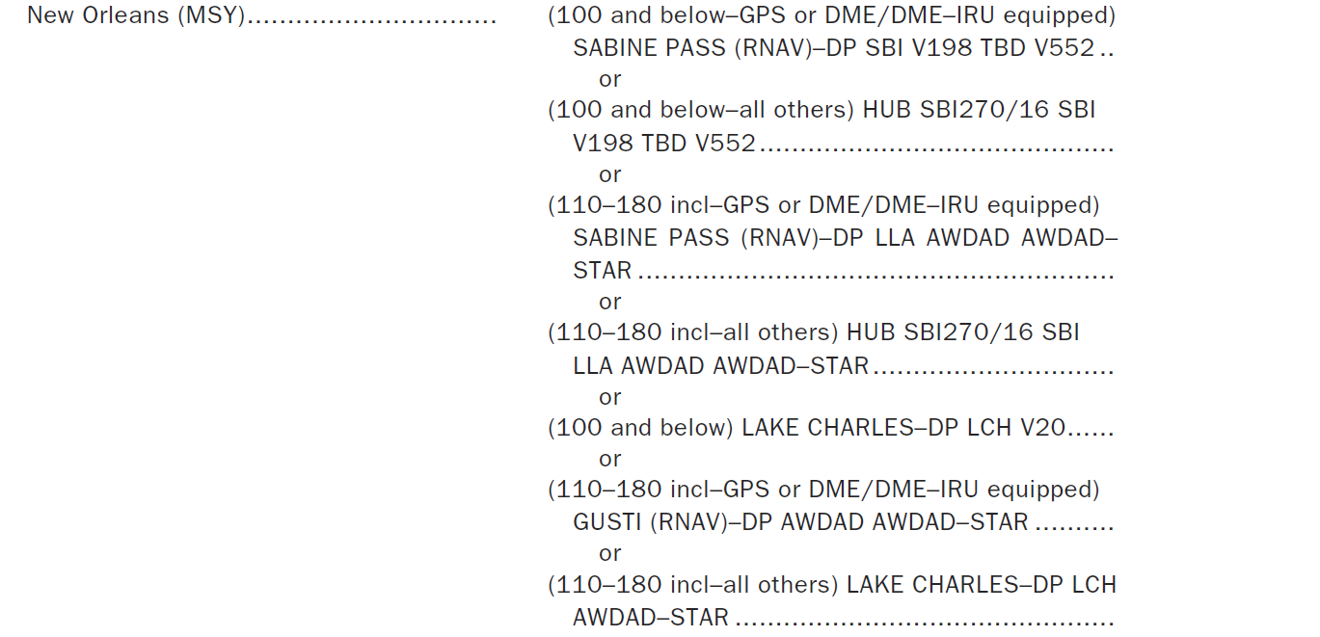
Low Altitude Preferred Route Formats A/FD

Slide 12
High Altitude Preferred Route Formats A/FD

Slide 13
Airway Notams
Part 1, Section 1 of Notices to Airmen will contain Airway changes and notices
MEA change
MOCA change
Fix changes
New / deleted airways
Required equipment changes

Slide 14
PTS Standards
Exhibits adequate knowledge of the elements related to ATS routes, and related pilot/controller responsibilities
Uses the current and appropriate navigation publications for the proposed flight
Selects and uses the appropriate communication facilities; selects and identifies the navigation aids associated with the proposed flight
Intercepts, in a timely manner, all courses, radials, and bearings appropriate to the procedure, route, or clearance
Maintains the applicable airspeed within ±10 knots; headings within ±10°; altitude within ±100 feet; and tracks a course, radial, or bearing within ¾-scale deflection of the CDI

Slide 15
Questions

Slide 16
Disclaimer
Instrument flight can be dangerous. Do not rely solely on this presentation – PROFESSIONAL INSTRUCTION IS REQUIRED
The foregoing material should not be relied upon for flight
ALTHOUGH THE ABOVE INFORMATION IS FROM SOURCES BELIEVED TO BE RELIABLE SUCH INFORMATION HAS NOT BEEN VERIFIED, AND NO EXPRESS REPRESENTATION IS MADE NOR IS ANY TO BE IMPLIED AS TO THE ACCURACY THEREOF, AND IT IS SUBMITTED SUBJECT TO ERRORS, OMISSIONS, CHANGE

