Slide 1
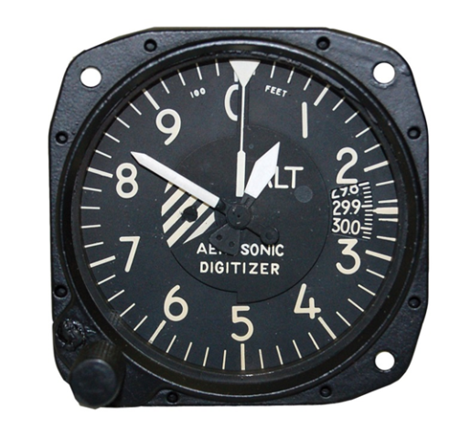
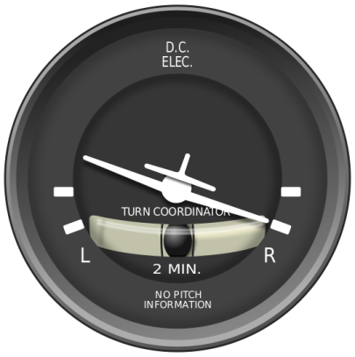
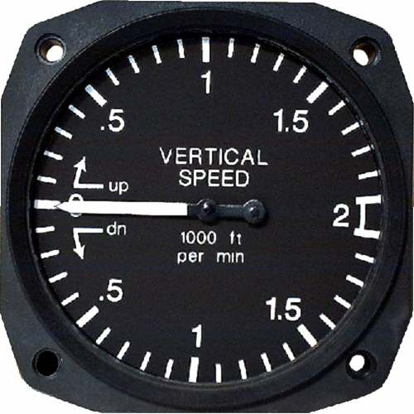
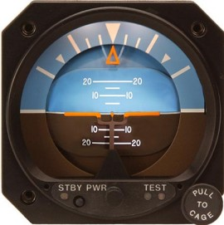
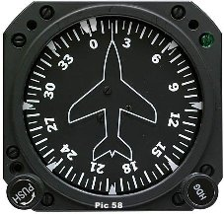
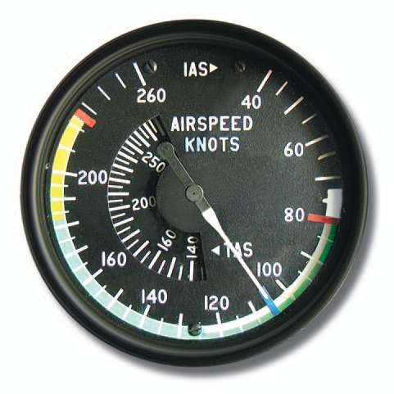
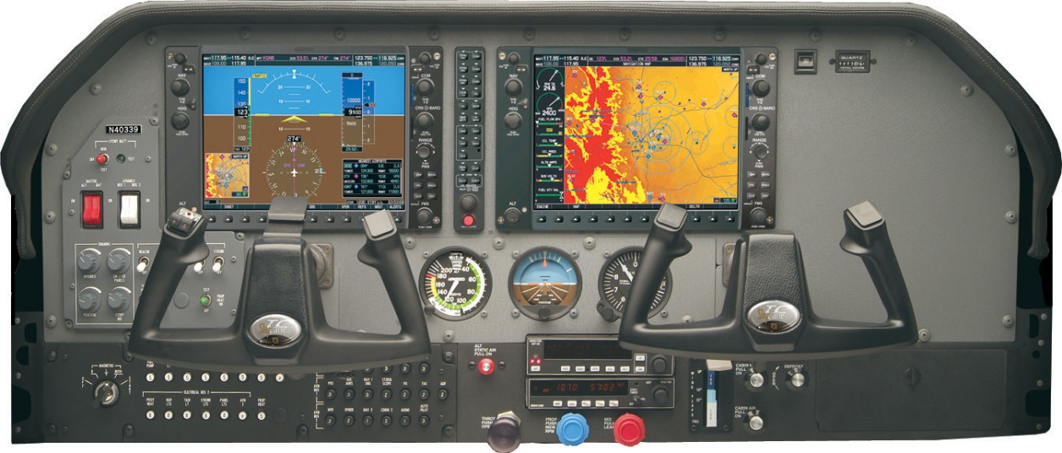
Aircraft Systems
and
Instruments

Slide 2
PTS Standards
Exhibits adequate knowledge of the elements related to applicable aircraft flight instrument system(s) and their operating characteristics to include—
  Pitot-static
  Altimeter
  Airspeed indicator
  Vertical speed indicator
  Attitude indicator
  Horizontal situation indicator
  Magnetic compass
  Turn-and-slip indicator/turn coordinator
  Heading indicator
  Electrical systems
  Vacuum systems
  Electronic flight instrument displays (PFD, MFD)

Slide 3
Instruments Required for Instrument Flight
DECKRAT
  Directional gyro
  Electrical source
  Clock with seconds displayed
  Kolsman-sensitive altimeter
  Radios and navigation equipment, as required for the flight
  Attitude indicator
  Turn coordinator with inclinometer

Slide 4
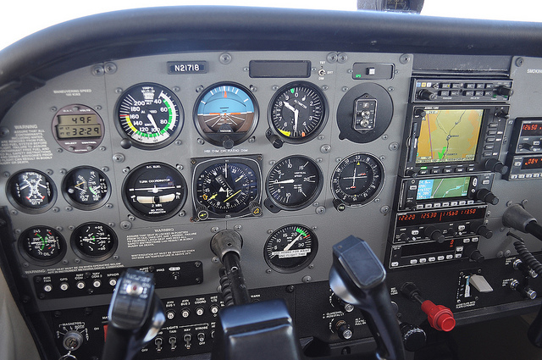
IFR Instruments
A
C
K
D
R
T
E
DECKRAT

Slide 5
VFR Day Instrument Requirements
A – airspeed indicator
T – tachometer (for each engine)
O – oil pressure gauge (for each engine using a pressure system)
M – manifold pressure gauge (for each altitude engine)
A – altimeter
T – temperature gauge (for each liquid cooled engine)
O – oil temperature gauge (for each air cooled engine)
F – fuel gauge
L – landing gear position indicator
A – anti collision lights (for aircraft certified after March 11th 1996)
M – magnetic compass
E – ELT
S – safety belts

Slide 6
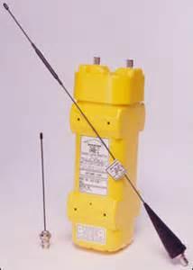
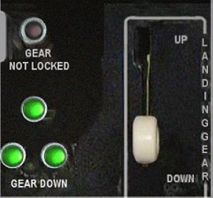
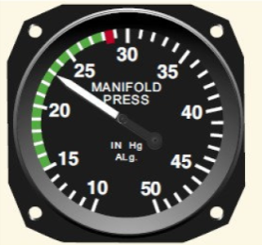

VFR Day Instrument Requirements
A2
M2
A1
F
O1 & 2
A Tomato Flames
A3
T1

Slide 7
VFR Night Instrument Requirements
A TOMATO FLAMES plus FLAPS
F – fuses (one complete spare set)
L – landing light (only if you are flying for hire)
A – anti collision lights
P – position lights
S – source of electricity (alternator, generator)

Slide 8
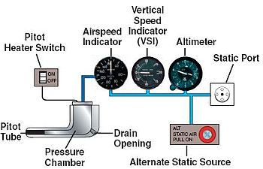
Pitot-Static System
Pitot-static system is a system of pressure-sensitive instruments that is used to determine airspeed, altitude, and vertical speed
System includes a pitot tube, static port(s), and the pitot-static instruments
  Pitot tube measures ram air pressure to provide airspeed
  Static port - often a flush-mounted hole on the fuselage measures static pressure

Slide 9
Pitot-Static System
Errors in pitot-static system readings can be extremely dangerous as you may lose airspeed, altitude, and vertical speed data
  Several commercial airline disasters have been traced to a failure of the pitot-static system – e.g. Air France Flight 447 - crashed after its pitot tubes were blocked by ice and the crew reacted incorrectly causing a stall from which they did not recover
Altimeter, transponder and the aircraft's static system must be inspected every 24 months for IFR operations – § 91.411
Aircraft with transponders must have the encoder and transponder checked every 24 months – § 91.413

Slide 10

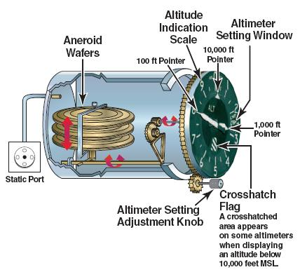
Altimeter
Altimeters compare the incoming static pressure with the pressure within its internal aneroid wafers
As the outside static pressure decreases with altitude, the aneroid wafers expand and cause the altimeter needle to rotate around the dial
Blockage of the static source will stop altimeter movement since the blockage stops any change in pressure
  Altimeter with a blocked static system will simply continue to show the same reading it had when the blockage occurred

Slide 11

Altimeter
The accuracy of an altimeter is subject to errors from:
  Nonstandard temperatures
    Caution should be exercised when flying in proximity to obstructions or terrain in low temperatures
  Nonstandard atmospheric pressure
    Caution should be exercised when flying in proximity to obstructions or terrain in low pressures
    Barometric pressure exceeds 31.00” – set altimeter to 31.00 below 18,000’
      At the beginning of the final approach segment, set the actual altimeter setting, if possible. If not, increase ceiling requirements by 100 feet and visibility requirements by 1/4 statute mile for each 1/10 of an inch of Hg above 31.00
    Pressure below 28.00” - flight by aircraft unable to set the actual altimeter setting is not recommended

Slide 12
Altimeter
  Aircraft static port position error
  Instrument error
    Mechanical and elastic errord
  Preflight altimeter must be within 75’ of known field elevation
  An “inch” error in the altimeter setting equals 1,000 feet of altitude. “GOING FROM A HIGH TO A LOW or HOT TO COLD, LOOK OUT BELOW.”
GPS altitude
  GPS devices read the GEOMETRIC altitude of the aircraft, relative to a sea-level baseline that is defined in the WGS84 coordinate system. This altitude is unaffected by atmospheric conditions. Aircraft Altimeters derive altitude by measuring the air pressure
  At low altitudes GPS altitudes will generally agree with the barometric altimeter, subject to altimeter temperature errors
  At higher altitudes, the GPS altitude and barometric altitude often diverge because of limitations of barometric altimetry

Slide 13
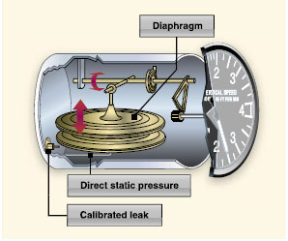
Vertical Speed Indicator
The VSI indicates the aircraft’s rate of climb or descent
The VSI uses a diaphragm connected to static pressure from the static port
The case has a calibrated nozzle that restricts the leakage of air so that there is a time delay between a change in static pressure and the pressure in the case
Thus, if the aircraft climbs (or descends), the pressure within the diaphragm will decrease (increase), while pressure in the case will decrease (increase) at a lower rate due to the presence of the nozzle
Movement of the diaphragm is translated into movement of a needle by a mechanical system

Slide 14
Vertical Speed Indicator
If static system is blocked, the VSI will show 0 and no change in climbs or descents
Errors
  Sudden or abrupt changes in aircraft attitude cause erroneous instrument readings
  While VSI needle immediately shows a change, accurate rate information is not instantaneous – can take 6 to 9 seconds
Needle should be at 0 on the ground and in level flight. This is a pre-flight check item
  If not at 0, you must allow for the error when interpreting the indications in flight
If turbulence is encountered, seek to maintain an appropriate pitch attitude instead of chasing the VSI needle or trying to maintain a steady rate.

Slide 15
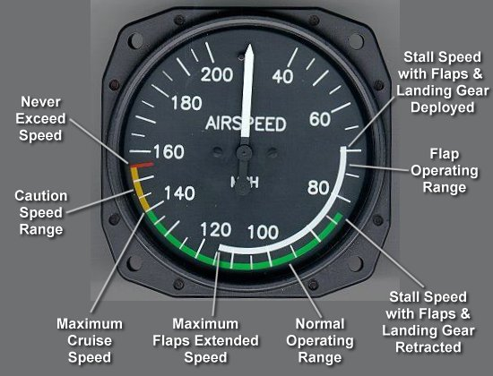
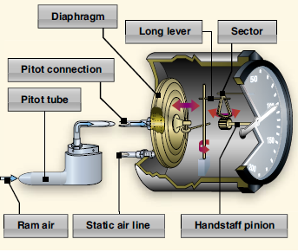
Airspeed Indicator
The input from the pitot tube is routed to a bellows in the instrument. The static input goes into the case surrounding the bellows. An increase in pitot pressure expands the bellows as long as the static pressure does not also increase.
The expansion of the bellows rotates a gear that turns the airspeed needle to display the aircraft’s airspeed

Slide 16
Pitot Static Blockages
Blockage | ASI Impact | Altimeter / VSI Impact
Pitot tube only (drain hole open) | Airspeed will decrease — possibly all the way to zero, if fully blocked | No impact
Pitot tube and pitot drain | Blockage would probably go unnoticed in level flight. In a climb or a descent, however, ASI will act as an altimeter because the trapped pitot pressure will be measured against varying static pressures (low speed shown near ground). ASI provides no useful airspeed information. | No impact
Static Port | ASI will act as a reverse altimeter – low airspeed above failure altitude; excessive airspeed below failure altitude. ASI provides no useful airspeed information. Very dangerous | VSI will not show changes in altitude; Altimeter will be frozen at failure altitude

Slide 17
Pitot Static Blockages
Many aircraft have alternate static systems
  Alternate static systems tends to reflect slighty higher altitude and slightly faster airspeed due to pressure difference between interior and exterior of the aircraft
  Can also use GPS altitude as a rough guide
Can also break glass on VSI to get approximate static pressure
Static line leak in pressurized aircraft – will show cabin altitude

Slide 18
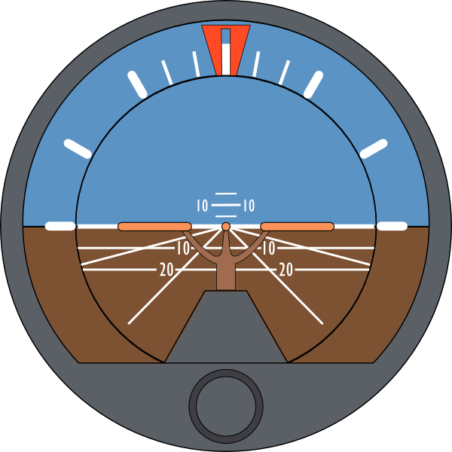
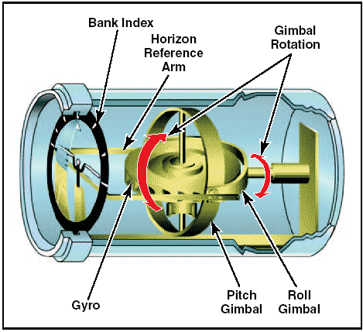
DECKRAT
Attitude Indicator
10°
20°
Pointer
Bank Scale
30°
45°
Pitch Scale
10°
Level /
Artificial Horizon
5°
90°
Horizon Adjustment Knob

Slide 19
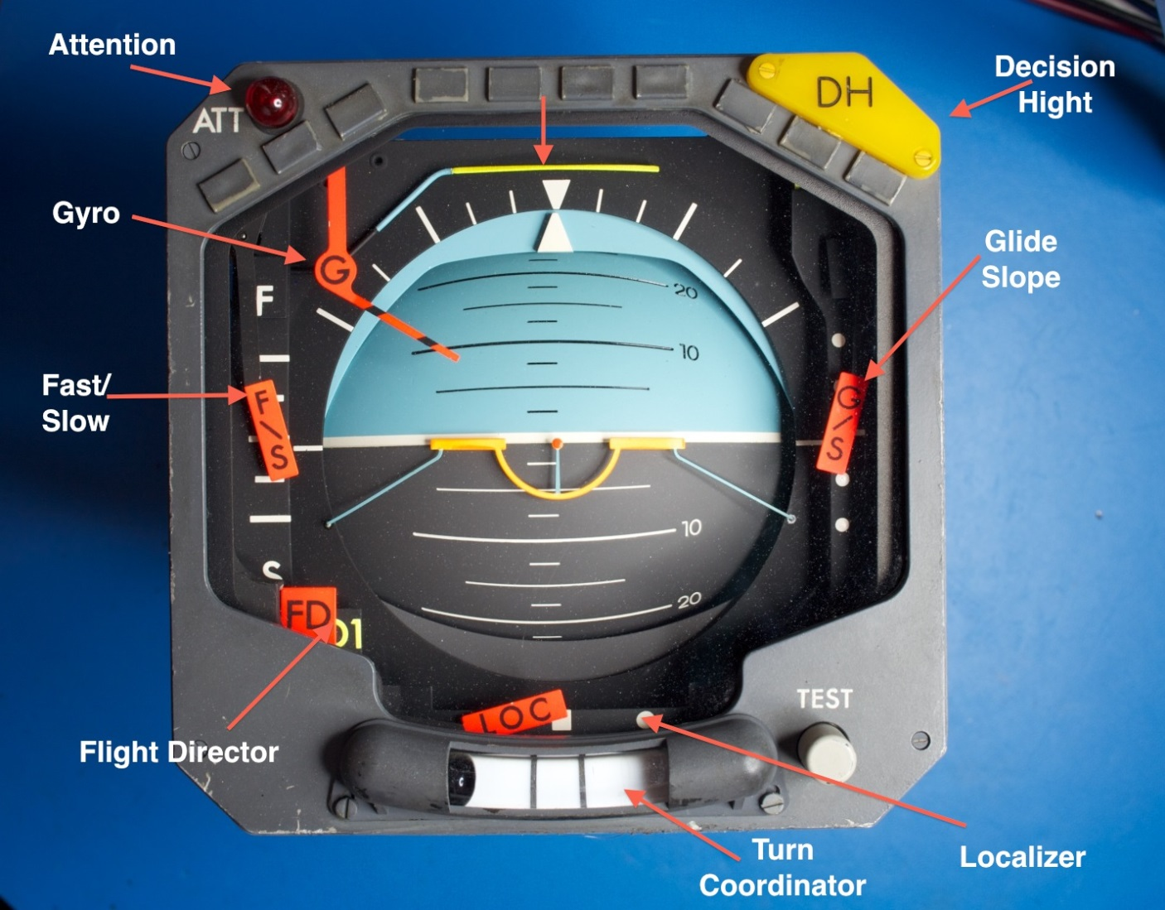
DECKRAT
Automatic Direction Indicator (ADI)
Key difference is how the pointer works

Slide 20
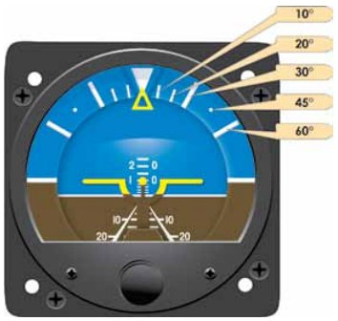
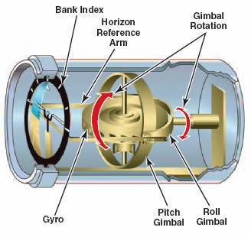
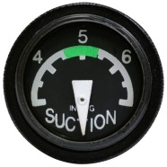
Attitude indicator
Depicts the orientation of the aircraft relative to Earth's horizon
  Gives immediate and direct indication of pitch and bank
  A primary instrument for IFR flight
Generally vacuum powered, but can be electrically powered
Functions using the principal of rigidity in space with a horizontal gyro - Aircraft rotates around the AI
Wings represent a pitch change of approximately 2°
  Set wings to proper position on the ground with knob on the bottom of the instrument

Slide 21
Attitude indicator
Attitude indicator errors:
  Can tumble if 100-110° of bank or 60-70° of pitch is exceeded
  Accelerations may cause a slight pitch up indication
  Deceleration may cause a slight pitch down indication
  Erection can take as long as 5 minutes, but normally occurs within 2 to 3 minutes
  Small bank angle and pitch error possible after a 180° turn
  May inaccurately display aircraft’s attitude, especially in skids and steep banked turns due to venting of gyro vacuum air
  Can fail if vacuum or electrical power lost, as applicable
These inherent errors are small and correct themselves within a minute or so after returning to straight-and-level flight

Slide 22
Attitude indicator
Preflight Check:
  After Engine Start
    When you turn the master switch on—listen to the gyros as they spin up. Any hesitation or unusual noises should be investigated
    Check the suction gauge or electrical flag indicators on the AI
    Allow time for gyros to spin up. If the horizon bar erects to the horizontal position and remains at the correct position for the attitude of the airplane, or if it begins to vibrate after this attitude is reached and then slowly stops vibrating altogether, it is operating properly
  Taxiing and Takeoff
    Horizon bar should remain in the horizontal position during straight taxiing, and not tip in excess of 5°during taxi turns

Slide 23
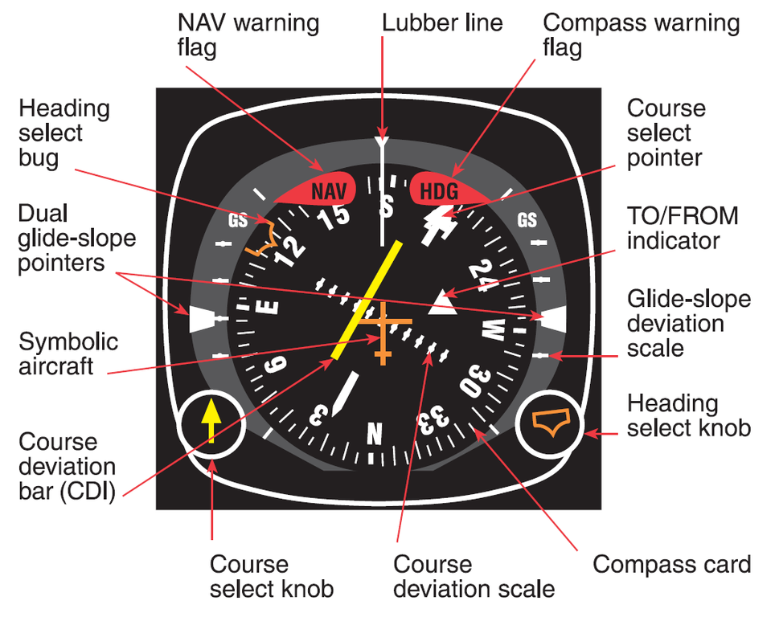
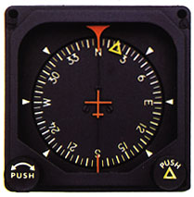
DECKRAT
Directional Gyro (DG)
Horizontal Situation Indicator (HSI)
Heading bug
Lubber Line
180° index – e.g, Where am I coming from
Compass card adjustment knob
Heading bug knob
Compass card

Slide 24
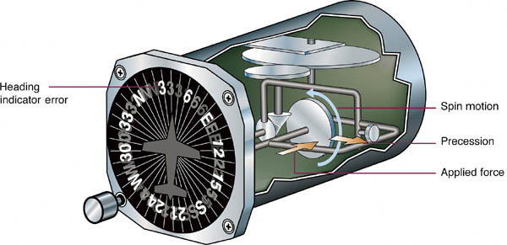
DG / HSI
Gyro stabilized heading indicator
  Indirect bank indicator (turns as heading changes)
Generally vacuum powered, but can be electrically powered
Functions using the gyroscopic principal of rigidity in space
  Senses rotation about vertical axis
DG is the primary means of establishing your heading in most cases due to magnetic compass errors

Slide 25
DG / HSI
As a result of Earth’s rotation, and because of small errors caused by friction and imperfect balancing of the gyro, the DG/HSI will drift or precess over time, and must be periodically reset from the compass
  3° / 15 minutes is acceptable precession
Compare the heading indicated on the DG/HSI with the compass in straight and level unaccelerated flight at least every 15 minutes and reset the DG/HSI, as necessary, to match the magnetic compass

Slide 26
DG / HSI
Errors
  May tumble if limits are exceeded
    Limits are approximately 55° of pitch and 55° of bank
  Precession
  During steep turns, pitching and rolling of the aircraft the changing relationship between the two gimbals in the instrument can result in an indication error or drift
  Erection can take as long as 5 minutes, but normally occurs within 2 to 3 minutes
  Can fail if vacuum or electrical power lost, as applicable

Slide 27
DG / HSI
Preflight Check:
  After Engine Start
    When you turn the master switch on—listen to the gyros as they spin up. Any hesitation or unusual noises should be investigated
    Check the suction gauge or electrical flag indicators
    Allow time for gyro to spin up and then set proper heading
  Taxiing and Takeoff
    DG/HSI should indicate turns in the correct direction, and precession should not be abnormal during taxi
    Should match runway heading before take-off (helps to confirm you are on the correct runway!)
      At idle power settings, the DG/HSI gyro may not be up to operating speeds and precession may occur more rapidly than during flight

Slide 28
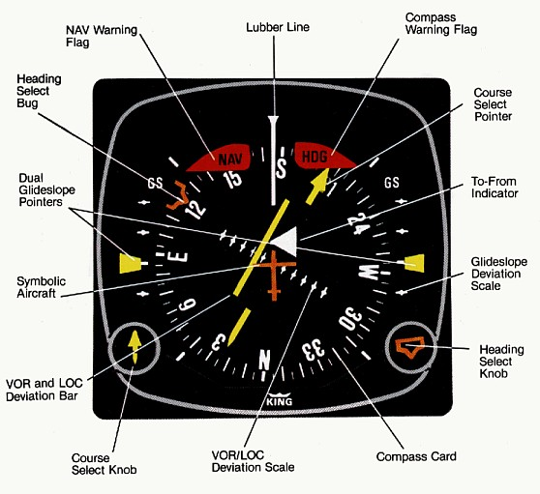
Horizontal Situation Indicator
HSI is a combination of the DG and OBS
Many heading indicators receive a magnetic north reference from a magnetic slaving transmitter, and generally need no heading adjustment
  HSI’s and DG’s that are not slaved are called "free" gyros, and require periodic adjustment
Generally same errors as DG, but can also lose magnetic slaving
Information of HSIs can be found in the VOR PowerPoint at http://bob-cfi.weebly.com/uploads/7/6/9/3/7693240/vor.pptx

Slide 29
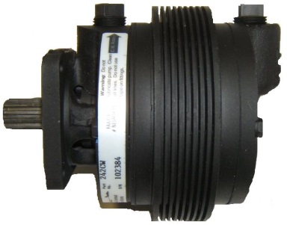
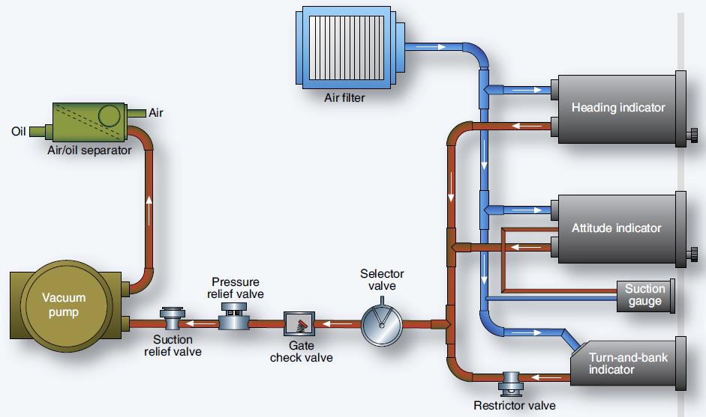
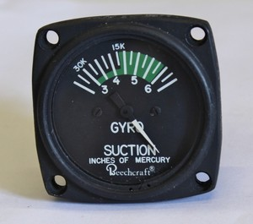
Vacuum System
Suction or vacuum is developed by a vacuum pump and the amount of vacuum is controlled by a vacuum relief valve / regulator located in the supply line
Pump can be engine driven or electrically driven. Some systems use a venturi arrangement to create suction.
The suction gauge monitors the vacuum developed in the system that actuates the HI and DG
The speed at which the AI and DG gyros spin must be within a certain range for correct operation. This speed is directly related to the suction pressure that is developed in the system and pulls a stream of air against the rotor vanes on the gyro which turns the AI or DG rotor
  Similar to a water wheel

Slide 30
Vacuum System
Engine failure, especially on single engine aircraft, may cause a loss of vacuum and as a result cause a loss of the AI and HI at a critical time
  This is why the turn and bank indicator operates with an electrically driven gyro in most cases

Slide 31
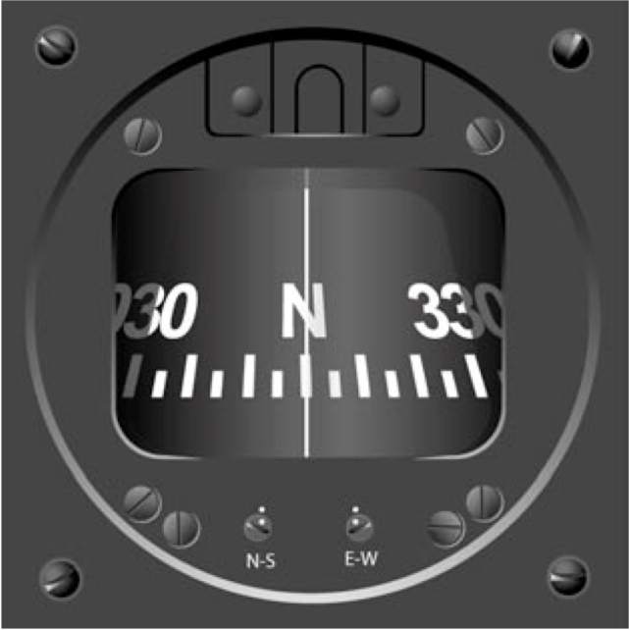
Magnetic Compass
Most everything you want to know about the compass for the PTS is in my Compass turn presentation available at:
http://bob-cfi.weebly.com/uploads/7/6/9/3/7693240/compass_turns.pptx

Slide 32

Magnetic Compass
Compass preflight checks
  Fluid-filled
  Moves freely
  Correctly indicates known headings (taxiways, runways) – can also use a compass rose to check
  Confirm deviation card is present

Slide 33
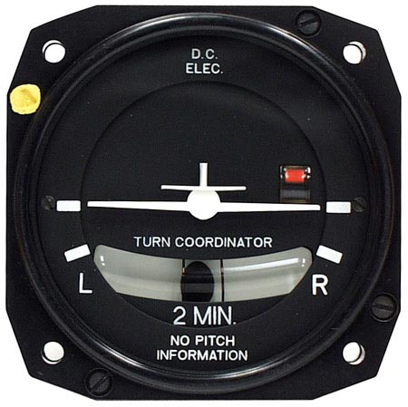
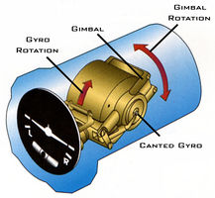
DECKRAT
Turn and Slip or Bank Indicator
Two Instruments in one

Slide 34
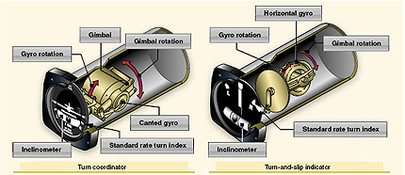
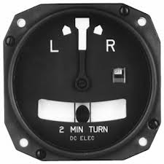
Turn Coordinator
Shows rate of turn and rate of roll into the turn
The rotor of the gyro in a turn coordinator is canted upwards 30°
  Thus, it responds not only to movement about the vertical axis, but also to roll movements about the longitudinal axis
Turn coordinator thus provides an indication of roll at the earliest possible time
The airplane’s wings provide the indication of wings level flight and the rate at which the aircraft is turning – mark is standard rate turn
  2 minutes normally; can be 4 minutes in fast aircraft
Provides no pitch information
Provides no bank information – only rate of turn
  Approximate angle of bank for standard rate turn = (TAS/10) + 5
Standard rate mark
Turn indicator

Slide 35
Slip Indicator
Inclinometer
  Shows the correct execution of a turn (coordinated) while banking the aircraft and indicates movement about the vertical axis of the aircraft (yaw)
  Ball movement is independent of the turn coordinator
    A round ball is set in a curved glass tube filled with dampening fluid
    The ball moves in response to gravity and centrifugal force experienced in a turn
Slip indicator

Slide 36
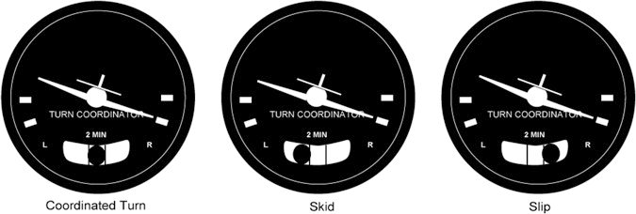
Inclinometer
Centrifugal force and HCL equal
Centrifugal force greater than HCL – reduce rudder into the turn or increase bank
Centrifugal force less than HCL – increase rudder into the turn or decrease bank

Slide 37
Turn Coordinator
Turn Coordinator errors
  If the vacuum or electrical supply fails the instrument will show no turn
    Usually has a warning flag
  Low voltage or suction may cause the turn coordinator to show a shallower turn than actual
  If gyro rotor speed is too high it will result in an excessive rate of turn indication

Slide 38
Turn-and-Bank Indicator
Preflight check
  Check that the inclinometer is full of fluid and has no air bubbles
  The ball should also be resting at its lowest point
  When taxiing, the turn coordinator should indicate a turn in the correct direction while the ball moves opposite the direction of the turn
  Check no failure flag is present

Slide 39
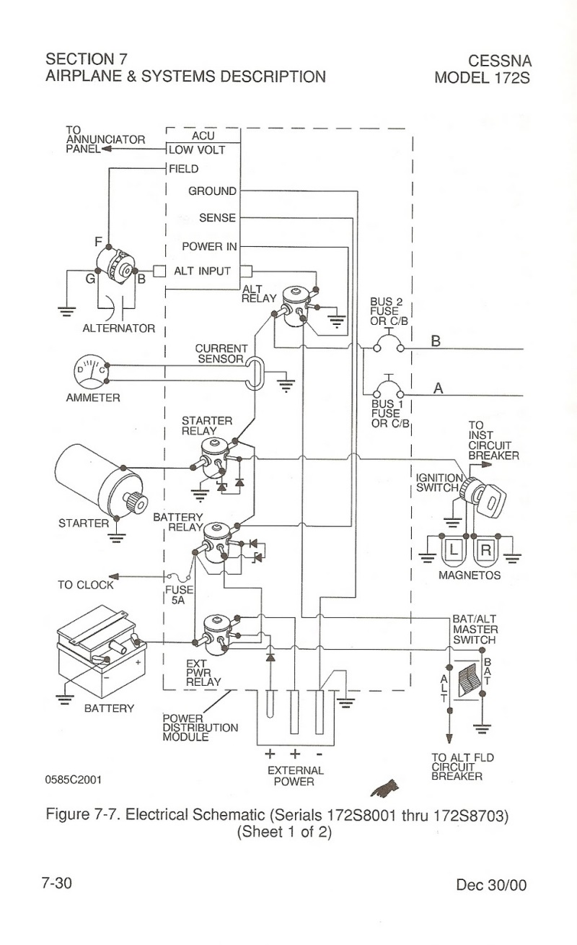
Electrical System
Electrical system is generally described in Section 7 (Systems Description) of the applicable aircraft’s POH.
  It is important to understand how the system works in order to troubleshoot a problem

Slide 40
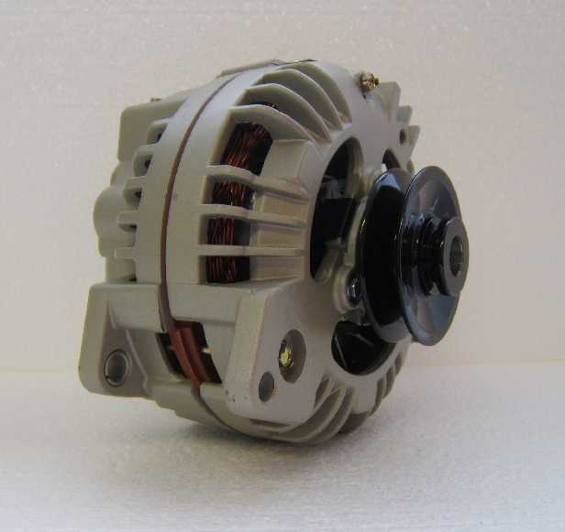

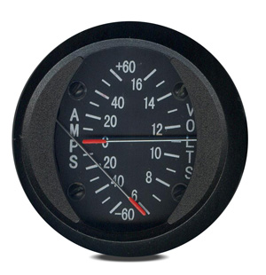
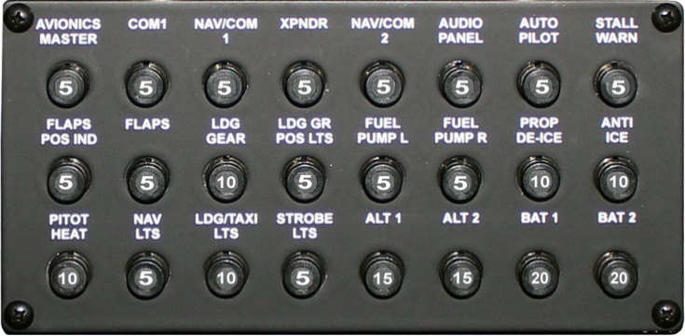
Electrical System
Major components
  Battery
  Alternator – produces power to operate equipment and charge the battery
  Circuit breakers – protect the system from overload
  Amps / volts gauges – provide information on the status of the system
  Master switch – Controls power to nearly all circuits on the aircraft
    Switch can have two sides
      Battery – powers the aircraft only from the battery
      Alternator – powers the aircraft using both battery and alternator supplied power
  Avionics power switch – Provides power to avionic equipment

Slide 41
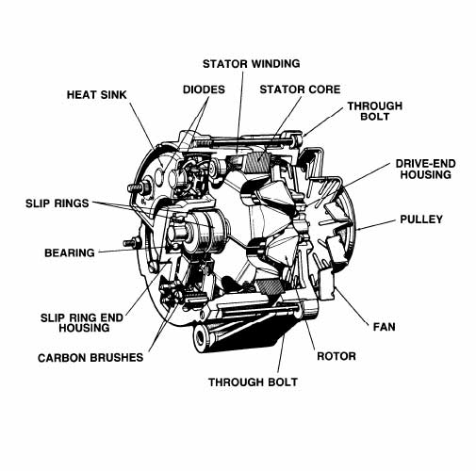
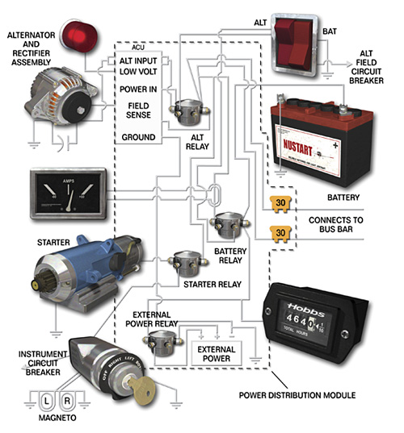
DECKRAT
Electrical Source
Most common electrical sources are a generator or alternator. Most modern light aircraft use alternators.

Slide 42
Electrical System
Potential problems
  Battery failure
  Alternator failure
  Bus failure
  Circuit breaker opens
  Electrical system fire
If the system fails (non-fire)
  Try to reset the alternator
  Reset circuit breaker (generally only once)
  Load shed non-essential equipment
  If electrical fire – follow POH
  Be prepared for loss of electrically powered radios and equipment
  Land, as necessary following a system failure, as battery power can be short lived

Slide 43
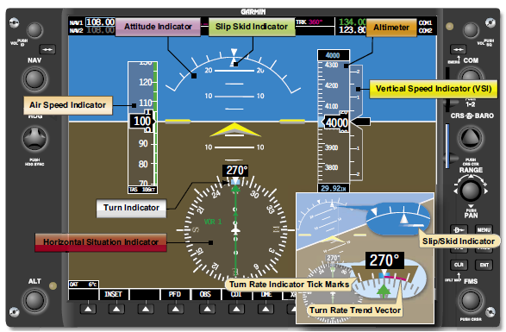
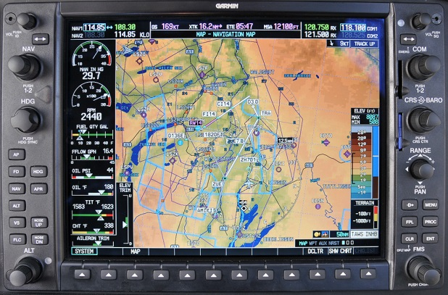
Electronic Flight Instrument Displays (PFD / MFD)
Digital flight displays combine all flight instruments onto a single screen which is called a primary flight display (PFD)
  The traditional “six pack” of instruments is now displayed on one liquid crystal display (LCD) screen
  Gyros are replaced by the Attitude Heading and Reference System (AHRS) unit
  Pitot static inputs are received by an air data computer (ADC). The ADC computes the difference between the total pressure and the static pressure, and generates the information necessary to display the airspeed on the PFD

Slide 44

Electronic Flight Instrument Displays (PFD / MFD)
MFD is a multi-function LCD screen surrounded by multiple buttons that can be used to display information in numerous configurable ways
MFDs often display navigation route, moving map, weather radar, NEXRAD, GPWS, TCAS and airport information all on the same screen

Slide 45
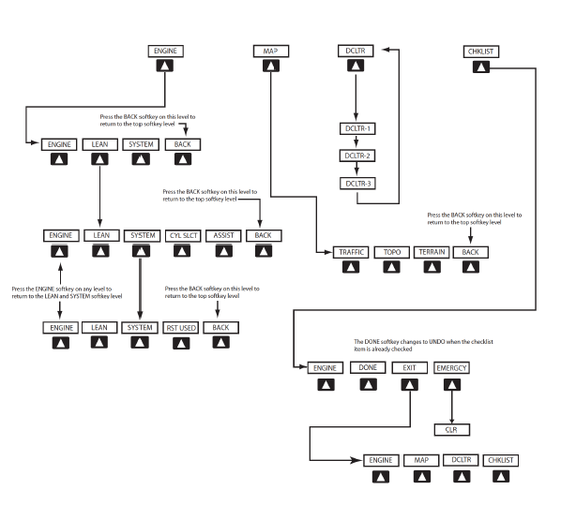
Electronic Flight Instrument Displays
Garmin G1000 MFD logic

Slide 46
Instrument Errors
Remember SRM skills – take a deep breath and think!
Remember your resources
  Pitot heat
  Alternate static sources
  GPS altitude capabilities
  Compare instruments powered from different sources vacuum gyros vs. electrical gyro (turn and bank) – gyros vs pitot/static
  POH / Checklists
Keep your scan moving and identify any instrument(s) that give you conflicting information
  Promptly recognizing a problem is key
    Don’t ignore red flags on instruments
  Identify the instrument or system that is in error by determining what makes sense and what doesn't
Develop a plan to determine which instrument has failed
  Slight pitch up should tell you whether the attitude indicator is working
  Bank should tell you wither the attitude indicator, turn and bank and DG are working

Slide 47
Instrument Errors
Remember that pitch plus power equals performance – Know your numbers
  As long as you have vacuum instruments, you can keep the airplane level
  Set the pitch and power for the performance you want and trust the airplane
Eliminate the erroneous instrument or system from your scan
  Keep a “post it” with you to cover an erroneous instrument to keep it from becoming a distraction.
  Remember, your scan will tend to pick up the abnormal
With a failed instrument make very small changes and only make one change at a time and then verify that the anticipated change shows up on the instruments
DON'T become fixated on any one instrument or system
  If you can't understand why an instrument is giving you a particular reading, there's a good chance there's a problem
  Integrate the readings from all other instruments and determine which instrument is erroneous and eliminate it from your scan
Advise ATC of your problem as soon as you have things under control – aviate, navigate then communicate

Slide 48
Instrument System Error
Bank Agreement – T&B, AI and DG
Pitch Disagreement -> Climb VSI, AI and Altimeter; Descent - ASI

Slide 49
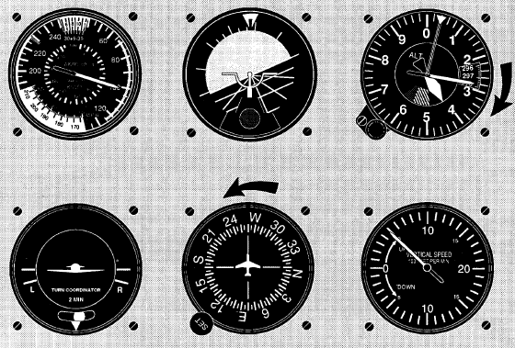
Instrument System Error
Error likely with
Vacuum system
– but verify
with compass to
rule out T&B
anomaly
Bank Disagreement – T&B wings level; AI and DG – Right turn
Pitch Disagreement -> Climb VSI and Altimeter; AI near wings level; ASI - constant

Slide 50
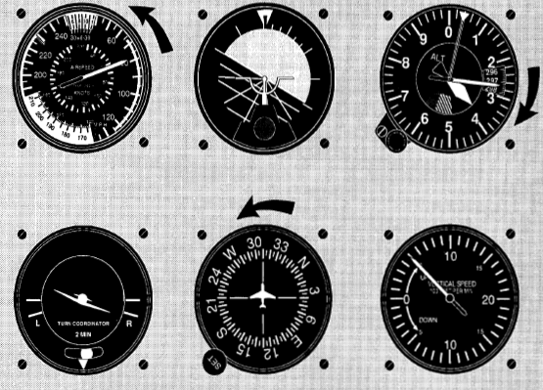
Instrument System Error
Bank Disagreement – T&B and DG right; AI– Left turn
Pitch Disagreement -> Climb ASI, VSI and Altimeter; AI Level

Slide 51
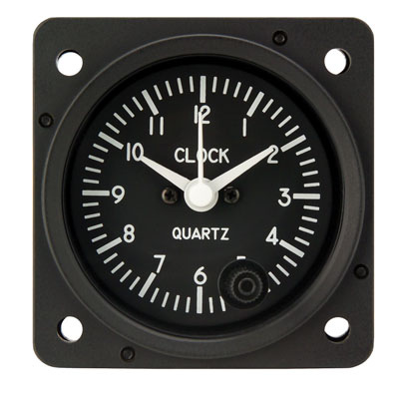
DECKRAT
Clock and Altimeter

Slide 52


Slide 53
Disclaimer
Instrument flight can be dangerous. Do not rely solely on this presentation – PROFESSIONAL INSTRUCTION IS REQUIRED
The foregoing material should not be relied upon for flight
ALTHOUGH THE ABOVE INFORMATION IS FROM SOURCES BELIEVED TO BE RELIABLE SUCH INFORMATION HAS NOT BEEN VERIFIED, AND NO EXPRESS REPRESENTATION IS MADE NOR IS ANY TO BE IMPLIED AS TO THE ACCURACY THEREOF, AND IT IS SUBMITTED SUBJECT TO ERRORS, OMISSIONS, CHANGE

