Slide 1
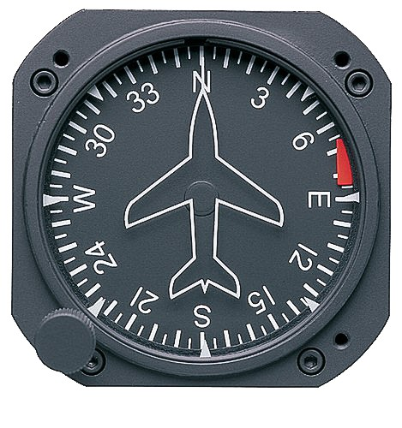
Timed Turns
90 Seconds
2 minutes
10 seconds
20 Seconds
30 Seconds
40 Seconds
50 Seconds
60 Seconds

Slide 2
Why Use A Timed Turn
Generally used when the DG ceases to function properly
Because the compass is unreliable (because of compass pitch limits and magnetic dip) in a turn, you will generally find it necessary to used timed turns in the event of a failure of the DG or vacuum system

Slide 3
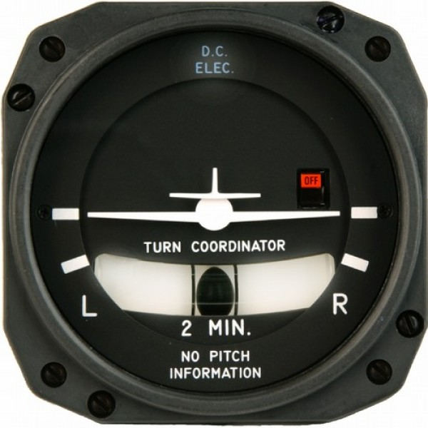
Standard Rate Turns
In a standard rate turn the pilot uses a standardized rate of turn in which the aircraft will make a 360 degree turn in two minutes (120 seconds) regardless of airspeed
Standard rate turn is indicated on turn coordinator or turn-slip indicator.
Standard Rate of Turn Indicator

Slide 4
Standard Rate Turns are NOT Standard Bank Turns
To achieve a standard rate turn at different airspeeds, you will have to vary the bank angle
A good rule of thumb for determining bank angle is to use approximately 20 percent of indicated airspeed
Because the maximum angle of bank for maneuvering an aircraft in instrument flight is generally 30° that will be a limit
70 knots true airspeed = approximately 12° of bank
90 knots true airspeed = approximately 15° of bank
120 knots true airspeed = approximately 19° of bank

Slide 5
Timed Turns
Establish a standard-rate turn as indicated by the turn coordinator
While you are practicing timed turns you can verify the rate of turn and accuracy if the turn coordinator. As the second hand of the clock passes a cardinal point (12, 3, 6, 9), check the heading on the heading indicator. While holding the rate of turn constant, note the indicated heading changes at 10 second intervals. If the airplane turns more or less than 30° in that interval, a larger or smaller deflection of the miniature aircraft of the turn coordinator is necessary to produce a standard-rate turn
Note any corrections necessary, if any, and apply them during timed turns
If SHORT on magnetic course increase turn coordinator one bar over std. rate turn
If LONG on magnetic course decrease turn coordinator one bar under std. rate turn
The same cross-check and control technique is used in making timed turns that is used for normal turns to a predetermined heading, except that the clock is substituted for the heading indicator

Slide 6
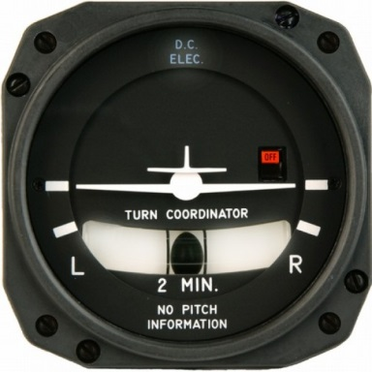
Timed Turn Instrument Usage
The miniature aircraft of the turn coordinator is primary for bank
The altimeter is primary for pitch
The airspeed indicator is primary for power control
Miniature airplane

Slide 7
Timed Turn Time Computation
Determine the new heading desired
Determine your current heading - magnetic compass while in level flight
Determine the number of degrees of turn required
Divide the number of degrees by 3 to determine the amount of time needed to reach the new heading
E.g., To turn from east (90°) to west (270°)
270 – 90 = 180 / 3 = 60 seconds

Slide 8
Timed Turn Techniques
Start smoothly rolling into the turn when the clock’s second hand passes a cardinal point
Hold the turn at the standard rate indication (or half-standard rate for small heading changes)
Begin rolling out of the turn when the computed number of seconds has elapsed
If the rates of roll-in and roll-out are the same, you can ignore the time taken during roll-in and roll-out
After roll-out is completed, check the compass to confirm that you are on the desired heading

Slide 9
Questions

Slide 10
Disclaimer
Instrument flight can be dangerous. Do not rely solely on this presentation – PROFESSIONAL INSTRUCTION IS REQUIRED
The foregoing material should not be relied upon for flight.
ALTHOUGH THE ABOVE INFORMATION IS FROM SOURCES BELIEVED TO BE RELIABLE SUCH INFORMATION HAS NOT BEEN VERIFIED, AND NO EXPRESS REPRESENTATION IS MADE NOR IS ANY TO BE IMPLIED AS TO THE ACCURACY THEREOF, AND IT IS SUBMITTED SUBJECT TO ERRORS, OMISSIONS, CHANGE.

