Slide 1
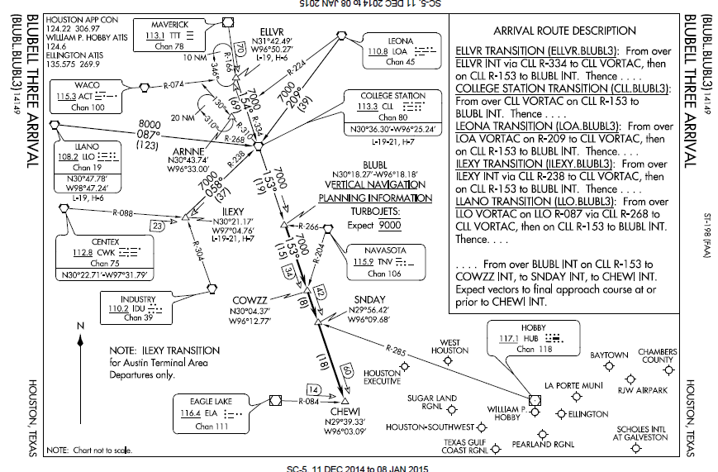
Standard Terminal Arrival Routes STARs

Slide 2
WHAT IS A STAR
A STAR is an IFR arrival route established by ATC to direct arriving IFR aircraft to an airport
Graphical and textual presentation
Very similar to a SID
Principal difference between SID and STARs is that the SID starts at the runway and connects to the enroute structure. STARs start at the enroute structure but do not make it down to the runway; they end at a approach gate, outer fix, instrument approach fix, or arrival waypoint where radar vectors commonly take over because STARs serve multiple airports
Several airports in the same area may share a STAR
STARs are designed to
simplify clearance delivery procedures
facilitate transition between en route and instrument approaches

Slide 3
Flying the Star
Pilots may be issued a clearance containing a STAR whenever ATC deems it appropriate
To use a STAR, a pilot must have at least the approved chart
RNAV STARs must be retrievable by the procedure name from the aircraft database and conform to charted procedure
Can’t just go “direct” point to point
Pilot can accept or refuse a STAR
Pilots should notify ATC if they do not wish to use a STAR by placing “NO STAR” in the remarks section of the flight plan or by the less desirable method of verbally stating the same to ATC
STARs charts are published in the Terminal Procedures Publication (TERPS) and precede the instrument approach plates for an airport

Slide 4
STAR Speeds and Altitudes
STARs may have speeds and/or crossing altitudes published that are:
Mandatory
Advisory - planning information to inform pilots what clearances or restrictions to “expect.” “Expect” altitudes/speeds are not considered STAR procedures crossing restrictions unless verbally issued by ATC.
Published speed restrictions are independent of altitude restrictions and are mandatory unless modified by ATC.
You must cross waypoints with published speed restrictions, at the published speed, and should not exceed this speed past the associated waypoint unless authorized by ATC or a published note to do so
“Expect” or advisory speeds and altitudes are not clearances and cannot be used in the event of lost communications unless ATC has specifically advised the pilot to expect these altitudes/speeds as part of a further clearance.

Slide 5
STAR Speeds and Altitudes
Published altitudes - Pilots navigating on a STAR must maintain last assigned altitude until receiving authorization to descend so as to comply with all published/issued restrictions. This authorization will often contain the phraseology “DESCEND VIA”
A descend via clearance authorizes pilots to:
Descend at pilot's discretion to meet published restrictions and laterally navigate on a STAR
When cleared to a waypoint depicted on a STAR, to descend from a previously assigned altitude at pilot's discretion to the altitude depicted at that waypoint
Once established on the depicted arrival, to descend and to meet all published or assigned altitude and/or speed restrictions
Minimum en route altitudes (MEA) are not considered restrictions; however, you must remain above all MEAs, unless ATC instructs you to descend below the MEA [CFIT / SA]
Air traffic will assign an altitude to cross a waypoint/ fix, if no altitude is depicted on a STAR.

Slide 6
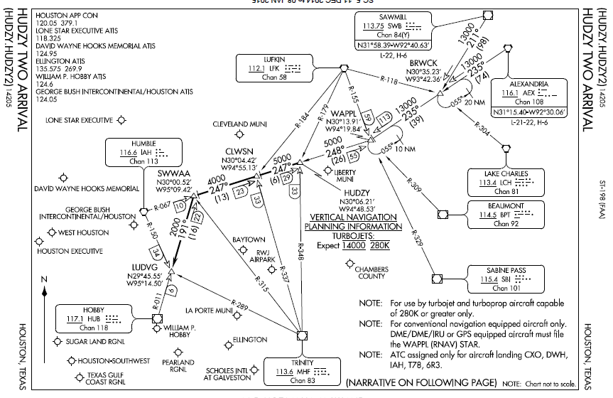
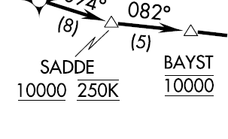
STAR Altitudes and Speeds
Expect altitude
/ speed
Transition
STAR
Altitude
Speed/ altitude
Restriction
Restrictions
Text on second page
Charts are not to scale!! – Note distances

Slide 7
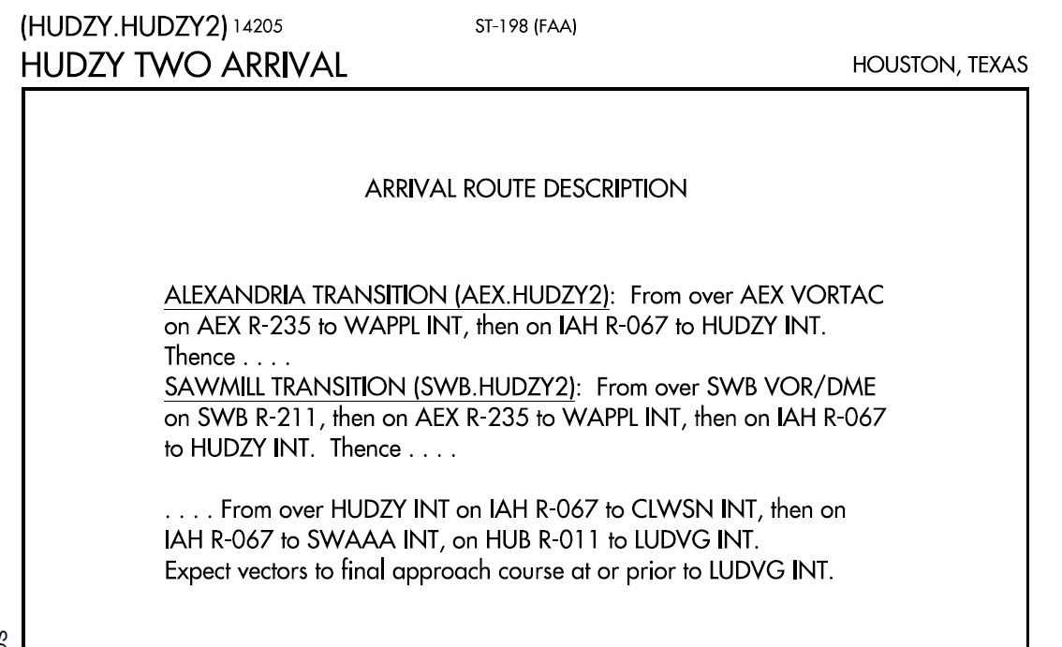
STAR Altitudes and Speeds
Textual description – page two

Slide 8
Speed Adjustments
Begin adjusting your speed at the minimum distance necessary prior to a published speed restriction that allows crossing the waypoint/fix at the published speed
Once at the published speed, maintain that speed until additional adjustment is required to comply with further published or ATC assigned speed restrictions or as required to ensure compliance with 14 CFR §91.117

Slide 9
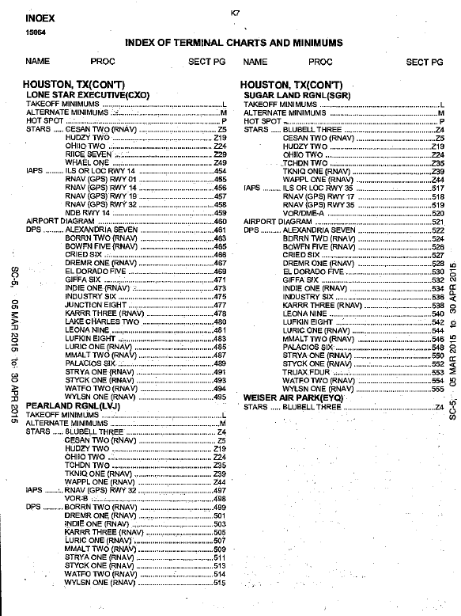
SID / STAR Selection
Stars are listed in the TERPS directory for each airport before the approaches
Star graphic presentations precede approaches for the airport in the TERPS
Many airports will have several STARs to choose among
Review the Stars and select the star that most closely aligns with your route of flight

Slide 10
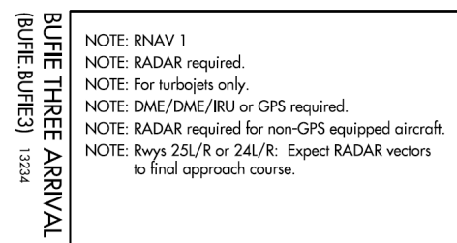
SID / STAR Selection
Be sure you can meet the altitude, speed and equipment requirements for a selected Star
Note some SIDS / STARS are turbojet, turboprop only. Some are RNAV only
RNAV1 / RNAV2 Notes – RNAV 1 STARS have higher equipment requirements and, often, tighter required navigation performance (RNP) tolerances than RNAV-2. For RNAV-1 STARS, pilots are required to use a course deviation indicator (CDI)/flight director, and/or autopilot in LNAV mode while operating on RNAV courses.
Your SID may have a common point with a STAR for your arrival airport – often that is the best combination
In which case the flight plan consists of a departure airport, SID, STAR and arrival airport for the entire route

Slide 11
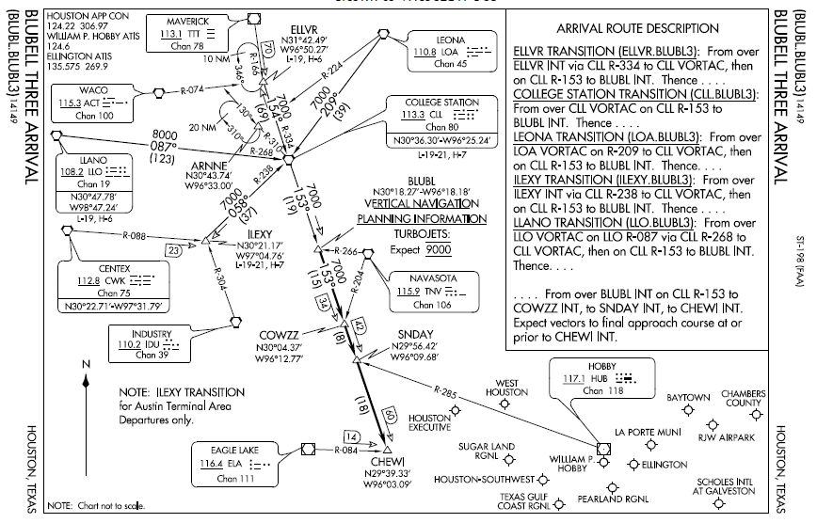
Star Transitions
How to file for the transition
A STAR transition is a published segment used to connect one or more enroute airways, or RNAV routes to the basic STAR procedure
Several routes that bring traffic from different directions into one STAR may exist
STAR name is usually the same as the last fix on the enroute transitions where they come together to begin the basic STAR procedure.
Transition Route
Radial line and value
Arrival Route

Slide 12
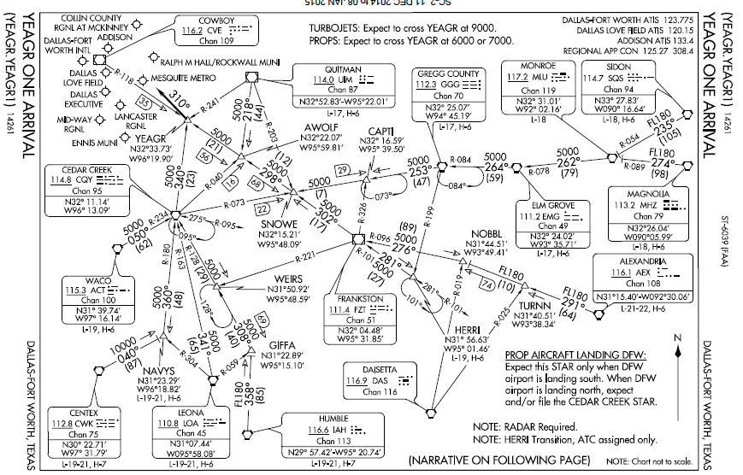
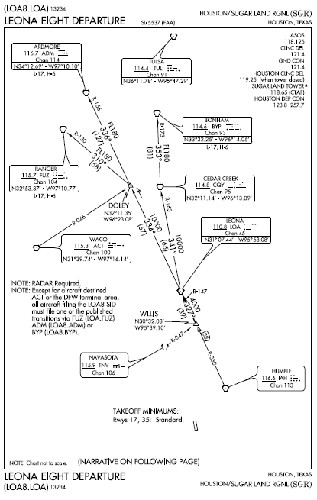
SID to STAR SGR to KDAL

Slide 13
Star Clearances
“Cleared XXXX Arrival”
No descent authorized
Must comply with published speed restrictions
“Cleared XXXXX Arrival, Descend At Pilot’s Discretion, Maintain One Zero Thousand”
Initiate descent at pilot’s discretion to 10,000’
All published altitude restrictions are canceled
All published speed restrictions remain in effect

Slide 14
STAR Clearances
Cleared Tyler One arrival, descend and maintain 6000” - requires the pilot to descend to 6000’ as directed, comply with any published speed restrictions, and maintain 6000’ until cleared for further vertical navigation with a newly assigned altitude or a “descend via” clearance.
“Descend via the Eagul Five arrival” - authorized descent at pilot's discretion on the Eagul Five arrival; you must descend in compliance with all published altitude and speed restrictions
“Descend via the Eagul Five arrival, except, cross Vnnom at or above one two thousand” - authorizes the same, but requires the pilot to descend so as to cross at Vnnom at or above 12,000
“Descend via the Eagul Five arrival, except after Geeno, maintain one zero thousand - authorized the aircraft to track laterally on the Eagul Five Arrival and to descend at pilot's discretion so as to comply with all altitude and speed restrictions until reaching Geeno and then maintain 10,000 until otherwise instructed
“Proceed direct Leoni, descend via the Leoni One arrival” - aircraft is authorized to proceed to Leoni, cross Leoni at the published altitude and then descend via the arrival. If a speed restriction is published at Leoni, the aircraft must slow to comply with the published speed

Slide 15
STAR Communication
Pilots cleared for vertical navigation using the phraseology “descend via” must inform ATC upon initial contact with a new frequency, of the altitude leaving, “descending via (procedure name),” the runway transition or landing direction if assigned, and any assigned restrictions not published on the procedure.
Skyhawk 121W is cleared to descend via the Eagul Five arrival, runway 26 transition:
“Skyhawk 121W leaving 6000, descending via the Eagul Five arrival runway two­ six transition.”
Skyhawk 121W is cleared to descend via the Eagul Five arrival, but ATC has changed the bottom altitude to 6,000:
“Skyhawk 121W leaving 10,000 for 6000, descending via the Eagul Five arrival, runway two ­six transition.”

Slide 16
ATC STAR Modifications
ATC will issue an altitude to maintain and all appropriate altitude restrictions when a vector will take you off an assigned procedure that contains altitude instructions or the previously issued clearance included crossing restrictions
ATC will advise you what to expect when the vector is completed
“Skyhawk 1472F fly heading zero nine zero, vector for spacing, descend and maintain 6000, expect to resume the XXXX Arrival”
Air traffic will assign an altitude to cross a waypoint/fix, if no altitude is depicted at the waypoint/fix, for an aircraft on a direct routing to a STAR
Air traffic must ensure obstacle clearance when issuing a “Descend Via” instruction to the pilot

Slide 17
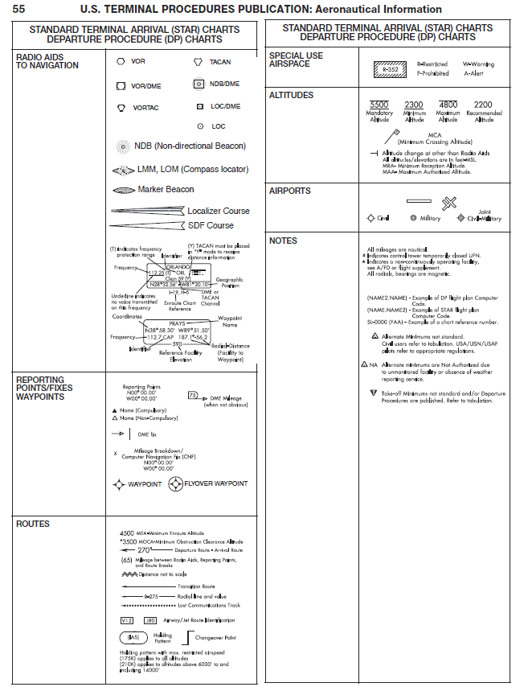
Reading the STAR
You can decode the symbology on a STAR by referring to the legend at the beginning of the TPP.

Slide 18
Questions

Slide 19
Disclaimer
Instrument flight can be dangerous. Do not rely solely on this presentation – PROFESSIONAL INSTRUCTION IS REQUIRED
The foregoing material should not be relied upon for flight
ALTHOUGH THE ABOVE INFORMATION IS FROM SOURCES BELIEVED TO BE RELIABLE SUCH INFORMATION HAS NOT BEEN VERIFIED, AND NO EXPRESS REPRESENTATION IS MADE NOR IS ANY TO BE IMPLIED AS TO THE ACCURACY THEREOF, AND IT IS SUBMITTED SUBJECT TO ERRORS, OMISSIONS, CHANGE

