Slide 1

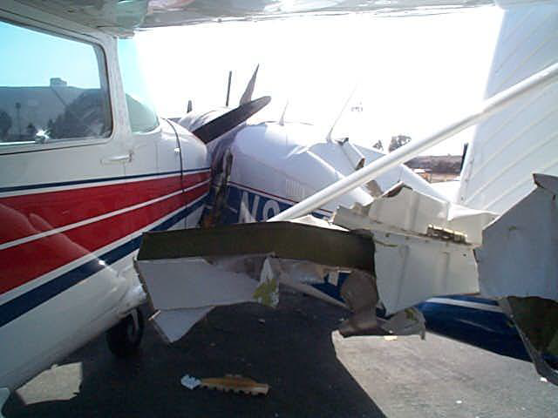
Special Emphasis Areas

Slide 2
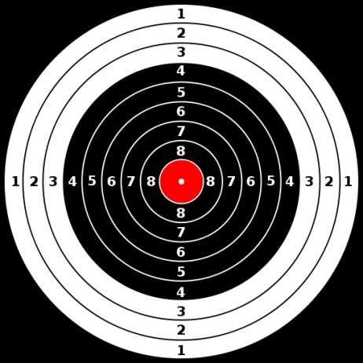
Special Emphasis Areas
Positive aircraft control
Procedures for positive exchange of flight controls (who is flying the airplane)
Stall/Spin awareness
Collision avoidance
Wake turbulence avoidance
Land and hold short operations (LAHSO)

Slide 3
Special Emphasis Areas
Runway incursion avoidance
  Hot spots
Controlled flight into terrain (CFIT)
Aeronautical decision making (ADM)
Checklist usage
Single pilot resource management (SRM)
Icing condition operational hazards, anti-icing and deicing equipment, differences, and approved use and operations

Slide 4
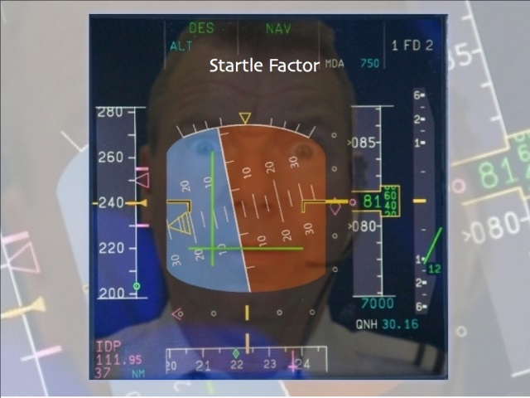
Positive Aircraft Control
Ability of the pilot to continually control the aircraft’s flight path and energy state sufficiently to safely accomplish required tasks within specified tolerances
  Requires situational awareness and taking appropriate actions in response
  Situational awareness - knowing the whole picture and how you fit into that situation.
    Ability to identify, process, and comprehend the critical elements of information about what is happening at a given point in time. It's knowing what is going on around you
  Common factors leading to a loss of situational awareness
    Repetition
    Stress
    Demands from management
    Demands from PIC
    Get there-itis
    Proximity rule
    Peer pressure
    Sophisticated aircraft syndrome
    New situations
    Critical areas
  Ask yourself, "How do these pieces fit together? Is this an important piece? Will it affect another piece of the puzzle? This is the processing and comprehension aspect of situational awareness

Slide 5
Positive Aircraft Control
More easily explained by examples of situations that are NOT positive control
    Rolling the airplane past standard rate while fixated on the wrong instruments, and inadvertently entering a spiral dive
    Allowing your airspeed to decay during a climb and only recognizing it when you feel the stall buffet
    Not adding power following level off from a descent
An instrument pilot is expected to be a perfectionist
  With excellent basic attitudes, skills and positive aircraft control, excellence will become your standard.

Slide 6
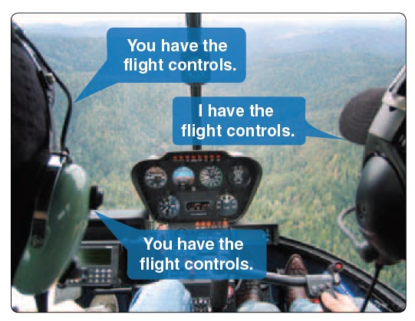
Positive Exchange of Flight Controls
Know Who is Flying the Airplane
Requires use of a positive three-step process whenever the flight controls are exchanged - a “Double Closed-Loop” communication
Verbal process
  The “Initiating” pilot states “I’ve (you’ve) got the flight controls”
  The “non-initiating” pilot repeats “You’ve (I’ve) got the flight controls”
  Lastly the “initiating” pilot repeats “I’ve (you’ve) got the flight controls”
Visually verify that the exchange of the flight controls has actually occurred
Contract - Vitally important in multi-person operations (especially during training and/or checking) that there is always a clear understanding between the crewmembers as to who actually has control of the aircraft

Slide 7
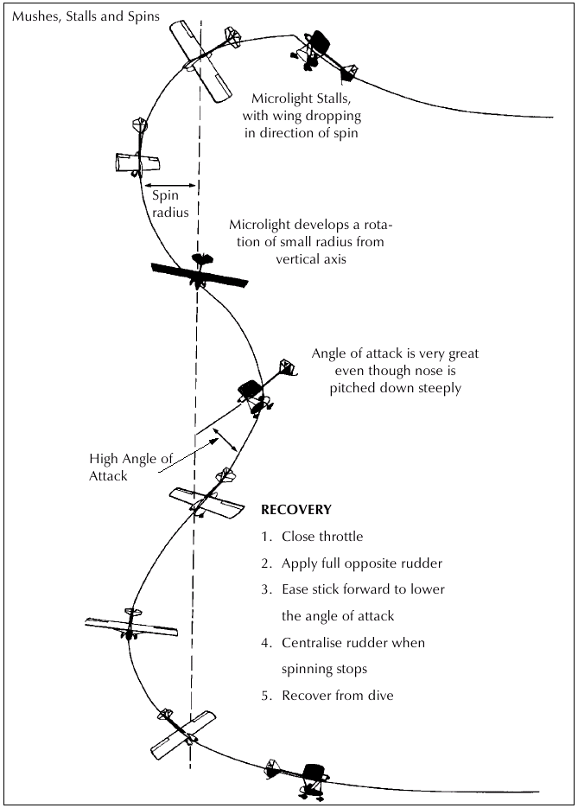
Stall/Spin Awareness
Aerodynamic factors related to spins
Flight situations where unintentional spins may occur
Procedures for recovery from unintentional spins

Slide 8
Aerodynamic Factors Related to Spins
An aircraft must be stalled before it can spin
One wing must be stalled more than the other for autorotation to develop
Aircraft must remained stalled to keep spinning
Autorotation
  The differential in stall amount on each wing also defines the differential in lift from each wing. A stalled wing still generates some amount of lift, just not enough to counter the weight of the airplane
  The low wing in a spin is turning in a smaller radius than the high wing. This creates a differential in angle of attack - the real cause of the spin
  The high, more lift-producing, wing continues to try to roll the airplane
  The resulting loss of vertical lift component drops the nose and a spin is the outcome

Slide 9
Flight Situations Where Unintentional Spins May Occur
Bank angle increased too much while airspeed slows
During a climbing turn when the aircraft is stalled
Any uncoordinated stall
Out of balance flight caused by inducing (or not preventing) yaw with rudder
Distractions may lead to uncoordinated stalls
  Skidding turn from base to final
  Emergency landing situation

Slide 10
Procedures for Recovery From Unintentional Spins
Recovery from a spin in IMC is a stressful affair. No visual indications other than the instruments. Disorientation is highly likely!
Technique
  Attitude indicator may be spinning or may fail altogether. It probably won’t be clear to you which way the airplane is turning. The turn coordinator is critical – one gauge that will save you
  Reduce power to idle to limit acceleration
  Neutralize the ailerons
  Apply full opposite rudder to stop (or slow) the turn
    Notice which wing is up on the turn coordinator and apply rudder to that side
  Push forward on the stick or yoke to reduce the angle of attack and break the stall
  Gently pull up to recover from the resulting dive
  Spin avoidance is the real objective. Don’t get into the predicament to begin with
Try recovery in the Redbird AATD!! It can be eye opening.

Slide 11
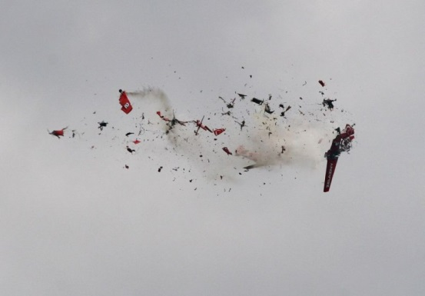
Collision Avoidance
FAR §91.111 and §91.113
You may not operate an aircraft so close to another aircraft to create a collision hazard
Just because you are on an IFR flight plan does not mean you don’t have to see and avoid traffic
  If you are in VMC it is your responsibility to visually scan for and avoid other aircraft
Considerations
  Recommended scanning
  Techniques for spotting traffic
  Visual problems associated with sighting conflicting traffic
  Aircraft “right of way” rules for conflicting traffic
  Proper procedures for uncontrolled airports
  High danger areas

Slide 12
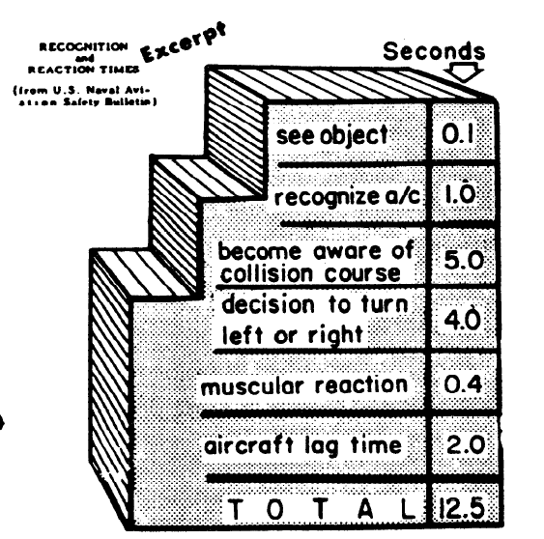
Collision Avoidance
See and Avoid
Remain constantly alert to all traffic movement within your area of operation
  Effective visual scanning
    Periodically scan the entire visual field outside to ensure detection of conflicting traffic
    Eyes may require several seconds to refocus when switching views between items in the cockpit and distant objects
    Effective scanning is accomplished by a series of short, regularly-spaced eye movements that bring successive areas of the sky into the central visual field. Each movement should not exceed 10°, and each area should be observed for at least one second to enable detection.
  Ability to gather information from radio transmissions from ground stations and other aircraft, and
  Creating a mental picture of the traffic situation
The performance of many aircraft, in both speed and rates of climb/descent, result in high closure rates limiting the time available for detection, decision, and evasive action

Slide 13
Collision Avoidance
See and Avoid
Horizontal back-and-forth eye movements seem to be preferred by most pilots - you should develop a comfortable scanning pattern and stick with it
Peripheral vision can be most useful in spotting collision threats from other aircraft, especially when a scan is stopped and the eyes are refocused
  Apparent movement is almost always the first perception of a collision threat
  Most important sight at night is peripheral vision
If another aircraft appears to have no relative motion, it is likely on a collision course with you. If the other aircraft shows no lateral or vertical motion, but is increasing in size, take immediate action to avoid it
Move your head to search around physical obstructions (e.g., door and window posts) which can block your vision of an area
Use all available eyes - other pilots (establish crew procedures) and brief your passengers to help you spot traffic

Slide 14
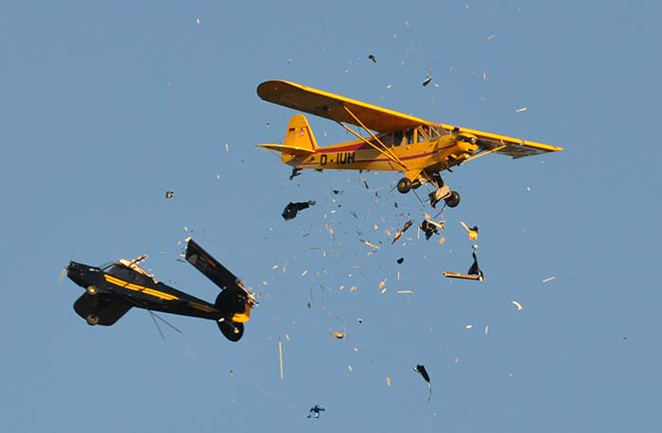
Collision Avoidance
See and Avoid - AIM 8-1-8
Use the horizon to judge altitude of conflicting aircraft
Consider risk of multiple threats
Keep an organized cockpit to permit more scanning time
Keep the windshield clean
Lights on – day or night

Slide 15
Collision Avoidance
Radio Use
Adhere to communications requirements
Use traffic advisory services
Initiate radio contact with the appropriate facility or self-announce before entering the perimeter of the service area or within 15 miles of a facility with no service area or as soon as ATC permits a switch to local frequency
Monitor frequencies of nearby airports and other services, even if not communicating with them
Transponder on
ADS-B system monitoring – but remember gaps

Slide 16
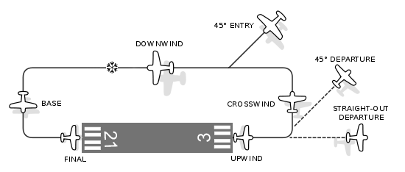
Collision Avoidance
Airport Traffic Patterns
LEFT turns (even on circle to land), unless otherwise published or instructed by ATC
Keep a sharp lookout for other aircraft in the pattern and communicate
Enter the pattern in level flight and allow plenty of spacing to avoid overtaking or cutting any aircraft off
Enter at traffic pattern altitude or circle to land altitude, as applicable
Remember VFR pilots may not know instrument intersections / reporting points

Slide 17
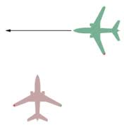
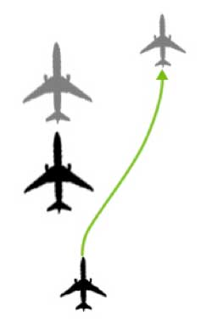
Right of Way Rules
FAR § 91.113
In distress – ROW over everyone else
Least maneuverable has right of way
  Balloon
  Glider
  Airship
  Engine driven aircraft
Converging – aircraft to the other one’s right has the right of way, subject to the maneuverability rules (if you see a red nav light, they have the right of way)
Overtaking – Alter course to the right to pass well clear of the overtaken aircraft
Head-on – Each aircraft should alter their course to the right
Landing
  Aircraft on final approach or landing has the right of way
  Aircraft at the lower altitude has the right of way – but you can’t use the rule to cut in front of another on final approach

Slide 18
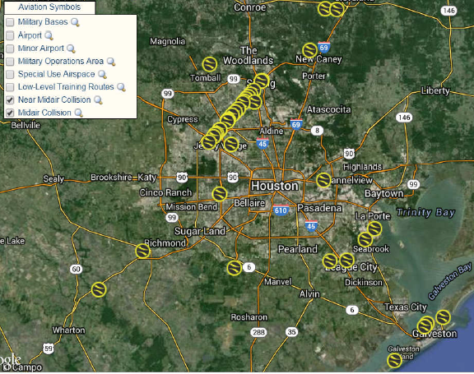
Extra Caution Around High Traffic / Danger Areas
Exercise caution where you may expect to find a high volume of traffic or special types of aircraft operation
  Class B, C and D areas, especially in flyway routes (e.g. I-10 corridor)
  Airport traffic patterns, particularly at airports without a control tower
  Below 3,000 feet AGL within five miles of an airport
  Airways
  Vicinity of VORs
  Other locations aircraft tend to cluster
  Restricted areas
  Warning areas
  Alert areas
  Military Operating Areas (MOA)
  Intensive student training areas
  Military low-level training routes
  Instrument approach areas

Slide 19
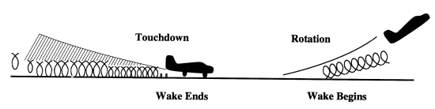
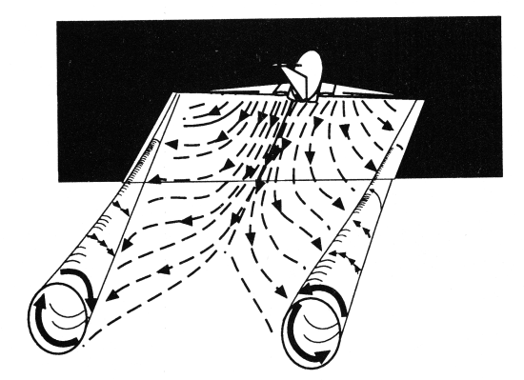
Wake Turbulence Avoidance
Aircraft wake produces counter-rotating vortices trailing from the wing tips
The vortices from larger aircraft pose problems
  Wake can impose rolling moments exceeding the roll-control authority of your aircraft
Visualize the location of the vortex wake generated by larger aircraft and adjust their flight path accordingly
  Vortices sink at a rate of several hundred feet per minute

Slide 20
Wake Turbulence Avoidance
Avoid the area within 100 feet of the vortex core
Note the rotation or touchdown point of the preceding aircraft
  Take off after the touchdown point of wake generator
  Land before the lift-off point of wake generator’s take off point
  When landing behind a wake generator - stay at or above the wake generator's final approach path and land after its touchdown point
  When taking off behind a departing wake generator - Rotate prior to the larger aircraft's rotation point, Continue climbing above the larger aircraft's climb path until turning clear of the aircraft's wake
  Vertical separation of 1,000 feet is generally safe in flight

Slide 21
Wake Turbulence Avoidance
Tailwind conditions can move the vortices of the preceding aircraft forward into the touchdown zone
A light quartering tailwind requires maximum caution - upwind vortex tends to remain in the touchdown zone
Heed “Caution - Wake Turbulence” ATC warning
Air traffic wake turbulence separations based on aircraft size – heavy designation (5 to 6 miles)
Counter control is usually effective and induced roll minimal in cases where the wingspan and ailerons of the encountering aircraft extend beyond the rotational flow field of the vortex

Slide 22

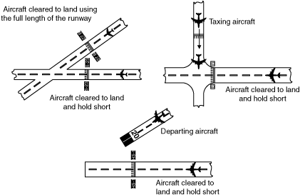
Land and Hold Short Operations (LAHSO)
Considerations
  Locations where LAHSO may be implemented
  Who is eligible to accept a LASHO clearance?
  Who initiates a LAHSO clearance?
  Must you accept a LAHSO?
  How is the landing distance available determined?
  Pilot responsibilities once a LASHO clearance is accepted

Slide 23
Locations Where LAHSO may be Implemented
At towered airports, ATC may clear a pilot to land and hold short of an intersecting runway, an intersecting taxiway, or some other designated point on a runway
Typically a LAHSO operation is initiated by ATC to expedite traffic
Pilots should only receive a LAHSO clearance when there is a minimum ceiling of 1,000 feet and 3 statute miles visibility

Slide 24
Must you accept a LAHSO? Who is Eligible to accept a LASHO clearance
Pilots may accept a LAHSO clearance only if the PIC determines that the aircraft can safely land and stop within the available landing distance
Pilots unfamiliar with LAHSO should not and student pilots cannot participate in LAHSO
The pilot-in-command has the final authority to accept or decline any land and hold short clearance and can decline a LAHSO clearance for any reason
  The PIC must decline a LAHSO clearance if he or she believes it would compromise safety
A LAHSO clearance, once accepted, must be adhered to, just as any other ATC clearance, unless an amended clearance is obtained or an emergency occurs. A LAHSO clearance does not preclude a rejected landing

Slide 25
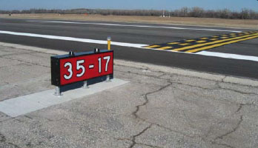

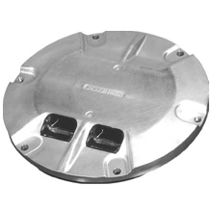
LAHSO Signage
Yellow hold-short markings prior to the intersecting runway or taxiway
Holding position signs on both sides of the runway adjacent to the runway hold lines
Red and white signage on both sides of the runway
In-pavement lighting
  Row of six or seven in-runway pavement unidirectional pulsing white lights that visually indicate the location of a LAHSO point on a runway. Lights will be on when LAHSO is in effect and off when LAHSO is not in effect

Slide 26
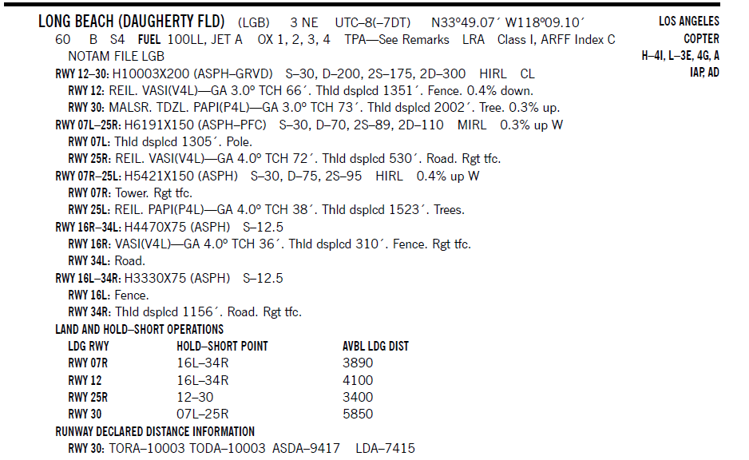
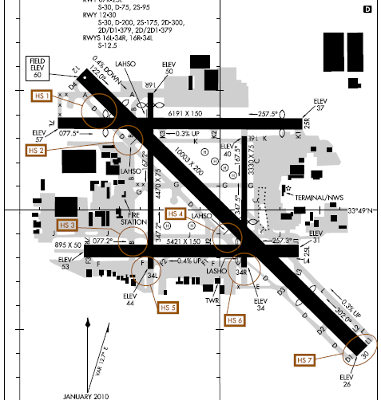
LAHSO – Published Data
Situational awareness is vital to the success of LAHSO. Situational awareness starts with having current airport information in the cockpit, readily accessible to the pilot. (An airport diagram assists in identifying your location on the airport)

Slide 27
LAHSO Operations
To conduct LAHSO, pilots should become familiar with all available information concerning LAHSO at their destination airport
Should have, readily available:
  Published available landing distance (“ALD”) (in AFD)
  Runway slope information for all LAHSO runway combinations at each airport of intended landing (in AFD)
  Knowledge about landing performance data (in POH)
  As part of a pilot's preflight planning process, pilots should determine if their destination airport has LAHSO
    Assess which LAHSO combinations will work given their aircraft's required landing distance
    Good pilot decision making is knowing in advance whether one can accept a LAHSO clearance if offered

Slide 28
How is the LAHSO Landing Distance Available Determined
ALD is that portion of the runway available for landing and rollout for an aircraft cleared to land and hold short
  Distance is measured from the landing threshold to the hold-short point
ATC is required to provide ALD on the ATIS, and when requested
PIC is responsible for determining the required landing distance (RLD) for his / her aircraft and ensuring that it does not exceed the ALD.

Slide 29
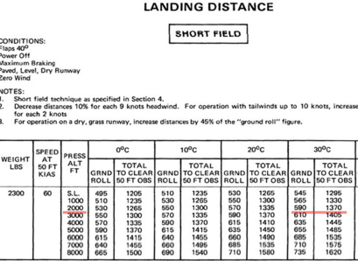
How is the LAHSO Required Landing Distance Determined
RLD is:
  POH chart distance over a 50-foot obstacle plus 1,000 feet
  Payload 6,000 lbs or greater or 20 seats or more, must add 60% to AFM distance
Required landing distance = 1,370’ + 1,000’ = 2,370’

Slide 30
LAHSO - ATC Communications
LAHSO information will be on ATIS
  ALD will be included in the ATIS
When ATIS is acknowledged to ATC, PIC should advise ATC if LAHSO cannot be accepted
If ATC gives you a LAHSO clearance, ATC needs a full read back that includes the words, “HOLD SHORT OF (RUNWAY/TAXIWAY/POINT)”

Slide 31
Pilot Responsibilities Once a LASHO Clearance Accepted
A pilot who accepts a LAHSO clearance must adhere to it, unless he or she obtains an amended clearance
If a rejected landing becomes necessary after accepting a LAHSO clearance, the pilot must maintain safe separation from other aircraft / vehicles and notify ATC as soon as possible

Slide 32
REJECTED LAHSO LANDINGS
A rejected landing must be initiated within the first third of the ALD or 3,000 feet, whichever is less
On go around, heading and/or altitude assignments must be flown as published (if published) until directed otherwise by ATC
  Some airports have specific rejected landing procedures – set out in AFD

Slide 33
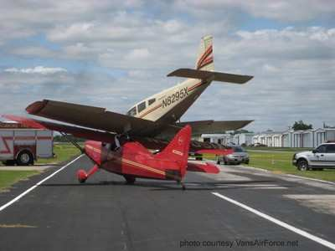
Runway Incursion Avoidance
Pilots should have a functional knowledge of at least the following:
  Runway and Airport signage and marking
  Proper Radio Procedures (for both controlled and uncontrolled airports)
  Possess and use a current airport diagram
  Maintain proper vigilance for conflicting traffic (both aircraft and ground vehicles)
  Airport “right of way” rules
  Use external aircraft lighting (especially when using or transiting airport runways)

Slide 34
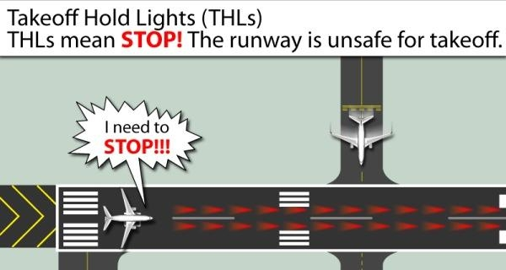
Runway Incursion
A runway incursion is the incorrect presence of an aircraft, vehicle or person on the protected area of a runway
Take off Hold Lights

Slide 35

Runway Incursion
Hot Spots
A hot spot is a location with a history of potential risk of collision or runway incursion, and where heightened attention is necessary
Aircraft movements should be planned and coordinated with ATC, for another layer of safety
Identification of hot spots helps avoid confusion by eliminating last-minute questions and building familiarity with known problem areas

Slide 36
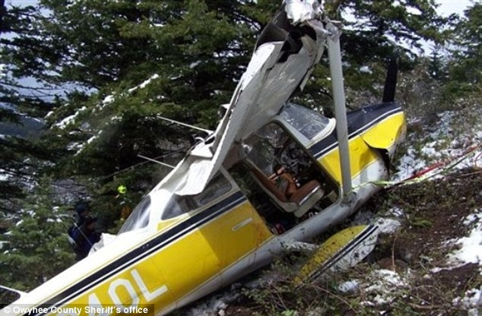
Controlled Flight Into Terrain (CFIT)
Controlled flight into terrain (CFIT) accidents and incidents are those in which an aircraft, under the control of the crew, is flown into terrain (or water) with no prior awareness on the part of the crew of the impending disaster
CFIT accounts for 17% of all GA fatalities
  More than half of the CFIT accidents occurred during IMC

Slide 37
CFIT
Scud Running
Get complete weather information, understand the significance of the weather information, and be able to correlate your skills and training, aircraft capabilities, and operating environment with an accurate forecast
Continued flight in reduced visual conditions compounded by night operations and/or overwater flight poses risks
  VFR pilots in reduced visual conditions may develop spatial disorientation and lose control, possibly going into a graveyard spiral, or descend to an unsafe altitude while trying to maintain visual contact with the surface

Slide 38
CFIT
Scud Running
CFIT risks associated with scud running
  Loss of aircraft control.
  Loss of situational awareness
  Reduced reaction time to see and avoid rising terrain or obstacles
  Inability of the pilot to operate the aircraft at its minimum controllable airspeed
  Getting lost or being off the preplanned flight path and impacting terrain or obstacle
  Reduced pilot reaction time in the event of an aircraft maintenance problem because of a low or lowering altitude
  Failure to adequately understand the weather conditions that resulted in the reduced conditions
  Breakdown in good aeronautical decision making
  Failure to comply with appropriate regulations
  Failure to comply with minimum safe altitudes
  Increased risk of hitting towers, especially along major highways
  Failure to turn around and avoid deteriorating conditions when first able

Slide 39
CFIT in IMC Conditions on an IFR Flight
Pilot must be qualified, current, and proficient for the intended flight
Aircraft must be properly equipped for the flight
Must have the proper charts and approach plates for the intended flight
  VFR charts, although not required, should be onboard as they can provide important obstacle and terrain data for an IFR flight
Knowing the planned procedure well enough to know if ATC is issuing an unsafe clearance or if the pilot flying is not following the published procedure
If in a crewed aircraft, both pilots have adequately briefed the flight and operation of the aircraft, including shared responsibilities
Have complete weather data for the flight, including knowing where visual meteorological conditions exist or a safe alternative is since many GA aircraft flown IFR have limited range or speed to fly out of un-forecasted weather conditions
Importance of maintaining situational awareness, both horizontal and vertical, throughout the flight to avoid flying into hazardous terrain or known obstacles

Slide 40
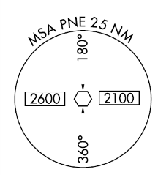
CFIT in IMC Conditions on an IFR Flight
Have complete knowledge on how to operate all aircraft equipment. This includes the limitations and operations of the navigation equipment
Follow FAA and industry recommended crew resource management principles. If a single-piloted flight, the pilot knows to use all available resources including air traffic control to help ensure a safe flight as well as any onboard resource such as a passenger or onboard charts or manuals
Pilot in command must follow rules for making a missed approach and be prepared to make a missed approach when conditions fall below minimums, or the approach becomes destabilized
Knowledge of minimum safe or sector altitudes and of the highest terrain in the area

Slide 41
CFIT in IMC Conditions on an IFR Flight
Pilot in command must be aware of the risks involved when transitioning from visual to instrument or from instrument to visual procedures on takeoff or landing
  Spatial disorientation
  Not uncommon for pilots to try to continue flying by visual reference when references are inadequate - In so doing, the pilot leans forward toward the windshield and inadvertently moves the yoke slightly forward causing the airplane to descend
  Estimations of flight visibility can be off
Pilot in command should use all available safety equipment installed in the aircraft and on the ground
Pilot in command should be aware of the risks involved in setting the aircraft's altimeter including inherent limitations of barometric altimeters

Slide 42
CFIT in IMC Conditions on an IFR Flight
Knowing the air traffic control system well enough to be proficient in it
Knowing when not to fly
Properly using an installed autopilot, if so equipped, to reduce workload
Proper use of checklists before reaching 1,000 feet AGL to minimize distractions when close to the ground
The importance of flying a stabilized approach (maintaining a stable speed, descent rate, vertical flightpath, and configuration throughout the final segment of the approach). The idea is to reduce pilot workload and aircraft configuration changes during the critical final approach segment of an approach. The goal is to have the aircraft in the proper landing configuration, at the proper approach speed, and on the proper flightpath before descending below the minimum stabilized approach height. The following are recommended minimum stabilized approach heights
  (1) 500 feet above the airport elevation during VFR weather conditions
  (2) MDA or 500 feet above airport elevation, whichever is lower, for a circling approach
  (3) 1,000 feet above the airport or touch down zone elevation during IMC

Slide 43
CFIT in IMC Conditions on an IFR Flight
Increased CFIT risk on non-precision approaches
Increased CFIT risk on high descent rates near the ground
The importance of good communications between the pilot and air traffic control concerning any flight instruction or clearance
The dangers of complacency for the single-pilot, as well as multi-piloted crews, when making routine flights
The dangers of misunderstanding air traffic control instructions or accepting an incorrect clearance
  Ask for clarification whenever in doubt about any instruction or clearance
The dangers of not knowing the safe altitudes for your en-route as well as your terminal area

Slide 44
CFIT in IMC Conditions on an IFR Flight
The most obvious way to avoid flying from cumulus into cumulo-granite is to be aware of and abide by all published minimum altitudes. Especially during approaches. Know where you are and where Mother Earth is at all times
When terrain elevations change frequently and quickly, it can become very challenging

Slide 45
CFIT Stupidity - Low-flying Aircraft Operating In VFR Conditions
This is a special category for those pilots flying below minimum safe altitudes
Some common low altitude CFIT factors are:
  Windshear and loss of flying speed
  Density altitude
  Failure to operate aircraft within operating limitations
  Failure to check an area from a safe altitude before descending into it (high reconnaissance and low reconnaissance)
  Flying between hills or over rivers below hill tops can result in a CFIT accident if a power line or cable is strung between the hills. Not all such lines are marked or charted
  Flying up a box canyon and not being able to fly up and out of it before impacting terrain
  Flying over rising terrain that exceeds an aircraft's ability or performance to climb away from the terrain
  Errors in pilot judgement and decision making

Slide 46
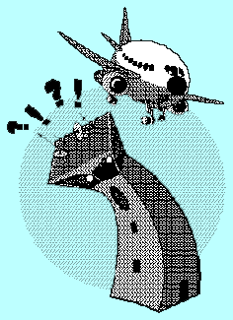
CFIT Stupidity - Low-flying Aircraft Operating In VFR Conditions
  Diversion of pilot attention
  Buzzing
  Crew distractions or a breakdown in crew resource management
  Operating in an unsafe manner
  Failure to maintain control of the aircraft when taking off or landing
  Failure to properly pre-plan the flight
  Operating in unfamiliar areas or depending upon untrained people to provide important flight data
  Not having an objective standard to make go-no go decisions for launching
  Failure to review all available data for the flight
  Lack of terrain knowledge and elevation of the highest obstacles within your immediate operating area
  Failure to properly plan a departure route when departing from unprepared areas such as helicopters or aircraft operating off an airport. Such factors include weight and balance, aircraft performance, height of obstacles, wind direction, trees, density altitude, rising terrain, length of takeoff area, and safe abort areas

Slide 47
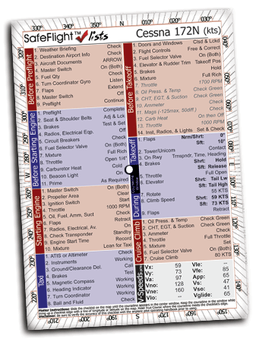
Checklist Usage
Aircraft checklist is a foundation of pilot standardization and cockpit safety – USE THEM
Improper use, or non-use, of checklists is a major contributing factor to aircraft accidents
Can use the checklist to do the items or to check that they’ve been done – best practice depends on circumstances and personality

Slide 48
Aeronautical Decision Making (ADM)
ADM is a systematic approach to the mental process of evaluating a given set of circumstances and determining the best course of action
There is no one right answer in ADM, rather each pilot is expected to analyze each situation in light of experience level, personal minimums, and current physical and mental readiness level, and make his or her own decision

Slide 49
Aeronautical Decision Making (ADM)
3P Model
Perceive – Process – Perform
  Perceive the “given set of circumstances” for your flight
  Process by evaluating the circumstances impact on flight safety
  Perform by implementing the best course of action

Slide 50
Aeronautical Decision Making (ADM)
Perceive
Develop a clear and comprehensive awareness of your particular situation - For each element, ask “what could hurt me, my passengers, or my aircraft”
PAVE Model
  Pilot in command
  Aircraft
  enVironment
  External pressures

Slide 51
Aeronautical Decision Making (ADM)
Process
Mentally process information about the circumstances that you have perceived / identified. The goal is to evaluate their impact on the safety of your flight, and consider “why must I CARE about these circumstances?”
  Consequences (e.g., departing after a full workday creates fatigue & pressure)
  Alternatives (e.g., delay until morning; reschedule meeting; drive)
  Reality (e.g., dangers and distractions of fatigue could lead to an accident)
  External pressures (e.g., business meeting at destination might influence me)
Good rule of thumb for the processing phase: if you find yourself saying that it will “probably” be okay, it is definitely time for a solid reality check

Slide 52
Aeronautical Decision Making (ADM)
Perform
Once you have perceived a hazard (step one) and processed its impact on flight safety (step two), it is time to PERFORM by taking the best course of action, and then evaluating its impact
  Mitigate or eliminate the risk
  Evaluate the outcome of your actions

Slide 53
Aeronautical Decision Making (ADM)
Common Errors in ADM
“Pilot error,” is an action or inaction that leads to a deviation from intentions and expectations
  Deficiencies in pilot’s ability to control aircraft
  Deficiencies in pilot’s "mental airplane" systems knowledge
  Decision errors or human limitations
    Filtering: Brain's working capacity is limited to about seven chunks, of information at one time, so we filter the flood of information arriving through our senses thus may unconsciously screen out vital information
    Filling in the Gaps: When there is more information than the brain can accurately perceive and process, it compensates by filling in the gaps and producing an interpretation that is not correct
    Patterns and Expectations: The brain uses existing knowledge and experience as a shortcut to processing new information. This tendency can be useful, but it can also be dangerous

Slide 54
Aeronautical Decision Making (ADM)
Common Errors in ADM
    Confirmation Bias: Human beings also have a tendency to look for information that confirms a decision we have already made. E.g., you might unconsciously give more weight to the information that supports your decision to press ahead
      Make a conscious effort to identify your expectations, and then be alert to how reality differs
    Framing: When you evaluate options for a decision, be sensitive to how you state, or "frame," your alternatives. If you frame the “continue flight” decision in positive terms you are probably more likely to decide on continuing. If, on the other hand, you frame the decision in negative terms (e.g., “I could get myself in real trouble if I push on”), you are more likely to divert to a safer destination.

Slide 55
Aeronautical Decision Making (ADM)
Decision Making – DECIDE Model
  Detect – that change has occurred
  Estimate – need to correct or react
  Choose – a course of action
  Identify – solution
  Do – the necessary action
  Evaluate – the effect of the action

Slide 56
Single Pilot Resource Management (SRM)
SRM is the art of managing all the resources (both onboard the aircraft and from outside sources (e.g., ATC and flight service stations ) available to a pilot prior to and during flight - to gather information, analyze it, and make decisions to ensure a successful flight
SRM includes the concepts of aeronautical decision-making (ADM), risk management, CFIT awareness, and situational awareness
SRM training helps the pilot maintain situational awareness by managing automation, associated aircraft control, and navigation tasks
This enables the pilot to accurately assess hazards, manage resulting risk potential, and make good decisions
SRM helps pilots develop methods of gathering information, analyzing it, and making decisions

Slide 57
Single Pilot Resource Management (SRM)
Recognition of hazards
  Understanding the risk
    Pilot needs to ask key questions
  Understanding the potential impact upon safety of the flight
  Interpreting information received about the risk correctly
  Implement risk mitigation strategy
    Good decision making

Slide 58
Single Pilot Resource Management (SRM)
Use of resources
  To make informed decisions during flight operations, a pilot must also become aware of the resources in and outside the plane
  Useful tools and sources of information may not always be readily apparent, learning to recognize these resources is important
  Pilot must also have the skills to evaluate when to use a particular resource and the impact its use has upon the safety of flight

Slide 59
Single Pilot Resource Management
Internal Resources
Ability to manage workload is the most valuable resource a pilot has
Passengers even those with no flying experience can help (verbal help, help reading charts, etc)
Verbal communication reinforces an activity - even if talking to yourself. Touching also helps
Pilot should have a thorough understanding of aircraft equipment and systems to help make good decisions
Checklists
Pilot’s operating handbook (POH)

Slide 60
Single Pilot Resource Management
External Resources
ATC – assistance not only decreases pilot workload, but also helps pilots make informed inflight decisions. ATC can provide:
  traffic advisories
  Radar vectors
  assistance in emergency situations
  Direction finding equipment
Flight Service
  En Route Flight Advisory Service (Flight Watch)
  Assist lost aircraft and aircraft in emergency situations - DF

Slide 61
Single Pilot Resource Management
5P Check
5 Ps are:
  Plan - basic elements of cross-country planning: weather, route, fuel, current publications, etc.
  Plane
  Pilot
    “IMSAFE” checklist
    Proficiency
    Currency
  Passengers and their capabilities - can read checklists, verify PIC performance of an action, re-verify that the gear is down and the lights are on, look for other aircraft, and even tune radios
  Programming
    Automation tends to capture the pilot’s attention and hold it for long periods of time
    Plan ahead and know the equipment and buttonology

Slide 62
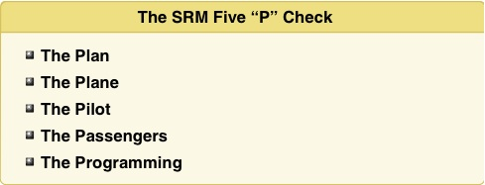
Single Pilot Resource Management
5P Check
5 Ps are used to evaluate the pilot’s current situation at key decision points during the flight or when an emergency arises
  Key decision points include preflight, pre-takeoff, hourly or at the midpoint of the flight, pre-descent, and just prior to the final approach fix or for VFR operations, just prior to entering the traffic pattern
Theory is that pilots have essentially five variables that impact their environment and can cause the pilot to make a single critical decision or several less critical decisions that when added together can create a critical outcome
Each of the 5 Ps can be either a help or a hindrance depending upon circumstances

Slide 63
Icing
There is a lot to consider in this area - See the Icing Presentation that is available on the same web page as this PowerPoint. That presentation fully covers icing conditions, operational hazards, anti-icing and deicing equipment, differences, and approved use and operations.

Slide 64


Slide 65
Disclaimer
Instrument flight can be dangerous. Do not rely solely on this presentation – PROFESSIONAL INSTRUCTION IS REQUIRED
The foregoing material should not be relied upon for flight
ALTHOUGH THE ABOVE INFORMATION IS FROM SOURCES BELIEVED TO BE RELIABLE SUCH INFORMATION HAS NOT BEEN VERIFIED, AND NO EXPRESS REPRESENTATION IS MADE NOR IS ANY TO BE IMPLIED AS TO THE ACCURACY THEREOF, AND IT IS SUBMITTED SUBJECT TO ERRORS, OMISSIONS, CHANGE

