Slide 1
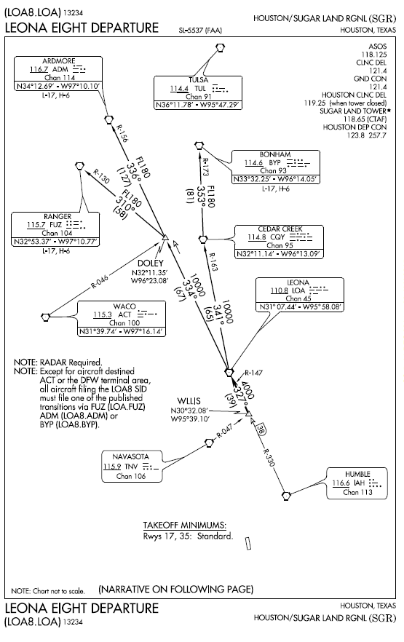
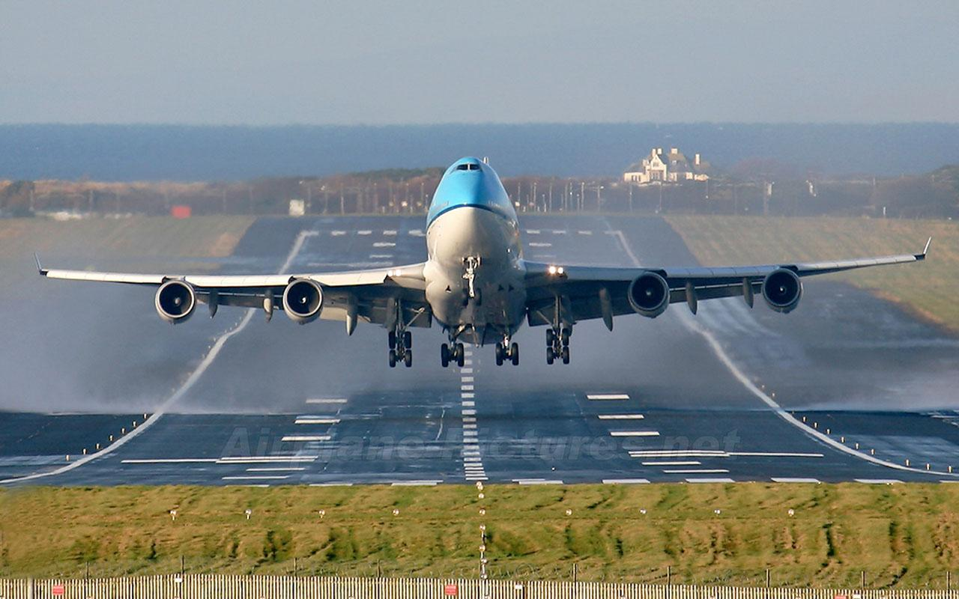
Departure Considerations

Slide 2
Departure Checklist
Initial obstacle clearance is largely up to YOU
Consider the terrain
Look at the sectional map and approach plates
Ask the locals
Check for a departure procedure (DP)
Consider if there are any climb gradients on the DP’s. If the gradient is too great, the time to find out is when your on the ground
Departure phase is over when:
ATC vectors you off a DP, unless otherwise advised by ATC
You reach an enroute fix

Slide 3
Departure Types
Diverse Departure
Obstacle Departure Procedure (ODP)
Standard Instrument Departure (SID)
Specific ATC Departure Instructions (includes Radar Vectors)
VFR departure to commence IFR enroute

Slide 4
Diverse or Omnidirectional Departure
Diverse departures are NOT published or noted generally
This departure capability is indicated by the absence of any other Obstacle Departure Procedure
With a diverse departure you can depart in any direction so long as you can climb 200’/NM
Any obstacle in the 40:1 plane will cause FAA to publish an ODP
As with other departures, you must climb to 400’ above the departure end of the runway elevation straight ahead (drift corrected). Thereafter can turn in shortest direction to your first fix

Slide 5
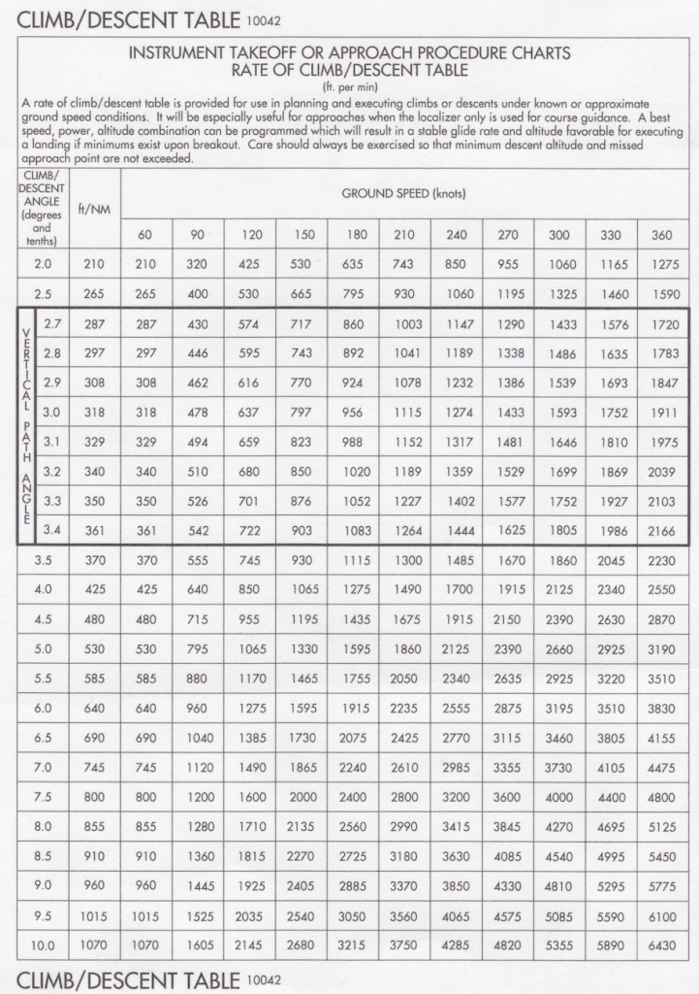
200’/NM Computation
Inside back cover of
TERPS

Slide 6
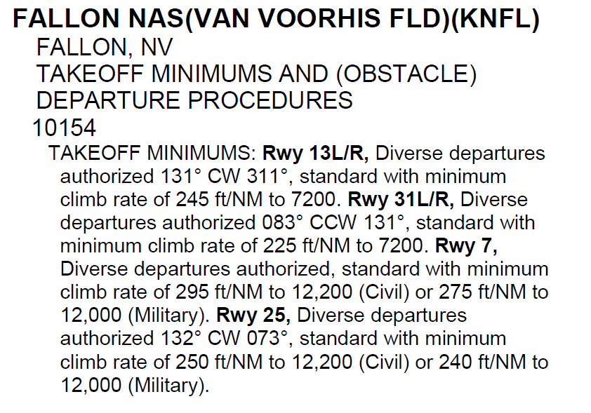
Diverse or Omnidirectional Departure
Diverse Vector Areas – if the diverse departure area is not 360°, the FAA will develop diverse vector areas
Diverse departure may have a published minimum climb requirement >200’/NM
DPs are listed by airport in the IFR Takeoff Minimums and (Obstacle) Departure Procedures Section, Section L, of the Terminal Procedures Publications

Slide 7
Obstacle Departure Procedure ODP
An ODP is a published departure procedure designed for obstacle avoidance during takeoff and climb, especially in a nonradar environment without vectors from air traffic control.
Generally it is a textual description, but can refer to a SID. An ODP can also be published as a graphic procedure. If the ODP is published as a graphic procedure, its name will be listed
Graphic obstacle DPs will include the term "(OBSTACLE)" included in the procedure title; e.g., TETON TWO (OBSTACLE).

Slide 8
Obstacle Departure Procedure ODP
ODPS are available
In the FAA terminal procedures publication, ODPs are located in a separate section at the front of the book. They are published with the takeoff minimums.
The existence of a textual ODP is indicated by the “T” symbol in a black triangle on FAA approach plates.
Jepp puts ODPs on the same page as the airport’s instrument approach procedures
Electronic flight bag (EFB) apps include ODPs as part of the subscription data.

Slide 9
Obstacle Departure Procedure ODP
Unlike with a standard instrument departure (SID), you do not need a clearance from ATC to fly an ODP.
If you plan to fly the ODP, you can note that in the remarks section of the flight plan
The textual ODP will only be assigned when required for traffic separation purposes by ATC
If not issued, you need not to fly the ODP, even in IMC conditions
Absent good reason, you should use the ODP
If not specifically assigned an ODP, SID, or radar vector as part of an IFR clearance, an ODP may be required to be flown for obstacle clearance, even though not specifically stated in the IFR clearance.
If you fly an unassigned ODP, ATC should be informed when the ODP being used contains a specified route to be flown, restrictions before turning, and/or altitude restrictions.

Slide 10
Obstacle Departure Procedure ODP
Some ODPs, which are established solely for obstacle avoidance, require a climb in visual conditions to cross the airport, a fix, or a NAVAID in a specified direction, at or above a specified altitude. These procedures are called Visual Climb Over Airport (VCOA) procedures.
To ensure safe and efficient operations, the pilot must verbally request approval from ATC to fly the VCOA when requesting their IFR clearance.
At some locations where an ODP has been established, a diverse vector area (DVA) may be created to allow radar vectors to be used in lieu of an ODP.
DVA information will state that headings will be as assigned by ATC and climb gradients, when applicable, will be published immediately following the specified departure procedure.

Slide 11
Obstacle Departure Procedure ODP
If an obstacle penetrates the 40:1 obstacle identification plane, the procedure will have:
A steeper climb gradient
Increased takeoff minima
A specific route
A combination of all
Many ODPs direct a pilot to a point from which diverse flight to the en-route structure can commence
The 40:1 obstacle plane begins at the departure end of the runway and slopes upward at 152' per NM until reaching minimum IFR altitude or entering the en-route structure
The area is limited to 25 NM in non-mountainous areas
The area is limited to 46 NM in mountainous areas
The pilot is then responsible for his own navigation on an assigned altitude or MEA/MOCA

Slide 12
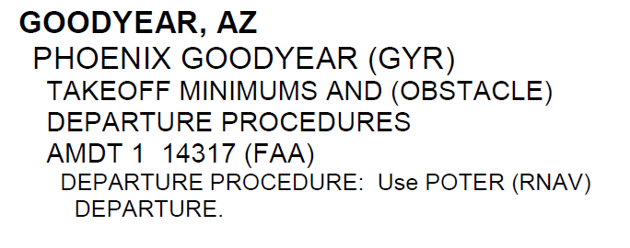
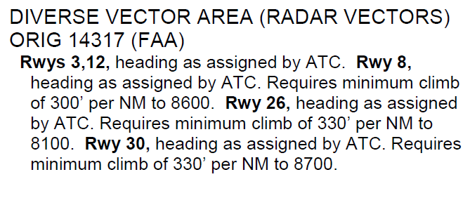
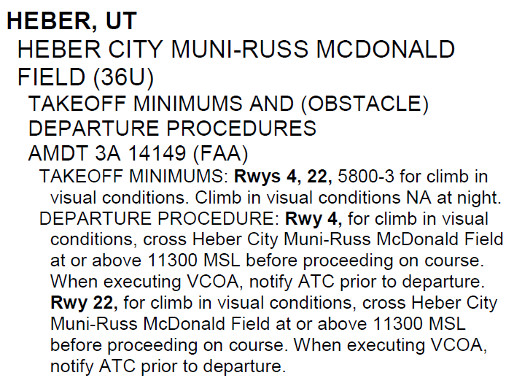
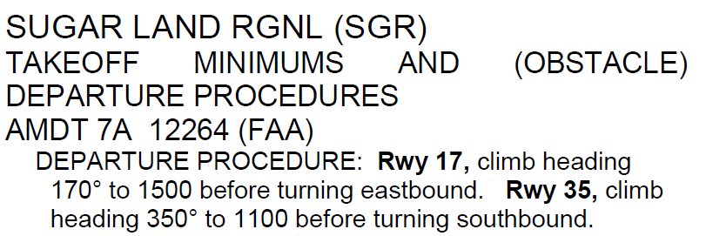
Obstacle Departure Procedure ODP

Slide 13
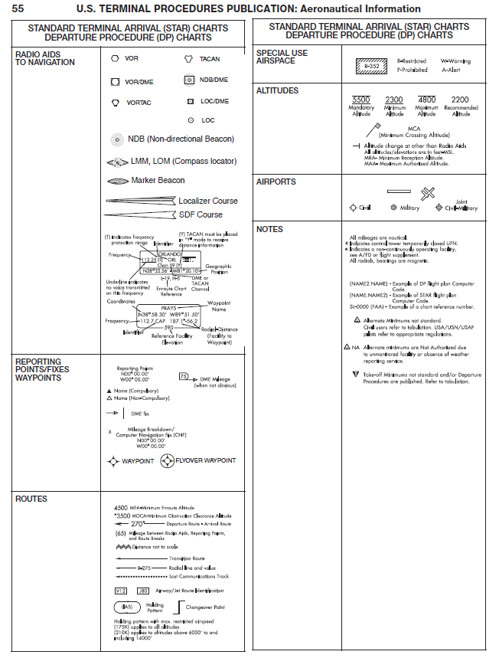
Reading the ODP / SID Chart
You can decode the symbology on a SID / ODP by referring to the legend at the beginning of the TPP.

Slide 14
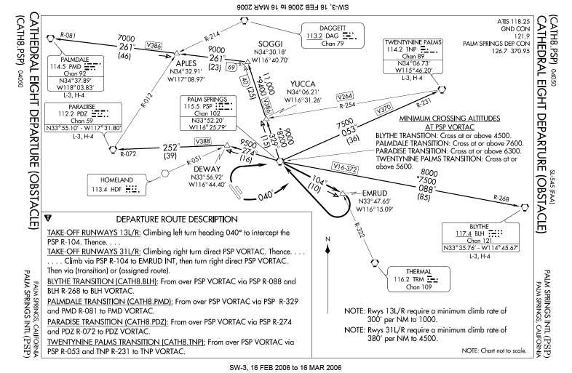
Obstacle Departure Procedure ODP

Slide 15
Low Close-In Obstacles
Located within 1 NM of the departure end of the runway
ODPs and SIDs do not provide protection from these obstacles
Purpose of the note in the textual or graphic description is to avoid excessive climb rates – while allowing the pilot to maneuver around these obstacles

Slide 16
Standard Instrument Departure SID
SIDS are preplanned IFR procedures which expedite departures and provide obstruction clearance from the terminal area to the appropriate enroute structure
SIDS simply clearance delivery and departure communications
A SID may be issued by name in an IFR clearance or requested by the pilot in the flight plan
Pilots do not have to accept a SID, but must advise ATC
Can do so when receiving a clearance, but better practice is to put “No SID” in the remarks section of the flight plan
SIDs ensure a safe climb out from an airport and provide separation between aircraft
ATC clearance must be received prior to flying a SID – differs from an ODP
Pilots are strongly encouraged to file and fly a DP at night, during MVFR conditions and in IMC, when one is available
RNAV SIDs must be retrievable by the procedure name from the aircraft database and conform to charted procedure - Can’t just go “direct” point to point

Slide 17
Standard Instrument Departure SID
SIDS are published in TERPS booklets along with approaches for an airport
Always printed graphically
It is the approved ATC departure route clearance required in the event of radio failure
A period (.) after a sentence means you will not proceed any further until you have accomplished this instruction

Slide 18
Standard Instrument Departure SID
If you accept a SID you must comply with all specified routings, altitudes, and specific restrictions
SIDs must be followed regardless of weather conditions, unless a deviation is approved by ATC
SID clearance from ATC will include both the departure name and transition (e.g., Joe Pool Nine Departure, College Station Transition).

Slide 19
Departure Categories
Pilot Nav
Pre-published routes that supply headings, altitudes, and reporting points for the transition from takeoff to the en-route structure.
Require minimal controller interaction and may provide multiple transitions for different initial routes
May require some initial ATC vectoring
You will leave the departure (heavy line) route at an assigned transition point
Departure transitions (lighter line) at assigned route
The DP must be discontinued to accommodate weather or traffic conditions
Amendments may be issued by ATC for route, but more frequently for altitudes
Published procedure is divided into a graphic section and a textual description section
Vector
Radar vectors will be provided by ATC
Similar to a radar departure
More flexible than a pilot nav SID for traffic, weather avoidance, or other restrictions
More ATC interaction – e.g., providing and acknowledging all altitudes, headings, and altimeter settings
Altitude deviations do not relieve the pilot from flying the route
Published procedure is divided into a graphic section and a textual description section

Slide 20
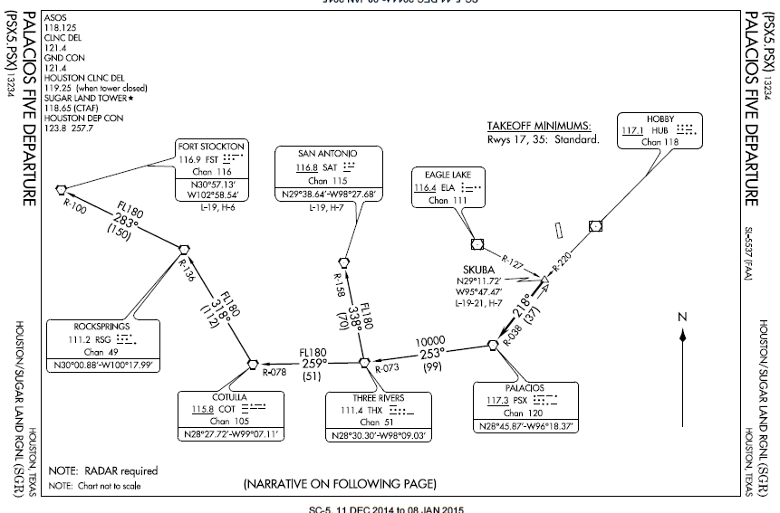
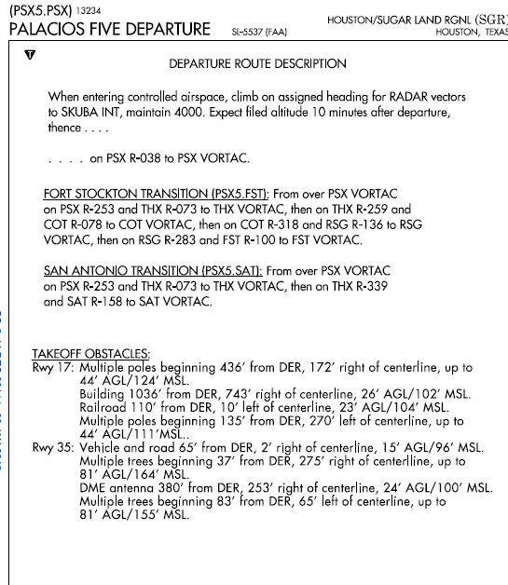
Standard Instrument Departure Pilot Nav SID
Graphic Description
Heavy line – pre transition
Textual Description
Radial line and value
Transition Route
Lighter line - Transition
Low Close-in
Obstacles -
1NM of the DER
Departure Route

Slide 21
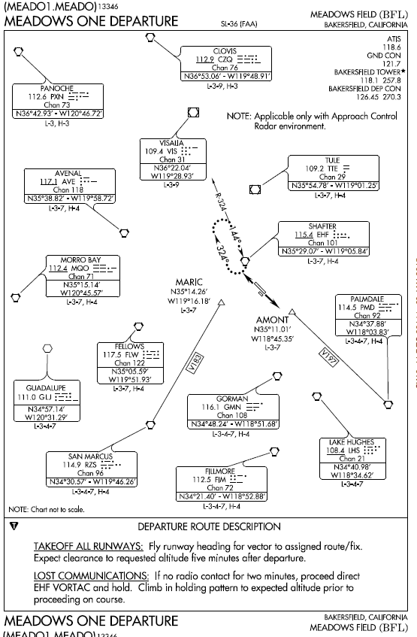
Standard Instrument Departure Vector SID
Graphic Description
Note that there are generally no route lines, except for a few transitions
Textual Description

Slide 22
SID / Transition Selection
Select a SID that:
Most closely aligns with your route of flight
For which you can meet the altitude, speed and equipment requirements
Procedural notes may include:
Aircraft equipment requirements (RNAV, DME, ADF, etc.)
ATC equipment in operation (radar)
Minimum climb requirements
Restrictions for specific types of aircraft (turbojet only)
Limited use to certain destinations
Transition routes fan out in various directions from the end of the basic SID to allow pilots to choose the transition route that takes them in the direction of intended departure
When filing a SID for a specific transition route, include the transition in the flight plan, using the correct departure and transition code

Slide 23
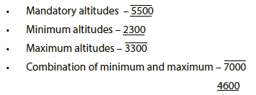
SID Altitudes
SID altitudes can be charted in four different ways
ATC can amend altitudes

Slide 24
SID Clearances
Must be familiar with the application of these types of clearances:
“Climb Via/Descend Via”
Climb/Descend Via “Except Maintain”
Climb/Descend “and Maintain”
“Climb and Maintain” or “Descend and Maintain”
Speed Phraseology

Slide 25
SID Clearances
“Climb Via” (AIM 5-2-8 e 4)
ATC clearance that requires compliance with a SID’s lateral path, speed restrictions and altitude restrictions until reaching the “Top Altitude” published on the SID
“Descend Via”
ATC clearance that requires compliance with a STAR’s lateral path and associated speed restrictions and provides a pilot-discretion descent to comply with published altitude restrictions until descending to the “Bottom Altitude”

Slide 26
SID Clearances
Climb Via/Descend Via Except Maintain”
Execute the SID’s Climb Via clearance to an ATC assigned “Top Altitude”
Execute a STAR’s Descend Via clearance to an ATC assigned “Bottom Altitude”
“Climb and Maintain” or “Descend and Maintain”
Vacate current altitude and commence an unrestricted climb/descent to comply with the clearance
For aircraft already climbing via a SID, or descending via a STAR, published altitude restrictions are deleted unless re-issued by ATC
Speed restrictions always remain in effect unless the controller explicitly cancels or amends the speed restrictions

Slide 27
SID Clearances
“Comply With Restrictions”
Requires aircraft joining or resuming a SID or STAR to comply with published restrictions
Used in lieu of reissuing individual restrictions
An ATC clearance that includes an IFR departure procedure
Is a clearance to fly the depicted route & assigned transition
Is a clearance requiring compliance with published speed restrictions
However, altitude assignment & vertical navigation is a separate clearance

Slide 28
SID Clearances
Receipt of a “Maintain” or “Climb & Maintain” altitude clearance means:
All published altitude restrictions are canceled
all published speed restrictions remain in effect

Slide 29
SID Speed Restrictions
“Climb Via” or “Descend Via”
Absent any qualifying instructions, issuance of a climb or descend via clearance cancels any previously issued ATC speed adjustment and provides pilot discretion to adjust speed while requiring compliance with upcoming restrictions. Where there are no upcoming speed restrictions, issuance of a “Proceed direct (WP name), climb via ....” cancels a previously issued speed adjustment and authorizes speed at pilot's discretion as appropriate for the phase of flight
ATC may require compliance with a previous ATC-issued speed adjustment using phraseology:
“Proceed direct XXXXX, maintain 100 knots until XXXXX, then descend via the XXXXX arrival, landing north”
Where there are no upcoming speed restrictions, issuance of a “Proceed direct (WP name), climb/descend via ....” cancels a previously issued speed adjustment and authorizes speed at pilot's discretion as appropriate for the phase of flight, ensuring compliance with 14 CFR 91.117 (e.g. 250kts <10,000’; 200ktsbelow B, within 4 nautical miles of the primary airport of a Class C or Class D airspace)

Slide 30
SID Speed Restrictions
“Resume Normal Speed”
Cancels ATC speed restrictions and allows pilot to return to normal aircraft speed where no restrictions are published on the procedure/route currently being flown
It does not delete speed restrictions on upcoming segments of flight (e.g. a SID / STAR later in the flight)
This does not relieve the pilot of those speed restrictions which are applicable to 14 CFR Section 91.117
“Resume Published Speed”
Cancels ATC issued speed restrictions; pilot is expected to comply with speeds published on the SID/STAR
“Delete Speed Restrictions”
Cancels ATC assigned, and
Cancels all published speed restrictions on a charted procedure

Slide 31
ATC Modification on a SID
ATC will issue an altitude to maintain and all appropriate altitude restrictions when a vector will take you off an assigned procedure that contains altitude instructions or the previously issued clearance included crossing restrictions
ATC must advise the pilot what to expect when the vector is completed
“Skyhawk 1472F, Fly Heading One Eight Zero, Vectors For Spacing, Maintain six thousand, Expect To Resume XXXX Departure”
Pilots may consider the SID canceled, unless the controller adds “expect to resume [SID name] departure”, in which case pilots should be prepared to rejoin the SID at a subsequent fix or procedure leg

Slide 32
SID Departure Clearance Amendments
A SID is canceled if you are vectored or cleared off of a SID-specified course, unless ATC adds "expect to resume SID" or otherwise indicates the deviation is temporary
If ATC reinstates a canceled SID, ATC must state the portion of routing that applies and restate applicable altitude restrictions
If the SID is canceled, departure control must indicate any portions of the SID that remain applicable and must restate altitude restrictions
If an altitude is changed or restated, either prior to or after departure, you can climb immediately to that altitude, unless ATC advises that any current altitude restriction remains in effect
The SID lateral path must be followed despite any altitude changes

Slide 33
SID / STAR ATC Communications
When changing frequencies or on initial contact advise ATC of current altitude, “Climbing/Descending Via” procedure name, and runway transitions if assigned; if issued an altitude or speed not contained on the SID/STAR, advise ATC of restrictions issued by the prior controller

Slide 34
Radar Departures
When taking off in the radar environment and no clearance is given to fly a SID, ATC departure instructions are normally issued in the form of a heading to fly on departure followed by radar vectors.
Vectors may be provided before or after takeoff
Exercise caution with this type of departure instruction if IMC will be encountered.
Comply with ODP climb gradients for the appropriate runway.
If IMC and there is a “climb to (altitude) before turning (direction)” for the runway, climb to the appropriate altitude before turning to the ATC issued heading.
ATC does not assume obstacle clearance responsibility until they state “radar contact”.
If any doubt exists to whether the instruction will provide obstacle clearance, pilots should fly the ODP instructions for the runway/airfield and advise ATC of their intentions.
Keep your situational awareness to avoid CFIT and can takeover your own navigation, if needed

Slide 35
Radar Departures
If radar contact is lost you will be asked to provide position reports
Upon initial contact, state your aircraft or flight number, the altitude you are climbing through, and the altitude to which you are climbing. The controller will verify that your reported altitude matches that emitted by your transponder

Slide 36
Take-off Minimums
Applicable to commercial operations
Should be followed by part 91 pilots
No pilot in a commercial operation may takeoff from a civil airport under IFR unless the weather conditions at time of takeoff are at or above the weather minimums for IFR takeoff - §91.175(f)
Minimums, if not otherwise stated are:
For aircraft with two engines or less—1 statute mile visibility
(ii) For aircraft with 3 or more engines—1/2 statute mile visibility
Non-standard minimums are found in TERPS Section C.

Slide 37
Departure Clearance Restrictions
Clearance void time – “Clearance void if not off by ____”
Airspace is kept open for you during this time – Other IFR traffic for the airport is suspended
Cannot depart after void time
Call ATC as soon as practicable but not more than 30 minutes if not off by void time
Hold for release – Used to delay your departure for traffic management reasons
Release time – Advises pilot of the earliest time they may depart “N___ released for departure at ____”
Expect Departure Clearance Time (EDCT) – Advises of delay – aircraft expected within 5 minutes of EDCT

Slide 38
Questions

Slide 39
Disclaimer
Instrument flight can be dangerous. Do not rely solely on this presentation – PROFESSIONAL INSTRUCTION IS REQUIRED
The foregoing material should not be relied upon for flight
ALTHOUGH THE ABOVE INFORMATION IS FROM SOURCES BELIEVED TO BE RELIABLE SUCH INFORMATION HAS NOT BEEN VERIFIED, AND NO EXPRESS REPRESENTATION IS MADE NOR IS ANY TO BE IMPLIED AS TO THE ACCURACY THEREOF, AND IT IS SUBMITTED SUBJECT TO ERRORS, OMISSIONS, CHANGE

