Slide 1
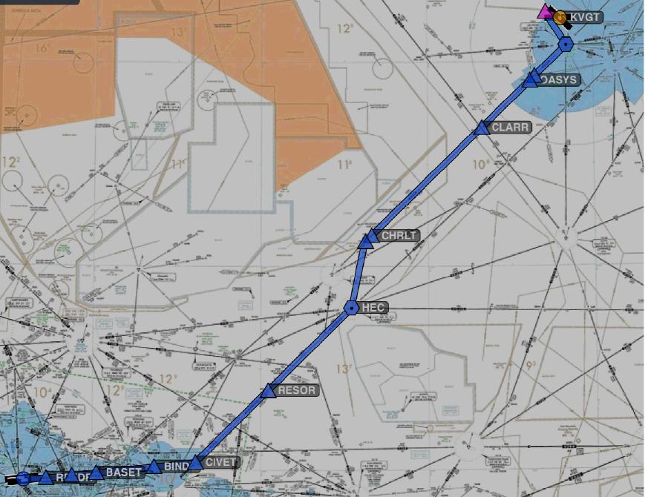
Cross Country Flight Planning

Slide 2
Standard Terminal Arrival Route Procedures
Use of STARs requires pilot possession of at least the approved chart
RNAV STARs must be retrievable by the procedure name from the applicable database
It is the responsibility of the pilot to accept or refuse an issued STAR
If you do not wish to use a STAR place “NO STAR” in the remarks section of the flight plan or by the less desirable method of verbally notifying ATC
STAR charts are published in the TERPS ahead of the approach charts for the applicable airport

Slide 3
Standard Terminal Arrival Route Descent Procedures
A descend via clearance instructs you to follow any altitude restrictions published on the standard terminal arrival (STAR). You must also comply with any other restrictions including airspeeds if charted or given by ATC
If ATC assigns you an altitude after issuing a descend via clearance the descend via clearance is cancelled and you must maintain the assigned altitude
You may also be assigned a modified “descend via” clearance in which case you must comply with the modification and then comply with the remainder of the published restrictions
If you are given an arrival with crossing restrictions you will only comply with those restrictions if told to “descend via” the arrival
ATC has to actually clear you for your descent unless the STAR actually says "after (fix name), cleared to XXXX feet"
If cleared to descend (not via) you are cleared to descend to the cleared altitude without respecting the published STAR altitude restrictions
Remember to consider terrain – ATC makes mistakes

Slide 4
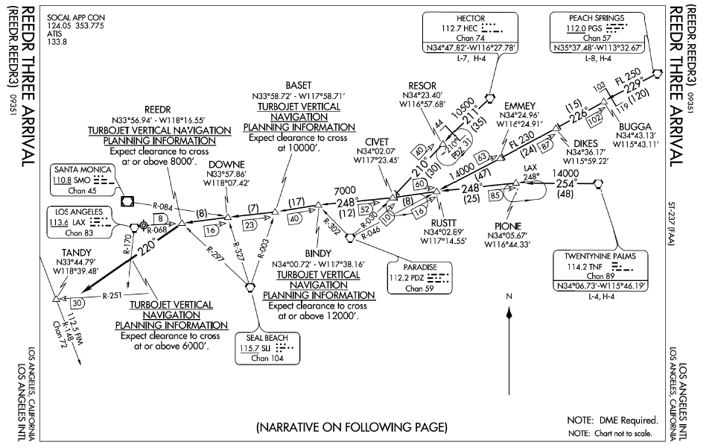
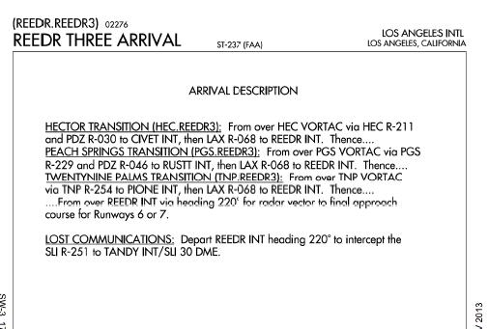
STAR
File Star in flight plan
by its code
E.g., Hec.Reedr3
Transistion.procedure

Slide 5
Picking the Star
Look at the available STARS in the TERPS for the destination airport
Locate those that are applicable to your direction of flight
Discard those that you cannot meet or are inapplicable
Turbojet only
Limited hours of use (e.g. for noise restriction) - e.g. LAX Redeye2
Inappropriate altitude requirements – e.g., LAX RIIVR2 which requires cross HEC at 17,000’
The consider which of the remaining work best for you considering aircraft performance, runways in use, and similar factors

Slide 6
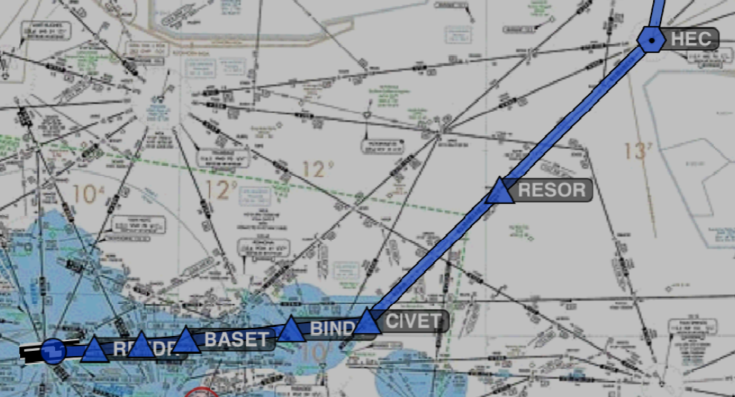
LAX STAR – REEDR THREE
HEC.REEDR3

Slide 7
Standard Instrument Approach Procedure Charts (IAP)
Information on approaches and approach charts are contained in the PowerPoints on this webpage addressing the various types of approaches – See http://bob-cfi.weebly.com/instrument-flight-lessons.html

Slide 8
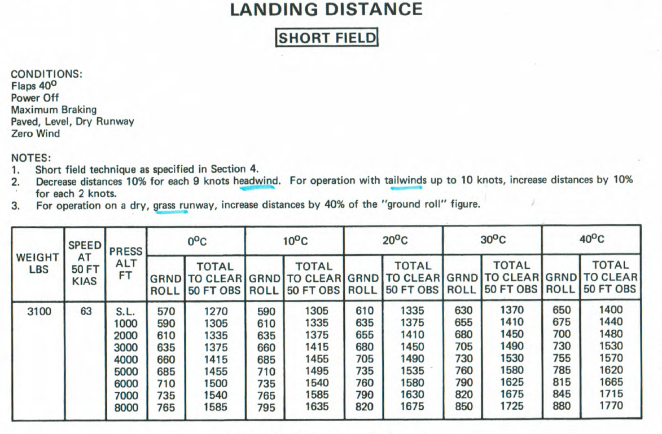
Landing Performance
Ground roll is 610’ with 125’ field elevation
Adjust for wind – 240 at 6kts – approx 5% reduction or 580’
No significant slope on any LAX runway

Slide 9
Destination Airport
Weather
Ceiling
Visibility
Winds vs runways and obstacles (obstacle clearance is based on groundspeed!)
Runway choice
Does it impact the departure procedure
Length
Delays
Taxi diagrams
Hot spots
Route
Frequency information
LAHSO

Slide 10
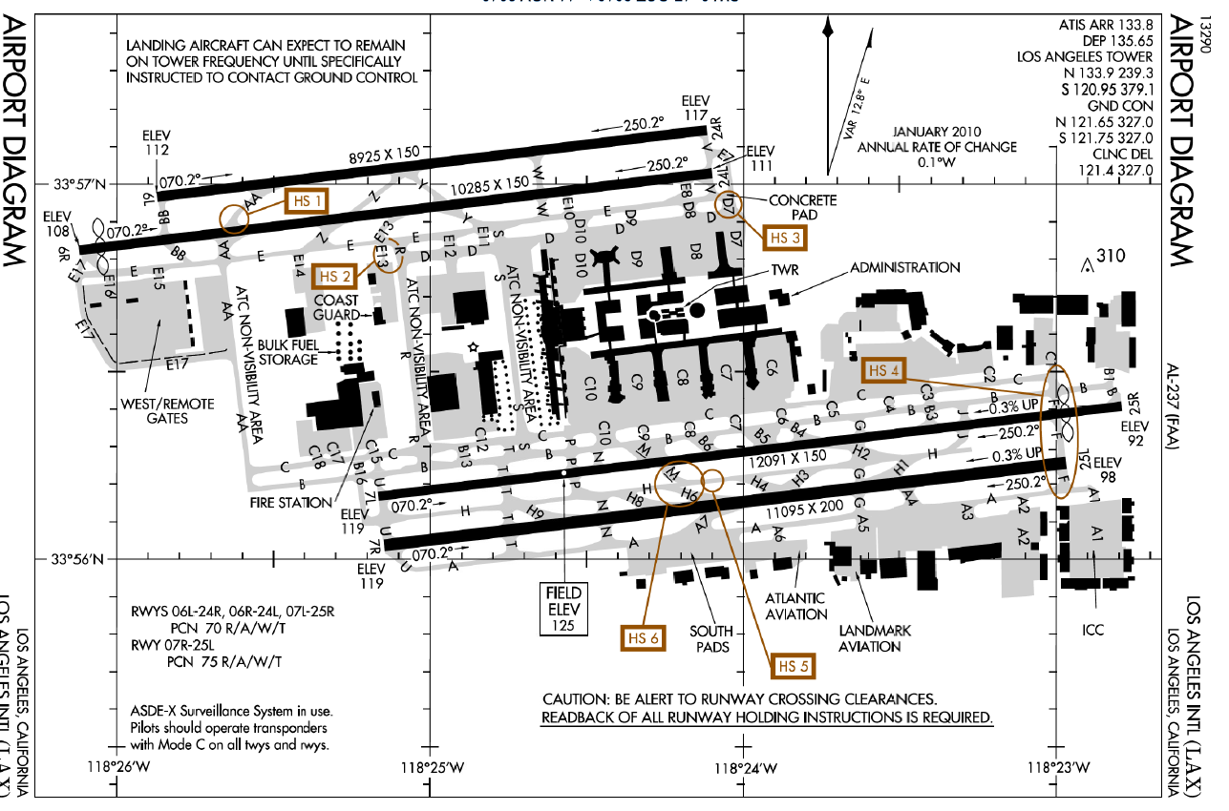
Destination Airport Runway Planning
Note hot spots
Notes are important
Note unusual frequency usage , e.g., North / South
Know your destination

Slide 11
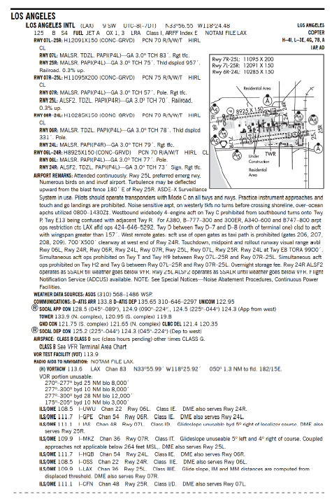
AFD Information
No LAHSO operations to consider

Slide 12
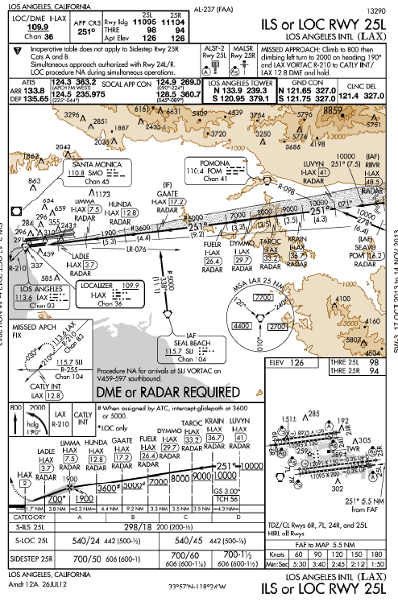
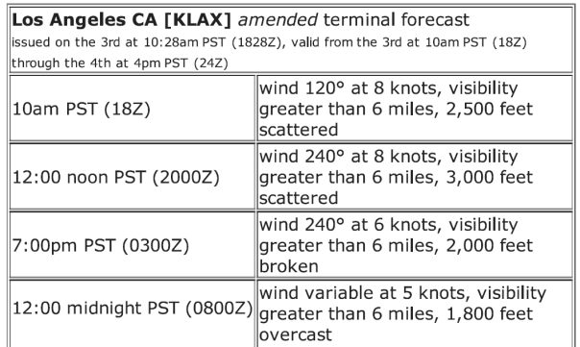
LAX Approach
Winds suggest a westward landing
Any of the 24 / 25 Runways will work – so try to get the closest one to your FBO

Slide 13
Landing
The aircraft must be in a position from which a safe approach to the runway or landing area can be made
Missed approach
When a landing cannot be accomplished upon reaching the missed approach point defined on the approach procedure chart, the pilot must comply with the missed approach instructions for the procedure being used or with an alternate missed approach procedure specified by ATC
See http://bob-cfi.weebly.com/uploads/7/6/9/3/7693240/missed_approach.pptx for more information on flying the missed approach

Slide 14
Fuel Planning
Must have enough fuel (§91.167)
To complete the flight to the intended destination
To fly from that airport to the alternate airport, if required; and
Fly after that for 45 minutes at normal cruising speed
May want to consider greater reserves depending upon circumstances

Slide 15
Fuel Usage / Flight Log
Orig | Dest | Heading | True Hdg | Leg Dist | Altitude | Wind | Grnd Spd | leg time |  | Fuel Used
KVGT | RUZCO | 280°M | 292.5 | 5nm | 5546.25 | 320/6 | 79.7 | 3.764115
RUZCO | LAS | 140°M | 152.5 | 12nm | 10785 | 0 | 77 | 9.350649
LAS | TOC | 219°M | 231.5 | 13nm | 12000 | 300/15 | 88.5 | 5 |  | 6.8
TOC | IDALE | 219°M | 230.5 | 13nm | 12000 | 300/15 | 136 | 10.73382 |  | 1.80686
IDALE | OASYS | 219°M | 231.5 | 2nm | 12000 | 300/21 | 136 | 0.882353 |  | 0.148529
OASYS | CLARR | 220°M | 232.5 | 20nm | 12000 | 300/21 | 136 | 8.823529 |  | 1.485294
CLARR | CHRLT | 220°M | 232.5 | 45nm | 12000 | 300/21 | 136 | 19.85294 |  | 3.341912
CHRLT | DISBE | 220°M | 232.5 | 2nm | 12000 | 300/21 | 136 | 0.882353 |  | 0.148529
DISBE | HEC | 186°M | 198.5 | 20nm | 12000 | 300/13 | 144 | 8.333333 |  | 1.402778
HEC | RESOR | 220°M | 232.5 | 35nm | 12000 | 300/13 | 136.5 | 15.38462 |  | 2.589744
RESOR | CIVET | 222°M | 234.5 | 30nm | 10000 | 305/11 | 138 | 13.04348 |  | 2.195652
CIVET | BINDY | 258°M | 270.5 | 12nm | 7000 | 310/2 | 141 | 5.106383 |  | 0.859574
BINDY | BASET | 258°M | 270.5 | 17nm | 7000 | 310/2 | 141 | 7.234043 |  | 1.21773
BASET | DOWNE | 258°M | 270.5 | 7nm | 5000 | 0 | 142 | 2.957746 |  | 0.497887
DOWNE | REEDR | 258°M | 270.5 | 8nm | 3000 | 220/5 | 139 | 3.453237 |  | 0.581295
REEDR | KLAX | 262°M | 274.5 | 7nm | 125 | 240/6 | 137 | 3.065693 |  | 0.516058
 |  |  |  |  |  |  |  | 1:58 |  | 23.59184

Slide 16
Fuel for Proposed Flight
Phase of Flight | Gallons | Source/Basis | Gallons remaining
Starting Fuel |  | POH | 75
Start and Taxi | 2 | POH Time, fuel, distance to climb table | 73
Climb to Altitude | 6.8 | POH Time, fuel, distance to climb table | 66.2
Enroute | 8 | POH Cruise Performance table (13 gph) | 56.2
Star | 7.78 |  | 48.42
Approach | 1 |  | 47.42
Travel to alternate | 2.2 | 10 minutes @6,000’ 72% BHP – POH Cruise Performance table (13 gph) | 45.2
Reserve | 9.75 | @6,000’ 72% BHP – POH Cruise Performance table (13 gph) | 35.45 gals remaining after reserve

Slide 17
Required Reporting
Required to maintain a listening watch on the appropriate frequency at all times - §91.183
You must make position reports upon passing certain reporting points
Reporting points are indicated by symbols on en route charts
Compulsory reporting point chart symbol is a solid triangle
“On request" reporting point chart symbol is the open triangle

Slide 18
Position Reports
Non-Radar
Flights along airways or routes - A position report is required over each designated compulsory reporting point
Flights Along a Direct Route – Position report is required over each reporting point used in the flight plan to define the route of flight
Flights in a Radar Environment
When informed by ATC that your aircraft is in "Radar Contact," discontinue position reports over designated reporting points
Resume position reporting when "RADAR CONTACT LOST" or "RADAR SERVICE TERMINATED

Slide 19
Position Report Contents
ID, Current fix name, time, altitude, IFR, remarks
Next fix name, ETA
Following fix name
AIM ¶5-3-2 d.

Slide 20
Additional Reports AIM ¶ 5-3-3
At all times
When vacating any previously assigned altitude or flight level for a newly assigned altitude or flight level
When an altitude change will be made if operating on a clearance specifying VFR-on-top
When unable to climb/descend at a rate of a least 500 feet per minute
When approach has been missed. (Request clearance for specific action; i.e., to alternative airport, another approach, etc.)
Change in the average true airspeed (at cruising altitude) when it varies by 5 percent or 10 knots (whichever is greater) from that filed in the flight plan
The time and altitude or flight level upon reaching a holding fix or point to which cleared
When leaving any assigned holding fix or point
Loss of navigation radio / GPs equipment and GPS anomalies
Upon encountering weather conditions which have not been forecast, or hazardous conditions which have been forecast
Any other information relating to the safety of flight

Slide 21
Additional Reports AIM ¶ 5-3-3
Non-Radar environment
When leaving final approach fix inbound on final approach (nonprecision approach)
When leaving the outer marker or fix used in lieu of the outer marker inbound on final approach (precision approach)
A corrected estimate at anytime it becomes apparent that an estimate as previously submitted is in error in excess of 3 minutes

Slide 22
Lost Communications
Preflight plan for lost communications
Where are the cloud tops and which way to nearest VFR
What is destination weather and alternate
Trouble shoot com
Stuck microphone
Unplug and adjust squelch.
Check audio selector
Confirm frequency
Try another radio
Reduce electrical load, if appropriate
Squawk 7600
Stay on published airways, transitions at published altitudes
Lost communications is an emergency under IFR conditions. You can deviate as necessary to resolve the problem

Slide 23
Lost Communications
During radio failure, when confronted with a situation not covered in the regulation, pilots are expected to exercise good judgment in their actions
Set transponder to 7600
Expect ATC to attempt to communicate with you by transmitting on guard frequencies and available frequencies of navaids

Slide 24
Flying the Lost Comm Plan FAR §91.185
VMC - If the failure occurs in VFR conditions, or if VFR conditions are encountered after the failure, the pilot shall continue the flight under VFR and land as soon as practicable and notify ATC
Not intended that the requirement to "land as soon as practicable" be construed to mean "as soon as possible“

Slide 25
Flying the Lost Comm Plan FAR §91.185
VMC - If the failure occurs in VFR conditions, or if VFR conditions are encountered after the failure, the pilot shall continue the flight under VFR and land as soon as practicable and notify ATC
Not intended that the requirement to "land as soon as practicable" be construed to mean "as soon as possible“
Primary objective is to preclude extended NORDO IFR operations in VMC

Slide 26
Flying the Lost Comm Plan FAR §91.185
IMC – Continue in accordance with the following:
Route
By the route assigned in the last ATC clearance received;
If being radar vectored, by the direct route from the point of radio failure to the fix, route, or airway specified in the vector clearance;
In the absence of an assigned route, by the route that ATC has advised may be expected in a further clearance; or
In the absence of an assigned route or a route that ATC has advised may be expected in a further clearance, by the route filed in the flight plan.

Slide 27
Flying the Lost Comm Plan FAR §91.185
IMC – Continue in accordance with the following:
Altitude - At the highest of the following altitudes or flight levels for the route segment being flown:
The altitude or fight level assigned in the last ATC clearance received;
The minimum altitude for IFR operations; or
The altitude or flight level ATC has advised may be expected in a further clearance

Slide 28
Flying the Lost Comm Plan FAR §91.185
Leave clearance limit.
When the clearance limit is a fix from which an approach begins, commence descent or descent and approach as close as possible to the expect-further-clearance time if one has been received, or if one has not been received, as close as possible to the estimated time of arrival as calculated from the filed or amended (with ATC) estimated time en route.
If the clearance limit is not a fix from which an approach begins, leave the clearance limit at the expect-further-clearance time if one has been received, or if none has been received, upon arrival over the clearance limit, and proceed to a fix from which an approach begins
Commence descent or descent and approach as close as possible to the estimated time of arrival as calculated from the filed or amended (with ATC) estimated time en route.

Slide 29
Flying the Lost Comm Plan FAR §91.185
Maintain the last assigned altitude or the minimum safe/sector altitude (emergency safe altitude if more than 25 NM from the facility), whichever is higher, until established on a segment of the published approach

Slide 30
NOTAM Information
Notices to Airmen (NOTAM) is a notice to alert aircraft pilots of potential hazards along a flight route or at a location that could affect the safety of the flight
Get them before you go – They often contain important changes / notices
Types
NOTAM (D) or distant NOTAMs - Disseminated for all navigational facilities that are part of the National Airspace System (NAS), all public use airports, seaplane bases, and heliports listed in the Airport/Facility Directory (A/FD) (e.g., such information as whether or not an airport or a certain facility is usable). NOTAM (D) information includes, among other topics, such data as taxiway closures, personnel and equipment near or crossing runways, and airport lighting aids that do not affect instrument approach criteria, such as VASI
NOTAM(L) - This type of NOTAM no longer exists, now part of NOTAM (D)

Slide 31
NOTAM Information
Types
Flight Data Center (FDC) NOTAMs - Issued when necessary to disseminate information that is regulatory in nature, e.g., amendments to published IAPs and other current aeronautical charts. They are also used to advertise temporary flight restrictions caused by such things as natural disasters or large-scale public events that may generate congestion of air traffic over a site
Temporary Flight Restrictions (TFRs) are also issued as FDC NOTAMs.
Pointer NOTAMs - Issued to highlight or point out another NOTAM, such as an FDC or NOTAM (D) NOTAM. This type of NOTAM will assist users in cross-referencing important information that may not be found under an airport or NAVAID identifier
Special use airspace (SUA) NOTAMs - issued when SUA will be active outside the published schedule times and when required by the published schedule
Military NOTAMs - NOTAMs pertaining to U.S. Air Force, Army, Marine, and Navy navigational aids/airports that are part of the NAS

Slide 32
NOTAM Information
Distribution Types
CLASS I NOTAMS - distributed by means of telecommunication
CLASS II NOTAMS OR PUBLISHED NOTAMS - distributed by publication in the Notices To Airmen Publication (NTAP) which is issued every 28 days
Online at http://www.faa.gov/air_traffic/publications/notices/a
Where are they found
Current NOTAMs are available from Flight Service Stations
Duats - Better source than FSS as there may be too many Notams for an FSS specialist to sort through and read to you
NTAP publication
Many private services
Notam contractions are decoded in the NTAP and on-line at http://www.faa.gov/about/office_org/headquarters_offices/ato/service_units/systemops/fs/alaskan/alaska/fai/notam/media/cntrns.pdf

Slide 33
NOTAM Information
Form of Notam
SGR SUGAR LAND RGNL
!SGR 10/056 SGR RWY 17/35 CLSD DAILY 0100-1100 1310290100-1311011100
!FDC 3/4137 SGR FI/T IAP SUGAR LAND RGNL, HOUSTON, TX. RNAV (GPS) RWY 17, AMDT 2... LNAV/VNAV DA 704/HAT 622

Slide 34
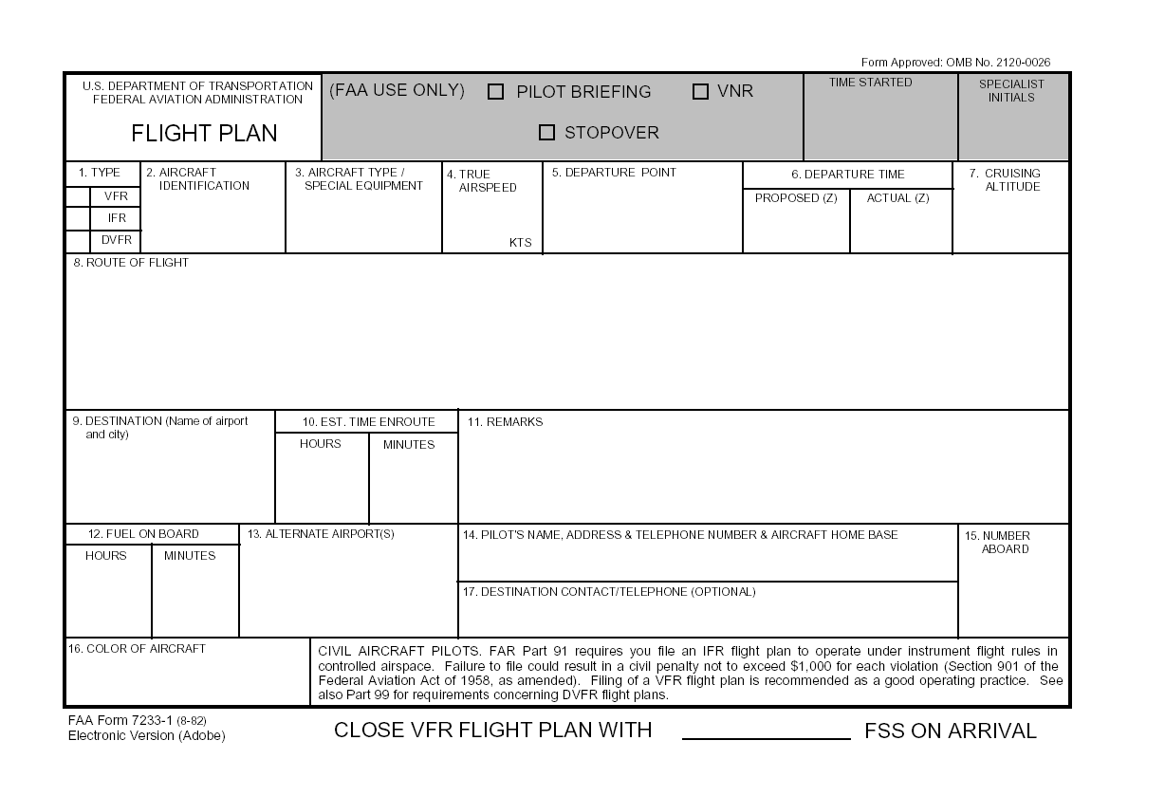
Complete and File a Flight Plan
See Following slide
True airspeed not indicated airspeed
Times are zulu
N
Use NAVAID codes, airport codes, and airways, as applicable. Do not enter departure airport or destination – those are in boxes 5 and 9. Start with the first checkpoint or instrument departure procedure followed by subsequent checkpoints. Can also use degree/miles from a navaid and/or lat / long points
If you will have more than one cruising altitude, only list the initial altitude
Special requests / issues – e.g. No SID/Stars
Remember the 1-2-3 rule (±1 hr, ceiling 2000 ft, visibility 3 mi).

Slide 35
Flight Plan Aircraft Equipment Suffix Table
You must file the appropriate equipment suffix in the equipment block (Box 3) of the Flight Plan
The equipment suffix informs ATC of:
The navigation and/or transponder capability of the aircraft (e.g., Advanced RNAV, Transponder with Mode C)
The aircraft and crew’s RVSM capability
Suffix | Equipment Capability
 | NO DME
/X | No transponder
/T | Transponder with no Mode C
/U | Transponder with Mode C
 | DME
/D | No transponder
/B | Transponder with no Mode C
/A | Transponder with Mode C
 | ADVANCED RNAV WITH TRANSPONDER AND MODE C (If an aircraft is unable to operate with a transponder and/or Mode C, it will revert to the appropriate code listed above under Area Navigation.)
/E | Flight Management System (FMS) with DME/DME and IRU position updating
/F | Flight Management System (FMS) with DME/DME position updating
/G | Global Navigation Satellite System (GNSS), including GPS or WAAS, with enroute and terminal capability.
/R | Required Navigational Performance. The aircraft meets the RNP type prescribed for the route segment(s), route(s) and/or area concerned.

Slide 36
Filing a Flight Plan
Call Flight Service Station and give them all the information above
Some FSS will take a flight plan on a answering machine
File on-line through a number of services including DUATS, Foreflight, etc.
Not all elements are transmitted to the FAA when filed with a private service or DUATS

Slide 37
Flight Plan Alternate Airport - §91.169
IFR Flight Plan MUST include an alternate airport UNLESS:
There is a standard instrument approach to, or special instrument approach procedure, for the first airport of intended landing; and
1 – 2 – 3 Rule - Appropriate weather reports or weather forecasts, or a combination of them, indicate for at least 1 hour before and for 1 hour after the estimated time of arrival, the ceiling will be at least 2,000 feet above the airport elevation and the visibility will be at least 3 statute miles
Alternate airport required weather
At the ETA at the alternate airport, the ceiling and visibility must be at or above:
If an instrument approach procedure has been published, or a special instrument approach procedure has been issued:
The alternate airport minima specified in that procedure
If none are specified, then:
For a precision approach procedure - Ceiling 600 feet and visibility 2 statute miles
For a nonprecision approach procedure - Ceiling 800 feet and visibility 2 statute miles
If no instrument approach procedure has been published and no special instrument approach procedure has been issued, for the alternate airport, the ceiling and visibility minima are those allowing descent from the MEA, approach, and landing under basic VFR

Slide 38
Flight Plan Alternate Airport - §91.169
Alternate airport
Some airports have a “NA” designation – e.g. they can’t be filed as an alternate, if the weather is below VFR conditions (based on §91.169(c)(1)(i) alternate airport minima)
Can be due to lack of weather reporting
Can be due to approach being unmonitored
Alternate minimums apply only to the legality of filing the airport as an alternate in the flight plan, not actually flying to it. When actually flying to the alternate, then the actual weather is what determines the applicability of the IAP

Slide 39
Filing a Flight Plan Alternate Airport - GPS
Pilots can flight plan to use a GPS-based approach at either the destination or the alternate airport, but not at both
At the alternate airport, you may plan for applicable alternate airport weather minimums using:
Lateral navigation (LNAV) or circling minimum descent altitude (MDA)
LNAV/vertical navigation (LNAV/VNAV) decision altitude (DA) if equipped with and using approved barometric vertical navigation (baro-VNAV)
RNP 0.3 DA on an RNAV (RNP) IAP if specifically authorized with approved baro-VNAV equipment
WAAS
WAAS users equipped with and using approved baro-VNAV equipment may plan for LNAV/VNAV or RNP 0.3 DA, at the alternate airport
WAAS users without baro-VNAV may still plan for LNAV at an alternate airport

Slide 40
Alternate Airport Selection
Adequate margin of safety is observed – SRM / ADM
Capabilities of the pilot
Aircraft performance capabilities
Aircraft issues
Equipment failures
Database failures / limits or chart limits
Simplicity of programming required to get to alternate
Altitudes / hazardous terrain required to reach the alternate
Icing issues
Facilities at the airport
More than one runway, in case something happens on the runway to another aircraft
Fire / Rescue
Runway length
Support services – car rental, hotel, food, FBO, fuel, etc.

Slide 41
Alternate Airport Selection
Approach and landing options
Would likely want to avoid an airport with only circling options
Meterological conditions and alternate weather reporting quality
Uncertainty in the timing of meteorological changes
Potential delays at the alternate or reaching the alternate
Alternate selection may also change based upon aircraft location at the time of diversion decision
E.g.- consider having at least thought about en-route alternates
Fuel planning
Avoid an alternate that leaves you no other good options if the alternate doesn’t work at arrival
Impact of unplanned or unanticipated routings and/or cruising levels
Impact of pre-takeoff taxi / hold for departure delays

Slide 42
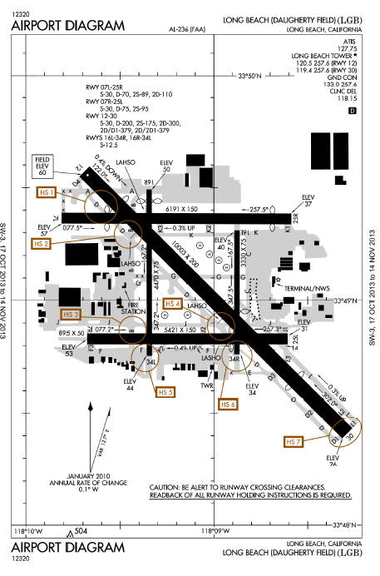
Alternate Airport Selection
Why Long Beach as an alternate?
Multiple runways with adequate length
Good approaches
Close by
Pilot fatigue
Minimal system programming
No hazardous terrain enroute
Unlikely to have significant delays
Good resources – FBO, food, fuel, hotel

Slide 43
Filing a Flight Plan Fuel Planning - §91.167
Must carry enough fuel (considering weather reports and forecasts and weather conditions) to--
Complete the flight to the first airport of intended landing;
Fly from that airport to the alternate airport; and
Applicable only if an alternate airport must be listed
Fly after that for 45 minutes at normal cruising speed
Consider known delays as well

Slide 44
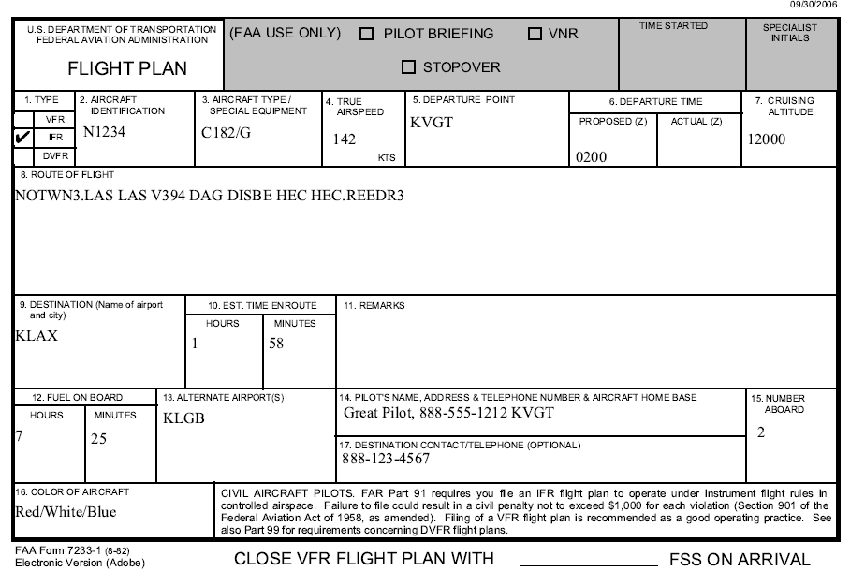
Flight Plan for Proposed Flight

Slide 45
GPS and RAIM
GPS and RAIM are discussed in the GPS Approaches PowerPoint on this same webpage - http://bob-cfi.weebly.com/uploads/7/6/9/3/7693240/gps_approaches.pdf

Slide 46
Weather Charts and Analysis
Weather charts are discussed in the Weather Chart PowerPoint on this same webpage - http://bob-cfi.weebly.com/uploads/7/6/9/3/7693240/weather_charts.ppsx
For weather analysis you should read a more compete text on this subject. I would suggest:
Gliem's Aviation Weather and Weather Services.
FAA's Aviation Weather For Pilots and Flight Operations Personnel (AC 00-6A)
Aviation Weather Services (AC 00-45G),
Weather chapters 11 and 12 in the Pilot's Handbook of Aeronautical Knowledge FAA-H-8083-25A
General Aviation Pilot’s Guide to Preflight Weather Planning, Weather Self-Briefings, and Weather Decision Making.

Slide 47
Icing
There is a lot to consider in this area - See the Icing Presentation that is available on the same web page as this PowerPoint at http://bob-cfi.weebly.com/uploads/7/6/9/3/7693240/icing.pptx. That presentation fully covers icing conditions, operational hazards, anti-icing and deicing equipment, differences, and approved use and operations

Slide 48
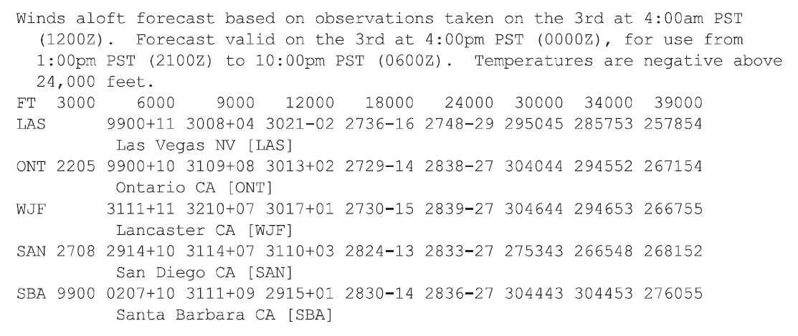
Icing Risk for Proposed Flight
There is no visible moisture at enroute altitudes, hence icing is unlikely, until descent where clouds are present
Temperatures at descent points of the route, are above icing temperature range
But consideration must be given to the potential of icing if there is a change in cloud tops

Slide 49
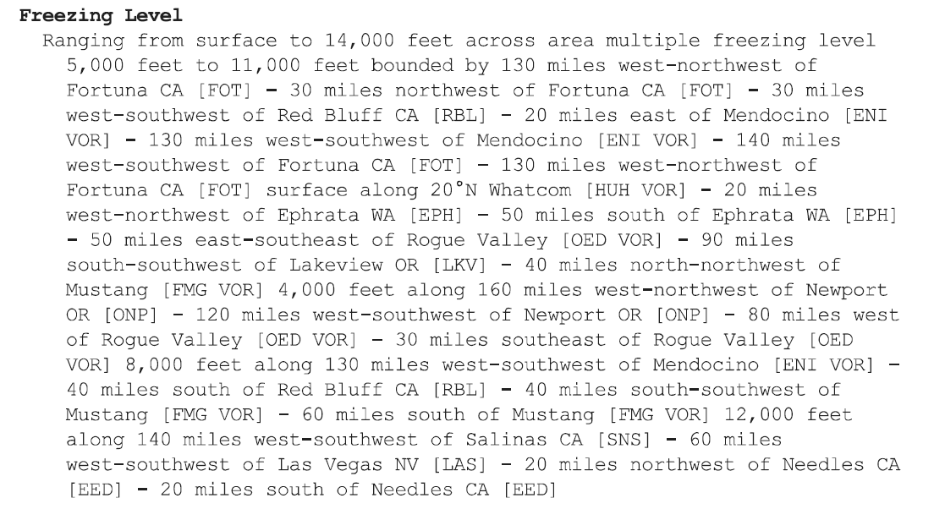
Freezing Level Report

Slide 50
SRM
Before you leave the ground – be sure to consider SRM and ADM – THIS IS A CRITICAL ASPECT OF PLANNING
There is a lot to consider in this area - See the SRM Presentation that is available on the same web page as this PowerPoint at http://bob-cfi.weebly.com/uploads/7/6/9/3/7693240/single-pilot_resource_management.pptx

Slide 51
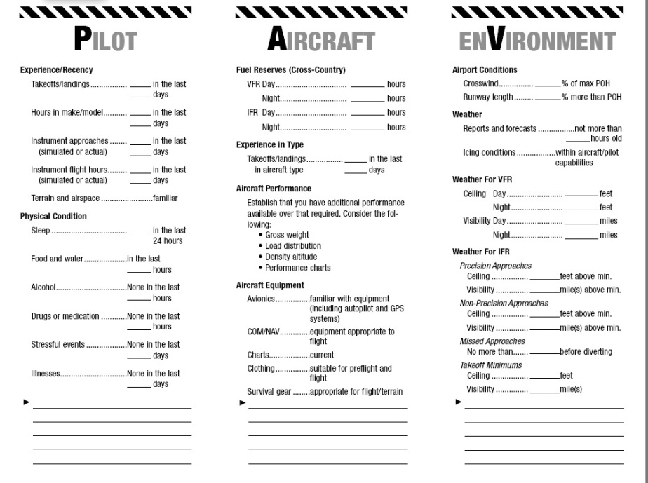
SRM
The FAA has produced some good SRM materials that are part of the IPC Guidance
I have attached them as the next few slides
Don’t leave home without the SRM Analysis

Slide 52
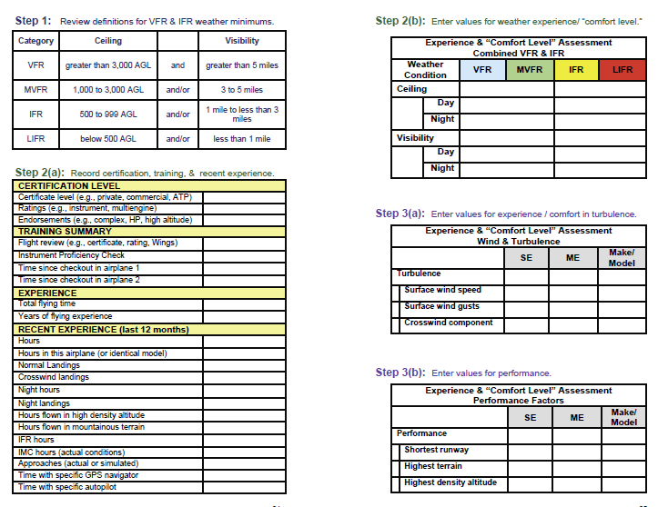

Slide 53
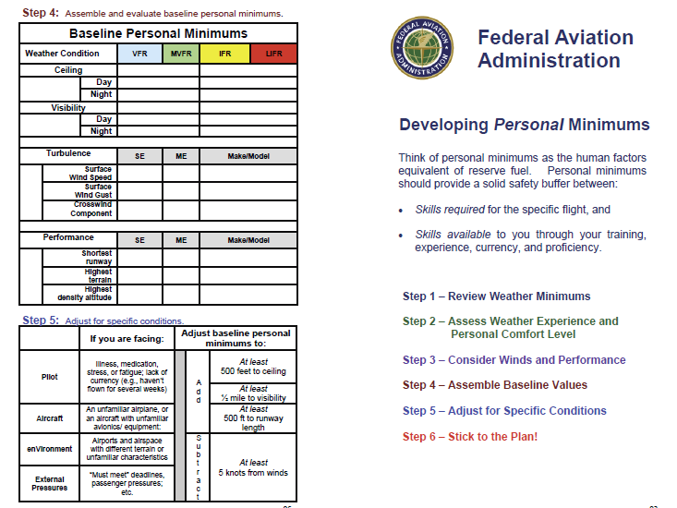

Slide 54
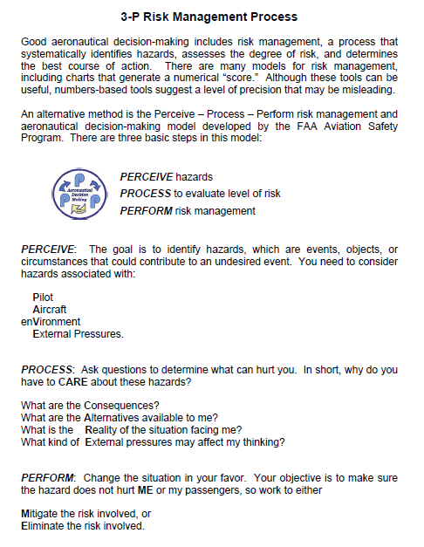

Slide 55
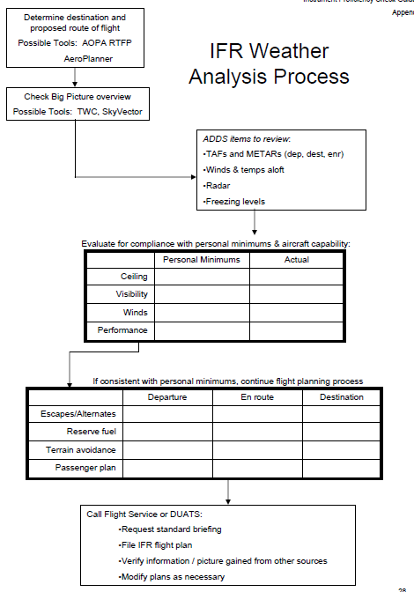

Slide 56
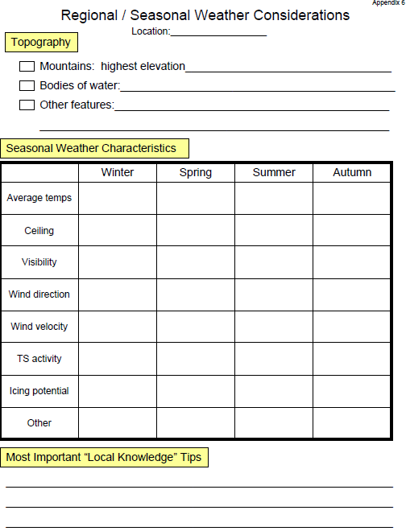

Slide 58
Disclaimer
Instrument flight can be dangerous. Do not rely solely on this presentation – PROFESSIONAL INSTRUCTION IS REQUIRED
The foregoing material should not be relied upon for flight
ALTHOUGH THE ABOVE INFORMATION IS FROM SOURCES BELIEVED TO BE RELIABLE SUCH INFORMATION HAS NOT BEEN VERIFIED, AND NO EXPRESS REPRESENTATION IS MADE NOR IS ANY TO BE IMPLIED AS TO THE ACCURACY THEREOF, AND IT IS SUBMITTED SUBJECT TO ERRORS, OMISSIONS, CHANGE

