Slide 1
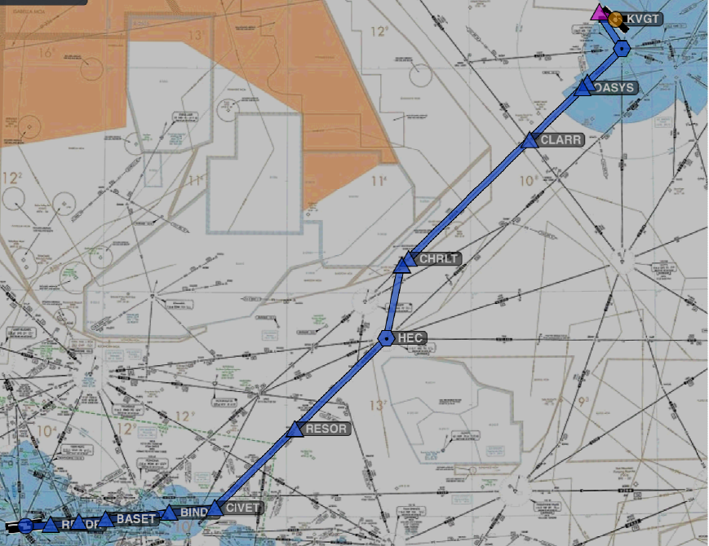
Cross Country Flight Planning

Slide 2
PTS Requirements
Exhibits adequate knowledge of the elements by presenting and explaining a preplanned cross-country flight. It should be planned using actual weather reports/forecasts and conform to the regulatory requirements
Exhibits adequate knowledge of the aircraft’s performance capabilities by calculating the estimated time en route and total fuel requirement based upon factors, such as—
  Power settings
  Operating altitude or flight level
  Wind
  Fuel reserve requirements
  Weight and balance limitations

Slide 3
PTS Requirements
Selects and correctly interprets the current and applicable en route charts, instrument departure procedures (DPs), RNAV, STAR, and Standard Instrument Approach Procedure Charts (IAP)
Obtains and correctly interprets applicable NOTAM information
Determines the calculated performance is within the aircraft’s capability and operating limitations
Completes and is able to file a flight plan in a manner that accurately reflects the conditions of the proposed flight
Demonstrates adequate knowledge of GPS and RAIM capability, when aircraft is so equipped
Icing
  Demonstrates the ability to recognize wing contamination due to airframe icing
  Demonstrates adequate knowledge of the adverse effects of airframe icing during pre-takeoff, takeoff, cruise, and landing phases of flight and corrective actions
  Demonstrates familiarity with any icing procedures and/or information published by the aircraft manufacturer

Slide 4
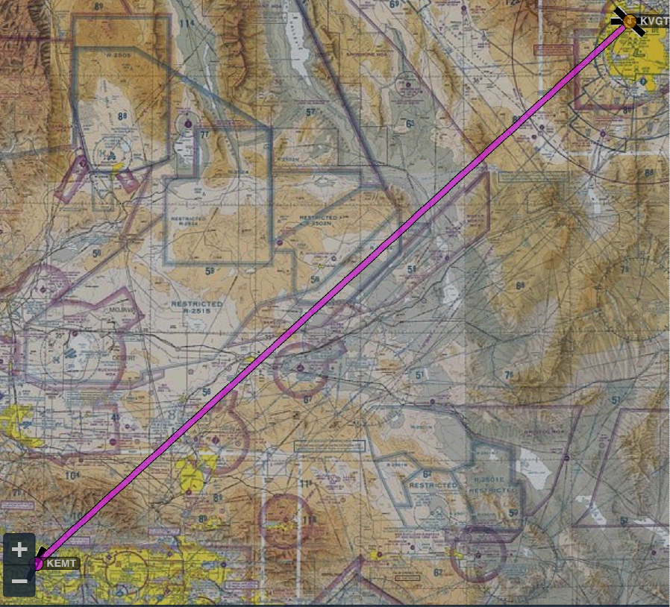
Cross-Country Flight Planning
Let’s plan a flight from KVGT to KLAX
The first thing I do is look at the magic magenta line for a direct flight on a VFR sectional chart to get an overview based on the IFR planning elements
Restricted area
Fort Irwin – GPS jamming potential
Terrain too high for aircraft climb performance
MOA

Slide 5
Preflight Planning Elements
§91.103
Each pilot in command shall, before beginning a flight, become familiar with all available information concerning that flight. This information must include—
  For a flight under IFR
    Weather reports and forecasts
    Fuel requirements
    Alternatives available if the planned flight cannot be completed
    Any known traffic delays of which the pilot in command has been advised by ATC
      Determine whether traffic delays might require holding

Slide 6
Preflight Planning Elements
§91.103
Each pilot in command shall, before beginning a flight, become familiar with all available information concerning that flight. This information must include—
  Runway lengths at airports of intended use
    Runway length should be at least 150% of values shown in the POH/AFM, or at least 200% of the POH/AFM numbers for a wet, icy, or otherwise contaminated runway
    Consider whether LAHSO procedures are in use
  Takeoff and landing distance information from the POH under expected values of airport elevation and runway slope, aircraft gross weight, and wind and temperature

Slide 7
The Route
Departure airport considerations
Departure procedures
Enroute considerations
Arrival considerations
Approach considerations
Destination airport considerations

Slide 8
Departure Airport Considerations
Frequencies
Clearance delivery process
Taxi
  Hot spots
  Route
Weather
  Ceiling – can I get back to land?
  Visibility
  Winds vs runways and obstacles (obstacle clearance is based on groundspeed!)
Runway choice
  Does it impact the departure procedure
  Length
Delays

Slide 9
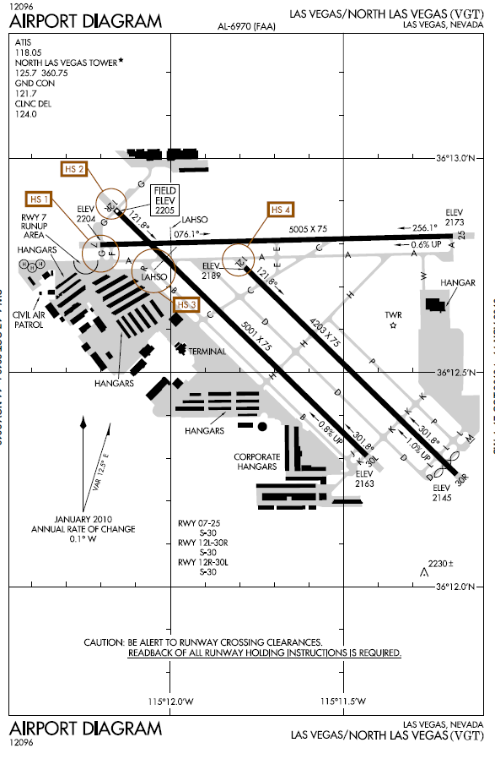
Departure / Destination Airport Considerations
Frequencies (be sure to listen to ATIS for weather and airport information)
Taxiways
Hot spots
Airport diagram and Airport facility directory are good places to start
Determine your location to understand your taxi route
Runway data

Slide 10
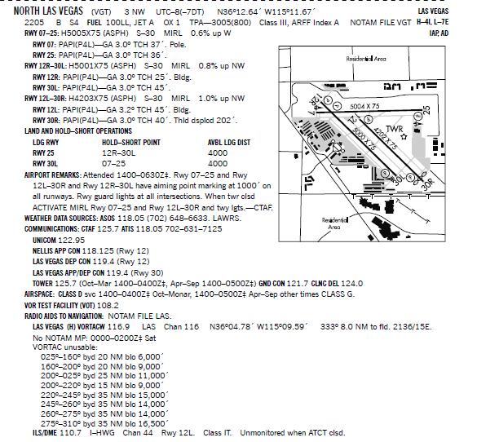
Departure / Destination Airport Considerations AF/D

Slide 11
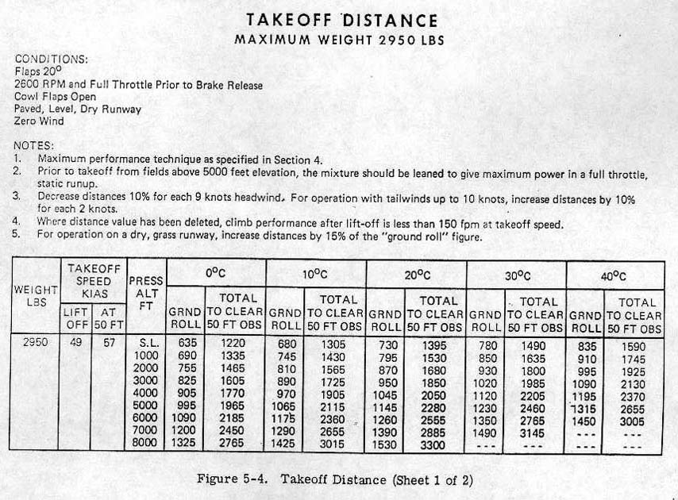
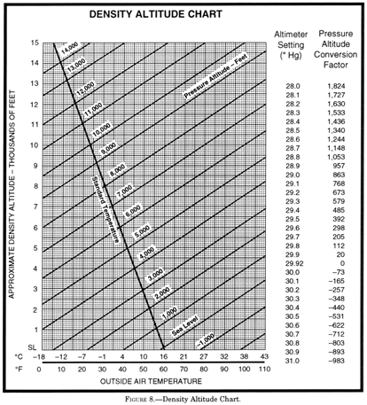
Departure Runway Planning
Can we take off given the aircraft weight, pressure altitude and temperature?
Runway required
  Airport elevation 2205’
  Metar = VGT 300553Z 32014KT 10SM OVC095 13/02 A2993 RMK AO2 SLP149
  29.93 =-10’ = 2195’ PA
  Ground roll =
Plenty of runway as shortest runway is 4203’ per AF/D

Slide 12

Runway Planning
Also consider runway slope impact, even if no factor is included in the take-off distance chart
  Rule of thumb
    Downslope takeoff distance is reduced about 5% per degree
    Upslope takeoff distance is increased about 7% per degree
  Listed in airport’s runway information in AFD, on taxi diagrams and on approach plate runway diagrams
If the runway distance is close to operational limits of the aircraft, be sure to compute the 50’ obstacle clearance distance to be sure take-off is viable

Slide 13

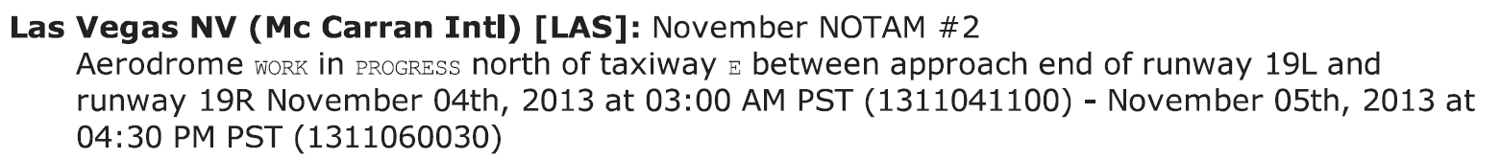
Runway Planning
Be sure to check Notams
  Runway closures / limits
  Taxiway closures / limits
  Lighting outages
Examples

Slide 14

Clearance Delivery
Towered airport
  Ground control / tower
  Clearance delivery
  May be able to receive a pre-taxi clearance - can get clearance up to 10 minutes prior to beginning taxi
Non-towered airport
  FSS by Phone
  FSS by Radio
    May have remote communications outlet (RCO)
    Ground Communication Outlet (GCO) - VHF radio to telephone connection to FSS – usually four key clicks on the radio to contact ATC and six key clicks to contact the FSS
  ATC by radio
  Depart the airport VFR if conditions permit and contact ATC for your clearance in the air
  Void time - Must depart before the clearance void time; if you fail to depart, you must contact ATC by a specified notification time, which is within 30 minutes of the original void time

Slide 15
Obtaining the Clearance
INITIAL RADIO CONTACT
In your initial radio communication with the clearance facility state:
  Aircraft identification
  Location on the airport
  Type of operation planned (ifr)
  Point of first intended landing and requested action (taxi/clearance on request/etc)

Slide 16
IFR Clearance Items
Clearance will be issued prior to take-off and will include the following items as appropriate, in the order listed:
  Aircraft identification
  Clearance limit
  Departure procedure or SID
  Route of flight
  Altitude data in the order flown
  Holding instructions
  Any special information
  Frequency and beacon information
Readback clearance items

Slide 17

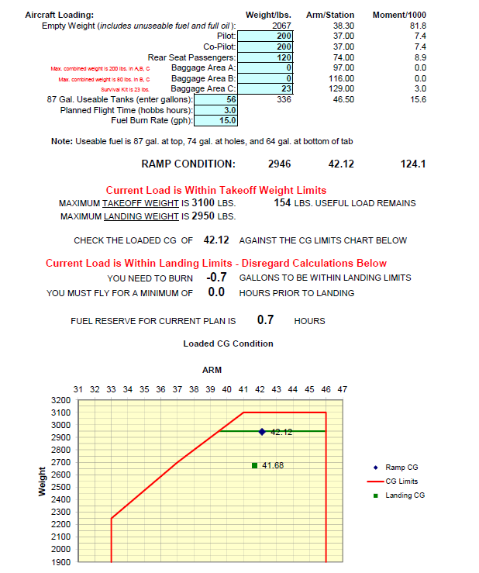
Weight and Balance Planning
Compute a weight and balance for the take-off weight through the landing weight to be sure you are within CG for the entire flight and not overweight at take off or landing
Can do with a computer program or by hand from the aircraft’s weight and balance
Take off
Landing
zero fuel

Slide 18

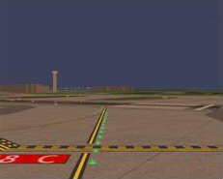

Airport Environment
Avoiding Runway Incursion
Stop bars - Row of red unidirectional, in-pavement lights installed along the holding position marking. When extinguished by the controller, they confirm clearance for the pilot or vehicle operator to enter the runway
Taxiway centerline lights - Work in conjunction with stop bars, are green in-pavement lights that guide ground traffic under low visibility conditions and during darkness
Runway guard lights - Elevated or in-pavement alternately flashing yellow lights, used to denote both the presence of an active runway and identify the location of a runway holding position marking

Slide 19
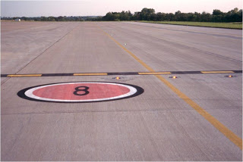
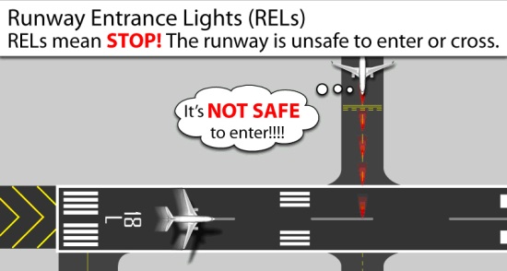
Airport Environment
Avoiding Runway Incursion
Clearance bars - Three yellow in-pavement lights that mark holding positions for aircraft. When used for hold points, they are co-located with geographic position markings
Geographic position markings - Used as hold points or for position reporting. They are “pink spots” outlined with a black and white circle and designated with a number, a letter, or both
Runway entrance lights - String of lights in center of taxiways/runway crossings illuminated red when there is high-speed traffic on or approaching the runway

Slide 20
Instrument Departure Procedures (DPs)
Departure procedures (DPs) are preplanned routes that provide a way to depart the airport and transition safely to the en route structure
Two types
  Obstacle Departure Procedures (ODPs) which are printed either textually or graphically
  Standard Instrument Departures (SIDs) which are always printed graphically
Higher than standard climb gradients are specified by a note on the departure procedure chart for graphic DPs, or in the Take-Off Minimums and (Obstacle) Departure Procedures section of the TERPS
AIM 5-2-8(e) provides that a pilot, prior to departing an airport on an IFR flight should:
  Consider the type of terrain and other obstacles on or in the vicinity of the departure airport;
  Determine whether an ODP is available;
  Determine if obstacle avoidance can be maintained visually or if the ODP should be flown; and
  Consider the effect of degraded climb performance and the actions to take in the event of an engine loss during the departure. Pilots should notify ATC as soon as possible of reduced climb capability in that circumstance

Slide 21
Obstacle Departure Procedure
ODPs are printed either textually or graphically
  Graphic ODPs will have (OBSTACLE) printed in the procedure title
ODPs provide obstruction clearance via the least onerous route from the terminal area to the appropriate en route structure
  ODPs are only used for obstruction clearance
  An ODP may drastically affect the initial part of the flight plan. You may have to depart at a higher than normal climb rate, or depart in a direction opposite the intended heading and maintain that for a period of time, any of which would require an alteration in the flight plan and fuel planning

Slide 22
Obstacle Departure Procedure
ODPs may be flown without ATC clearance, unless an alternate departure procedure (SID or radar vector) has been specifically assigned by ATC
  As a general rule, ATC will only assign an ODP from a non-towered airport when necessary for aircraft to aircraft separation
    ATC, however, assumes that you will use a published ODP when departing from a non-towered airport
    ATC must be notified if you do not have ODPs available by noting "no DP" in the flight plan or by advising ATC
  Can enter “will depart (airport) (runway) via textual ODP in remarks section of flight plan
  A graphic ODP may also be filed in an instrument flight plan by using the computer code included in the procedure title
ODP procedures are listed in the front of the approach chart booklets under the heading Takeoff Minimums and Obstacle Departure Procedures. Each procedure is listed in alphabetical order by city and state
  Graphical procedures are included with the airport information in the TERPS

Slide 23
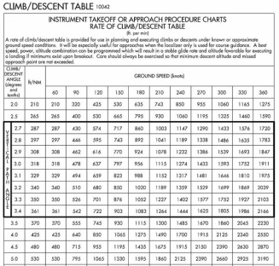
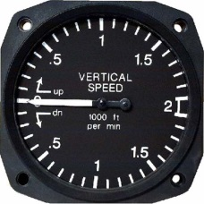
Obstacle Departure Procedure
When should you fly an ODP?
  In most cases, but especially at night, in IMC and in marginal VMC
When departing without an ODP or SID, how can you ensure terrain/obstacle clearance until reaching a published MEA?
  Obstacle clearance for all departures, including diverse, is based on the pilot crossing the departure end of the runway at least 35 feet above the departure end of runway elevation, climbing to 400 feet above the departure end of runway elevation before making the initial turn, and maintaining a minimum climb gradient of 200 feet per nautical mile (FPNM), unless required to level off by a crossing restriction, until the minimum IFR altitude
    Back cover of Terps has a climb rate table
      90 knots = 300 ft/min for 200’ NM
      120 knots = 400 ft/minfor 200’ NM
  Computed as:
  Ground speed / 60 = NM/min
  NM/min X required climb gradient =
  Required feet per min rate

Slide 24
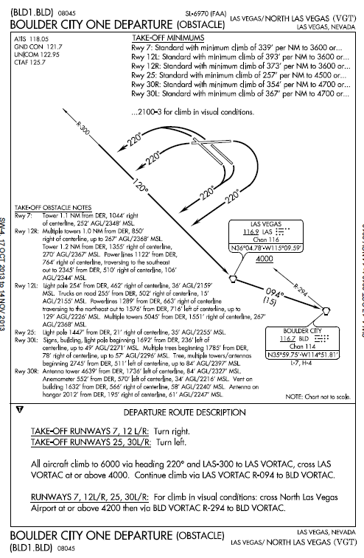
Obstacle Departure Procedure
Graphical
Climb rates required
Graphical procedure shows the route graphically and includes a textual description as well
Obstacle notes
Route description

Slide 25
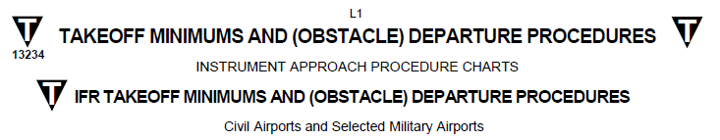
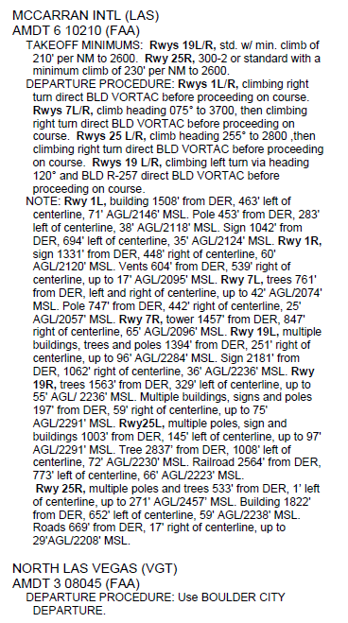
Obstacle Departure Procedure
Textual
Textual ODPs are described in the front of the TERPS booklet in the Takeoff Minimums section
Textual ODP
Cross reference to KVGT’s graphical ODP

Slide 26
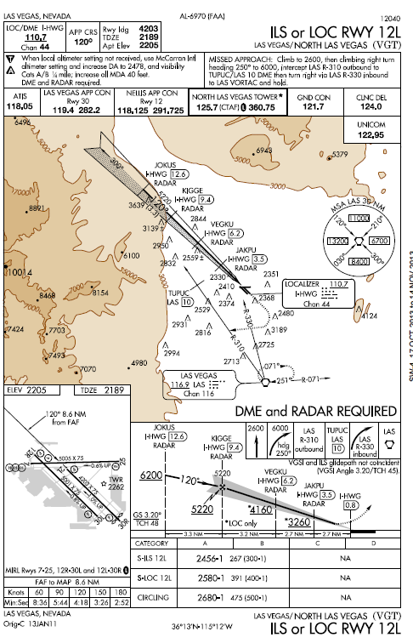
Obstacle Departure Procedure
Indication
To determine if an airport has alternate take off minimums or an ODP look for a triangle T in the approach plates or in the Take-Off Minimums and (Obstacle) Departure Procedures section of the TERPS

Slide 27
Standard Instrument Departure Procedure
SIDs are air traffic control (ATC) procedures printed in graphic form to provide obstruction clearance and a transition from the terminal area to the appropriate en-route structure
SIDs are primarily designed for system enhancement and to reduce pilot/controller workload, but consider obstacle clearance
Unlike an ODP, ATC clearance must be received prior to flying a SID
If you do not have SIDs or do not want to fly them place the statement “NO SIDs” in the remarks section of your flight plan
  You are not required to depart using a SID

Slide 28
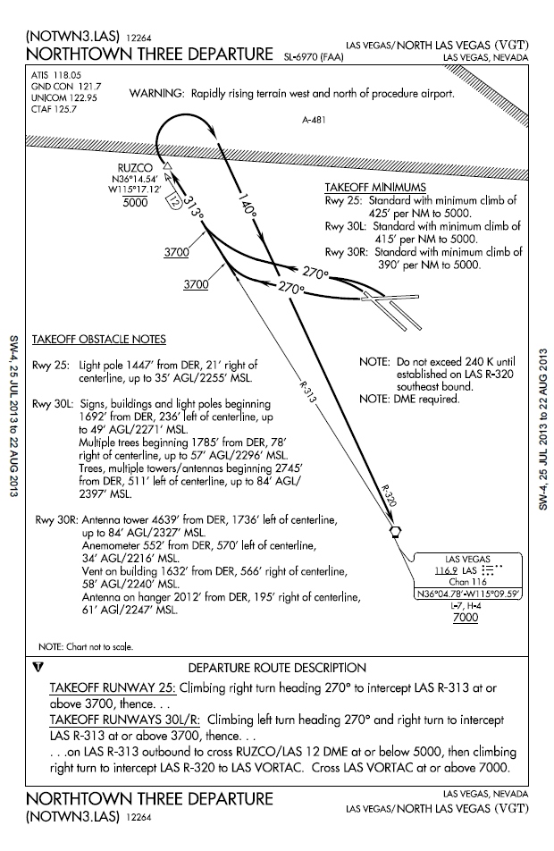
Standard Instrument Departure Procedure
Climb rates
SIDs are included in the TERPS immediately after the applicable airport’s approach plates
  SID charts depict the departure route, navigational fixes, transition routes, and required altitudes
Review vector SID charts prior to use because they often include nonstandard lost communication procedures
Limits / notes
Obstacle notes
Route description

Slide 29
Standard Instrument Departure Procedure
Typically, transition routes fan out in various directions from the end of the basic SID to allow pilots to choose the transition route that takes them in the correct direction
A transition route includes a course, a minimum altitude, and distances between fixes on the route
To file a SID in your route include the code from the bottom of the plate – eg. NOTWN3.LAS in the route described in the flight plan
  When filing a SID for a specific transition route, include the transition in the flight plan, using the correct departure and transition code
  clearance from ATC will include both the departure name and transition e.g., Joe Pool Nine Departure, College Station Transition

Slide 30
Departure Procedure Nomenclature
Based upon equipment required
  Non-RNAV DP - Established for aircraft equipped with conventional avionics using ground-based NAVAIDs
  RNAV DP - Established for aircraft equipped with RNAV avionics; e.g., GPS, VOR/DME, DME/DME, RNP, etc.
  Radar DP - Radar may be used for navigation guidance for SID design. Radar SIDs are established when ATC has a need to vector aircraft on departure to a particular ATS Route, NAVAID, or Fix
Based on Nav Responsibility
  PILOT NAV –
    Allows you to provide your own navigation with minimal radio communication
    May include initial radar vectors to help you join the procedure, but the majority of the navigation will remain the pilot’s responsibility
  VECTOR SIDS
    Usually requires ATC to provide radar vectors from just after takeoff until reaching the assigned route or a fix depicted on the SID chart
    Procedure does not include departure routes or transition routes because independent pilot navigation is not involved

Slide 31
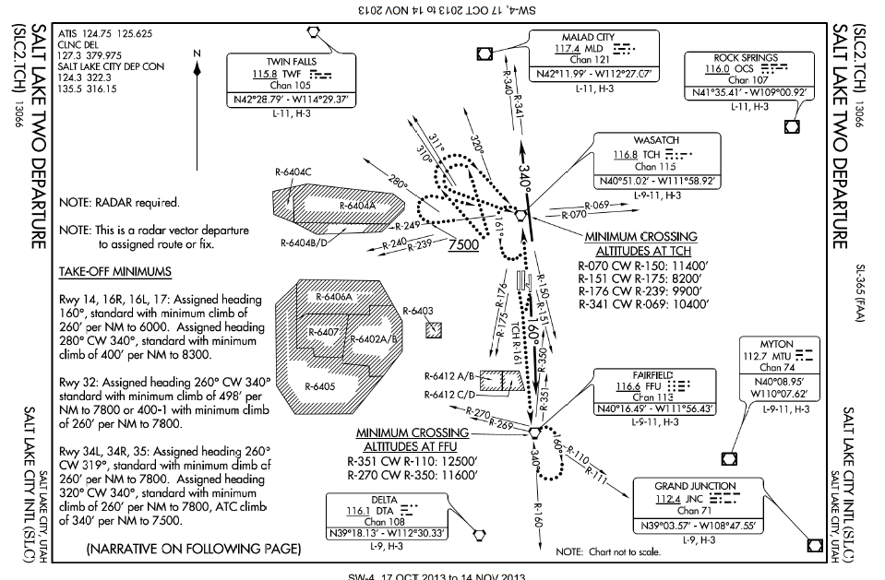
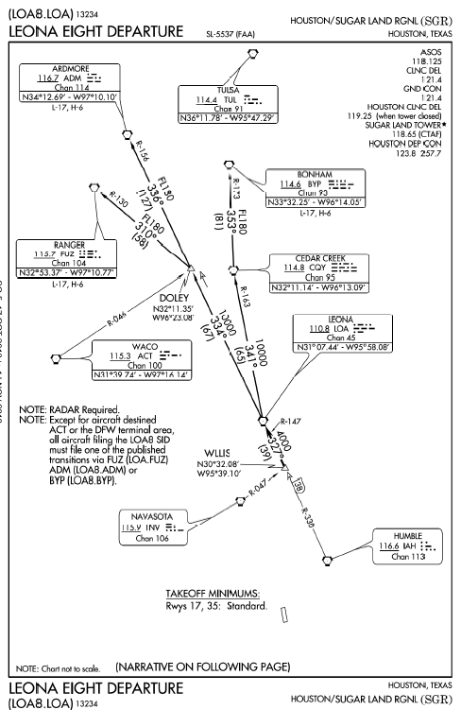
Departure Procedure
Vector Sid Example
Pilot Nav Sid

Slide 32
Takeoff Minimums
FAA establishes takeoff minimums for every airport that has published standard instrument approaches
  Used by commercially operated aircraft - Part 121 and 135 - 1 statute mile visibility for single and twin engine aircraft
  Smart to use for Part 91 operations, but not required
NACO charts list takeoff minimums only for runways with non-standard minimums
  Listed by airport in alphabetical order in the front of the TERPS
  Airport with non-standard takeoff minimums, has a “triangle T” or “trouble T” in the notes section of the instrument procedure chart

Slide 33

Departure Procedures are Important
On November 8, 2007, a Cessna T182T, on a route similar to our direct magenta line, was destroyed after impacting Potosi Mountain during climb to cruise, about 13 miles southwest of Las Vegas after departing KVGT on a SW heading. Both ATP rated pilots were killed. Had they followed the departure procedure, the mountain could have been avoided.
On January 16, 1942, 15 minutes after takeoff from Las Vegas Airport (now Nellis Air Force Base) the TWA aircraft slammed into Potosi Mountain, at an elevation of 7,770 ft, and was destroyed

Slide 34
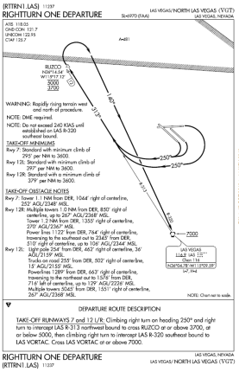

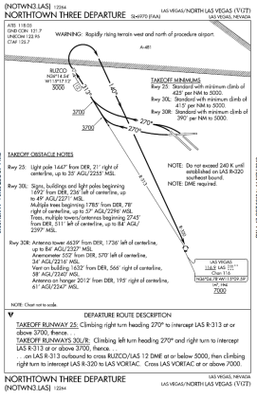
What’s Our Departure Plan
Consider the departure paths in the SIDs and determine if you can use a DP
  ODP - Possible
  Rightturn – doesn’t serve runways 30L/R – so not good for us
  Northtown - Possible
Be sure to check notes on the procedure – can you meet the requirements
Can you meet the climb gradient to specified altitude
  Metar = VGT 300553Z 32014KT 10SM OVC095 13/02 A2993 RMK AO2 SLP149

Slide 35
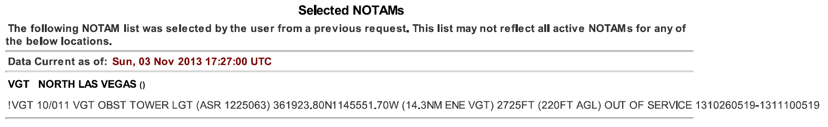
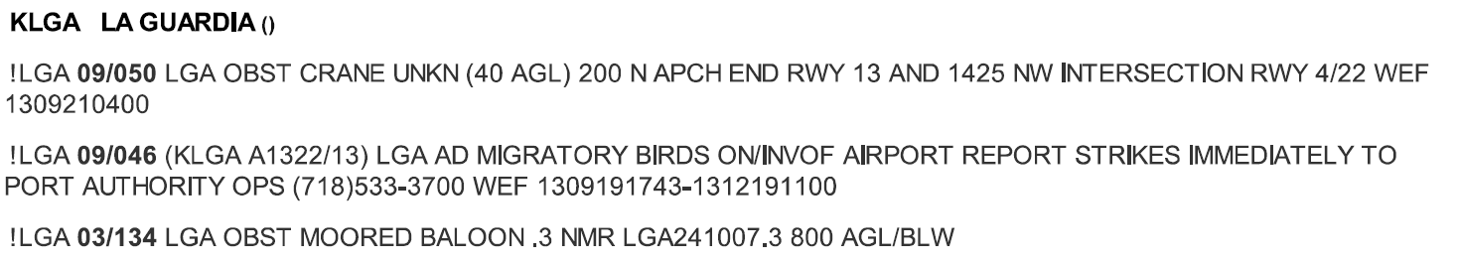

Departure Notams
Check Notams for new / temporary obstacles, unlit obstacles or other dangers that may affect your departure
Changes to departure procedures

Slide 36
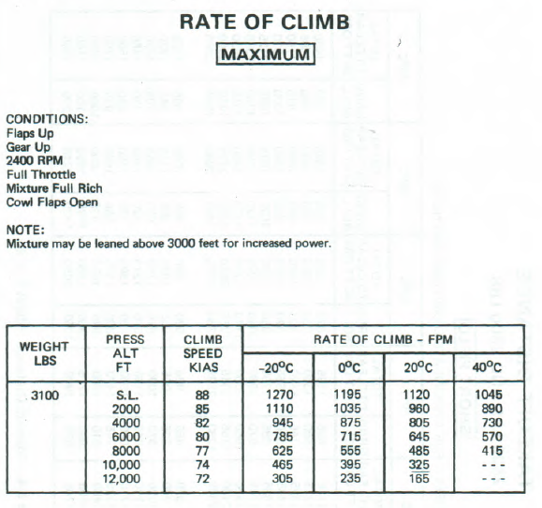
Climb Performance
Climb rate for 13° is 986’/min
To get climb per NM
85kts*/60 min = 1.41 NM minute
Climb performance per NM
986’/1.41=699’ per NM
* Assumes ground speed is the same as indicated – but must adjust airspeed by wind factor for actual ground speed
Assuming we use Northtown Three course of 313°, ground speed will be computed by converting IAS to TAS = 88.2kts; Ground speed with wind = 74.3/kts yielding climb of 796’ per NM
We can use any DP because our rate is more than 425’ (highest required rate)
From Performance section of POH
  Metar = VGT 300553Z 32014KT 10SM OVC095 13/02 A2993 RMK AO2 SLP149

Slide 37
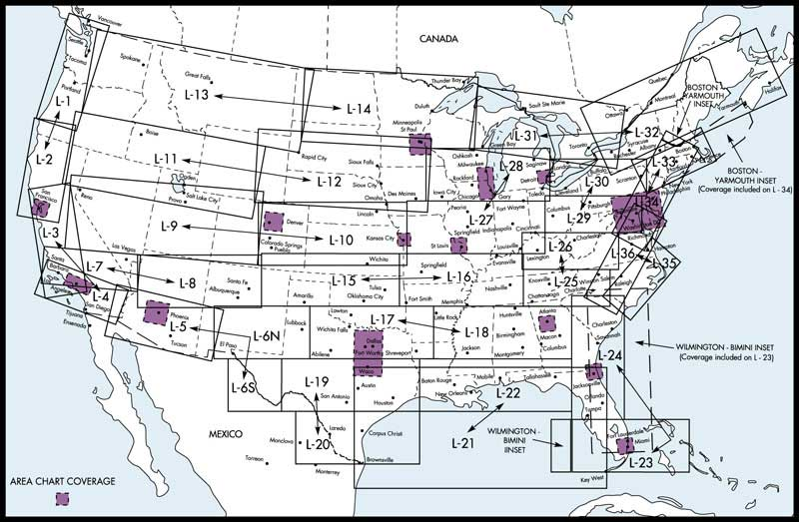
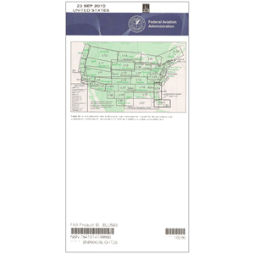
En-Route Charts
IFR en-route low altitude charts used for IFR below 18,000 feet MSL
Charts are revised every 56 days
Low en-route chart symbols are described in the Aeronautical Chart Users Guide
  Available at http://aeronav.faa.gov/content/aeronav/online/pdf_files/Chart_Users_Guide_11thEd.pdf
Charts show: (i) Air Traffic Services; (ii) Airports that have an Instrument Approach Procedure or a minimum 3000' hard surface runway; (iii) Airways/Route Data; (iv) Cruising Altitudes; (v) fixes/ATC Reporting Points; (vi) Limits of controlled airspace; (vii) Military Training Routes; (viii) Off Route Obstruction Clearance Altitudes (OROCA); (ix) Radio aids to navigation; (x) RNAV Routes; (xi) Special Use Airspace Areas; (xii) Tabulations (MTRs, SUAs, MOAs, Airport data)

Slide 38
En-Route Charts
Additional information on en route phase is contained in the PowerPoint on this webpage entitled Airways - What you always wanted to know - http://bob-cfi.weebly.com/uploads/7/6/9/3/7693240/ats_routes.pptx

Slide 39
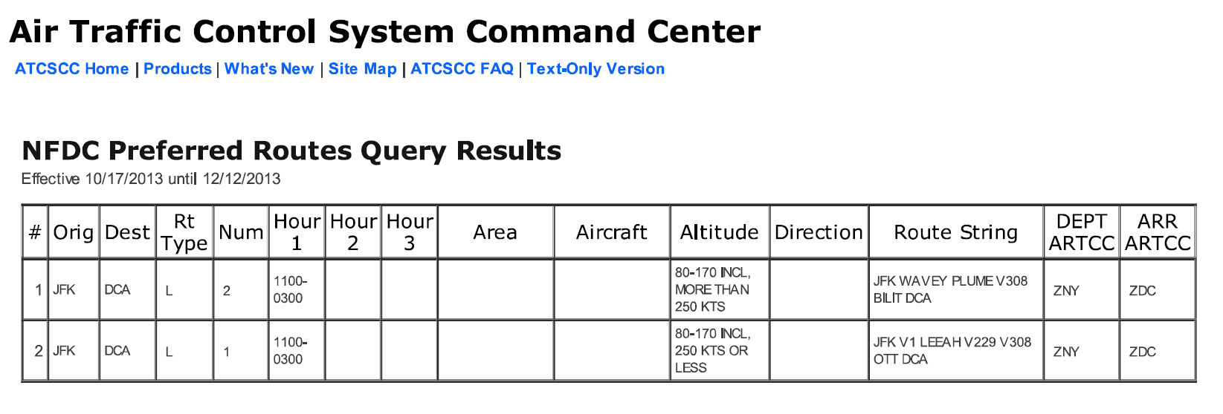
En-Route
Airways and Route Systems
First look for preferred routes between your city pair (may not be best for you, however) –
  Available online at http://www.fly.faa.gov/rmt/nfdc_preferred_routes_database.jsp
  There are none between Las Vegas and Los Angeles
Sample preferred routing from NY to DC

Slide 40
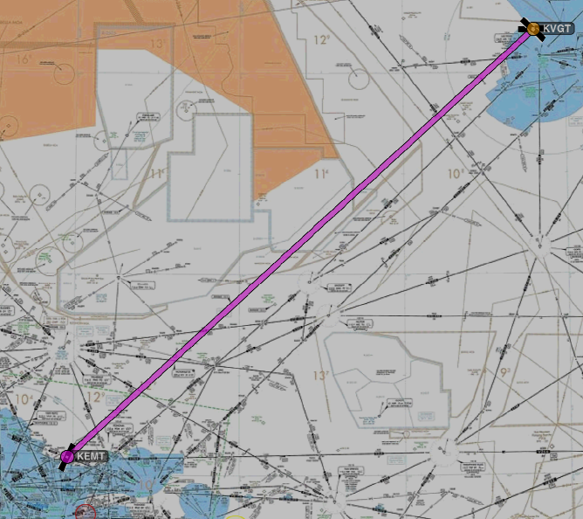
En-Route
Airways and Route Systems
Next I look at the magic magenta line on the IFR chart to see:
  What airways head the right way
  Navaid to navaid routes are possible
  RNAV options
Can also use a flight planning program such as DUATS to propose an initial route for consideration

Slide 41
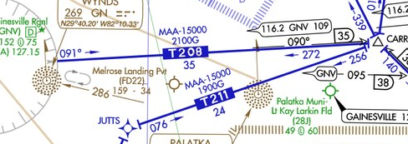
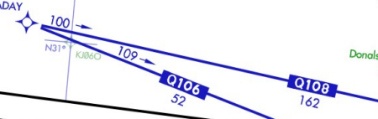

RNAV
Area navigation or random navigation (RNAV) allows pilots to choose any course within a network of navaids, rather than navigating directly to and from navaids
  Provides a shorter flight distance, reduces congestion, and allow flights into airports without beacons
Published RNAV routes - Q-Routes and T-Routes
  Can be used by aircraft with RNAV capability, subject to any limitations or requirements noted on en route charts, in applicable Advisory Circulars, or by NOTAM
  RNAV routes are depicted in blue on aeronautical charts and are identified by the letter "Q" or "T" followed by the airway number (e.g., Q-13, T-205)
    T-routes are available for RNAV aircraft from 1,200 feet above the surface (or in some instances higher) up to but not including 18,000 feet MSL. T-routes are shown on Enroute Low Altitude Charts as a blue line.
    Q-routes are available between 18,000 feet MSL and FL 450 inclusive. Q-routes are depicted on Enroute High Altitude Charts.
MRB

Slide 42
RNAV
“Unpublished” RNAV route
  Direct routes between waypoints defined in terms of latitude/longitude coordinates, degree-distance fixes, or offsets from established routes/airways at a specified distance and direction
    Radar monitoring is required
What is the Magnetic Reference Bearing (MRB), and what are the limitations on its use?
  Magnetic Reference Bearing (MRB) is the published bearing between two waypoints on an RNAV/GPS/GNSS route. The MRB is calculated by applying magnetic variation at the waypoint to the calculated true course between two waypoints
  The MRB enhances situational awareness by indicating a reference bearing (no-wind heading) that a pilot should see on the compass/HSI/RMI etc., when turning prior to/over a waypoint en route to another waypoint
  Pilots should use this bearing as a reference only, because their RNAV/GPS/GNSS navigation system will fly the true course between the waypoints

Slide 43
RNAV
AIM ¶5-1-8 d. RNAV route requirements:
  File airport-to-airport flight plans
  Plan the RNAV portion of the flight plan to begin and end over appropriate arrival and departure transition fixes or appropriate navaids. Use of preferred departure and arrival routes (DP/STAR), preferred, where established
  File route structure transitions to and from the random route portion of the flight
  Define the random route by waypoints using degree-distance fixes based on navaids
  File a minimum of one route description waypoint for each ARTCC through whose area the random route will be flown. Waypoints must be located within 200 NM of the preceding center's boundary.
  File an additional route description waypoint for each turnpoint
  Plan additional route description waypoints as required to ensure accurate navigation via the filed route of flight.
  Navigation is the pilot's responsibility, unless ATC assistance is requested.
  Plan the route of flight so as to avoid Prohibited and Restricted Airspace by 3 NM unless permission has been obtained to operate in that airspace and the appropriate ATC facilities are advised

Slide 44

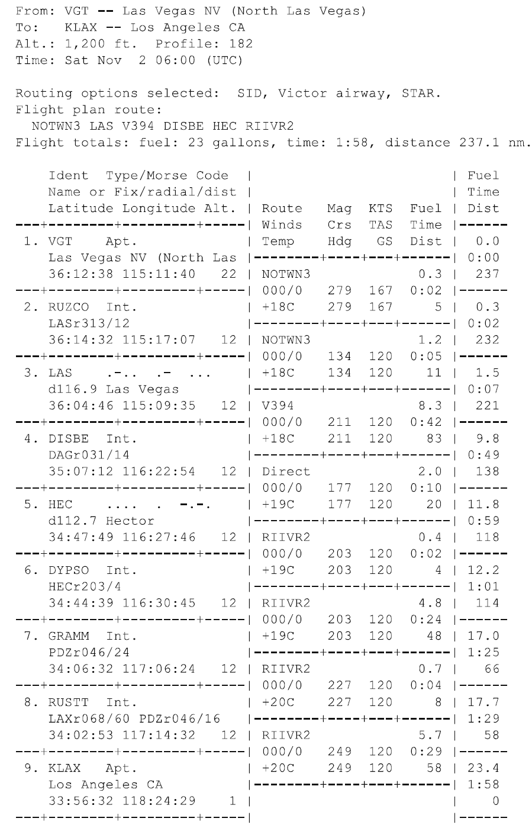
En-Route
Airways and Route Systems
Once the initial route is selected consider whether there is a better route based upon:
  Aircraft performance
  MEA / MOCA / MORA (Minimum Off Route Altitudes)
  Notams
  Weather
  Distance

Slide 45
Know the Aircraft’s Performance
Calculate the estimated time en route and total fuel requirement based upon factors, such as—
  Power settings
  Operating altitude or flight level
  Wind
  Fuel reserve requirements
  Weight and balance limitations
Determine whether the route is within the aircraft’s capability and operating limitations

Slide 46
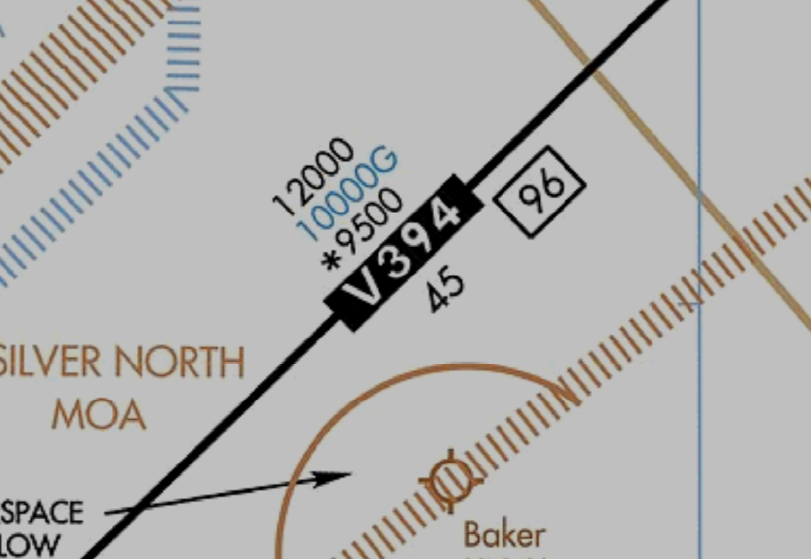
Aircraft’s Performance Sufficient for the Route
MEA
Look at MEA, MOCA and MORA along the entire route
  Is the aircraft’s performance sufficient / service ceiling higher than MEA
  Can you meet climb / crossing requirements
GPS MEA
MOCA

Slide 47
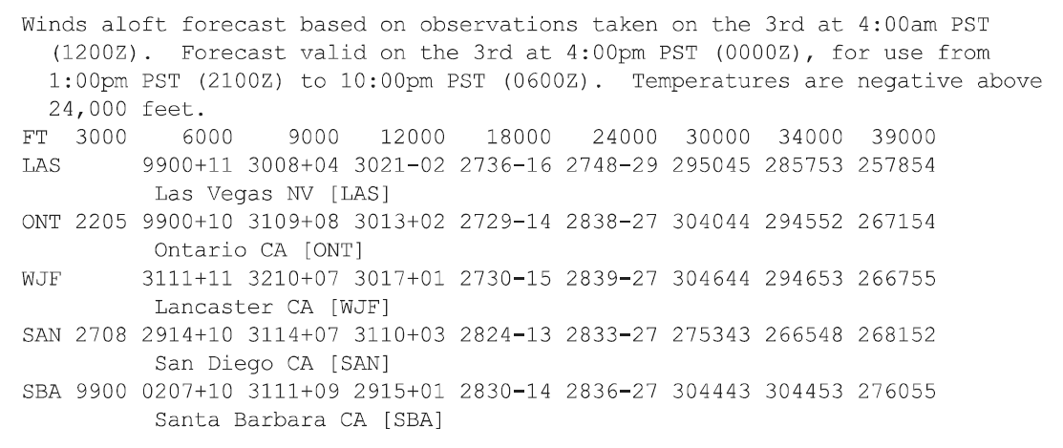
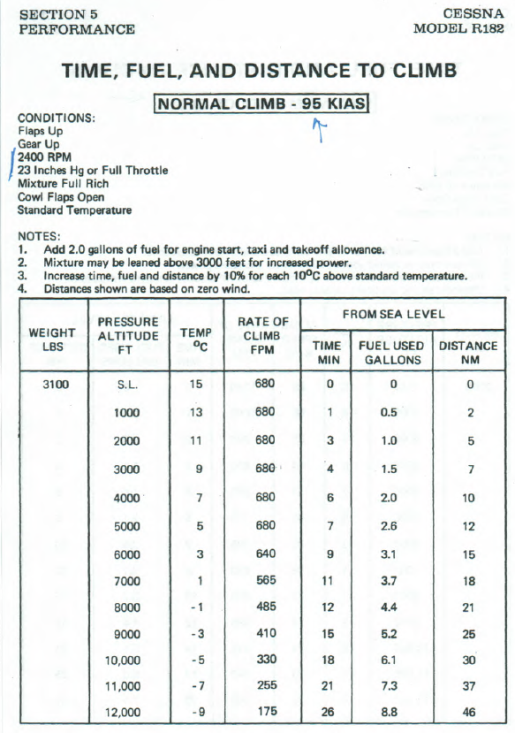

Aircraft’s Performance at the Route Altitude
Altitude selection is generally based on MEA, wind’s impact on performance and climb performance
12,000 is MEA and practical limit of the aircraft – so we will use 12,000
  Remember you can climb for higher segments and then descend for lower MEA segments

Slide 48
Aircraft’s Performance Climb to the Route Altitude
Take departure pressure altitude and subtract from route altitude – 2,000 Departure to 12,000 cruise
Result
  Time – 23 minutes
  Fuel used – 7.8 gal. + 2 gal. for takeoff/taxi
  Distance – 41 NM
  Adjust for wind and temperature per notes
Note: climb performance drops to less than 500 fpm; will need to notify ATC - AIM 5-3-3 a.(1)(c)
Consider whether another route with lower altitudes will be better

Slide 49
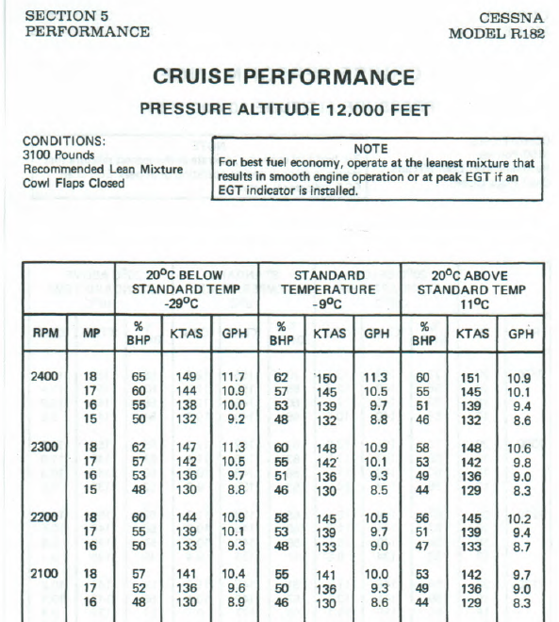

Aircraft’s Performance at the Route Altitude
Temp at altitude
13° @2000 - 20° = -7°
Select performance based on mission
  Speed – 150kts MP=18”/2400 RPM/11.3 gph
  Economy – 130 kts MP=15”/2300 RPM / 8.5 gph
  Compromise – 142 kts 2300/17”/10.1 gph

Slide 50
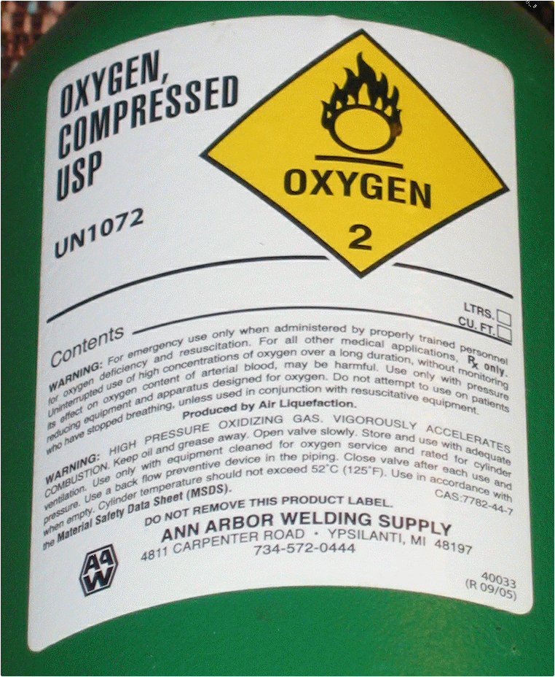
Oxygen Planning
§91.211
Above 12,500’ up to and including 14,000’ for that part of the flight at those altitudes that is of more than 30 minutes duration
Above 14,000’ must use oxygen at all times
Passengers – Above 15,000’ must be provided with oxygen
Suggested night use above 5,000’
No oxygen required on our flight because it remains below 12,500’

Slide 51

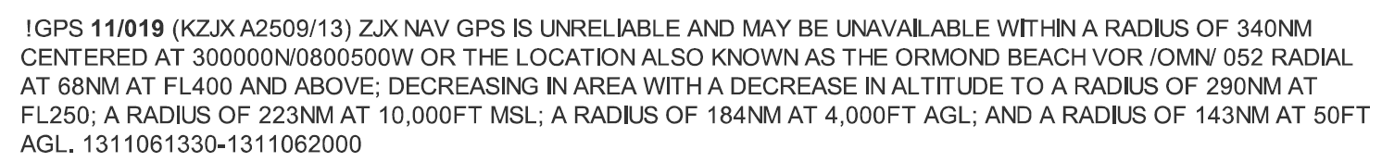
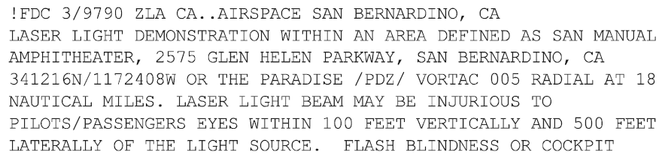
En-route Notams
TFRs
  Quick map view - http://tfr.faa.gov/tfr_map_ims/html/index.html
Navaids
  Out of service
  Limitations on use
GPS notams
Dangers – e.g. laser light show
MOA activity
Unmanned aircraft
ATC communication outages

Slide 52
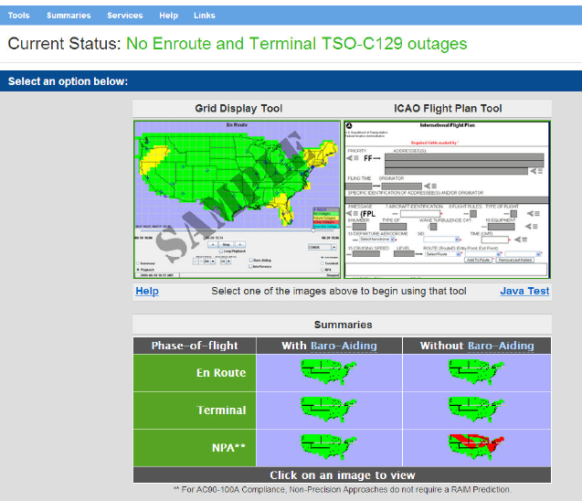
RAIM Prediction
Can do from GPS receiver – read the manual for the specific unit procedure
Online – See e.g., http://www.raimprediction.net/

Slide 53
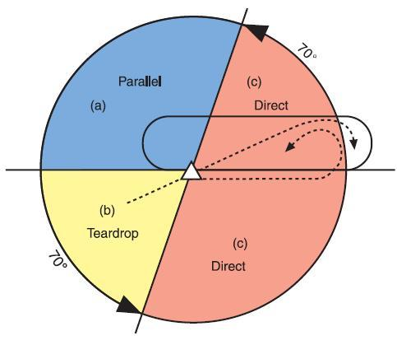
Traffic Delays
Air Traffic Control System Command Center - http://www.fly.faa.gov/flyfaa/usmap.jsp - website provides general delay information for airports
Advisories are normally issued for: (a) ground stops and (b) ground delay programs
Best source of known delay information is a briefer

Slide 54
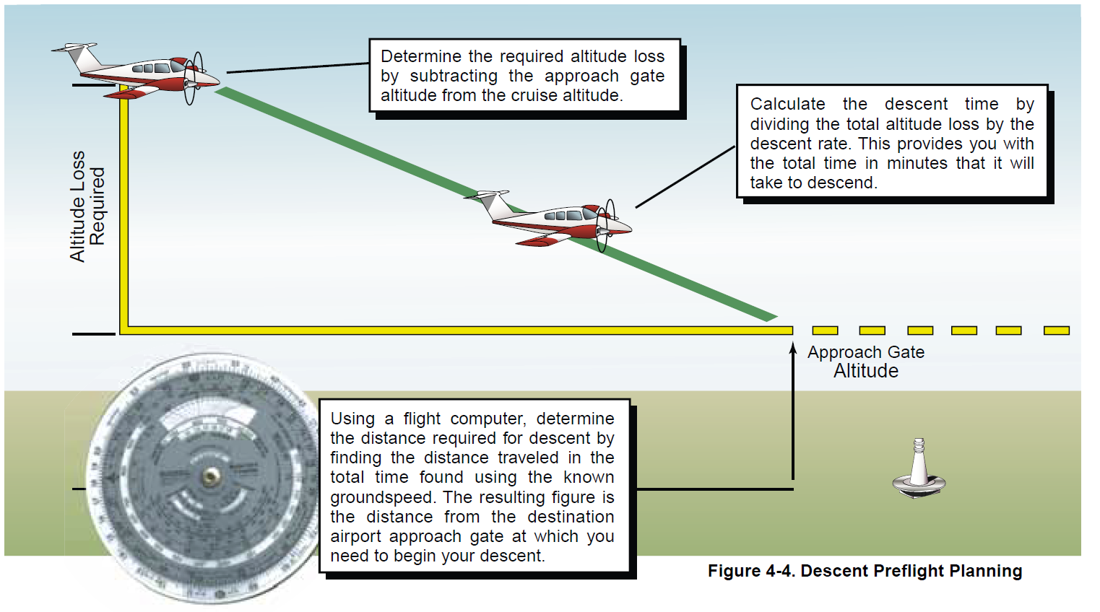
Descent Planning
Planning the descent is important in order to properly dissipate altitude and airspeed to arrive at the approach gate properly configured
  The approach gate is an imaginary point used by ATC to vector aircraft to the final approach course

Slide 55
Descent Planning
Types of descent Authorizations
Descend and maintain XX Thousand feet -Descend at the optimum rate for your aircraft until 1,000 feet above the assigned altitude, then descend at a rate between 500 and 1,500 feet per minute (FPM) to the assigned altitude
Descend “… at pilot’s discretion.” You may begin the descent whenever you choose and at any rate you choose
  You also are authorized to level off, temporarily, at any intermediate altitude during the descent. However, once you leave an altitude, you may not return to it
  You may request this type of clearance so that you can operate more efficiently – e.g. to remain above the clouds for as long as possible, to conserve fuel or to avoid prolonged flight in icing conditions

Slide 56
Descent Planning
Inappropriate descent planning and execution during arrivals has been a contributing factor to many fatal aircraft accidents – CFIT
  Know the terrain
  Know your vertical position and horizontal position

Slide 57
Standard Terminal Arrival Route Procedures
A STAR is an IFR arrival route for aircraft destined to certain airports
  RNAV STAR/FMSP are used by aircraft equipped with FMS or GPS
    Pilots navigating on STAR/RNAV STAR/FMSP procedures must maintain last assigned altitude until receiving authorization to descend
Purpose of STARs is to simplify clearance delivery procedures and facilitate transition between en route and instrument approach procedures
STARs start at the en route structure but don’t make it down to the pavement; they end at a fix or NAVAID designated by ATC (typically an approach gate, outer fix, instrument approach fix, or arrival waypoint in the terminal area), where radar vectors commonly take over
  STAR and approach procedure should connect to one another in such a way as to maintain the overall descent and deceleration profiles
  STAR officially begins at the common NAVAID, intersection, or fix where all the various transitions to the arrival come together
    Usually named according to the point at which the procedure begins
Many STARs contain specific lost communication procedures

Slide 58
Standard Terminal Arrival Route Procedures
A STAR may have mandatory speeds and/or crossing altitudes published
  Published speed restrictions are independent of altitude restrictions and are mandatory unless modified by ATC
  A STAR is simply a published routing; it does not have the force of a clearance until issued specifically by ATC
    For example, MEAs on STARs are not valid unless stated within an ATC clearance or in cases of lost communication
  Descent authority will be by specific instruction or “descend via” the procedure (may also contain exceptions)
    “Descend via the Reedr3 arrival.”
    “Descend via the Reeder3 arrival, except, cross DOWNE at or above six thousand”
May also contain planning information depicted to inform pilots what clearances or restrictions to “expect”
  “Expect” altitudes/speeds are not considered authorized unless verbally issued by ATC
  Not to be used communications are lost unless ATC specifically advised the pilot to expect these altitudes/speeds as part of a further clearance

Slide 59


Slide 60
Disclaimer
Instrument flight can be dangerous. Do not rely solely on this presentation – PROFESSIONAL INSTRUCTION IS REQUIRED
The foregoing material should not be relied upon for flight
ALTHOUGH THE ABOVE INFORMATION IS FROM SOURCES BELIEVED TO BE RELIABLE SUCH INFORMATION HAS NOT BEEN VERIFIED, AND NO EXPRESS REPRESENTATION IS MADE NOR IS ANY TO BE IMPLIED AS TO THE ACCURACY THEREOF, AND IT IS SUBMITTED SUBJECT TO ERRORS, OMISSIONS, CHANGE

