Slide 1
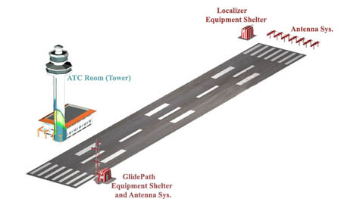
ILS Approaches

Slide 2
ILS Approach Nomenclature
ILS
Converging ILS
The ILS "converges" with another approach and thus has higher minimums. Usually if there are two converging approaches the ATIS will broadcast that converging approaches are in effect.
ILS or LOC
ILS LOC ONLY N/A
ILS Y & Z designators indicate important differences (IAP’s, FAP’s, MAP’s, FAC’s, Minimums, etc.) between multiple approaches to the same runway using the same base navigation equipment
ILS
RNAV/GPS
VOR
NDB
Generally, Z’s have the lower MDA’s/DA’s

Slide 3
ILS - Instrument Landing System
Most accurate approach typically available - lower minimums - height and visibility
Typically approximate 200 feet AGL minimum before visual contact with the runway environment is required
Offers horizontal, range and vertical guidance
Displayed on the Course Deviation Indicator (“CDI”), Horizontal situation Indicator (“HSI”) or glass panels
It is a “precision approach“ because it has vertical guidance
Approaches with only horizontal (lateral) guidance are referred to as non-precision approaches

Slide 4
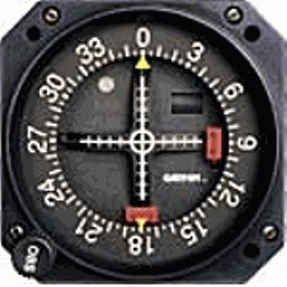
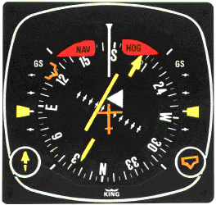
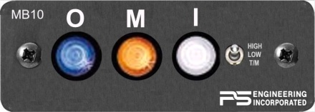
ILS - Instrument Landing System
Required equipment
CDI with glideslope display, HSI or glass cockpit display
You also often need a marker beacon receiver to indicate passage over ground components of some ILS
An ADF or RMI, is also useful for orientation on some approaches, but typically are not required for an ILS approach

Slide 5
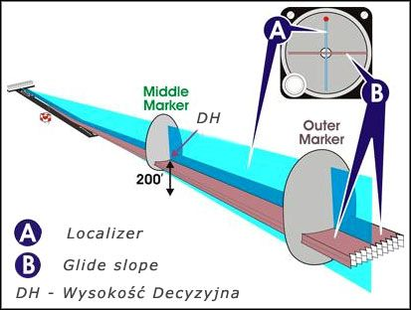
Information Received
Range information is received from outer and middle markers and sometimes an inner marker beacon
Guidance information
- Vertical from glide slope
- Lateral or azimuth from localizer
ILS approaches also have visual guidance information:
approach lights, touchdown and centerline lights, runway lights

Slide 6
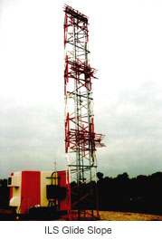
ILS Ground Radio Equipment
Localizer – Provides "left/right" azimuth guidance. Think of it as the same as the VOR needle - just more sensitive(3°- 6° vs 10°). The closer you get to the runway, the more sensitive it is.
Glide Slope: Provides vertical guidance.
Alarm flags

Slide 7
Localizer Signals
Tune the localizer frequency (108.1 – 111.95) – first digit after the “.” is always an odd #
Glide slope frequency (329.3MHz – 335MHz) is paired to the localizer frequency. Don’t need to tune the glide slope separately.
Morse code identifier – identify it. Good idea to keep it on in the background
Goal - Keep the needles centered to
form a cross

Slide 8
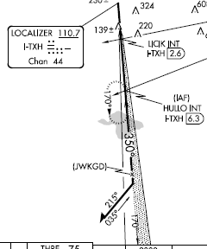
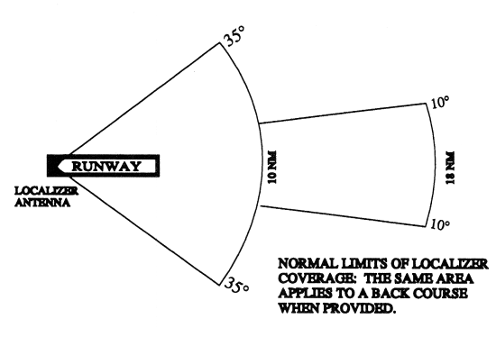
ILS – Localizer
Localizer course width is 3° to 6° (full scale – one side to the other)
Actual width varies to assure 700 feet full scale course width at runway approach threshold - based upon runway length and localizer antenna location (e.g. a short runway will have a wider angle)
- ILS is always aligned with the runway
Near the outer marker, a one-dot deviation puts you about 500 ft. from the centerline. Near the Middle Marker, one dot means you're off course by 150 ft.
Localizer identifier is a three-letter identifier preceded by the letter I-
CDI works by comparing strength of blue and yellow signals (90 and 150 Hz signals).
Blue Sector 150 Hz signal
Localizer signal is normally usable up to 18 NM from the field with a course width of 14° from 10 to 18nm. Course width is up to 35° from 10nm to the runway
Yellow Sector 90 Hz signal

Slide 9
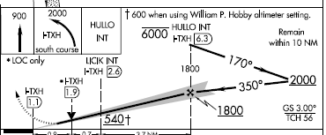
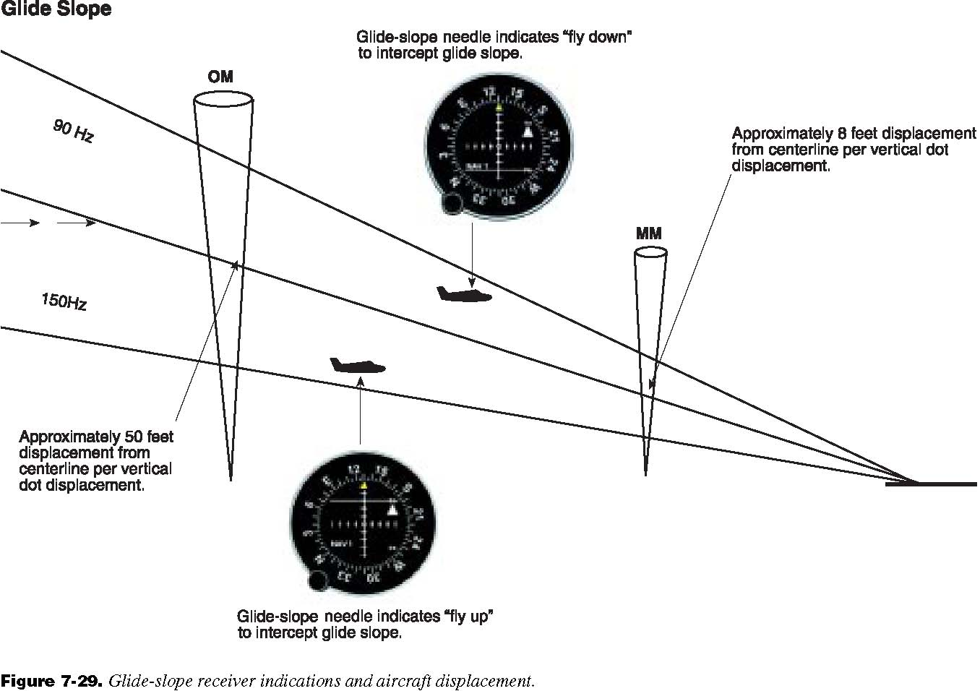
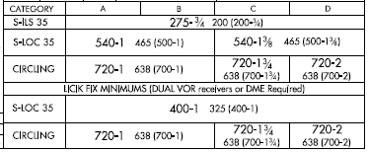
ILS – Glide Slope
Glide slope is generally at a 3° slope (300’ per nm)
Glide slope width is 1.4° - 3 X more sensitive than the localizer and 12 X more sensitive than a VOR - hence full scale deflection is .7°
Glide slope is more sensitive closer to the runway
Glide slope signal width - 5nm=350’ width; 3nm=210’ and 1nm=70’
At OM each dot of deviation is approx 50’ excursion; at the MM one dot is 8’ deviation
- Goal is touchdown at touchdown zone ≈ 1000’ past the threshold while passing over threshold at TCH
Glide slope only approved to DA; below that use only with visual supplementation

Slide 10
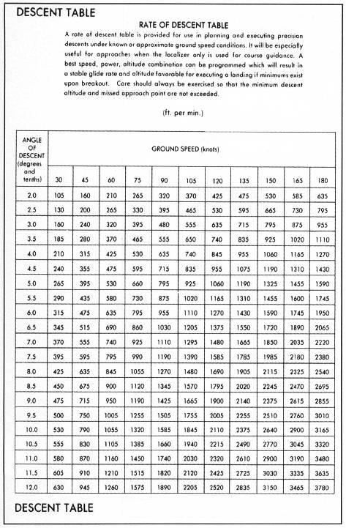
Rate of Descent for 3° Glide Slope
Ground Speed - Knots | 60 | 90 | 120 | 150 | 180
Descent Rate feet per minute | 300 | 450 | 600 | 750 | 900
3° Glide Slope formula - Rate of descent = ground speed × 5
General formula - Rate of descent = glide slope angle × ground speed × (100 / 60)
Note - A rate of descent table is included on the inside back cover of the Terminal Procedures publication (TERPS)

Slide 11
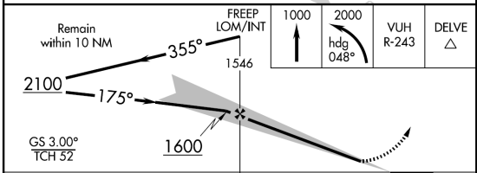
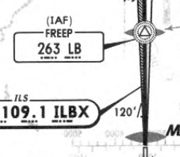
Outer Marker Beacons
Normally identifies the Final Approach Fix
Situated 4 to 7 miles from the runway
threshold along the localizer's extended
center line
Transmits a 400 Hz tone - two dashes per second
Blue light on the marker beacon receiver will flash
Often combined with an NDB to make a Locator Outer Marker (LOM)
Most ILS approaches have no outer marker but use other means, such as VOR intersections, DME, GPS, or radar fixes to identify range position
OM Identifier FIRST two letters of ILS
Range >= 15 miles and operate between 190 and 535 KHz
Solid line is the NDB
Triangle= Intersection
Circle = NDB
Elliptical shape=Marker beacon

Slide 12
Inner / Middle Markers
Middle Marker –
middle marker alerts the pilot that the missed approach point (typically 200 feet above the ground level) has been passed and that the missed approach should have been initiated if unable to land
Located on the extended center line normally at the decision height (missed approach point). This is usually .5 to .8 miles from the runway threshold.
Amber light on marker beacon will light, and a pattern of dot-dashes will be heard at a frequency of 1,300 Hz.
Identified by last two letters of the ILS (BX for ILBX)
Inner Marker –
located at the runway threshold - Used on category II and III
Marker beacon receiver’s white light will flash and you will hear a series of “dots”
Don’t need to "tune" Marker beacons. All beacons transmit on the same frequency, 75 MHz. Marker beacon receiver is pre-tuned to this frequency

Slide 13
Marker Beacons
Marker Beacon Receiver Indications
MARKER | CODE | LIGHT | SOUND
OM | _ _ _ | BLUE | 400 Hz two dashes/second
MM | ._._._ | AMBER | 1300 Hz Alternate dot and dash
IM | . . . . | WHITE | 3000 Hz only dots
BC | . . . . | WHITE
4 to 7 NM from the runway threshold @ glide slope intercept
.5 to .8 NM from the threshold, @ the Decision Height (200 AGL)
Note that the sound will get “faster" and the tone will become
"higher" for the markers closer to the airport

Slide 14
ILS Lighting
Approach lighting
Approach lights help you transition from the cockpit displays to outside visual reference for the landing.
There are a various ways these are displayed. The lighting consists of white and red lights.
Will talk about this in a later session

Slide 15
Using the CDI
CDI is a performance instrument – Keep it in the scan
Set the OBS to the localizer course – No effect on indication
Look at CDI for needle location and trend; BUT FLY THE ATTITUDE INDICATOR / DG – don’t chase the CDI
Intercept angle <30° - center the localizer as early as practicable
Initially steer localizer course +/- wind correction – heading should generally be established by the outer marker
Make corrections with gentle coordinated turns to reference headings on the DG using bracketing
Make corrections early and often to avoid the need for large corrections – remember corrections become finer and finer as you get closer due to the “funnel effect” of the ILS signals
Back course is reverse sensing – except on HSI

Slide 16
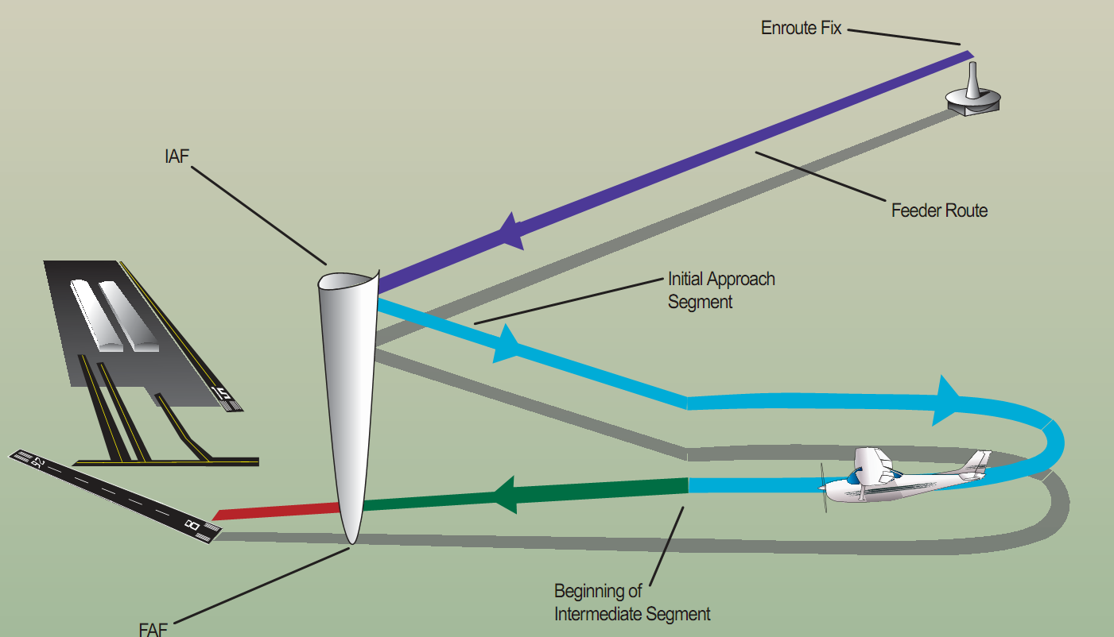
Approach Segments
Outer marker or other fix
Decision height on glideslope

Slide 17
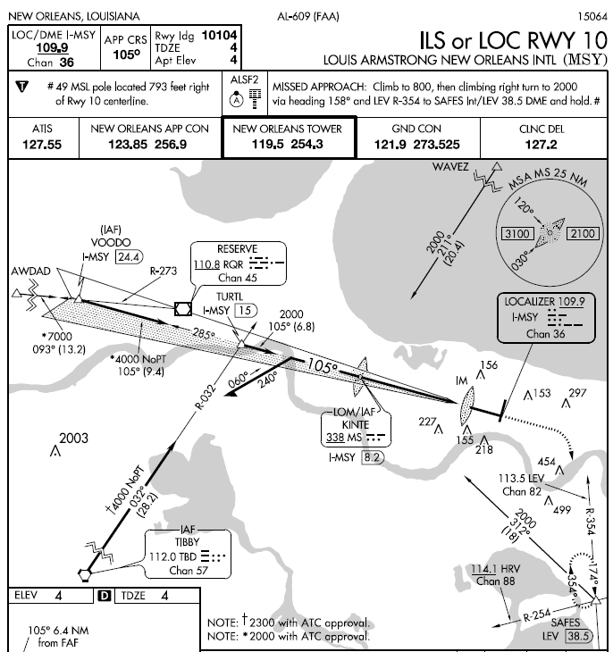
Initial Approach Fix / Initial Segment
Starting the Approach
ILS approach starts at the initial approach fix (IAF) – There can be several IAF’s – IAFS join at one or more common intermediate segments
You will reach the IAF from a “feeder route” which can be a radar vector
IAF is where the initial approach segment begins.
Purpose is to align the aircraft with the intermediate or final approach segment
Accomplished by using a DME arc, a course reversal, such as a procedure turn or holding pattern, or by following a terminal route that intersects the final approach course
Mandatory reporting non-radar
When leaving the outer marker or fix used in lieu of the outer marker inbound on final approach (precision approach) or when leaving final approach fix inbound on final approach (nonprecision approach)

Slide 18
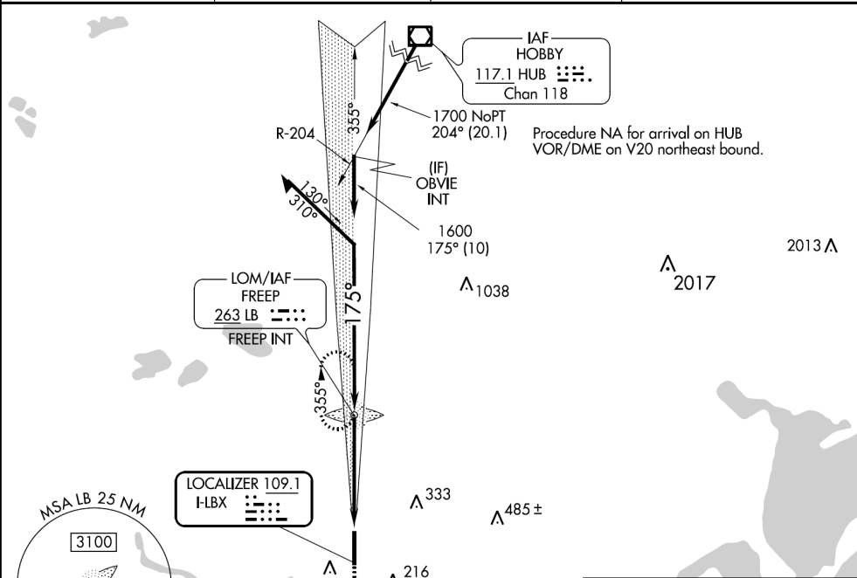
Initial Approach Fix / Initial Segment
Starting the Approach
IAF is usually a designated intersection, VOR, NDB, or DME fix
IAF may be collocated with the intermediate fix of the instrument approach. In that case there is no initial approach segment
Initial approach segment usually ends at the intermediate approach segment or at an Intermediate Fix (IF)

Slide 19
Intermediate Segment
Starting the Approach
Intermediate segment positions the aircraft for the final descent to the airport
normally aligned within 30° of the final approach course
Segment begins when
you are proceeding inbound to the FAF,
are properly aligned with the final approach course, and
are located within the prescribed distance prior to the FAF
May not be charted –
Approach with a procedure turn is the most common example of an uncharted IF
Intermediate segment begins when you intercept the inbound course after completing the procedure turn
Ends at beginning of final segment

Slide 20
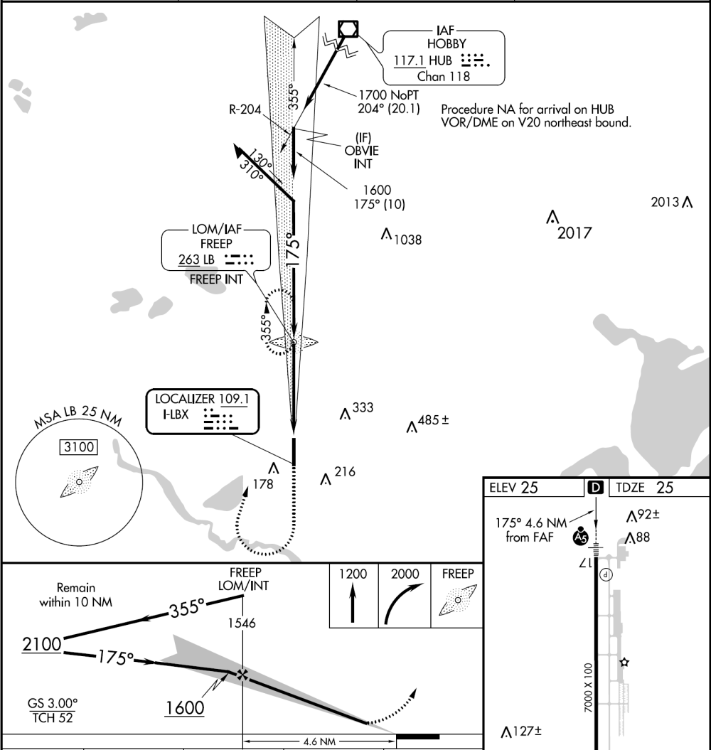
Final Segment
Starting the Approach
Final approach segment for an ILS begins at the glide slope intercept altitude shown on the chart (lightening bolt).
If ATC authorizes a lower intercept altitude, the final approach segment begins upon glide slope interception at that altitude
For a non-precision localizer approach, the final approach segment begins either at a designated FAF, depicted as a cross on the profile view, or at the point where the aircraft is established inbound on the final approach course
Mandatory ATC report – When you go missed in non-radar environment

Slide 21
Before the Initial Segment
Preflight – Plan the approach – Must be familiar with “all available information concerning a flight” prior to departure and FDC Notams
Enroute – Get weather (ATIS, FSS information, etc.) to help determine likely approaches and review
Calculate / review performance data, approach speeds, and power settings – confirm aircraft and weather are appropriate for the ILS procedure for aircraft’s certified category or, if higher, the actual speed to be flown
Set navigation / communication and automation - The navigation equipment required for an approach is generally indicated by the title of the procedure and chart notes

Slide 22
Before the Initial Segment
Review and brief the approach – Don’t forget to brief the missed approach
Begin reducing speed
Obtain ASOS/ATIS/AWOS on comm 2 – listen in the background
Note the time you cross the LOM / IAF

Slide 23
Initial Segment
Complete briefing the approach
Begin landing checklist – complete before final segment
Reset comm and nav radios with required frequencies
Comply with the clearance and approach
Finish reducing power to approach settings
Configure aircraft for landing – Initial flaps

Slide 24
Approach Briefing
Brief and review approach to assure you can execute it - Complete before the end of Initial segment
Runway length, Touchdown Zone elevation and airport elevation
Localizer identifier and frequency
Final approach course
Approach lighting type
Approach name
Flashing lights
Takeoff minimums / procedures – non-standard
Missed approach information
Special notes – often important!
Frequencies
Minimums for use as an alternate –> non-standard - - Can’t be used as a legal alternate
Dark = pilot controlled lighting;

Slide 25
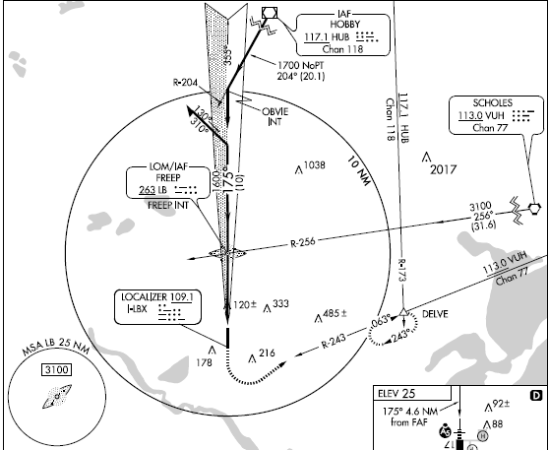
Approach Briefing
Plan view – mentally run through the approach
Front course (shaded right side)
IAF w/no procedure turn and nav aid info
Outbound course
Altitude and heading for segment
Procedure turn direction and heading information
Mileage to intersection from the nav aid
IAF with procedure turn (also outer marker)
Mileage to feeder intersection
Highest obstruction (largest size)
Inbound course
Transition route to IAF
Glide slope intercept
Missed approach frequency information
Localizer information
Missed approach hold
Distance and center identifier
Missed approach course
Holding course – in and outbound
Initial missed
approach
heading
Obstruction height may not be accurate
Holding point for missed approach
Sector minimum safe altitude
Center of MSA
Obstruction (not highest)

Slide 26
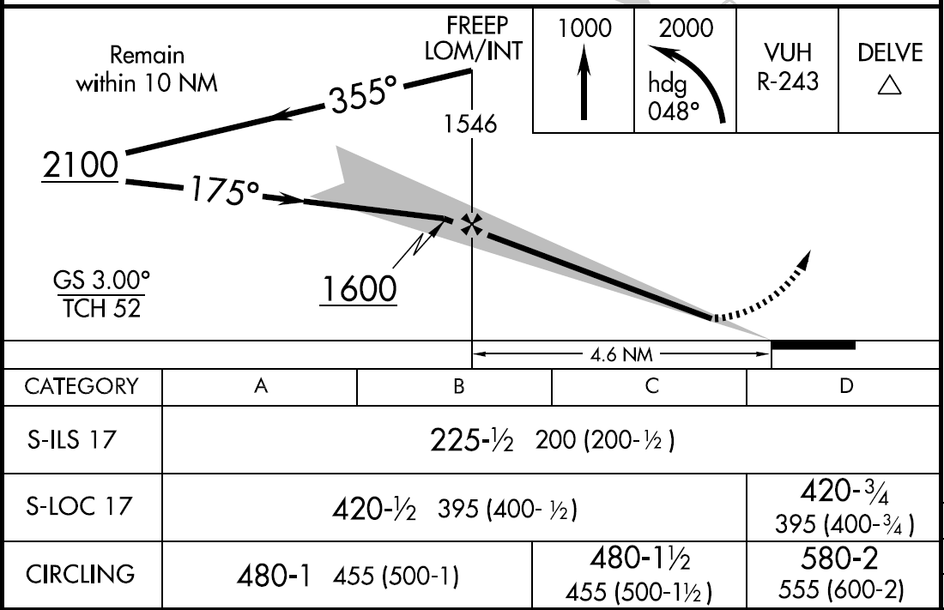
Approach Briefing
Profile view – mentally run through the approach
Minimum altitude for procedure turn can descend on inbound to intercept
Limiting note
Procedure turn outbound heading
IAF
Glide slope altitude at LOM
Graphical missed approach information
Non-precision FAF (point to begin MAP timing)
Inbound course
Glide slope angle /
Threshold crossing height
Mileage to threshold
Runway
Aircraft category
A <= 90
B < 121
C < 141
Minimums
NON-Precision approaches - must time for MAP
Glide slope intercept altitude MSL

Slide 27
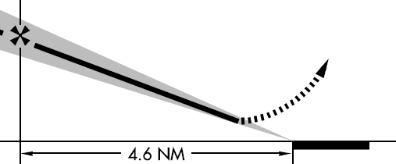
Missed Approach Briefing
Missed Approach Timing Information – required only for non precision localizer approach

Slide 28
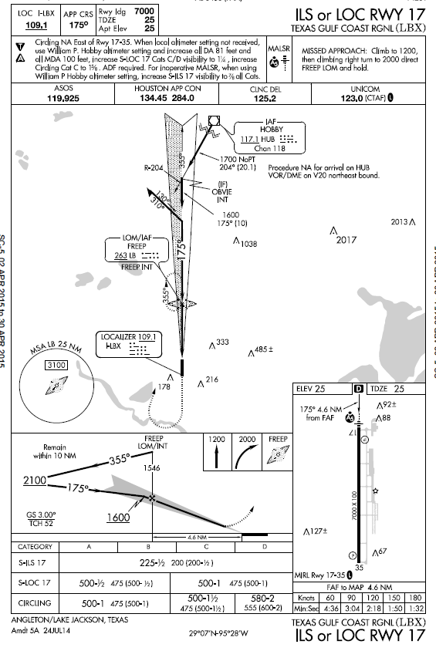
Let’s Fly – The Initial Segment
Radios tuned to LOM for LOM location/missed.
Confirm Morse code and leave on softly in the background
Reduce power to approach setting
Cross over the LOM at or above 2,100 feet – ADF needle and/or blue marker light will start flashing and you will hear dashes as you cross LOM
Turn to track outbound on the I-LBX localizer (355 degree) and begin descent to 2100, if higher
Begin timing - taking into account your groundspeed or tune DME - remember that your procedure turn must be completed within 10 miles of the LOM. Track outbound far enough, considering the wind, to give you enough distance to become stabilized before your descent begins
After 1 to 2 minutes on being established on the Localizer begin outbound turn left starting the Procedure Turn
Can be 310° degrees or other heading on protected side of course
Begin timing for 1 minute when wings are level.

Slide 29
Let’s Fly – The Initial Segment
After 1 minute turn right to 130° to re-intercept I-LBX (inbound localizer)
As the ILS localizer needle begins to move note the rate of movement to time the beginning your turn inbound on I-LBX (175°) localizer
Once inbound you are beginning the intermediate segment!

Slide 30
Let’s Fly – The Intermediate Segment
Inbound on I-LBX (175°)
Verify power settings for the approach and drop first notch of flaps
Descend from 2100 to 1600 – intercept is not less than 1600!
Glide Slope needle should start to come down from the top of the CDI/HSI (always intercept GS from below to avoid false glide slope signals above the real signal)
Set radios for missed approach Nav 1 on ILBX / ADF (263) or GPS to FREEP
When the glide slope needle reaches the middle of the CDI/HSI, drop the gear (some wait to FAF) and start your descent towards the DA
Corrections become smaller and smaller the closer you get to the runway

Slide 31
Let’s Fly – The Intermediate Segment
Watch for the blue OM light to flash, listen for "dah, dah, dah“, or the ADF needle to slew around from nose to tail
Start timing for missed approach on localizer approach or circle to land – good idea for ILS too
Likely to be told to switch to local frequency – swap comm 1 to 123.0
Complete landing checklist (try to complete as much as possible before GS intercept)
You are now at the final segment!

Slide 32
Let’s Fly – The Final Segment
Confirm gear down
Second notch flaps – Check in white arc
Final speed reduction
Glance out the window to look for the runway environment
You reach the DA 225’ (306’ with Hobby altimeter setting - +81’ per notes) (DA is MSL – DH is AGL) (DA is MAP)
If you now have an identifiable segment of the approach environment unmistakably visible and identifiable you may continue the approach if (FAR 91.175):
Visibility is above the minimums for approach category
You are in a position to make a normal descent to the intended runway using normal maneuvers

Slide 33
Let’s Fly – The Final Segment
If not, commence missed approach turn - do not turn out early (e.g. if full needle deflection)
Don’t wait for a fix or elapsed time or level off and look for the runway environment
Drop full flaps, if applicable, and land
If using circling approach level off at 500’ and continue to MAP based on timing
At MAP:
Runway environment in sight
Visibility above minimums
Able to make a normal descent to intended runway

Slide 34
NOTAMS
Antenna structure registration
Unsuitable
KLBX
03/008 - OBST TOWER 276 (259 AGL) 5.30 SSW LGTS U/S (ASR 1045650). WIE UNTIL 29 MAR 13:01 2011. CREATED: 14 MAR 13:01 2011
03/002 - OBST TOWER 274 (260 AGL) 4.53 SW LGTS U/S (ASR 1268444). WIE UNTIL 20 MAR 09:10 2011. CREATED: 05 MAR 09:10 2011
01/004 - NAV RWY 17 ILS MM DCMSN. 07 JAN 20:48 2011 UNTIL UFN. CREATED: 07 JAN 20:48 2011
Sugar Land
12/003 - NAV RWY 35 ILS DME UNMON. WIE UNTIL UFN. CREATED: 22 DEC 15:50 2010
WEF - with effect from, or effective from.
WIE - with immediate effect

Slide 35
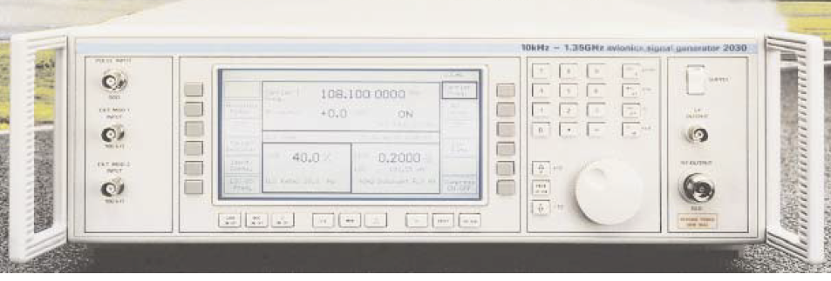
Monitoring of an ILS
Any failure of the ILS must be detected immediately by the pilot – Will see flag drop on HSI / CDI
Ground station often also monitored to determine if an ILS has failed - monitors continually assess the ILS signals. If a deviation beyond preset limits is detected, the ILS will either be automatically switched off or the navigation and identification components will be removed from the carrier signal
These actions will activate the failure flag on the CDI

Slide 36
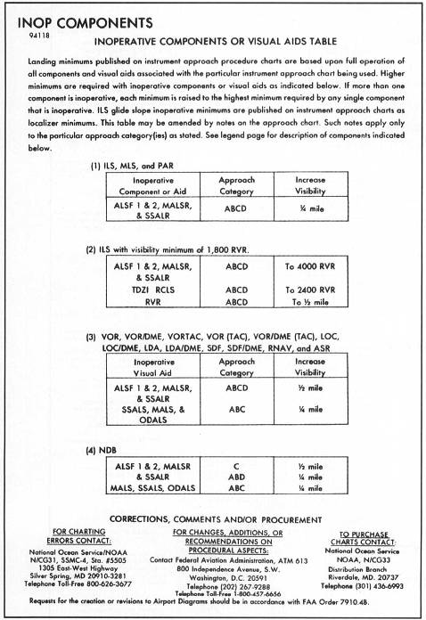
Inoperative Components
Inoperative localizer – If the localizer fails, neither an ILS nor a LOC approach are authorized
Inoperative glide slope: If the glide slope fails, the ILS reverts to a nonprecision localizer approach. Watch for “LOC ONLY N/A” approaches where localizer approaches are not approved.
Refer to the Inoperative Component Table (page A1) in the Terminal Procedures Publication (TPP), for adjustments to minimums due to inoperative airborne or ground system equipment.
Inoperative approach lights – add ¼ mile to visibility
Inoperative outer marker – You can substitute
Compass locator
Precision approach radar
Airport surveillance radar
DME fix
VOR fix
NDB fix
FAR § 91.175

Slide 37
Considerations
If you are low on the glide slope – do NOT climb – level off and re-intercept
Make small adjustments – see what happens and readjust
Remember sensitivity increases as you get closer to the runway
Hardest segment from GS intercept to DH to maintain descent rate, speed and course precisely
DO NOT FLY GS / LOC needles – bad things will happen! Watch AI / HSI/DG
With aircraft properly trimmed small changes in power will cause a pitch change and allow you to maintain airspeed
Must execute missed after the DA if you lose sighting of the runway environment
Remember rotating the OBS ring changes the course ring on the CDI/HSI, but has no affect on the needle – Localizer has only 1 radial
rotate the OBS to the desired localizer heading as a reminder of where you are going
Runway environment
Approach lighting system – not below 100’ AGL until you see red side lights or red terminating bar
Runway or runway markings or lights
Threshold, threshold markings or lighting
REILS
VASI
Touchdown zone or markings or lighting
Know for the approach
IAF and how to arrive at the FAF
Where to expect GS intercept
Minimum altitudes for each segment and DA
Missed approach procedure

Slide 38
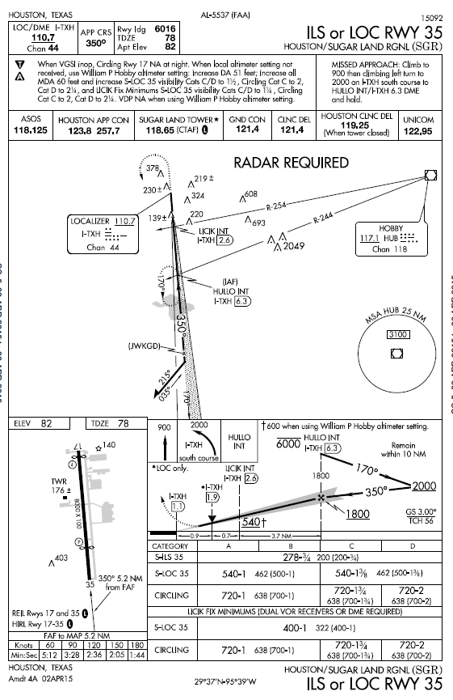
Sugar Land ILS 35
Differences
IAF is localizer fix at 6.3 DME / HUB 244 radial
MSA based upon a nav aid not primary to the approach
Non-standard hold at missed approach

Slide 39
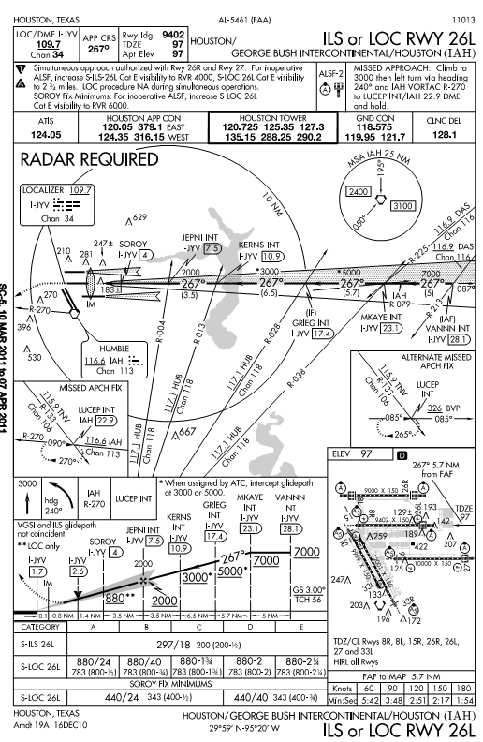
More complicated ILS - IAH
Approach notes – simultaneous approaches, inop equipment,
Rader required for the approach
IAF w/ VOR fix along the localizer or DME
Intermediate fix
Multiple GS intercept altitudes
Alternate missed approach procedure
Inner marker
Visual descent point – A point on the final approach course of a non-precision straight-in approach procedure from which a normal descent from the MDA to the runway touchdown point may be commenced, provided the approach threshold of that runway, or approach lights, or other markings identifiable with the approach end of that runway are clearly visible to the pilot
Multiple step down altitudes for LOC
RVR instead of SM visibility
Alternate minimums with fix OOS

Slide 40
Side Step Maneuver
A procedure by which a pilot flies the instrument approach to one runway and upon becoming visual makes gentle coordinated turns to a parallel runway located with 1200’ to either side of the instrument runway
Commence the sidestep as soon as you are visual and can identify the parallel runway

Slide 41
Simultaneous Approaches
ATC may conduct parallel approaches if >4300 feet exists between runways with non-conflicting missed procedures
If >2500’ but < 4300’ feet between runways with non-conflicting missed procedures – ATC can conduct 2 SM staggered parallel approaches
ATC can also conduct converging ILS approaches with sufficient spacing for runways with a 15° to 100° angle difference – ILS chart will denote converging approach – e.g. DFW

Slide 42
PTS Standard Area of Operation VI. B.
Exhibits adequate knowledge of the precision instrument approach procedures
Accomplishes the appropriate precision instrument approaches as selected by the examiner
Establishes two-way communications with ATC using the proper communications phraseology and techniques, as required for the phase of flight or approach segment
Complies, in a timely manner, with all clearances, instructions, and procedures
Advises ATC anytime that the applicant is unable to comply with a clearance.
Establishes the appropriate airplane configuration and airspeed/V-speed considering turbulence, wind shear, microburst conditions, or other meteorological and operating conditions.
Completes the aircraft checklist items appropriate to the phase of flight or approach segment, including engine out approach and landing checklists, if appropriate
Prior to beginning the final approach segment, maintains the desired altitude ±100 feet, the desired airspeed within ±10 knots, the desired heading within ±10°; and accurately tracks radials, courses, and bearings
Selects, tunes, identifies, and monitors the operational status of ground and airplane navigation equipment used for the approach.

Slide 43
PTS Standard Area of Operation VI. B.
Applies the necessary adjustments to the published DA/DH and visibility criteria for the airplane approach category as required, such as—
NOTAMs
Inoperative airplane and ground navigation equipment.
Inoperative visual aids associated with the landing environment.
NWS reporting factors and criteria
Establishes a predetermined rate of descent at the point where the electronic glideslope begins, which approximates that required for the aircraft to follow the glideslope
Maintains a stabilized final approach, from the Final Approach Fix to DA/DH allowing no more than ¾-scale deflection of either the glideslope or localizer indications and maintains the desired airspeed within ±10 knots.
A missed approach or transition to a landing shall be initiated at Decision Height
Initiates immediately the missed approach when at the DA/DH, and the required visual references for the runway are not unmistakably visible and identifiable
Transitions to a normal landing approach only when the aircraft is in a position from which a descent to a landing on the runway can be made at a normal rate of descent using normal maneuvering

Slide 44
PTS Standard Area of Operation VI. B.
Maintains localizer and glideslope within ¾-scale deflection of the indicators during the visual descent from DA/DH to a point over the runway where glideslope must be abandoned to accomplish a normal landing.
Uses MFD and other graphical navigation displays, if installed, to monitor position, track wind drift and other parameters to maintain desired flight path
Demonstrates an appropriate level of single-pilot resource management skills

Slide 45
QUESTIONS

Slide 46
Disclaimer
Instrument flight can be dangerous. Do not rely solely on this presentation – PROFESSIONAL INSTRUCTION IS REQUIRED
The foregoing material should not be relied upon for flight
ALTHOUGH THE ABOVE INFORMATION IS FROM SOURCES BELIEVED TO BE RELIABLE SUCH INFORMATION HAS NOT BEEN VERIFIED, AND NO EXPRESS REPRESENTATION IS MADE NOR IS ANY TO BE IMPLIED AS TO THE ACCURACY THEREOF, AND IT IS SUBMITTED SUBJECT TO ERRORS, OMISSIONS, CHANGE

