Slide 1
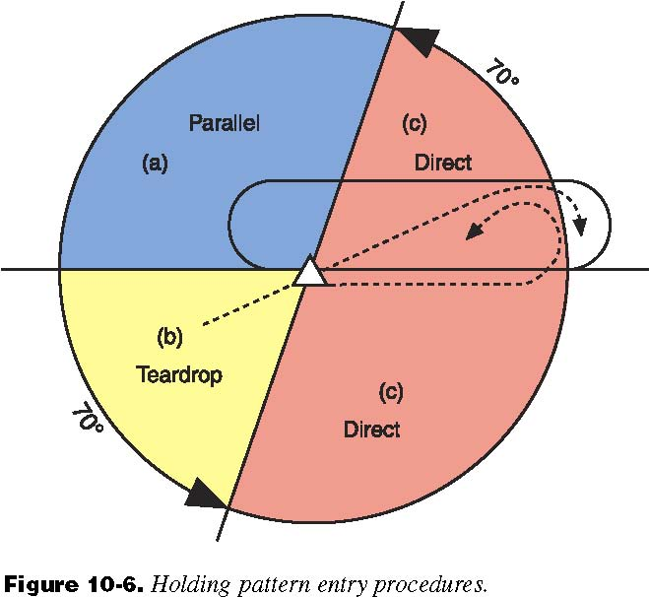
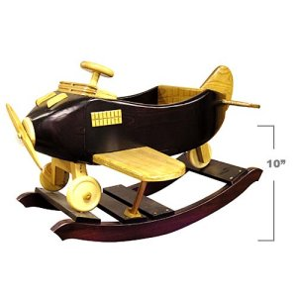
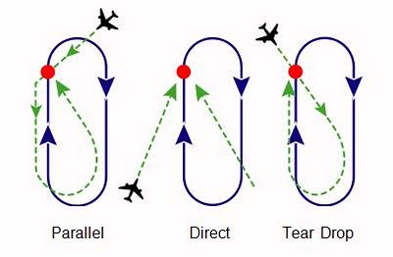
Letting Time Pass By -
How to Hold

Slide 2
Why
Permits ATC to adjust traffic flow so that it fits into the separation standards - congestion
Maintains separation while awaiting further enroute clearance
Maintains separation while waiting for other aircraft to commence an approach
Maintains separation while waiting for a storm to pass or a runway to be cleared
Maintains separation while waiting for an arrival slot
Several aircraft may fly the same holding pattern at the same time, separated vertically by 1,000 feet or more (a “stack or holding stack”)
One airport may have several holding patterns; depending on where aircraft arrive from or which runway is in use, or because of vertical airspace limitations.

Slide 3
The Hold
A hold is a “racetrack” shaped closed-course, where the start of the turn at one end is either a VOR, NDB, intersection of VOR radials or a DME distance (the “holding fix”)
The hold can have left-hand or right-hand turns
Correct direction for a given hold is shown on the IFR chart (you can't choose the direction yourself)
Standard is turns to the right, use right turns if no direction is specified
Altitude for the holding pattern may also specified on the applicable chart
The hold can be divided into four parts
Turn at each end (180 degrees, and performed at standard rate = one minute)
The leg on each side (outbound and inbound) – generally one minute
One turn in the hold therefore will take about four minutes

Slide 4
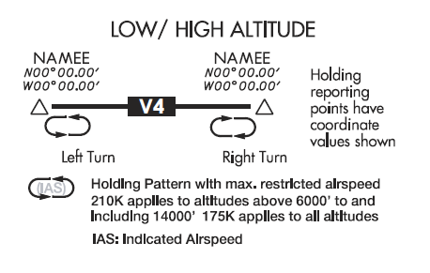
The Hold
Timing generally begins here
No direct tracking information on outbound leg – estimate heading for winds
Turn should be standard rate and never greater than 30°
This is the main tracking leg

Slide 5
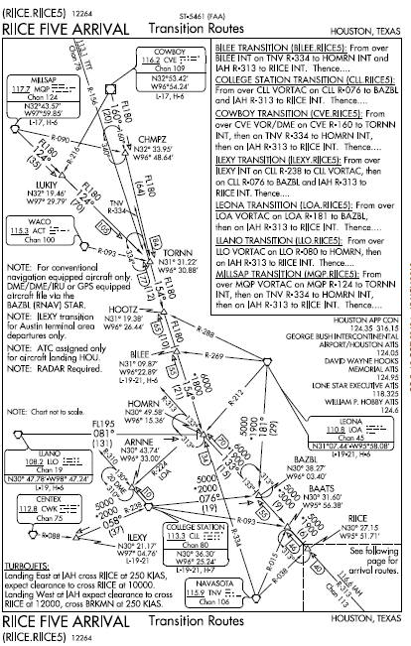
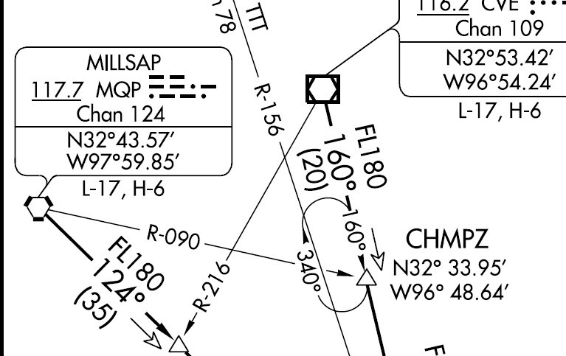
The Hold
VOR of hold radial
Intersection VOR
Course
Inbound/outbound
Turn direction
Hold fix –
Name and
Position

Slide 6
Information ATC will Provide
A hold clearance is generally given 5 minutes ahead and contains the following components:
clearance to the holding fix
direction to hold from the holding fix;
a specified radial, course, or inbound track that is used for the hold;
the DME distance to be used for the outbound leg, if applicable;
the altitude or flight level to be maintained;
the time at which further clearance or approach clearance is to be expected (in the event of a communications failure)
When a holding pattern is charted, ATC may omit all holding instructions except the charted holding direction and the statement “as published.”
But will issue complete holding instructions when on pilot request
PHRASEOLOGY-
HOLD (direction) OF (fix/waypoint) ON (specified radial, course, bearing, track, airway, azimuth(s), or route.)
If leg length is specified, (number of minutes/miles) MINUTE/MILE LEG
If direction of turn is specified, LEFT/RIGHT TURNS.

Slide 7
Interpreting ATC Clearance
The direction from the fix (Hold east of XYZ on the 090 radial) including the radial or bearing to hold.
This holding direction is the side to hold on but is not the course for the inbound direction
A radial is from a VOR, a bearing is TO an NDB
Using a DME hold requires that you change your time for a leg into a distance for a leg
Using DME you turn after the DME distance outbound regardless of time
Expect further clearance (EFC) is required information for a hold. If ATC fails to give it, ask for it – Don’t accept a hold without it!

Slide 8
Non-Published Holds
If given a non-published hold you should
Write down the instructions
Sketch out a diagram of the hold
Start at the fix
Draw the inbound leg with an arrow toward the fix
Show turn direction

Slide 9
Lost Communications
If you are unable to obtain holding instructions prior to reaching the fix
Hold in a standard pattern
Hold on your arrival course to the fix
Request instructions as soon as possible

Slide 10
Preparation to Enter a Hold
First slow down
Entering a hold with excess speed increases the probability that you will fly out of protected airspace
Do not reduce speed sooner than three minutes before reaching the fix and no later than the holding fix
You can get ATC approval if you wish to slow up sooner, however
Know when you arrive at the holding fix
Make your outbound turn within six seconds of crossing the holding fix, unless less than 180 degree turn on entry

Slide 11
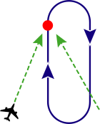
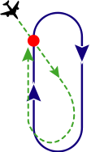
Entering the Hold
The entry to the holding pattern is often the hardest part for a pilot
Three standard types of entries:
Direct – fly directly to the holding fix, and immediately begin the first turn outbound – if less than 180 degree turn outbound continue past the intersection for 1 second for each 3° less than 180°
Parallel - Fly to the holding fix, turn outbound to parallel the inbound course on the non-holding side (left turn on standard pattern) for one minute outbound, and then turn back (left turn), fly directly to the fix, and continue in the hold
Teardrop - fly to the holding fix, turn into the protected area (outbound heading less 30 degrees) (plus 30° for non-standard pattern), fly for one minute, and then turn back inbound, to intercept the inbound course and proceed to the fix and continue from there

Slide 12
Entering the Hold
The proper entry procedure is determined by the angle difference between the direction the aircraft flies to arrive at the holding fix and the direction of the inbound leg of the holding pattern
The instrument PTS does not say the FAA methods must be used or prohibit use of any procedure so long as you remain in the protected airspace on the holding side of the fix

Slide 13
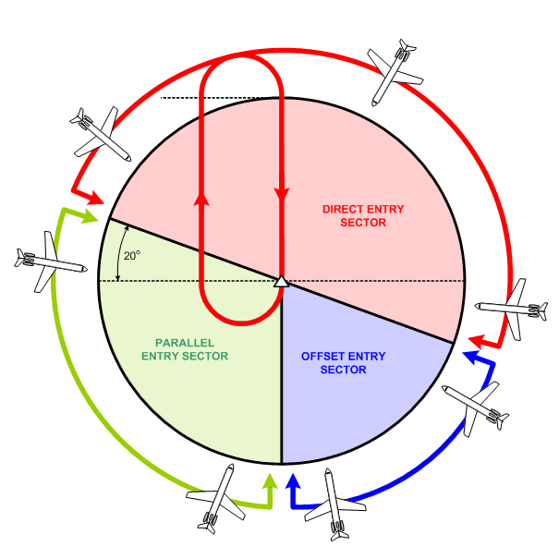
The Hold Entry
Right hand turn

Slide 14
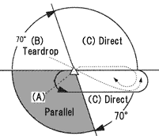
Hold Entry – Left Turns

Slide 15
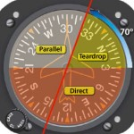
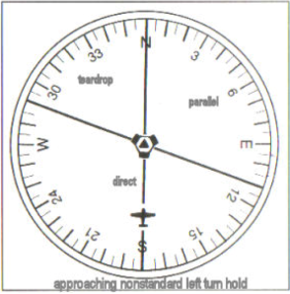
Hold Entry and the DG
260° outbound course – parallel entry (with right turns)
Course toward holding fix
Parallel and teardrop reverse
For right hand turn entry
Superimpose the
outbound course on
the DG to determine
Entry while inbound
To the holding fix
120° outbound course – direct entry with right turns
Assume center of HI is the holding fix

Slide 16
Hold Parameters
One minute inbound legs are made in holds ≤14,000’
> 14,000’ – legs are extended to 1.5 minutes.
Maximum speeds
Up to 6,000 ft MSL: 200 KIAS
From 6,001 to 14,000 ft MSL: 230 KIAS
14,001 ft MSL and above: 265 KIAS
Many aircraft have a specific holding speed published by the manufacturer
Use a lower speed at which the aircraft uses less fuel per hour than normal cruise speed

Slide 17
Hold Parameters - Altitude
If No minimum holding altitude
Maintain last assigned altitude until you leave the hold and are established on the inbound course
Minimum holding altitude assigned at an outer fix
Remain at assigned altitude
Following clearance can descend to the MHA
Once established on inbound course can descend to approach altitude
Minimum holding altitude- The lowest altitude for a holding pattern which assures navigational signal coverage, communications, and meets obstacle clearance requirements

Slide 18
ATC Reporting
Upon entry
Time
Altitude
When leaving the hold

Slide 19
Timing
Time outbound leg
When abeam the holding fix
To/From flag flip flop if VOR is holding fix
Wings level if intersection, waypoint or DME holding fix
90 degree +/- wind on ADF
If can’t determine holding fix, then begin when wings are level at the end of the outbound turn
Key is to adjust outbound leg to have a 1 minute inbound leg (or 1.5 minutes over 14,000’)
Two rules of thumb
Double the inbound deviation – e.g. 50 seconds inbound requires 1:20 outbound and 1:10 inbound requires a 40 second outbound
For tailwinds reduce outbound leg by 2 seconds per knot of tail wind and increase by 2 seconds for each knot of headwind
For large deviations make several progressive adjustments
Formula: (initial outbound/initial inbound) = (adjusted outbound time / required inbound time 60 or 90 seconds generally)
When departing the fix adjust your leg length to arrive over the fix as close as possible to the departure time

Slide 20
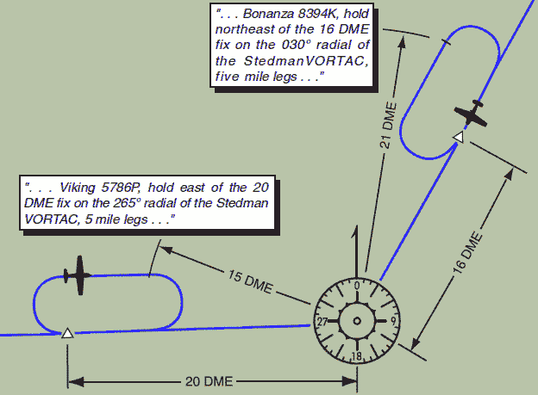
DME Fixes
If holding at a DME fix and the inbound course is:
Toward the Navaid, the fix distance is the lowest DME
Away from the Navaid, the fix distance is the highest DME

Slide 21
Intersection Holds
Inbound course should be set on VOR 1
If you are holding on a fix towards the VOR, the TO flag will show throughout the pattern
If you are holding on a fix away from the VOR, the from flag will show the entire time
On VOR 2 select the cross radial (from the VOR) rather than the bearing to the VOR – This way the CDI will be on the same side as the ground station as you approach the radial

Slide 22
Holding Wind Correction
Compensate for headwind / tailwind on inbound and outbound legs by timing
Pattern will not be as symmetric with crosswind
Turn into the wind – tend to undershoot inbound
Turn with the wind – tend to overshoot inbound
Double outbound wind correction angle on the inbound leg – If wind is small may need to triple correction up to 30°
Remember crosswind correction will be to the opposite side on inbound and outbound legs!
Larger drift correction than 1:1 is required to adjust for drift in the turn back inbound (want more correction than just parallel course)
Failure to use this technique may allow for drift onto the non-protected side of the hold or make it difficult to intercept the course and fix
Generally takes 2 or 3 circuits to get wind correction down

Slide 23
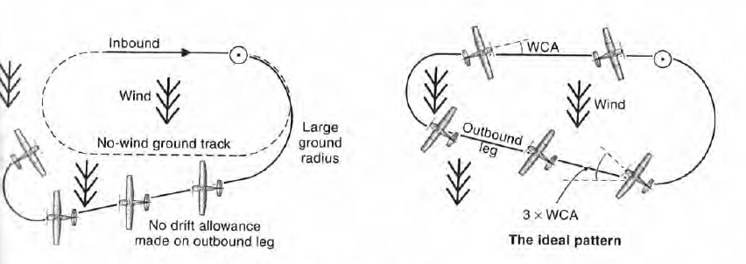
Holding Wind Correction
Note small radius on turn into the wind; If your turn is too wide, increase bank up to 30°
Note large turn radius when turning downwind; If your turn is too steep decrease the bank midway through the turn

Slide 24
Holding Fix on an Approach
Where holding at a fix associated with an approach AND timed approach procedures are being used, DO NOT execute a procedure turn unless you advise ATC
Holding aircraft are expected to proceed inbound on final approach directly from the hold when the clearance is received

Slide 25
Common Errors
Improper entry procedure
Failure to recognize holding fix passage
Failure to follow ATC instructions
Improper timing
Poor wind drift correction
Failure to have the inbound course on the VOR OBS during the entire procedure (OBS will be show reverse commands on the outbound leg, however)

Slide 26
PTS Standards
Exhibits adequate knowledge of the elements related to holding procedures.
Changes to the holding airspeed appropriate for the altitude or aircraft when 3 minutes or less from, but prior to arriving at, the holding fix
Explains and uses an entry procedure that ensures the aircraft remains within the holding pattern airspace for a standard, nonstandard, published, or non-published holding pattern
Recognizes arrival at the holding fix and initiates prompt entry into the holding pattern
Complies with ATC reporting requirements
Uses the proper timing criteria, where applicable, as required by altitude or ATC instructions.
Complies with pattern leg lengths when a DME distance is specified.
Uses proper wind correction procedures to maintain the desired pattern and to arrive over the fix as close as possible to a specified time
Maintains the airspeed within ±10 knots; altitude within ±100 feet; headings within ±10°; and tracks a selected course, radial or bearing within ¾-scale deflection of the CDI
Uses MFD and other graphical navigation displays, if installed to monitor position in relation to the desired flightpath during holding
Demonstrates an appropriate level of single-pilot resource management skills

Slide 27
Turn – to heading for entry
Time – on outbound leg – 1 min – at fix crossing for teardrop and parallel entry; when abeam / wings level for direct
Twist – Set OBS for inbound course
Throttle – Reduce to hold speed
Talk – ATC report entry, time and altitude and leaving hold
Holding Questions

Slide 28
Disclaimer
Instrument flight can be dangerous. Do not rely solely on this presentation – PROFESSIONAL INSTRUCTION IS REQUIRED
The foregoing material should not be relied upon for flight
ALTHOUGH THE ABOVE INFORMATION IS FROM SOURCES BELIEVED TO BE RELIABLE SUCH INFORMATION HAS NOT BEEN VERIFIED, AND NO EXPRESS REPRESENTATION IS MADE NOR IS ANY TO BE IMPLIED AS TO THE ACCURACY THEREOF, AND IT IS SUBMITTED SUBJECT TO ERRORS, OMISSIONS, CHANGE

