Slide 1
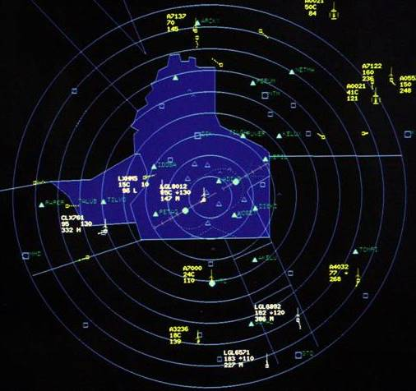
AIR TRAFFIC CONTROL CLEARANCES AND PROCEDURES

Slide 2
AIR TRAFFIC CONTROL CLEARANCES
You must
Exhibit adequate knowledge of the elements related to ATC clearances and pilot/controller responsibilities to include tower en route control and clearance void times
Be able to copy correctly, in a timely manner, the ATC clearance as issued
Determine that it is possible to comply with ATC clearance
Interpret correctly the ATC clearance received and, when necessary, requests clarification, verification, or change
Read back correctly, in a timely manner, the ATC clearance in the sequence received
Uses standard phraseology as contained in the Aeronautical Information Manual when reading back clearances and communicating with ATC
Sets the appropriate communication and navigation systems and transponder codes in compliance with the ATC clearance
Demonstrates an appropriate level of single-pilot resource management skills

Slide 3
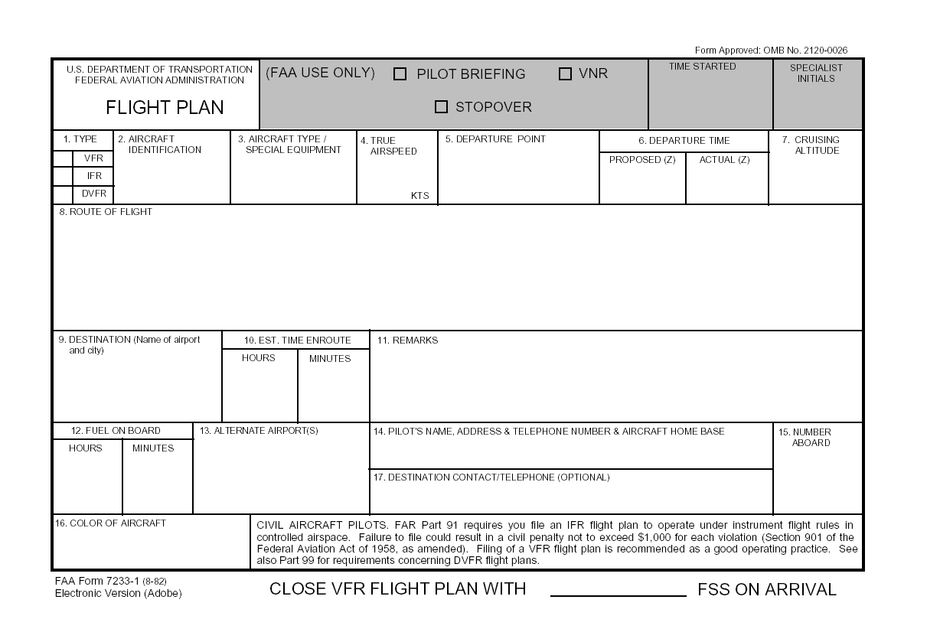
The Flight Plan
The clearance starts with the filing of a flight plan
FSS
Duats
Service – e.g. Foreflight
Pop-up with ATC
Be sure that you accurately calculate the time of flight as this can impact other aspects of the flight – e.g. lost comms approach timing, etc.
X

Slide 4
Getting Your Clearance
How
Clearance delivery
Control tower
By radio with FSS – e.g., dedicated remote communications frequency outlet
By phone with FSS or applicable ATC facility
FSS specialist will relay the clearance from the TRACON or Center
By radio with approach or center – can be difficult to copy and more complex.
Some facilities do not like to tie up the frequency with clearances.
On the radio to clearance delivery "Clearance, Cessna 1472F, IFR to KDAL”
If it is ground or tower you are talking to substitute clearance for Ground or Tower
Be ready with pen in hand to write your clearance down
Copy the clearance first, then try to decipher it, and then, if parts of it don't make sense, query the controller for clarification

Slide 5
ATC Clearance Elements and Order IFR – C R A F T
Aircraft Identification
Clearance limit - where you are cleared to.
Generally, clearance limit is the destination airport; can be closer location for expediency
Departure procedure
Route of flight
Altitudes
Initial and expected altitude and time
Holding instructions
Special instructions / information
Usually not used - When used typically it is about a composite flight plan, e.g., "Maintain VFR on top, if not VFR on top maintain 5,000 and advise“
Frequency and transponder code information

Slide 6
Clearance Limit
Limit of the IFR clearance, beyond which you cannot fly IMC, unless you either receive a further clearance, or choose to terminate your IFR flight plan
Limit is almost always your destination airport, however, it can also be a fix, VOR, etc. prior to the destination airport

Slide 7
Route
You proposed a route when you filed your flight plan
ATC will try to issue a clearance that is close to that route; but, the route may differ based upon traffic flow, controller workload and other factors
Think of the route as a contract with the controller
If the route is the same as you filed, the clearance may be “as filed” or “as filed except”
May include a SID and/or STAR or a tower enroute clearance

Slide 8
Altitude
Each IFR clearance needs to have altitude information included.
How high you can climb and when
Generally done by assigning an initial altitude and then a time or place when/where you can expect higher
Also given, as with many ATC instructions, so that in the event of lost communications, pilots know how to proceed with their flight
May receive a "climb via" SID instructions

Slide 9
Frequency
Departure Frequency for an airport is the frequency of the controller that the aircraft will contact immediately after takeoff
From SGR it is typically Houston Departure 123.8

Slide 10
Transponder
You will be assigned a specific squawk code
Will not be 1200

Slide 11
Correct and Timely Copying of an ATC Clearance
Many systems exist to copy ATC clearances
Specific abbreviations / shorthand
Specific forms
Key is to be ready to copy
Know expected route and navaids
Have pen and paper ready when requesting clearance
Copy clearance as it is being read by controller
Use clearance shorthand that works for you

Slide 12
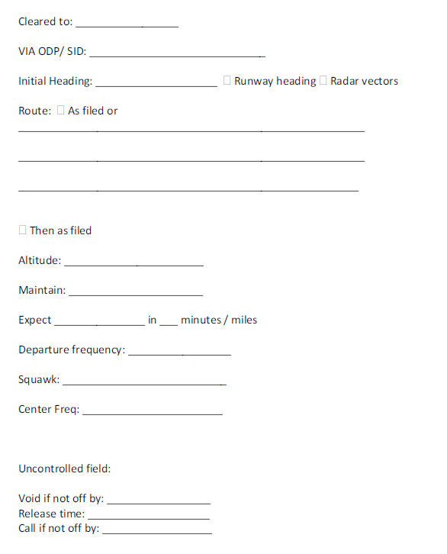
Clearance Recordation

Slide 13
Read Back of Clearance
Controllers expect you to read back all relevant information that affects the direction, speed, and altitude of your flight:
Heading assignments;
Altitude assignments;
Speed assignments;
Altimeter settings (because altimeter accuracy influences your aircraft’s altitude;)
Rate of climb or descent assignments;
Route, route changes, including holding pattern instructions;
Approach and landing clearances;
Takeoff and departure clearances;
Taxi instructions
Frequency changes should always be read-back in full
Neither the FARs nor the AIM state exactly what must be included in your read-back, but a strong recommendation to acknowledge instructions from ATC

Slide 14
Read Back of Clearance
Read back the clearance
Correctly
In a prompt manner
In the sequence received
Using standard terminology
Pilots of airborne aircraft should read back those parts of ATC clearances and instructions containing altitude assignments or vectors as a means of mutual verification
Read back of the "numbers" serves as a double check and reduces communication errors
Include the aircraft identification in all read-backs and acknowledgments

Slide 15
Clearance Read Back
Inform ATC of any items you missed
Correct any errors and read-back those items again for controller confirmation
Anticipate and note "read-back correct" confirmation from controller
Reading back of initial clearance does not imply acceptance
Study pilot/controller glossary for standard terminology

Slide 16
Validation of Clearance
Be certain that you confirm that is possible to comply with the clearance
Aircraft capabilities
Pilot capabilities
Terrain / CFIT
FARs
Pilot must request an amended clearance if the clearance would cause deviation from a rule or regulation or place the aircraft in jeopardy

Slide 17
Validation / Clarification of Clearance
Assure you correctly interpret the ATC clearance
When necessary, request clarification, verification or change
Study each clearance element
If in doubt, request clarification
If unable, request amendment

Slide 18
Pilot/Controller Responsibilities
AIM 5-5-1 sets out responsibilities more fully
Pilot general responsibilities
FAR 91.3 - Pilot in command is directly responsible for, and is the final authority for the safe operation of, an aircraft. In an emergency pilots can deviate from any rule as needed
Acknowledge receipt and understanding of clearances
Responsible for questioning any heading or altitude believed to be incorrect
Pilot must request an amended clearance if the pilot believes that an ATC clearance would cause deviation from a rule or regulation or place the aircraft in jeopardy
If a pilot acknowledges traffic, the pilot is responsible to follow the leader avoid such conflicting traffic and to avoid wake turbulence
Pilot is always responsible to see and avoid traffic when operating in VMC
To operate under IFR in controlled airspace (Sec. 91.173)
File an IFR flight plan
Obtain an ATC clearance
Pilot and controller responsibilities overlap in many areas providing redundancy

Slide 19
Pilot/Controller Responsibilities
Controller responsibilities
First priority is for the separation of aircraft and to the issuance of radar safety alerts
Other functions are performed on a time-available basis
If pilot acknowledgements are incorrect, distorted, or incomplete, the controller will correct, as appropriate
Issuing appropriate clearances
In IFR clearances, assigning altitudes above the minimum IFR altitudes in controlled airspace

Slide 20
Clearance Void Time
Provision in a clearance for that clearance to be void (automatically cancelled) if aircraft not airborne by a specified time, the clearance void time
May be received when operating from an airport without a control tower
If not airborne prior to the clearance void time, advise ATC as soon as possible
ATC normally advises pilot of time allotted to notify ATC in this event (cannot exceed 30 minutes)
If ATC in not notified within 30 minutes after aircraft misses clearance void time, then aircraft is considered overdue and search and rescue procedures are begun
Other IFR operations are suspended until aircraft contacts ATC or until 30 minutes after clearance void time
Prohibited to use the clearance after the void time = to no clearance

Slide 21
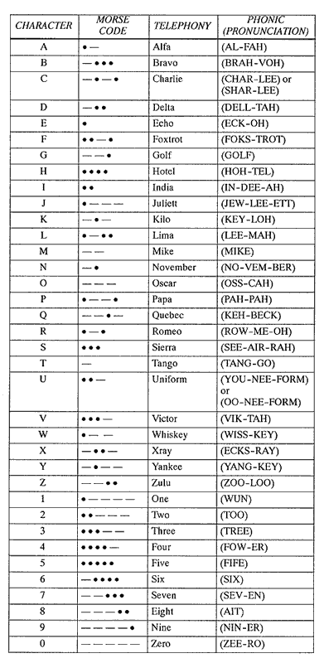
Standard Phraseology
AIM 4-2-7 - Phonetic Alphabet
Federal Aviation Administration Pilot / Controller Glossary (P/CG)
http://www.faa.gov/air_traffic/publications/ATpubs/PCG/index.htm

Slide 22
Sets Communication and Navigation Radios and Transponder Codes
Set communication and navigation frequencies appropriate for the ATC clearance
Set communication and navigation equipment frequencies as much as possible during low workload periods, e.g., prior to takeoff
Recommend left-to-right top-to-bottom approach for radio set up
Set heading indicator bug on initial assigned departure heading
Set primary COMM radio to tower or UNICOM frequency
Set departure frequency in standby position
Enter and check assigned route, all waypoints, including DP, in GPS and activate flight plan, if applicable
Set primary navigation system (e.g., VOR, GPS, etc.): enter, check frequency and ID (if in range) of first enroute station, and set OBS to initial assigned course
Set secondary COMM radio to departure frequency
Set secondary NAV radio to the frequency of the approach facility (e.g., ILS) that would be used in case of emergent return to departure airport in IMC
Set transponder to assigned code
Standby mode until ready for takeoff, then switch to ALT mode
Some airports require transponder to be on during taxi

Slide 23
Compliance With Clearances
You Must:
Exhibit adequate knowledge of the elements related to ATS routes, and related pilot/controller responsibilities
Use the current and appropriate navigation publications for the proposed flight
Select and use the appropriate communication facilities; select and identify the navigation aids associated with the proposed flight
Perform the appropriate aircraft checklist items relative to the phase of flight
Establish two-way communications with the proper controlling agency, using proper phraseology
Comply, in a timely manner, with all ATC instructions and airspace restrictions
Exhibit adequate knowledge of communication failure procedures
Intercept, in a timely manner, all courses, radials, and bearings appropriate to the procedure, route, or clearance
Maintain the applicable airspeed within ±10 knots; headings within ±10°; altitude within ±100 feet; and tracks a course, radial, or bearing within ¾-scale deflection of the CDI
Demonstrate an appropriate level of single-pilot resource management skills

Slide 25
Disclaimer
Instrument flight can be dangerous. Do not rely solely on this presentation – PROFESSIONAL INSTRUCTION IS REQUIRED
The foregoing material should not be relied upon for flight
ALTHOUGH THE ABOVE INFORMATION IS FROM SOURCES BELIEVED TO BE RELIABLE SUCH INFORMATION HAS NOT BEEN VERIFIED, AND NO EXPRESS REPRESENTATION IS MADE NOR IS ANY TO BE IMPLIED AS TO THE ACCURACY THEREOF, AND IT IS SUBMITTED SUBJECT TO ERRORS, OMISSIONS, CHANGE

